Slide 1
Wind Power
Division B/C
Georgia Tech Event Workshop Series 2024-25

Slide 2
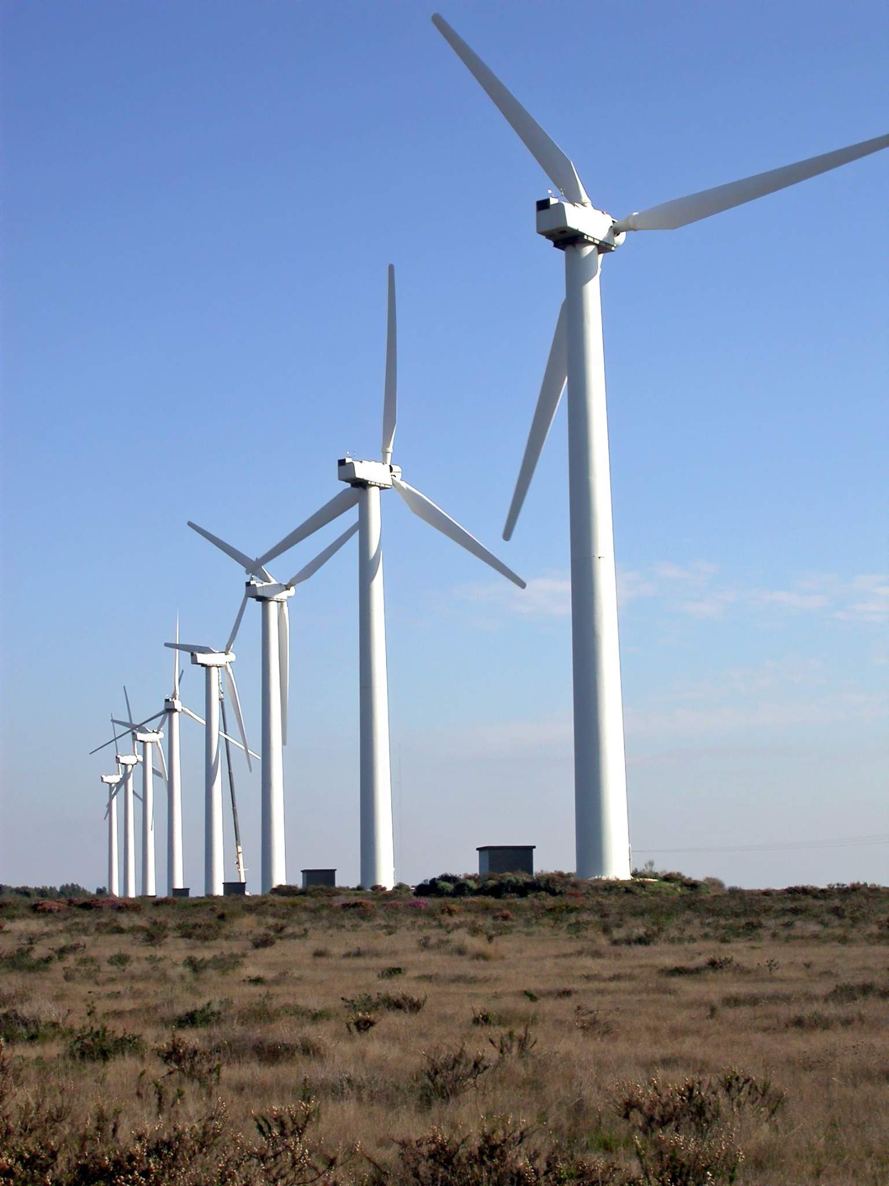
01
RULES SHEET
02
DIFFICULT TOPICS
03
COMMON QUESTIONS
04
TIPS FROM A VETERAN
05
OTHER FREE RESOURCES
Notes:
For Builds: Replace difficult topics with physical principles involved in the build and replace common questions with common designs

Slide 3
The Rules Sheet
While you can bring unlimited notes, they won’t be super useful unless they’re organized, so make sure to use tabs/labels and include a Table of Contents
Don’t bring your own test stand, although making one will be helpful during the testing phase
Class III Calculators: Non-graphing, programmable calculators (no TI-84s)
Notes:
Highlight key points from the rules sheet: DESIGN LOGS that basically grant free points, most tested-on topics, point distribution so that competitors know what to prioritize, allowed notes and equipment, etc.

Slide 4
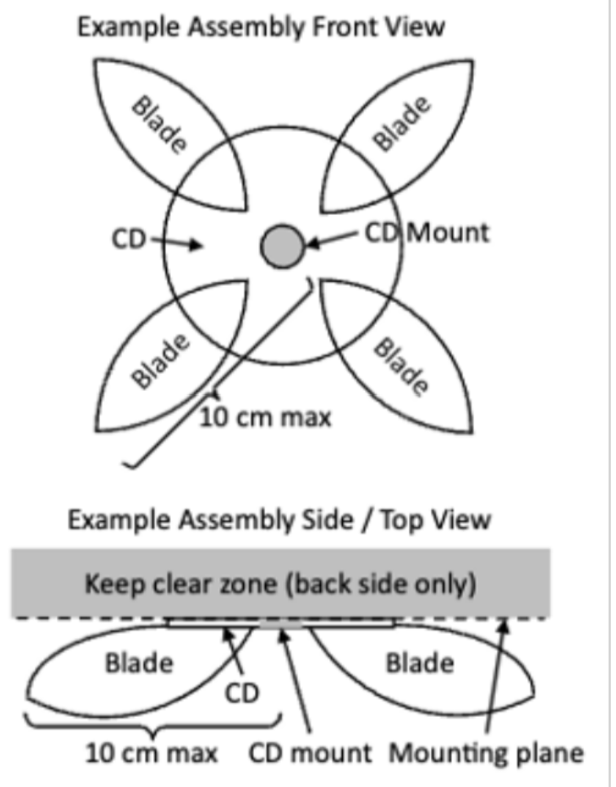
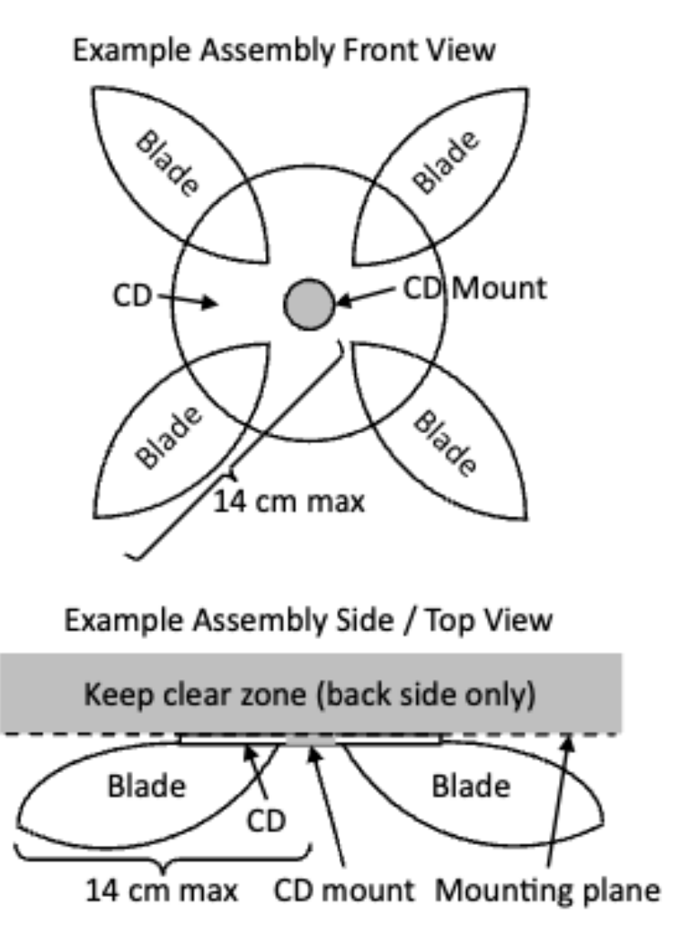
The Rules Sheet
Div C:
The only difference between Div. C and Div B. rules this year is the maximum radius of the build (10 cm vs. 14 cm)
Stay within these limits to avoid 10% deduction or disqualification (radius measured from center of CD)
Where to buy a CD?
Buy for $10 on Amazon
Ask parents for old CDs
Blades must not extend behind CD or be heavy enough to cause damage to the testing set-up
The lighter your device, the faster it spins/the more power it generates, so this is against your best interest anyways
VS
Div B:
Notes:
Highlight key points from the rules sheet: DESIGN LOGS that basically grant free points, most tested-on topics, point distribution so that competitors know what to prioritize, allowed notes and equipment, etc.

Slide 5
The Rules Sheet
Topics Covered in Written Test (Part I: The Competition):
Rotor and blade design of wind turbines
Types of generators and their design
Power storage
Power transmission and distribution
Siting (finding a location) and installing wind turbines and power storage/distribution systems <- new this year
History and societal impacts of wind power
Use this list as a starting point for research and organizing notes
Ex: gather information on one topic per week, split topics between partners
These topics are what event supervisors are referencing when writing exams
They are vague so the best strategy is to just collect as much related info on each concept as possible
Notes:
An equal number of questions on each topic

Slide 6
The Rules Sheet
You have 2 minutes and 15 seconds to optimally position your blade—use it!!!
Make sure you’re testing your build at a high and low fan speed
Notes:
Highlight key points from the rules sheet: DESIGN LOGS that basically grant free points, most tested-on topics, point distribution so that competitors know what to prioritize, allowed notes and equipment, etc.

Slide 7
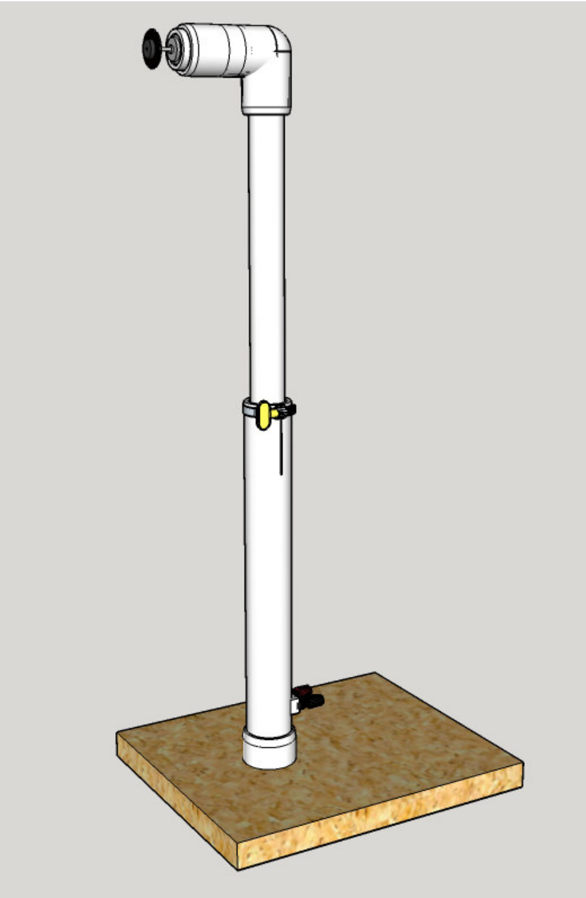
Making Your Test Stand
Having one of these to test your build before competition is incredibly useful!
You can find detailed instruction for how to build and test stand and the materials involved on the:
Official Science Olympiad Website
Links for Buying Materials:
20” Box Fan
DC Motor attached to CD holder
PVC Pipes
Adjustable Clamps
1k Ohm Resistors
Notes:
Pull some questions from exams on the scioly wiki test exchange, first give attendees a couple minutes to read over them/work through them, then walk them through the answers

Slide 8
DIFFICULT TOPICS
Notes:
This section should focus on topics that are more math-based (harder to self-teach), concepts that come only usually up in college level courses, or concepts that you struggled with when you competed in this event

Slide 9
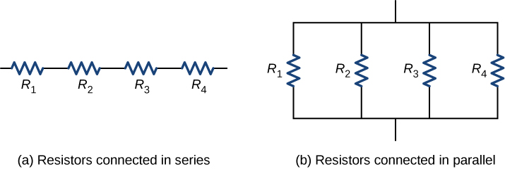
Topic 1: Circuit Analysis
Exam writers may ask you to solve a simple circuit as part of the power storage or transmission topic
Success on questions like these comes with a lot of practice
Keys to circuit analysis are
Ohm’s Law: V = IR
Power Equation: P = IV
Energy Equation: E = PΔt = P(dt)
Resistors in Series/Parallel: R = R + … + R ; R = 1 / (1/R + … + 1/R )
S
1
n
P
1
n

Slide 10
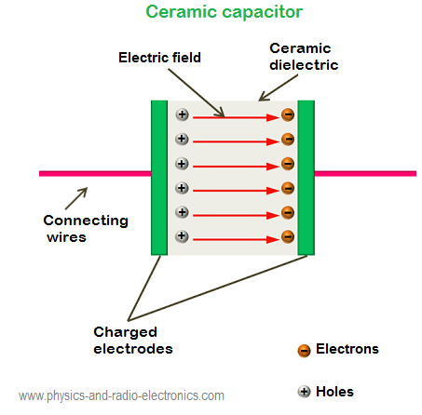
Topic 1: Circuit Analysis
Capacitors:
A passive, two-terminal device that stores electric charge short-term
Two metal plates separated by an insulating material (dielectric)
Important Equations:
Q = CV
Q = Charge (Coulombs)
C = Capacitance (Farads)
V = Voltage (Volts)
C = ϵ A/d
ϵ = Electrostatic Constant:
A = Plate Area (m^2)
d = Distance Between Plates (m)
0
0
Notes:
Units are important

Slide 11
Topic 1: Circuit Analysis
Capacitors take time to charge and discharge, which can be visualized in this simulation
I(t) = C (dV/dt)
Current is equal to the capacitance times the change in voltage over time
Once charged, current stops flowing in a circuit
To find the voltage across a capacitor at a particular point in time after connected to a voltage source, we solve the differential equation to yield:
Notes:
Units are important

Slide 12
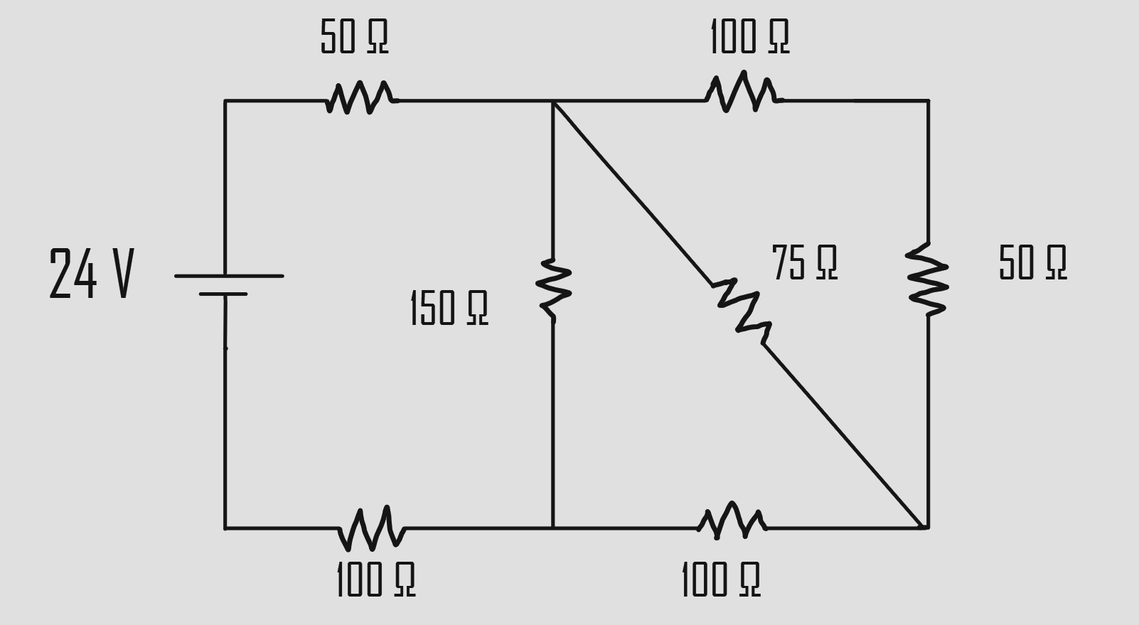
Example Question: Circuits
Imagine the circuit below is a network of power transmission lines.
Calculate the energy dissipated across the 75 ohm resistor after 30 seconds:
Notes:
Pull some questions from exams on the scioly wiki test exchange, first give attendees a couple minutes to read over them/work through them, then walk them through the answers. Try to get a mix of multiple choice and short answer or matching

Slide 13
Answer
R(tot) = 50 Ω + 1/[1/(1/[1/(100 Ω + 50 Ω) + 1/75 Ω] + 100 Ω) + 1/150 Ω] + 100 Ω = 225 Ω
I(tot) = 24 V/225 Ω = 0.107 A
I(75 Ω) = 0.107 A [(100 Ω + 50 Ω)/(100 Ω + 50 Ω + 75 Ω)] = 0.0711 A
P(75 Ω) = (0.0711 A)2 (75 Ω) = 0.379 W
E = 0.379 W * 30 s = 11.4 J
Notes:
Pull some questions from exams on the scioly wiki test exchange, first give attendees a couple minutes to read over them/work through them, then walk them through the answers. Try to get a mix of multiple choice and short answer or matching

Slide 14
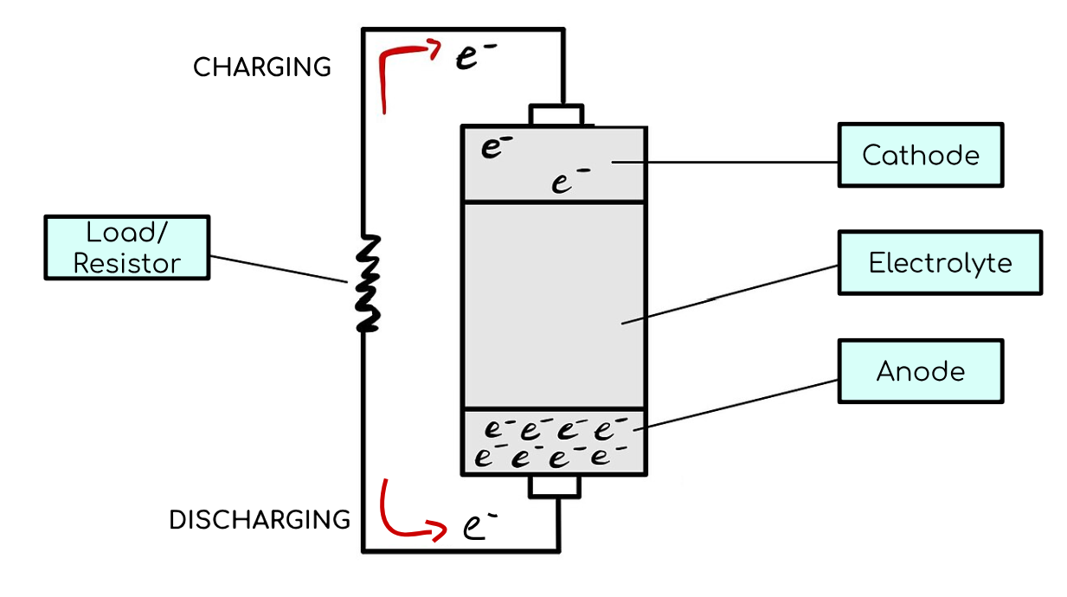
Topic 2: Batteries
Batteries are generally used for long-term energy storage
Know several types of batteries and their applications
Battery Capacity (Ampere x hours or Ah):
Measure of ability to store or supply electrical energy
Describes how much current is provided by the battery in a certain interval of time
Ex: a battery that supplies 15 Amperes in 10 hrs has a capacity of 150 Ah
Current Rate (C-Rate: hrs^-1) =
(Discharge or Charge Current)/Capacity
Ex: At 2C, a 10 Ah battery will supply 20 A for 30 minutes
Notes:
Feel free to add more topics and make sure that there are plenty of pictures/diagrams!

Slide 15
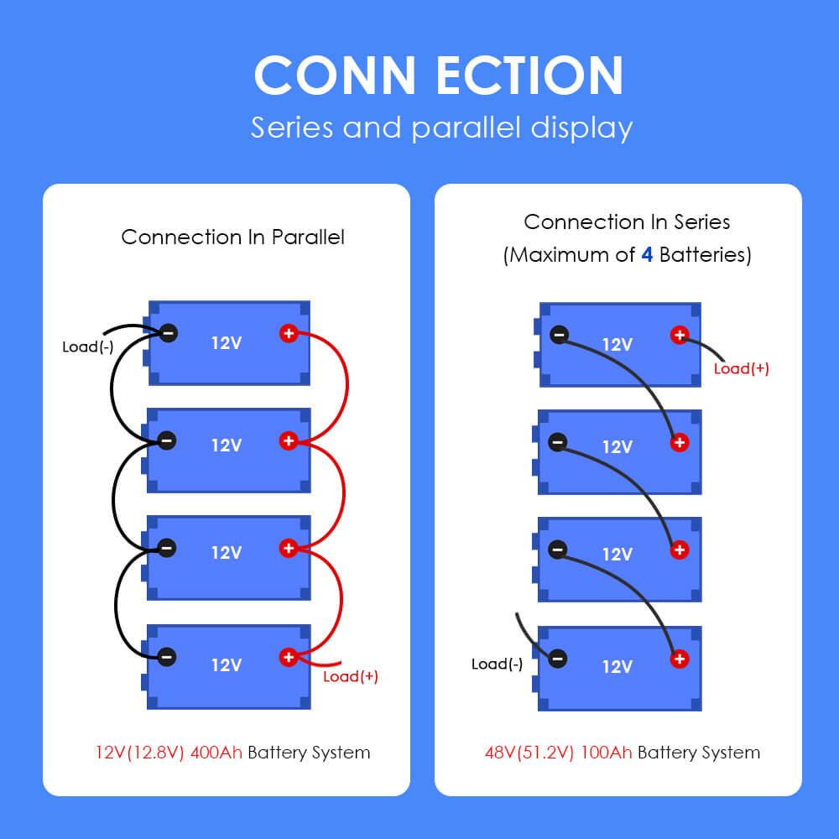
Topic 2: Batteries
Batteries in parallel will have summed capacities and unchanged voltage
Batteries in series will have unchanged capacities and summer voltages
Question: If a lithium-ion battery has a C-rate of 4C and a capacity of 234 Ah, what is its discharge current?
Answer: 4 hrs-1 x 234 A-hrs = 936 A
Notes:
Pull some questions from exams on the scioly wiki test exchange, first give attendees a couple minutes to read over them/work through them, then walk them through the answers

Slide 16
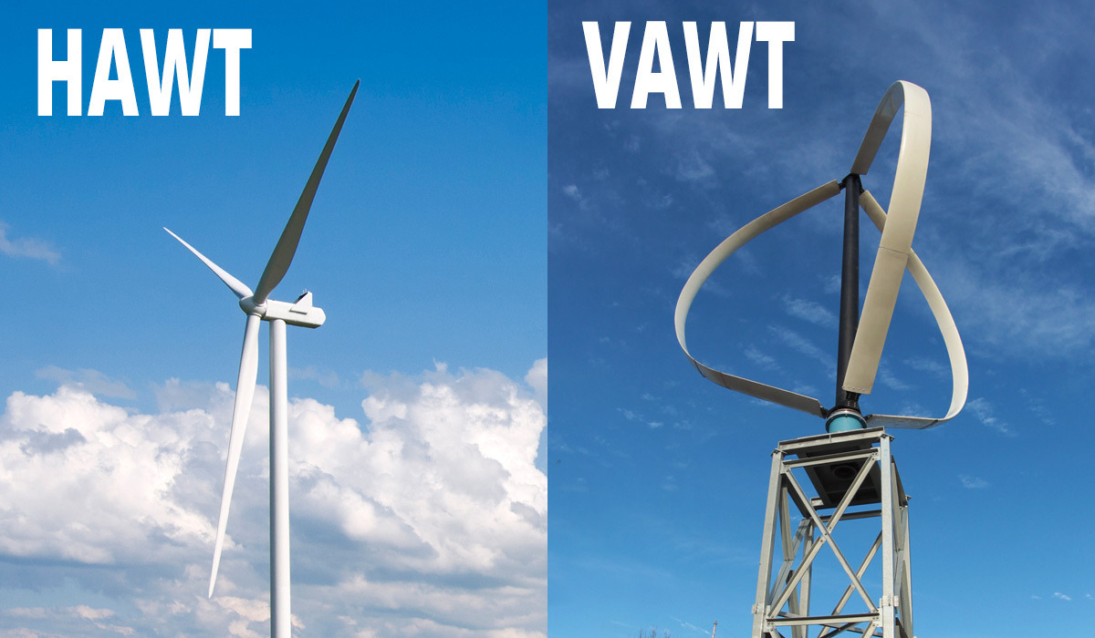
Topic 3: Types of Wind Turbines
Horizontal Axis Wind Turbines (HAWTs)
Vertical Axis Wind Turbines (VAWTs)
Advantages:
Can harness wind power from all directions without a gear system
Easier maintenance because it is lower to the ground
Advantages:
Can harness stronger winds higher in the atmosphere
Are self-starting
Generally, perform reliably
Disadvantages:
Require a yaw system to move the rotor such that it’s facing the wind
Difficult/expensive installation process
Disadvantages:
Lower efficiency due to complex aerodynamic design
Experience vibration due to turbulent and slower air flow near the ground
Notes:
Self starting - can accelerate to a speed faster than the velocity of the wind

Slide 17
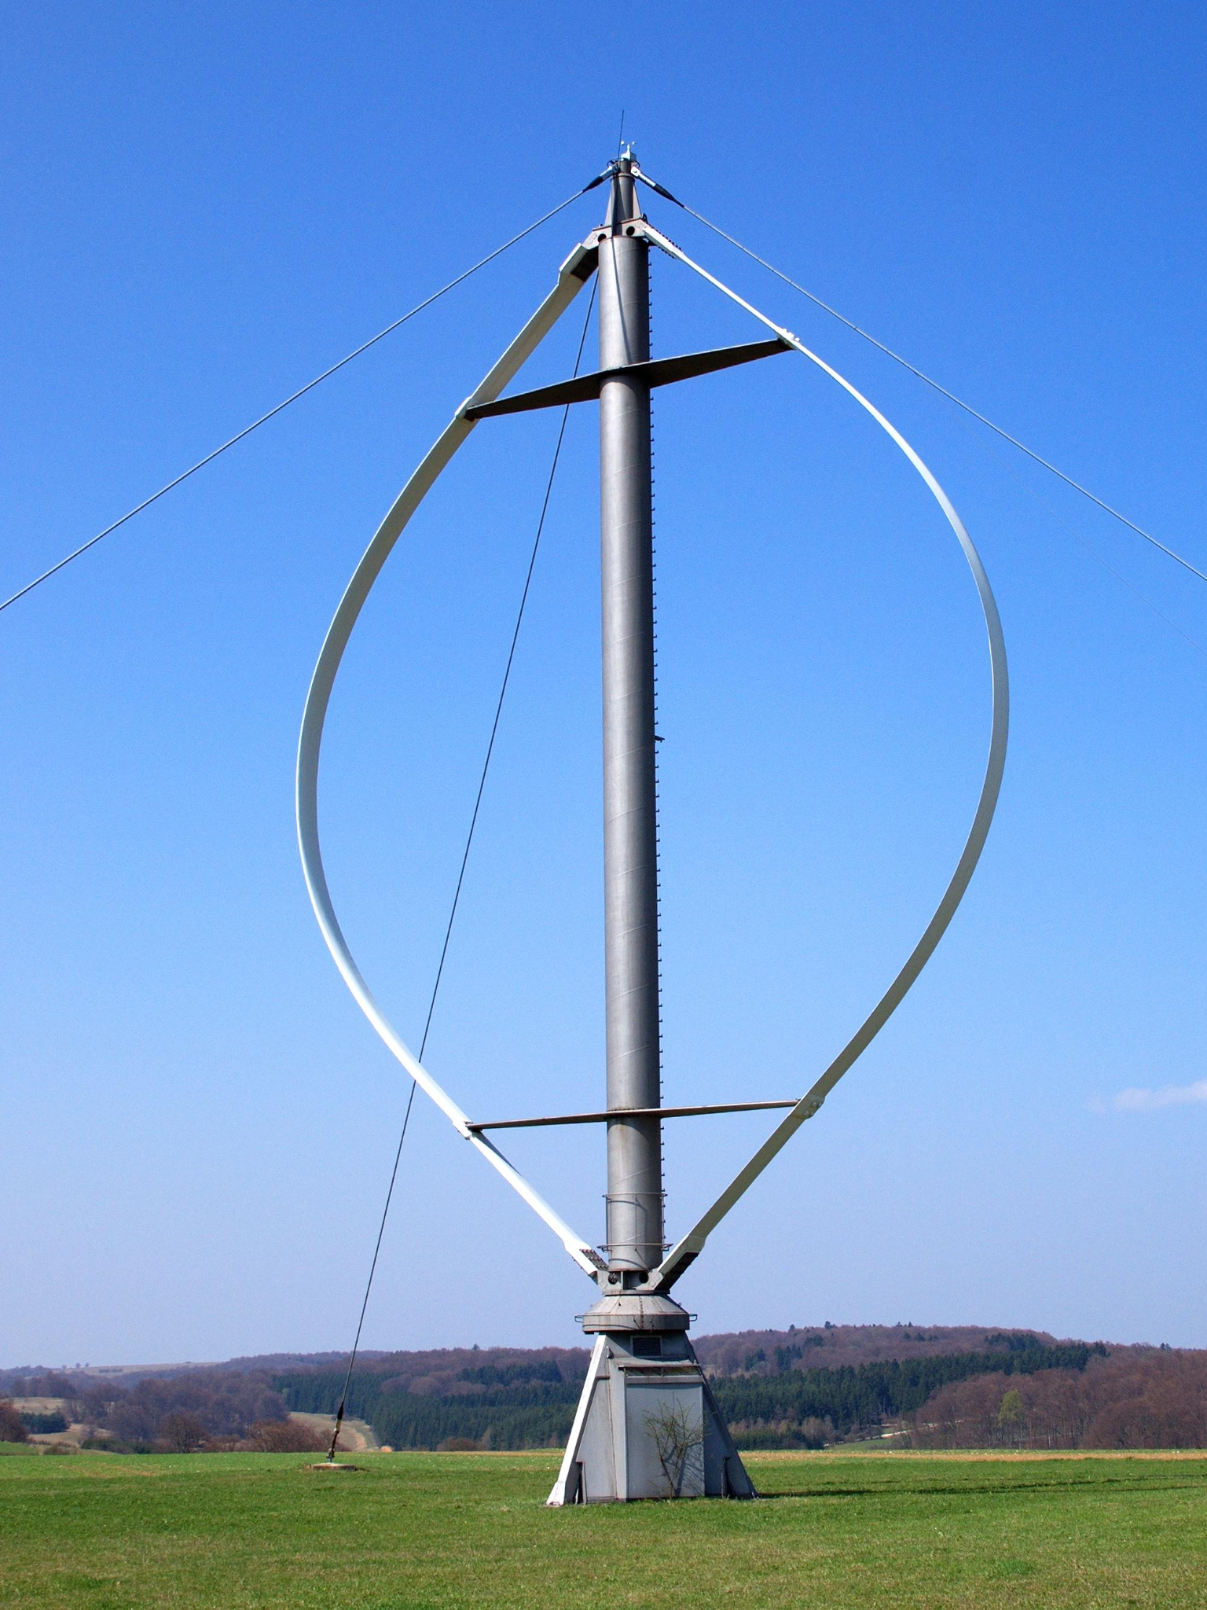
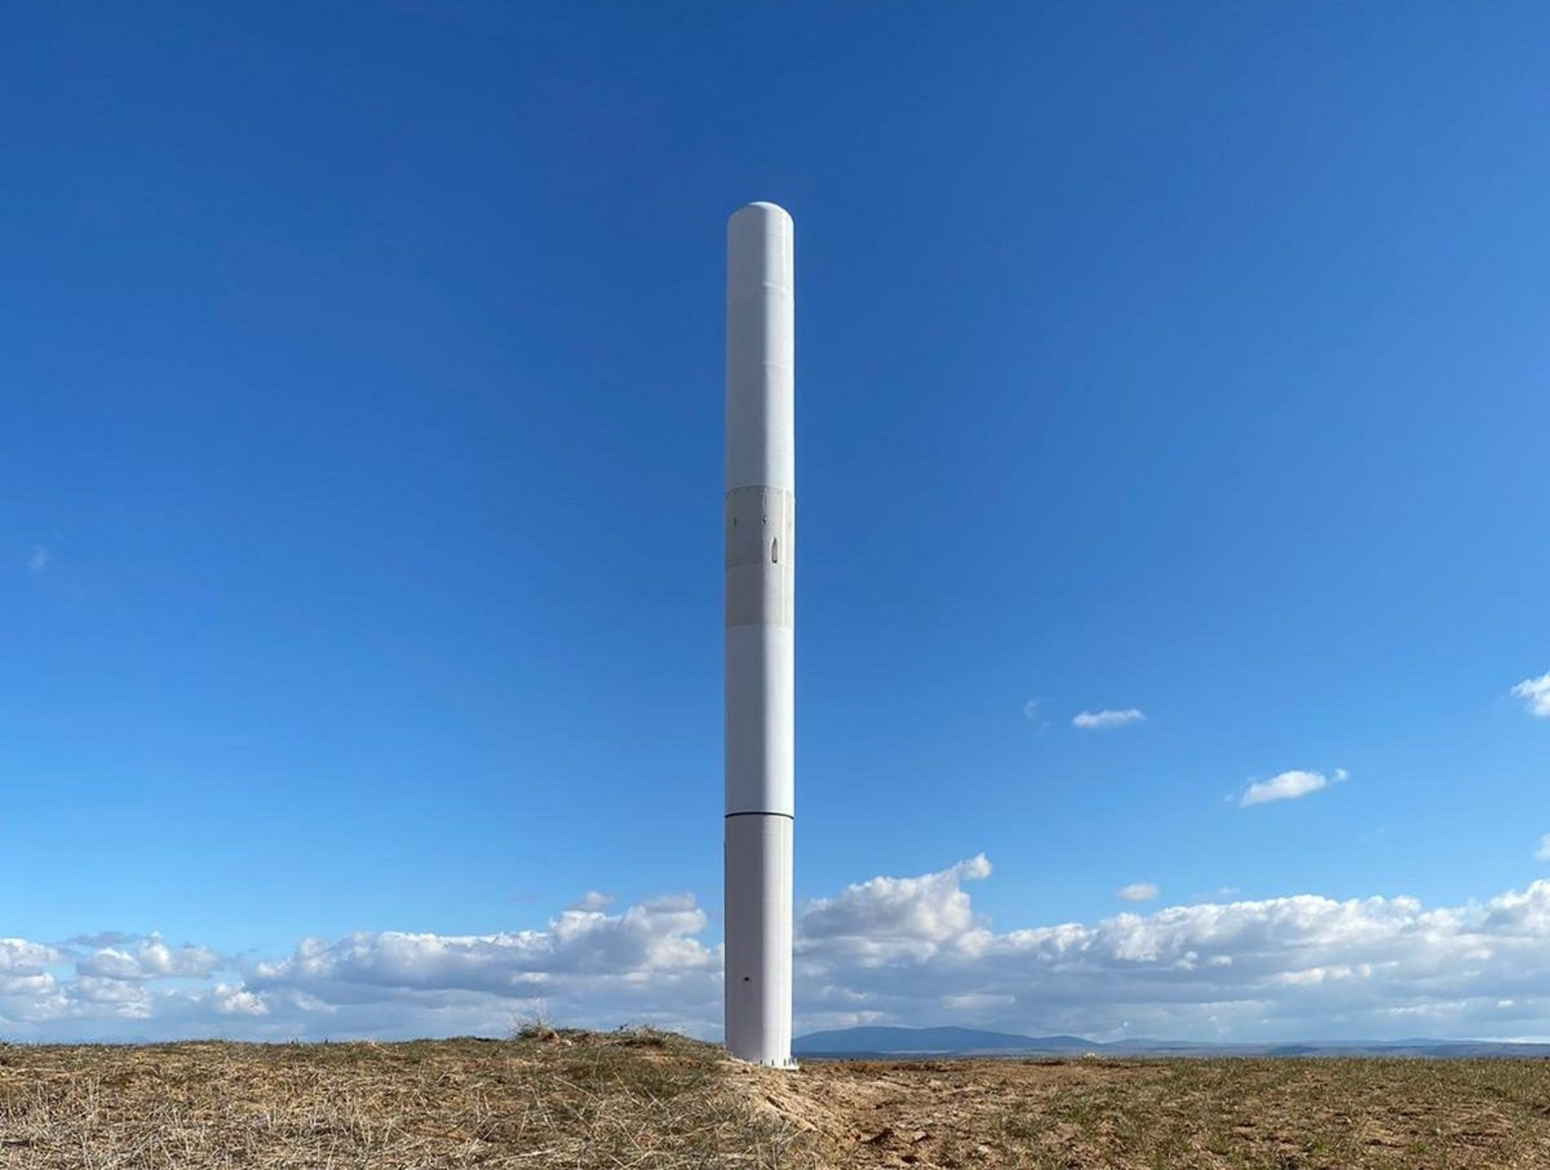
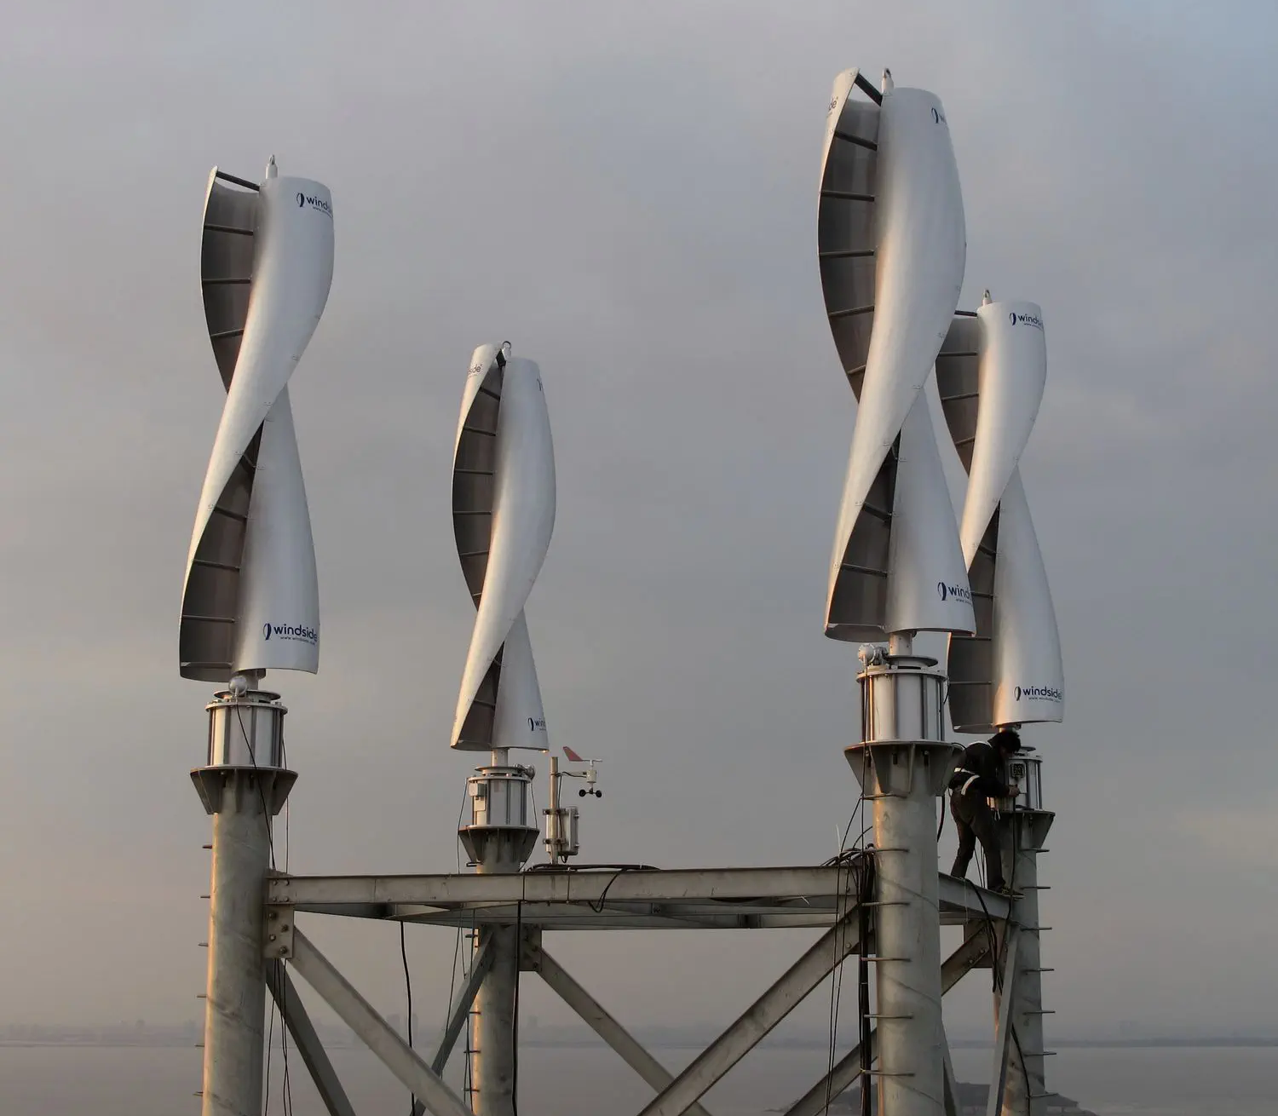
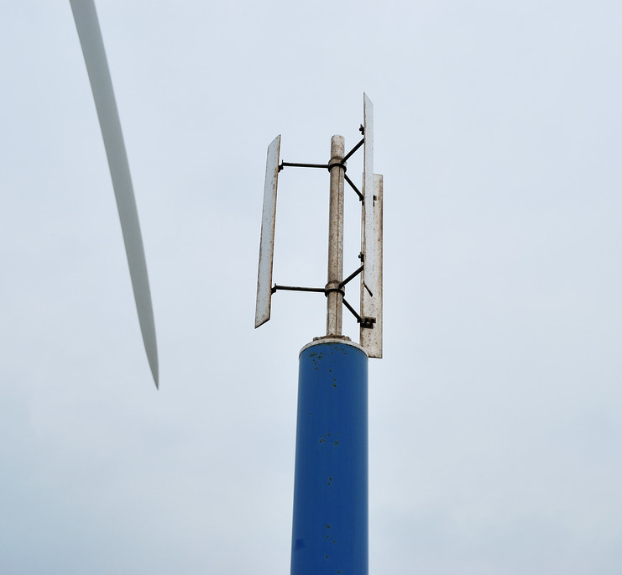
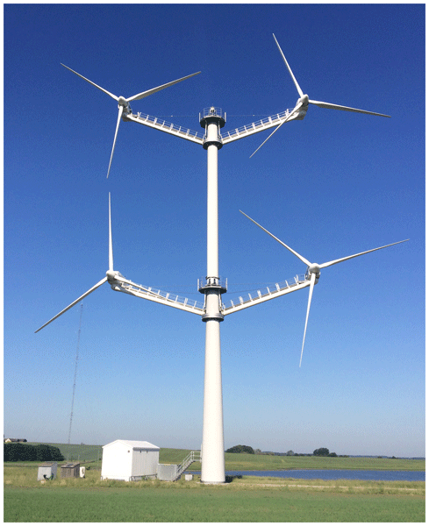
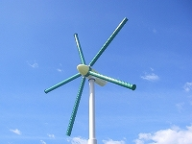
Example Question: Matching
Vortex
Savonius
Darrieus
Savonius
Darrieus
Vortex
Magnus
Multi-Rotor
Magnus
Multi-Rotor
Notes:
Self starting - can accelerate to a speed faster than the velocity of the wind

Slide 18
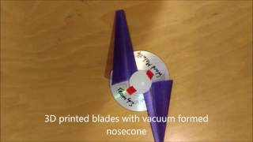
Potential Build Designs

Slide 19
Tips from a Veteran
Start going through practice tests about a month before your first competition
Will shed light on topics you still need to take notes on/study
Designate one person to come up and test your build and one person to remain taking the written test (this will optimize your time)
The simpler your design, the better!
2-3 blades is often most effective, cardstock/construction paper works as a great blade material, you can experiment with different blade shapes
Make sure you are familiar with the different types of power plants and have their diagrams in your notes
Notes:
Use this section to talk about any strategies you used to navigate the event when you competed. For example, how did you manage your time, how did you organize your notes, how did you split topics up between you and your partner, etc.?

Slide 20
Tips from a Veteran
There’s a very large chance that either a matching question or labeling the diagram question will show up on your exam
To prepare, ensure that you have a definitions list in your notes and several diagrams of things like generators and wind turbines
For historical/environmental impact info, the Wind Power SciOly Wiki Page, the US Energy Information Administration, and Renewable Energy World are all great resources
Wikipedia is also your friend, but avoid copying and pasting whole Wikipedia pages onto your notes because you will waste time sifting through info
Don’t take the event too seriously! Prioritize having fun : )
Notes:
Use this section to talk about any strategies you used to navigate the event when you competed. For example, how did you manage your time, how did you organize your notes, how did you split topics up between you and your partner, etc.?

Slide 21
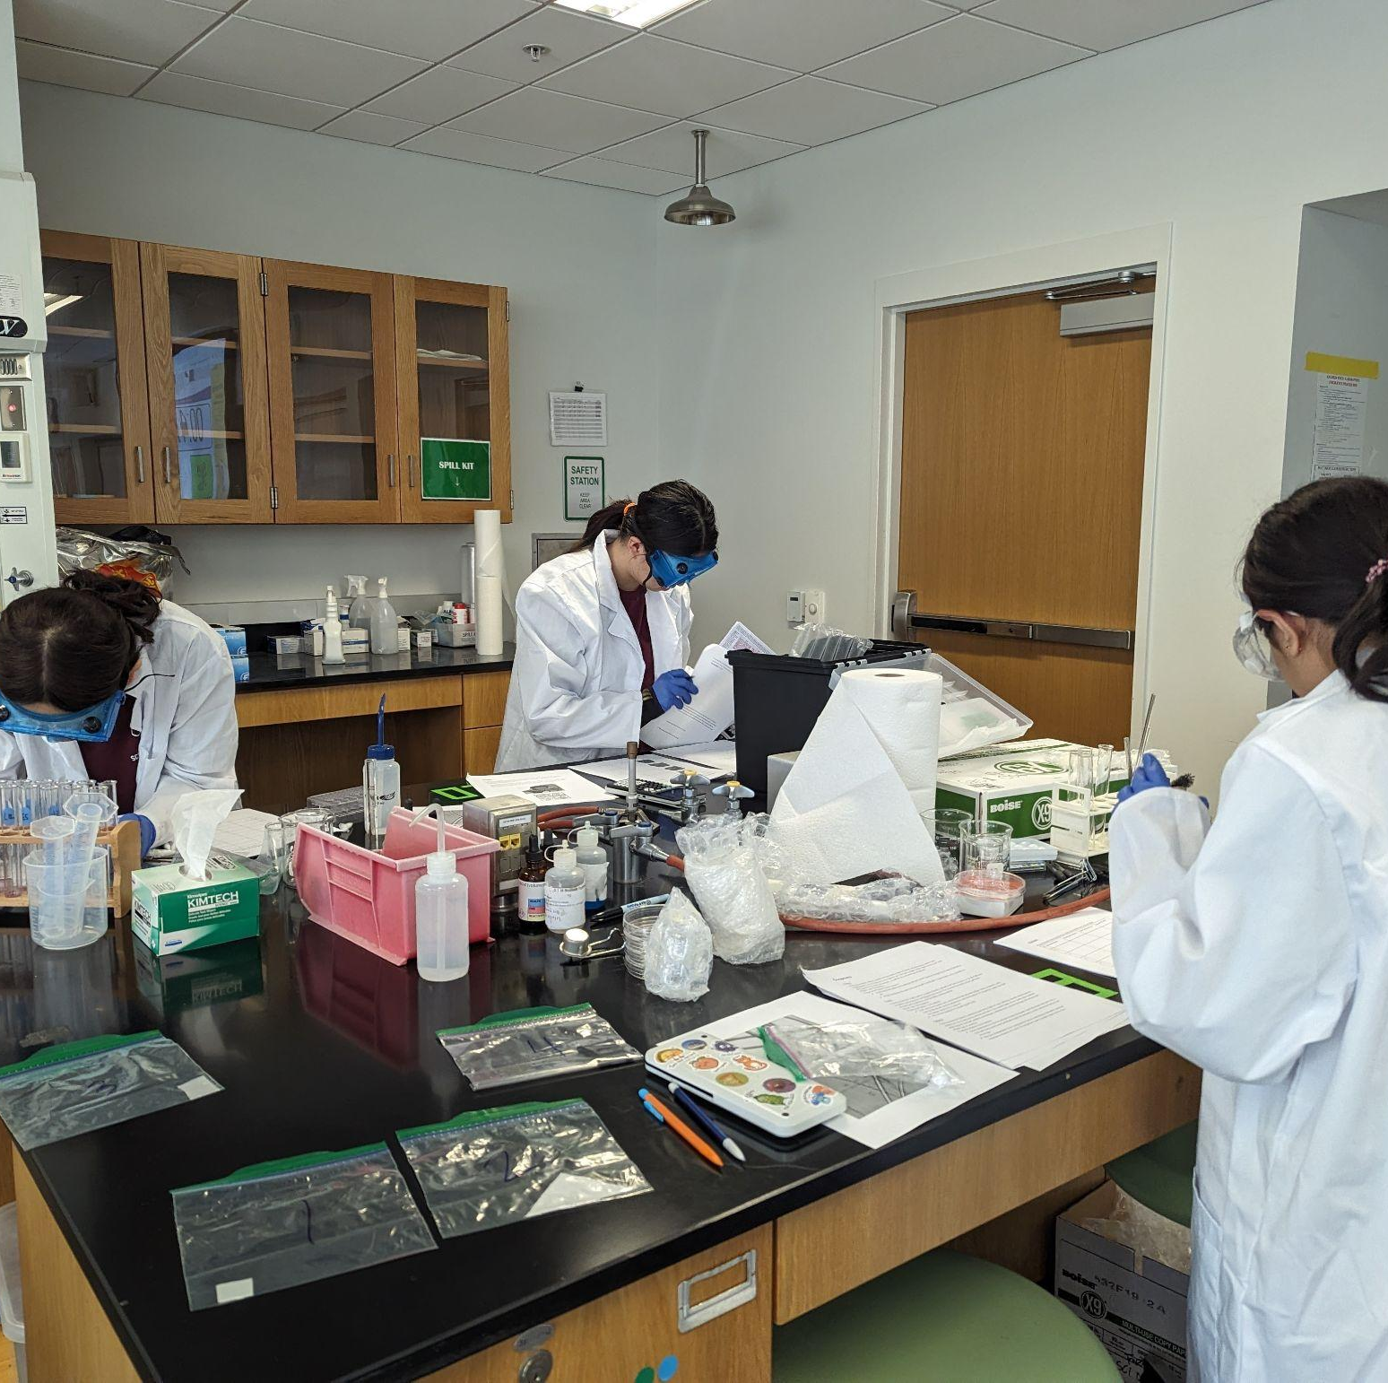
THANKS!
Notes:
(replace picture with a picture from one of our tournaments)

