Slide 1
Write It Do It
[Division B/C]
Georgia Tech Event Workshop Series 2024-25

Slide 2
01
RULES SHEET
02
TIPS FOR WRITERS
03
TIPS FOR DOERS
04
TIPS FROM A VETERAN
05
OTHER FREE RESOURCES
Notes:
For Builds: Replace difficult topics with physical principles involved in the build and replace common questions with common designs

Slide 3
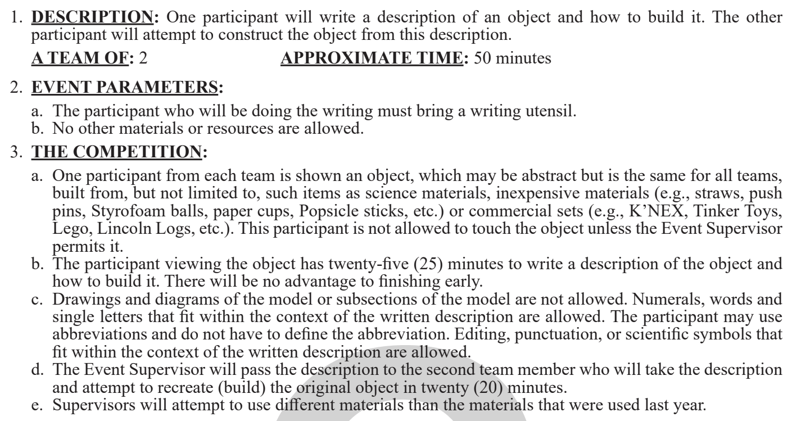
The Rules Sheet
Basic rules:
25 minutes for writer, 20 minutes for doer
Drawings and diagrams not allowed–keep it to something you can type on a keyboard!
Tiebreaker–for doers only :)
Notes:
Highlight key points from the rules sheet: DESIGN LOGS that basically grant free points, most tested-on topics, point distribution so that competitors know what to prioritize, allowed notes and equipment, etc.

Slide 4
The Rules Sheet
Scoring: the team that builds the model that most resembles the original wins
The more points, the better!
Size, location, color, orientation, connection
You typically receive points for just having an item on the model (when time is almost up, try and get as many things as possible stuck on!)
Notes:
Highlight key points from the rules sheet: DESIGN LOGS that basically grant free points, most tested-on topics, point distribution so that competitors know what to prioritize, allowed notes and equipment, etc.

Slide 5
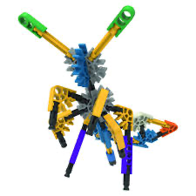
Tips for Writers
Describe the build in references, frequently - saying things like “it should look like a giraffe” or “in an L-shape” can give your writer important check-ins that they are on the right path. “What does it look like, after this step?”
Leave some white space - don’t just make a wall of text that’s hard to read, and hard to find your place in
Label/number objects, concisely - name them whatever makes sense AND distinguishes them from all other objects. Several of the same object can be numbered, as long as you’re clear which is which
Always be very clear what object you’re referring to!
Erasing completely takes longer than crossing out
Remember that you can change perspectives - you can tell your builder to turn the whole build 90 degrees, or flip it upside down - they aren’t restricted to only what you as the writer can see

Slide 6
Tips for Writers 2
If low on time, it’s worth the points to overgeneralize details - “draw a spiderweb”, instead of specifying 3 hexagons with lines through the vertices
Use your best judgement on what matters - sometimes the colored line on the bottle cap needs to face outwards, sometimes it doesn’t matter
General rule of thumb is if you have the time to worry about it, then worry about it
Start thorough on the “roots and trunk” of the build, then worry about the leaves
If your builder can’t understand what the base of the build is supposed to look like, everything you write after that depends on the base will be wrong
Writers tend to write more thoroughly at first, and then less detailed as they run out of time - so start with the important stuff!
Use your judgement to determine the pace you need to go at - speed sacrifices clarity/details and vice versa

Slide 7
Tips for Doers
Read all of your writer’s instructions before starting anything–try and picture in your mind what this model should look like!
Approach the building methodically, if something is unclear or confusing, don’t panic! Use your best judgment on what to do.
Go through the instructions step-by-step. If you read too fast, or rush, you may skip something crucial.
Prioritize accuracy over speed. You’ll get more points for a half-built, but completely accurate model than a fully put-together, inaccurate model.
Double check small details–points for orientation, location, and color (differentiate between light and dark versions of something) will quickly add up and make up a large portion of your overall score
Notes:
Feel free to add more topics and make sure that there are plenty of pictures/diagrams!

Slide 8
Tips for Doers (on a time crunch)
Be very aware of your time - going too slow for details can mean you don’t even get halfway through the build
If something doesn’t make sense, that’s when you need to slow down, reread, see where you’ve gone wrong
Time IS a tiebreaker - if you get an extremely easy build (as is common at some invitationals and regionals), then time is going to be the deciding factor
A lot of builds can have a lot of parts - not necessarily anything confusing or things that throw you off, just a LOT of parts. These need to be built fast, just to be able to complete the build (writers, you can also let your builders know when they need to go fast, and when they should take time for details - mark important paragraphs, tell them that it’s a short build, etc.)
Notes:
Feel free to add more topics and make sure that there are plenty of pictures/diagrams!

Slide 9
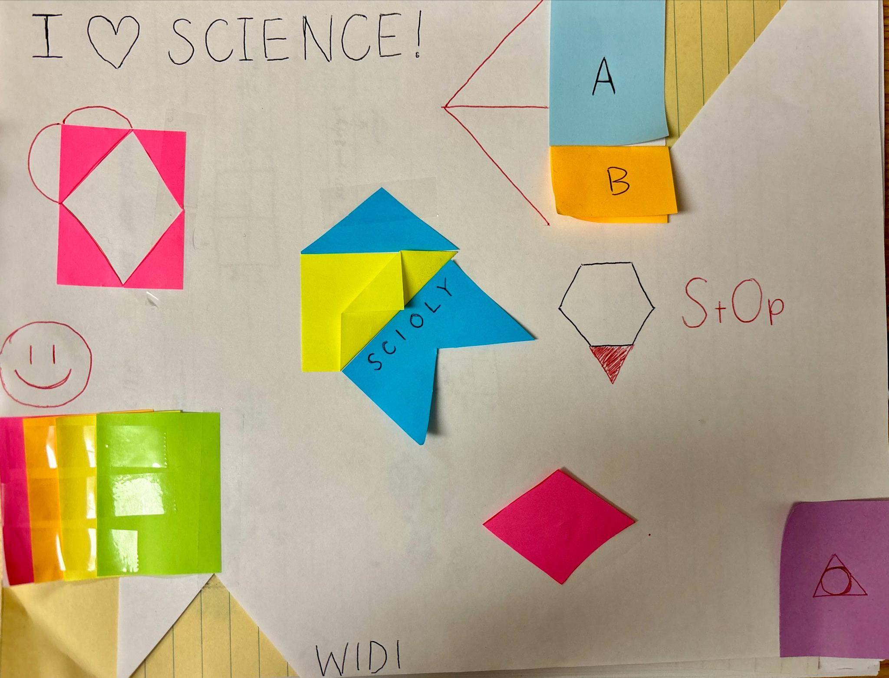
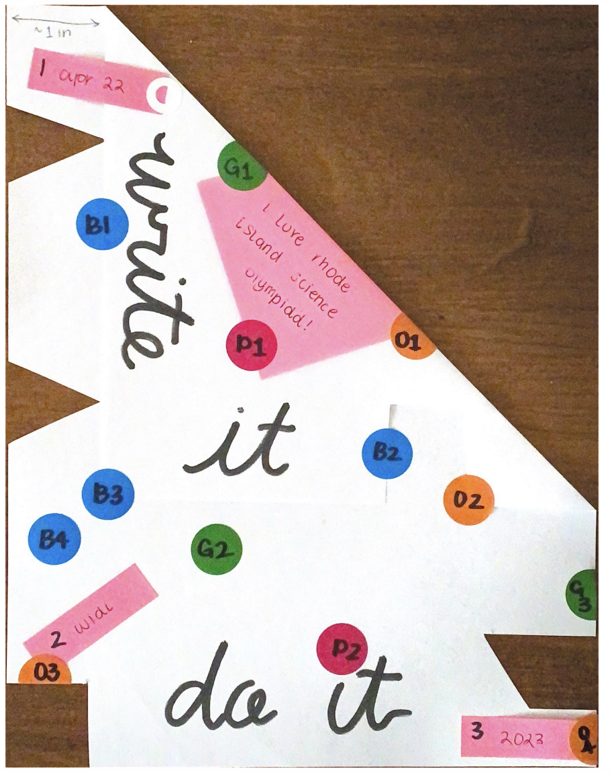
Example models
Notes:
Pull some questions from exams on the scioly wiki test exchange, first give attendees a couple minutes to read over them/work through them, then walk them through the answers. Try to get a mix of multiple choice and short answer or matching

Slide 10
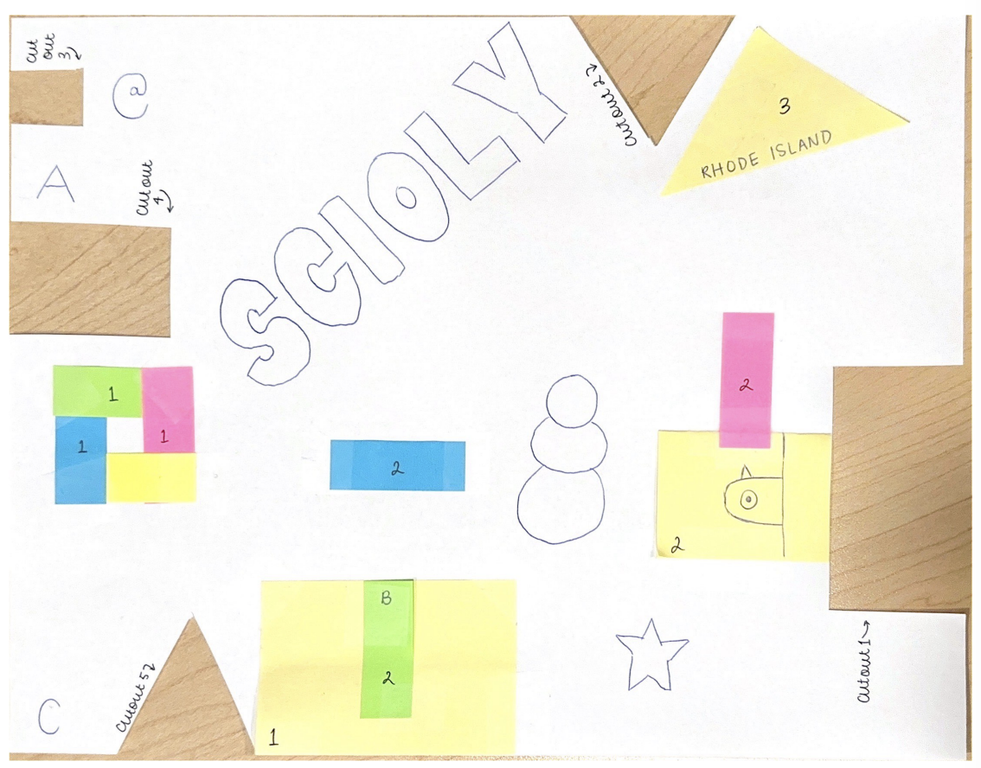
Example models
Notes:
Pull some questions from exams on the scioly wiki test exchange, first give attendees a couple minutes to read over them/work through them, then walk them through the answers. Try to get a mix of multiple choice and short answer or matching

Slide 11
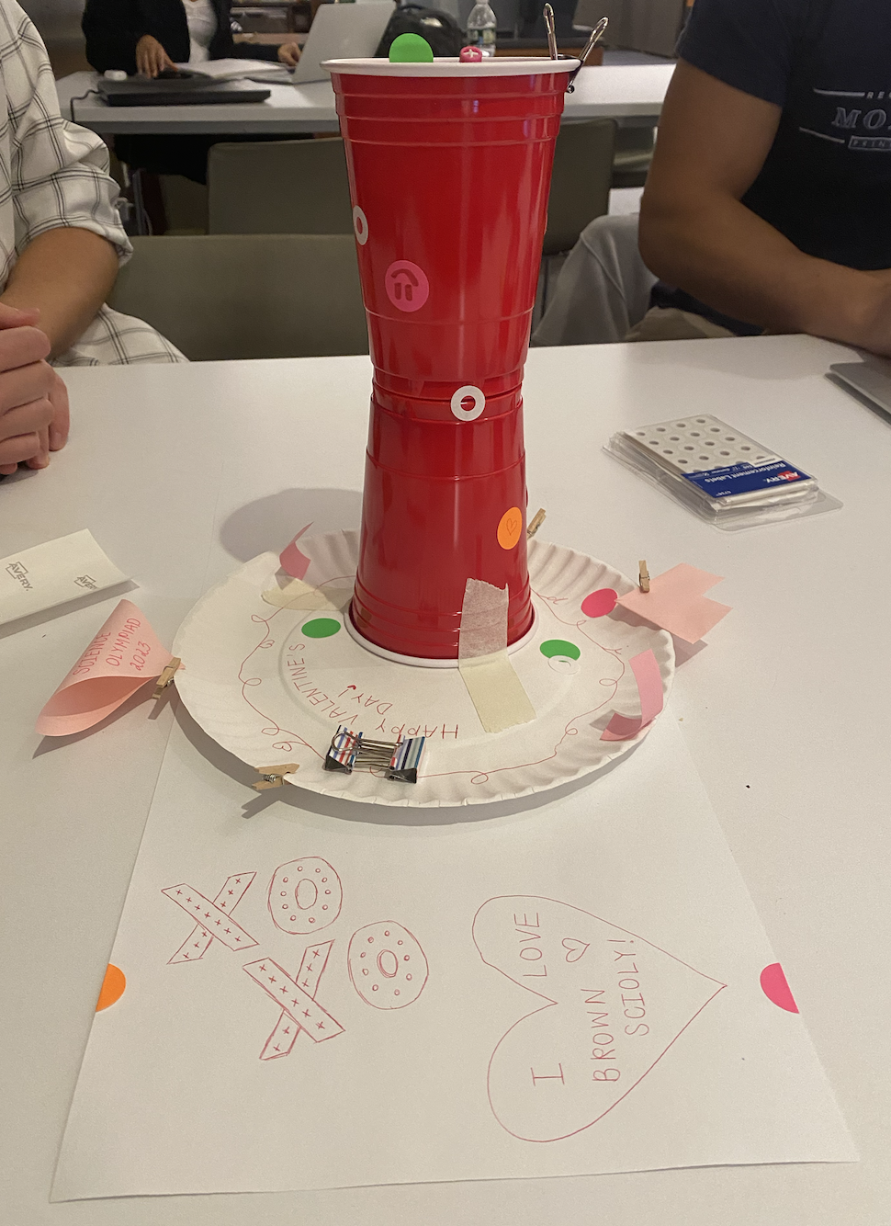
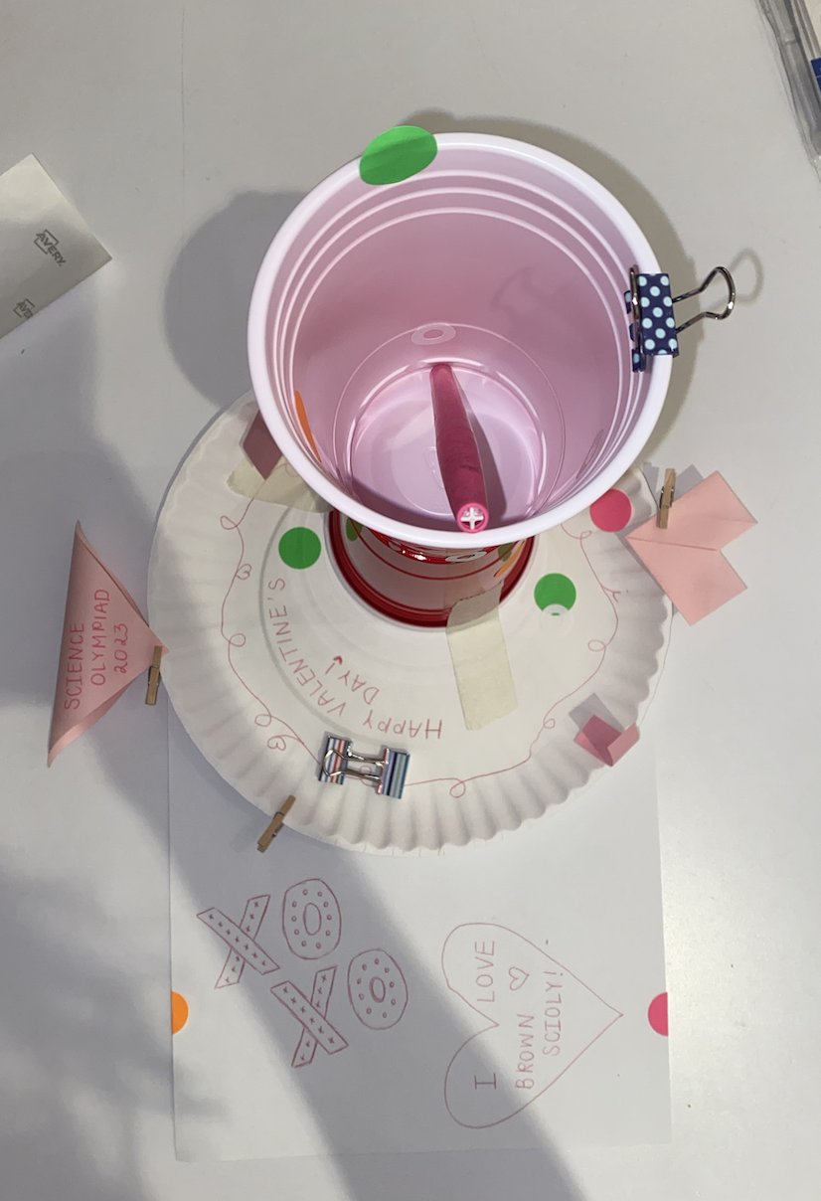
Example models
Notes:
Pull some questions from exams on the scioly wiki test exchange, first give attendees a couple minutes to read over them/work through them, then walk them through the answers. Try to get a mix of multiple choice and short answer or matching

Slide 12
Tips from a Veteran
Time management is incredibly important - as both a writer and a doer, you need to know how to pace yourself
People that think alike tend to do better as a pair - someone who looks at the words you write and thinks the same thing. If you can, test for it
Writing in a way your doer understands takes a lot of practice - so practice as much as possible, many DIFFERENT KINDS of builds! (origami, K’NEX, drawings)
Come up with standards between the two of you that you have in common - use centimeters (width of pinky), inches, thumb-lengths, whatever works for you. Some I used: cardinal directions, x/y/z dimensions, degrees clockwise/counterclockwise, left/right/front/back/up/down (make sure to define front vs back!), clock times, “standing up”, “lying down”, “upside down”
(in my experience) Time is majorly important to this event - on easy builds, you want to win the tiebreaker, and on hard builds, you want to finish as much as you can
Notes:
Use this section to talk about any strategies you used to navigate the event when you competed. For example, how did you manage your time, how did you organize your notes, how did you split topics up between you and your partner, etc.?

Slide 13
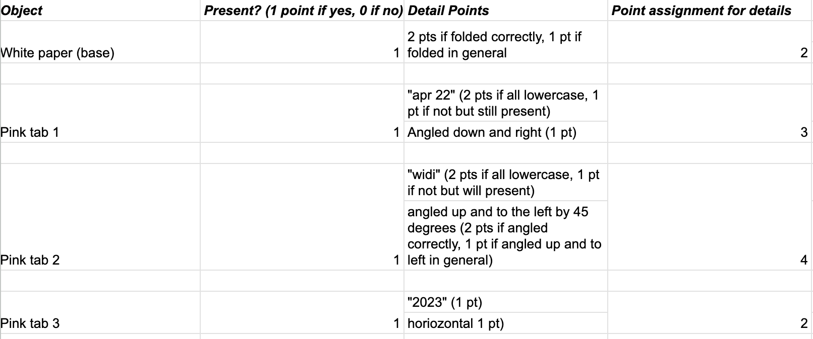
Tips from an Event Supervisor
Find the best ways to maximize your points (high yield strategies!)
You will get points just for having objects–some event supervisors will provide points for getting something really close to what it’s supposed to be (lettering, orientation)
Notes:
Use this section to talk about any strategies you used to navigate the event when you competed. For example, how did you manage your time, how did you organize your notes, how did you split topics up between you and your partner, etc.?

Slide 14
Additional Resources
Try new models/techniques! What are common shapes?
Invitationals provide past exams/models that you can practice with!
SUBWAY STATIONS
Try “asynchronous” builds! Practice is practice
Origami makes for very low-effort builds that are surprisingly difficult
Yes, Saturn is the ringed one. This planet is a gas giant, and it’s composed mostly of hydrogen and helium
Notes:
Here, you can link or mention any online or book resources that helped you in this event when you were a competitor. Try to avoid general resources like scioly wiki, because they probably already are familiar with it.

Slide 15
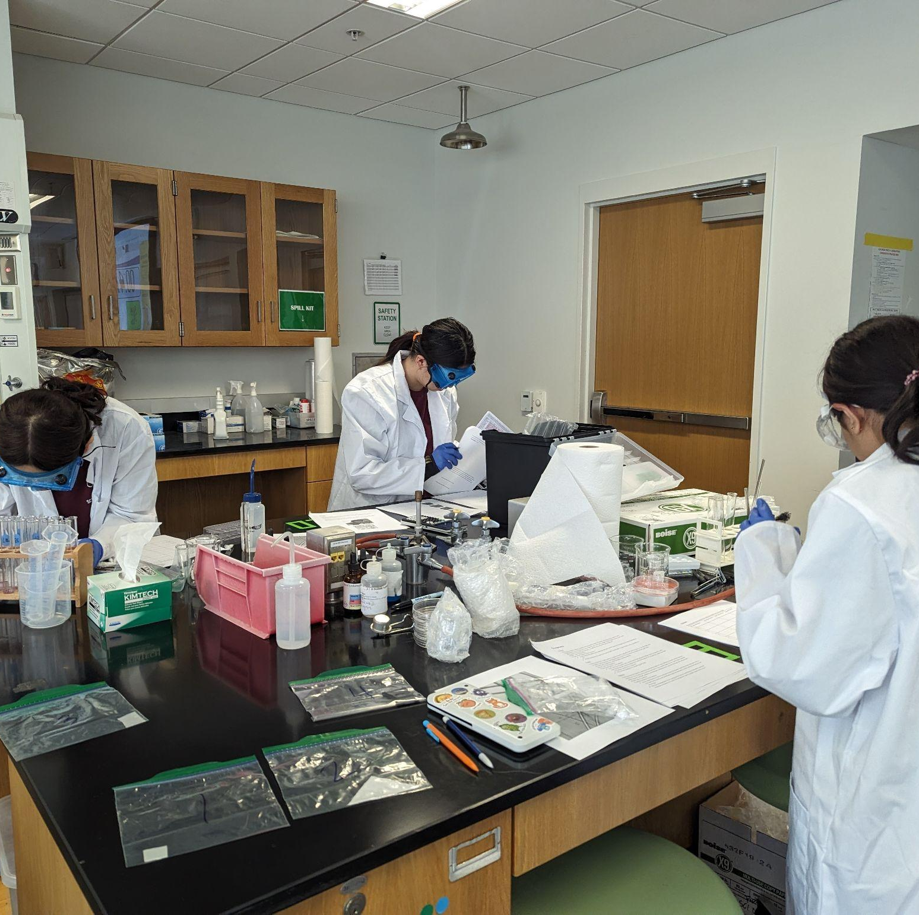
THANKS!
Notes:
(replace picture with a picture from one of our tournaments)

