Slide 1
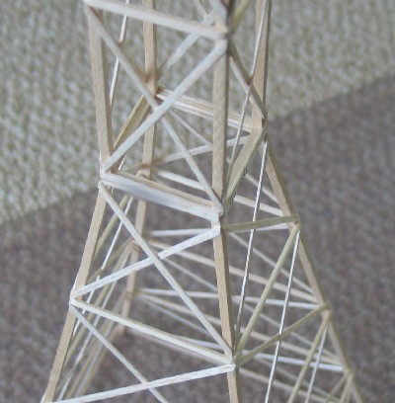
Tower
Division B/C
Georgia Tech Event Workshop Series 2024-25

Slide 2
01
RULES SHEET
02
DIFFICULT TOPICS
03
TIPS FROM A VETERAN
04
OTHER FREE RESOURCES
Notes:
For Builds: Replace difficult topics with physical principles involved in the build and replace common questions with common designs

Slide 3
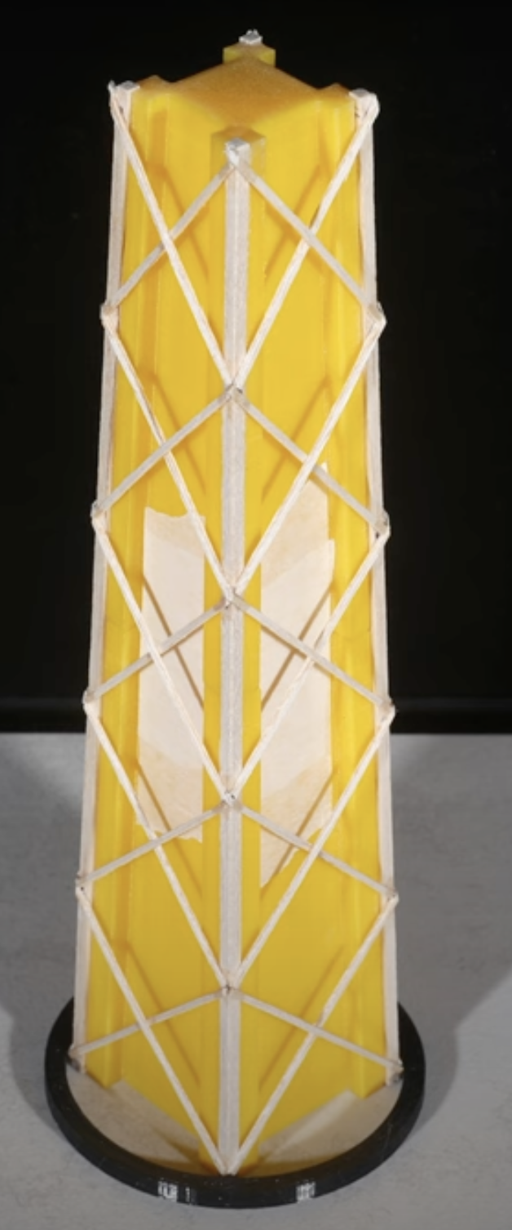
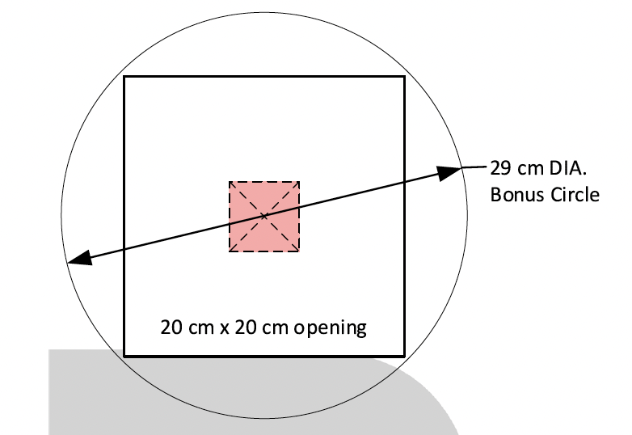
The Rules Sheet
Dimension (50cm tall)
Bonus point
Scoring
Make sure not to get tier down
During competition
Div B rule
Notes:
Highlight key points from the rules sheet: DESIGN LOGS that basically grant free points, most tested-on topics, point distribution so that competitors know what to prioritize, allowed notes and equipment, etc.

Slide 4
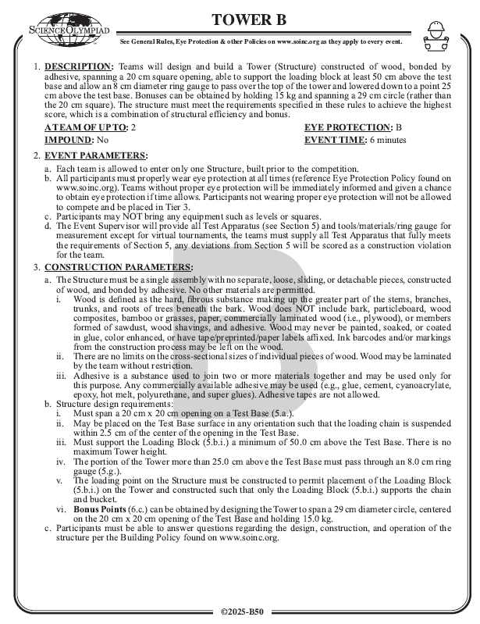
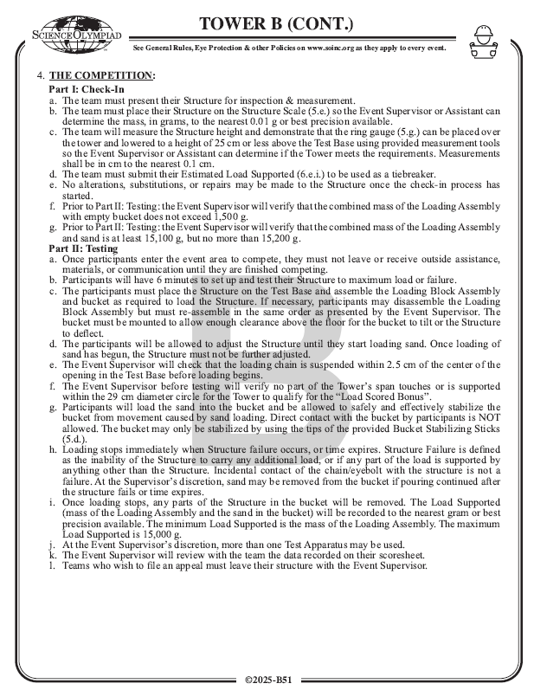

Slide 5
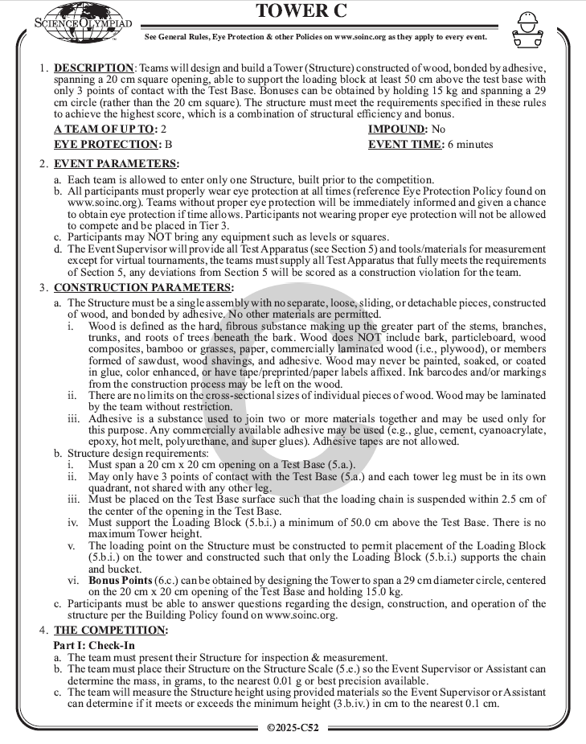
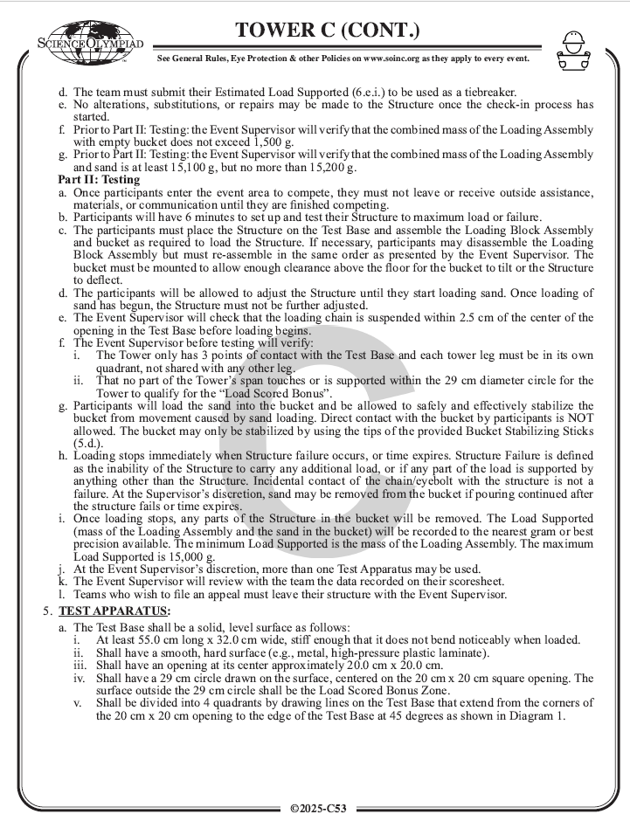

Slide 6
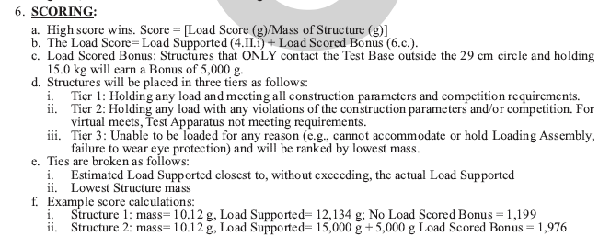
Scoring

Slide 7
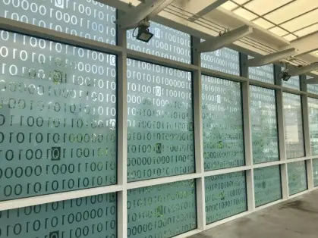
DIFFICULT TOPICS
Notes:
This section should focus on topics that are more math-based (harder to self-teach), concepts that come only usually up in college level courses, or concepts that you struggled with when you competed in this event

Slide 8
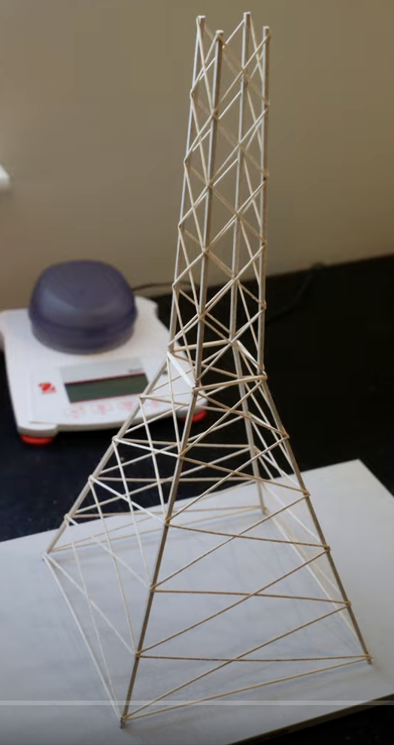
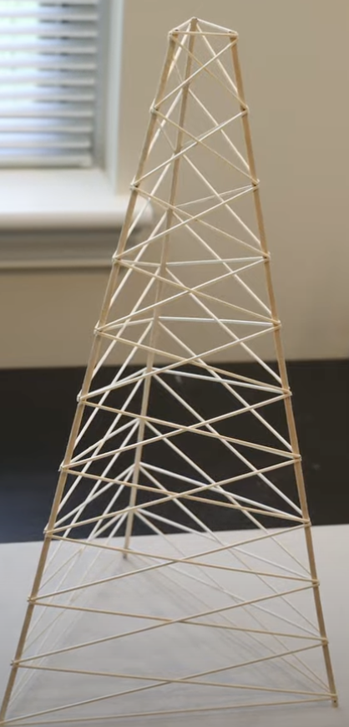
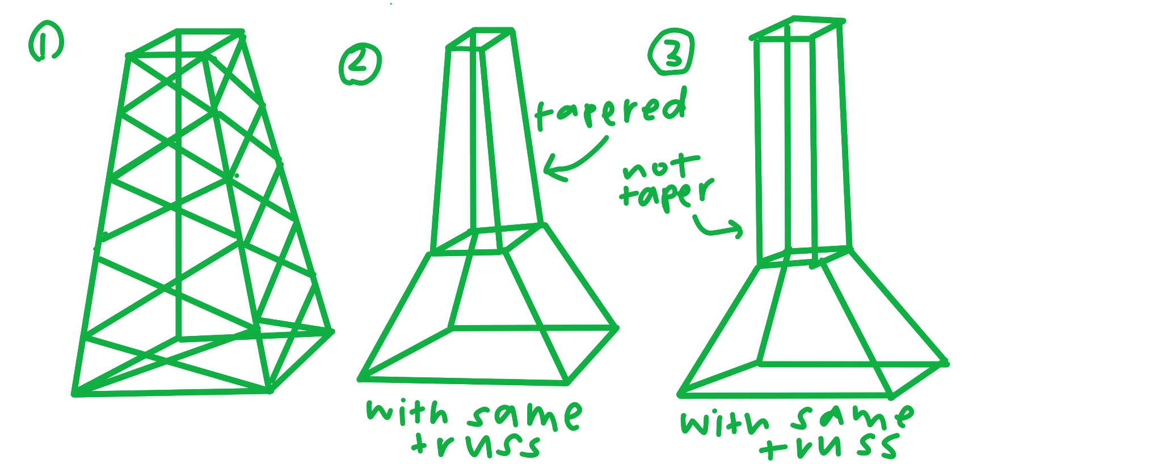
Topic 1: how to design/shape

Slide 9
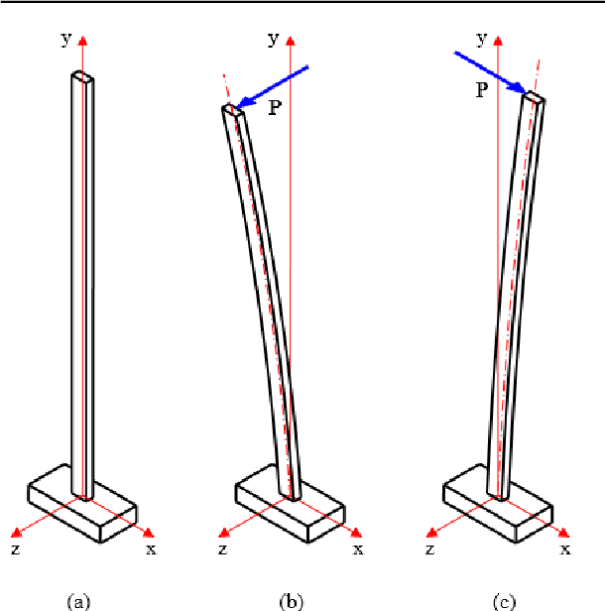
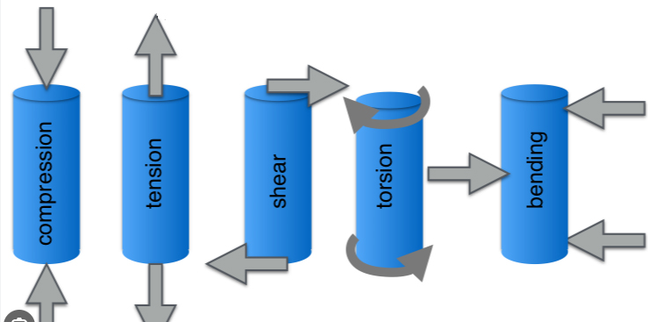
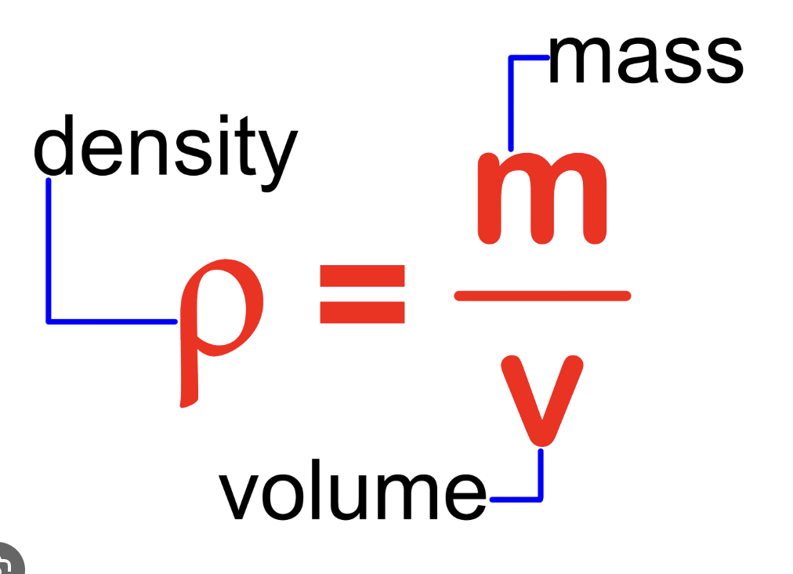
Topic 1: force act on each members
Density
Force

Slide 10
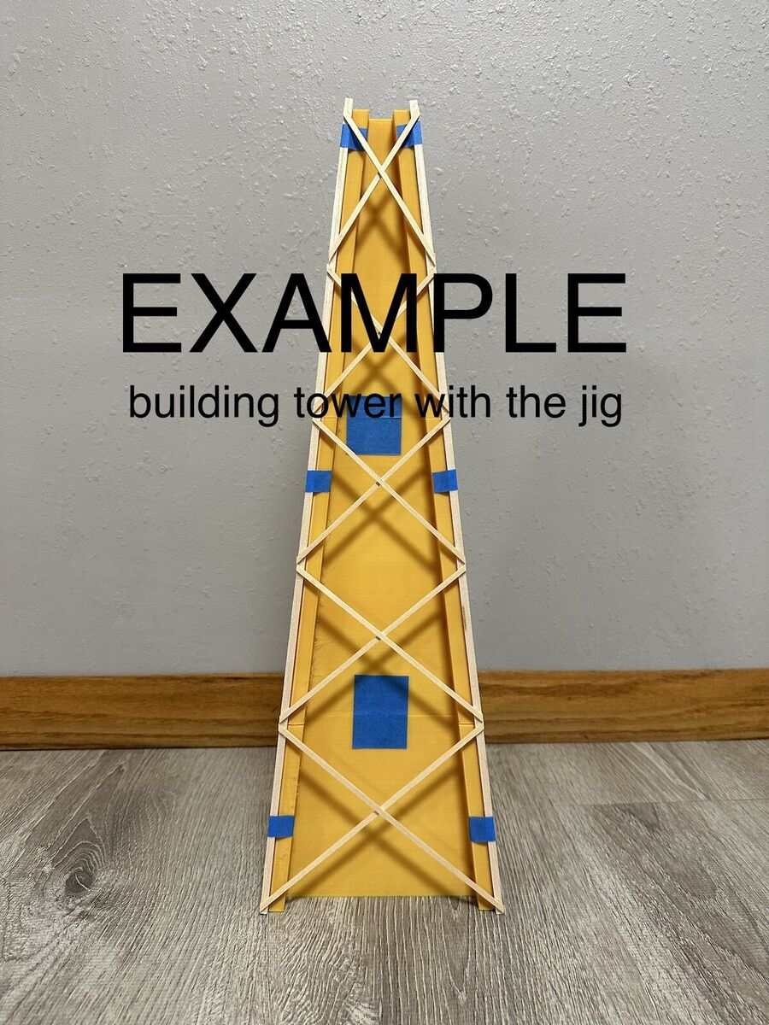
Topic 2: [craftsmanship]
Consistency
Glue
Wood
jig

Slide 11
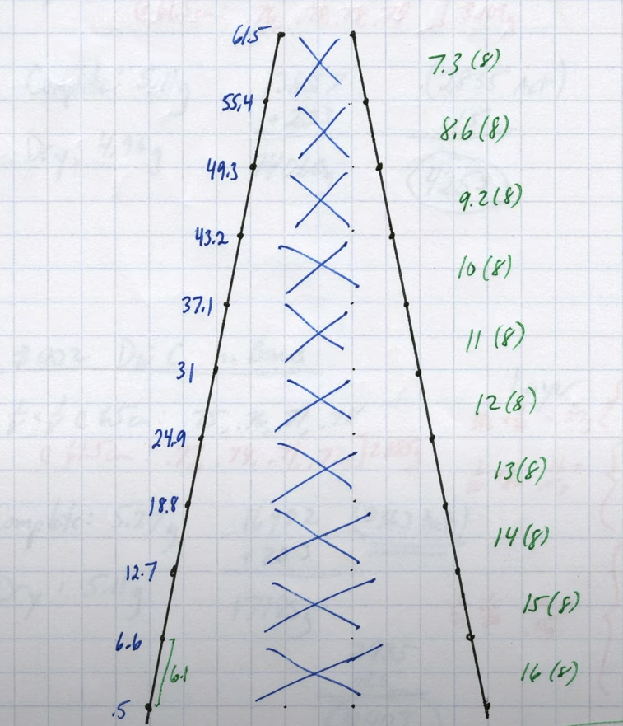
Topic 3: [data collection]
Log
Measure
video(slow motion)
Notes:
Feel free to add more topics and make sure that there are plenty of pictures/diagrams!

Slide 12
Tips from a Veteran
Observe during competition
Learn from mistake
Build a lot and test a lot with well documentation
Notes:
Use this section to talk about any strategies you used to navigate the event when you competed. For example, how did you manage your time, how did you organize your notes, how did you split topics up between you and your partner, etc.?

Slide 13
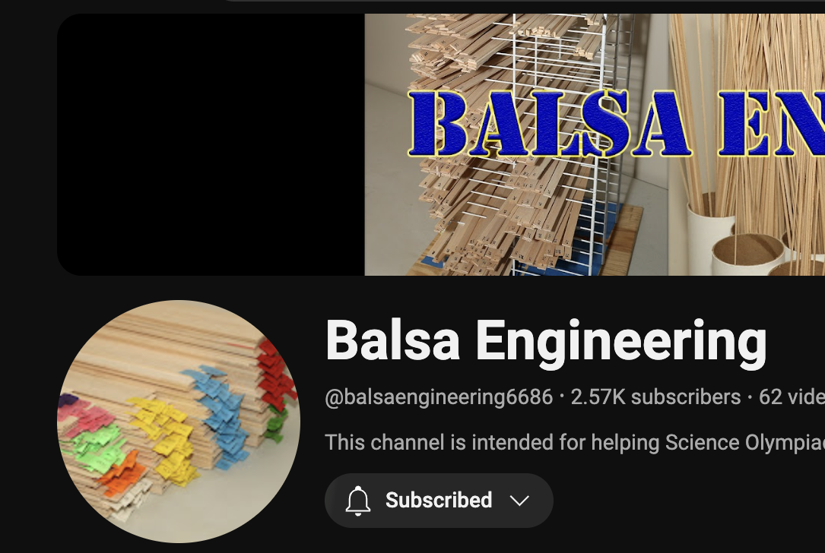
Additional Resources
Resource 1
SUBWAY STATIONS
link
Yes, Saturn is the ringed one. This planet is a gas giant, and it’s composed mostly of hydrogen and helium
Notes:
Here, you can link or mention any online or book resources that helped you in this event when you were a competitor. Try to avoid general resources like scioly wiki, because they probably already are familiar with it.

Slide 14
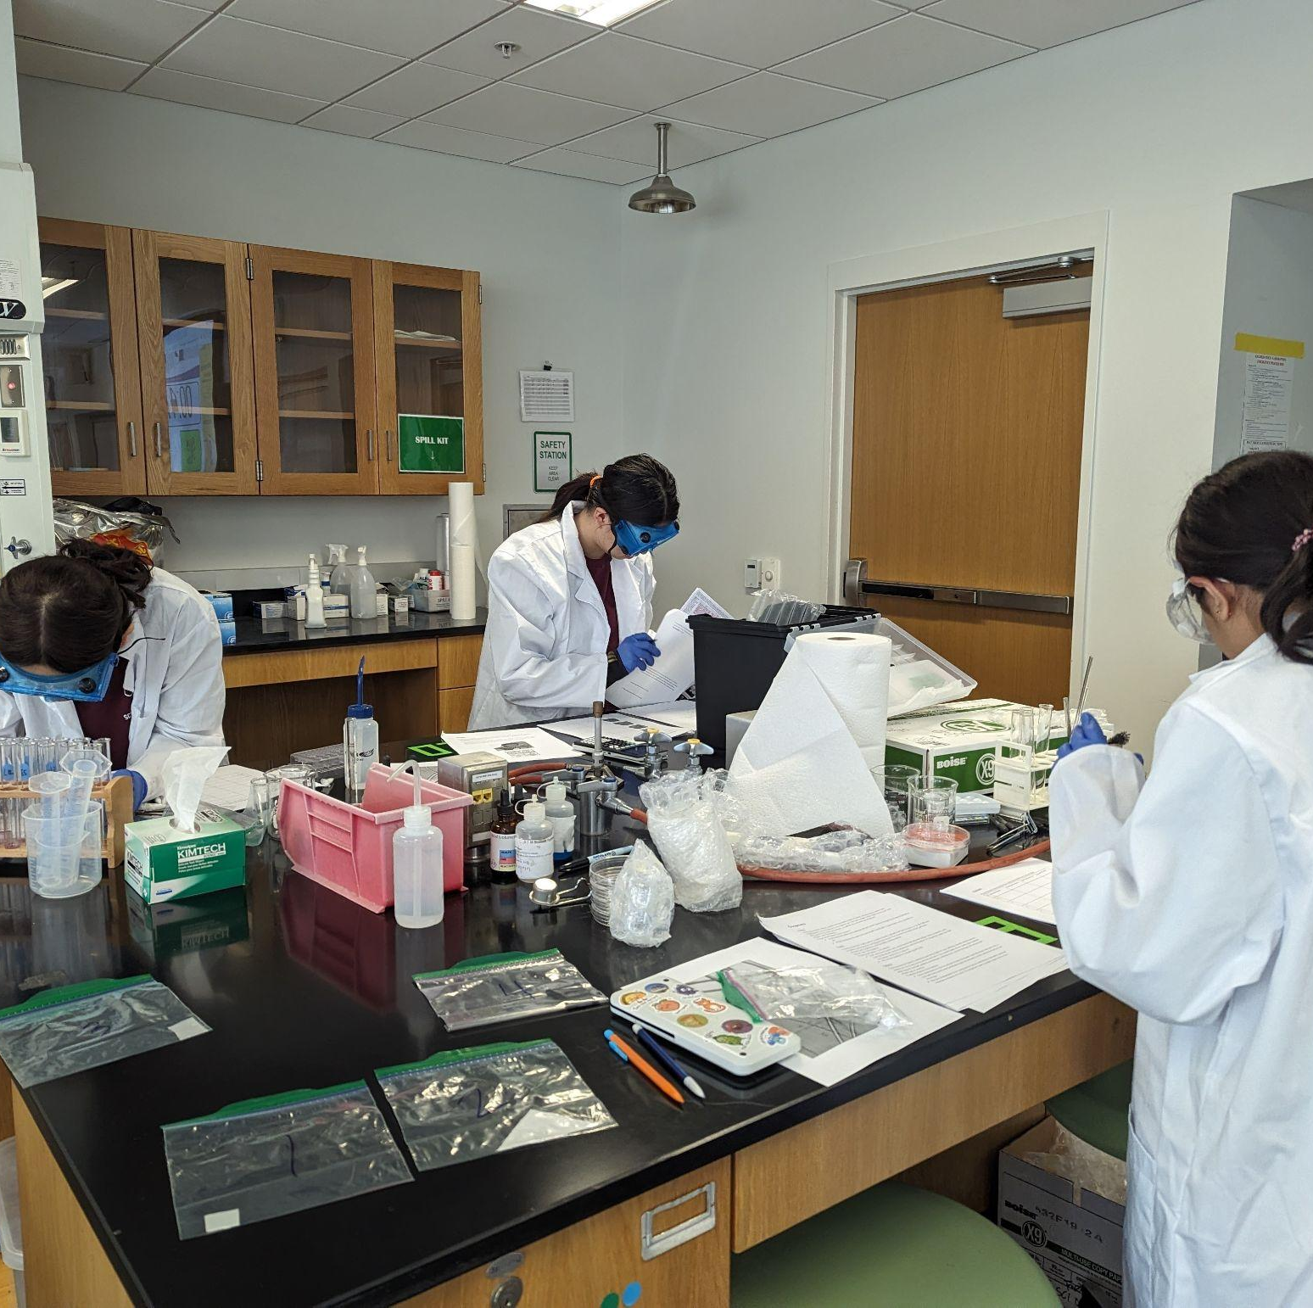
THANKS!
Notes:
(replace picture with a picture from one of our tournaments)

