Slide 1
Scrambler
Division B
Georgia Tech Event Workshop Series 2024-25

Slide 2
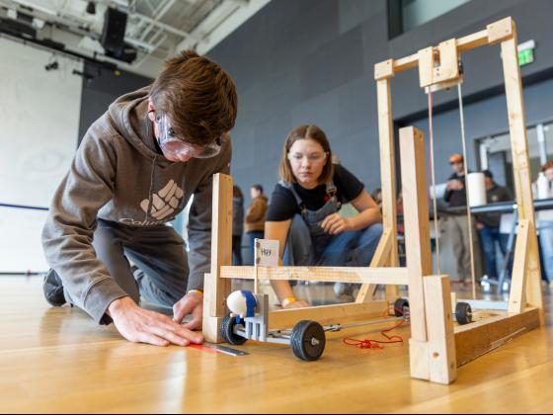
01
RULES SHEET
02
DIFFICULT TOPICS
03
TIPS FROM A VETERAN
04
OTHER FREE RESOURCES
Notes:
For Builds: Replace difficult topics with physical principles involved in the build and replace common questions with common designs

Slide 3
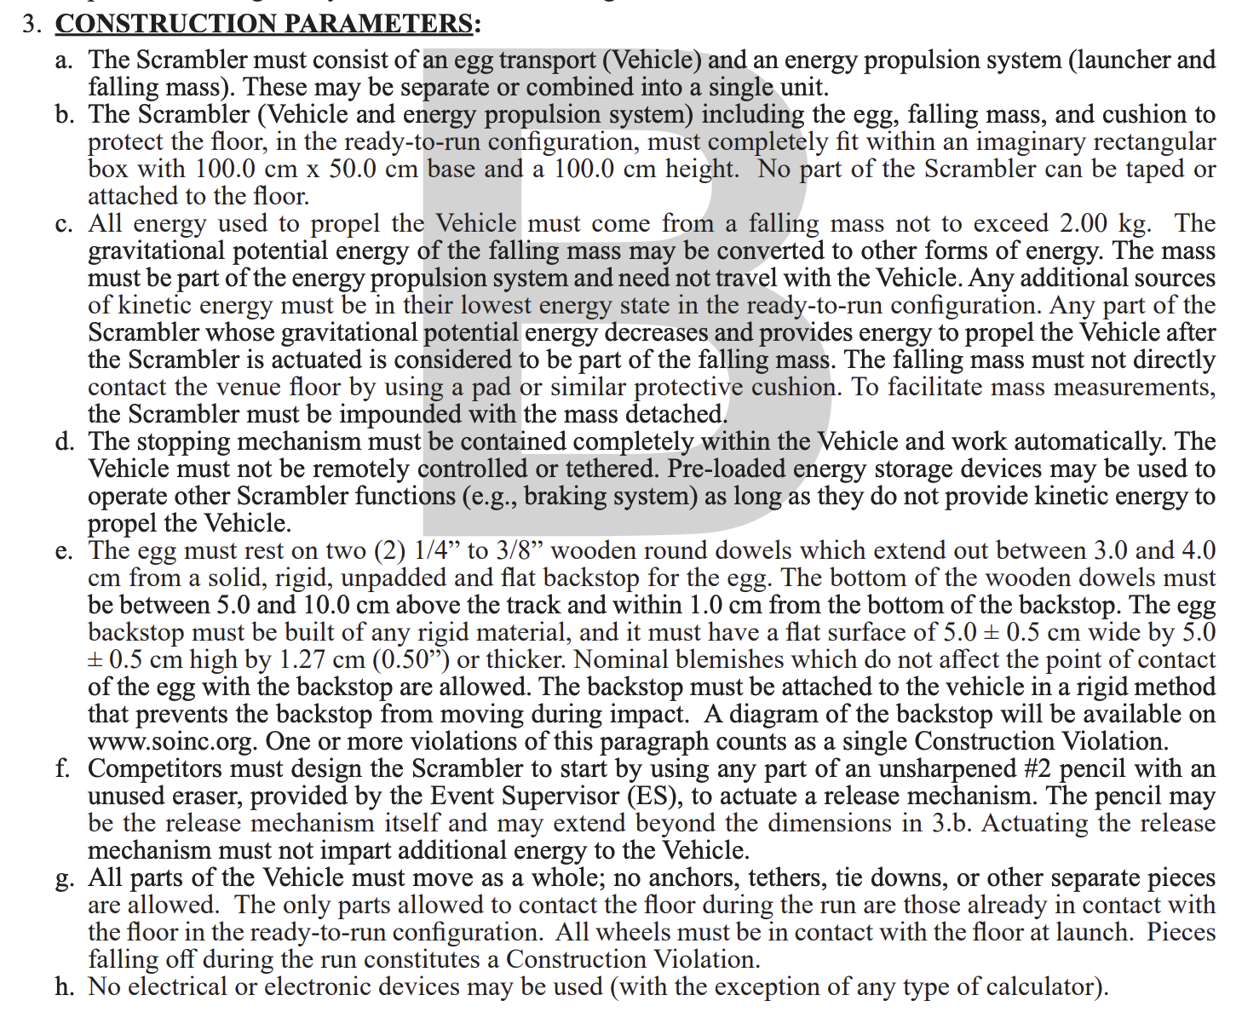
The Rules Sheet
Basically have these memorized. Meet these criteria at all costs even if the device doesn’t do what you want it to. Getting tiered is extremely detrimental.
Make sure the device is able to be released using a pencil and fits the dimensions.
Notes:
Highlight key points from the rules sheet: DESIGN LOGS that basically grant free points, most tested-on topics, point distribution so that competitors know what to prioritize, allowed notes and equipment, etc.

Slide 4
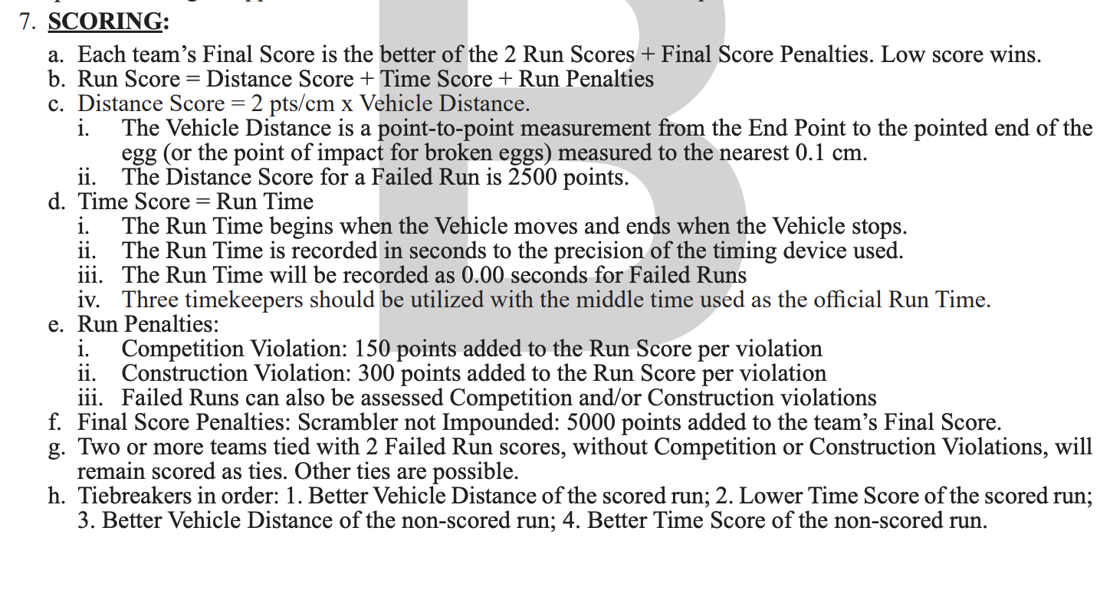
Scoring
Accuracy > Speed
Prioritize consistent launcher for your car and consistent/accurate stopping mechanism
Find different ways to reduce slippage when the car stops for accuracy.
Notes:
Highlight key points from the rules sheet: DESIGN LOGS that basically grant free points, most tested-on topics, point distribution so that competitors know what to prioritize, allowed notes and equipment, etc.

Slide 5
DIFFICULT TOPICS
Notes:
This section should focus on topics that are more math-based (harder to self-teach), concepts that come only usually up in college level courses, or concepts that you struggled with when you competed in this event

Slide 6
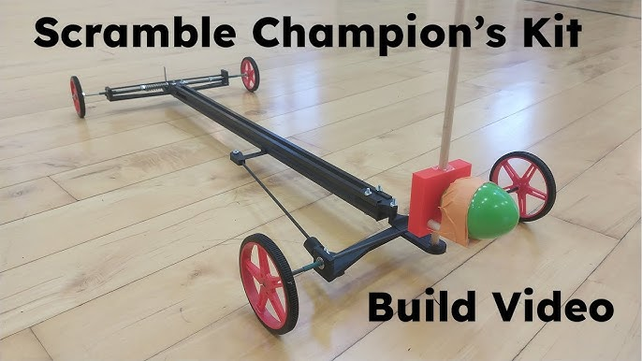
Topic 1: Goals
Prioritize consistency and basic capability
Minimize changed variables between trials as much as possible to isolate independent variables
Design on the right
Pros
Kit, can focus on consistency
Realistic for a first competition
Cons
Not that customizable

Slide 7
Topic 2: Consistency
Perfect the # of wheel turns for distances (depending on your stopping mechanism)
Change independent variable to reach as many distances as you can
I usually start with increments of 0.5m and half the increments each time I go through them all
Get to each distance within a certain threshold 3 times in a row before moving on.
Make logs even though they’re not mandatory and record everything.
The more data you have, the more you can extrapolate
Only after you have the bare-minimum. Have a device that can go the full distance first before working on achieving all the distances in between.

Slide 8
Topic 3: Late-Stage
Benefits:
Custom for our launcher dimensions
Varying weight based on 3D-printing infill
Focus on reducing time rather than high accuracy
Cons:
More skills required and harder to do
(variation of initial kit)
Presentation of 3D Model and Explanation of how launcher + device works
Notes:
Feel free to add more topics and make sure that there are plenty of pictures/diagrams!

Slide 9
Tips from a Veteran
Prioritize consistency above everything else
Collect as much information about your device as possible before competitions
Logs
Measurements
Make sure it meets rules requirements
Do NOT get tiered.
Make sure you know what is realistic for your timeline
Get inspired by other designs and whatever you think you can make consistent
Notes:
Use this section to talk about any strategies you used to navigate the event when you competed. For example, how did you manage your time, how did you organize your notes, how did you split topics up between you and your partner, etc.?

Slide 10
Additional Resources
Unphayzed Kit
Website to buy and watch tutorials on how to build the Champion’s Kit by Unphayzed.
OnShape
Free 3D Modeling software, easy to learn, no download needed.
Notes:
Here, you can link or mention any online or book resources that helped you in this event when you were a competitor. Try to avoid general resources like scioly wiki, because they probably already are familiar with it.

Slide 11
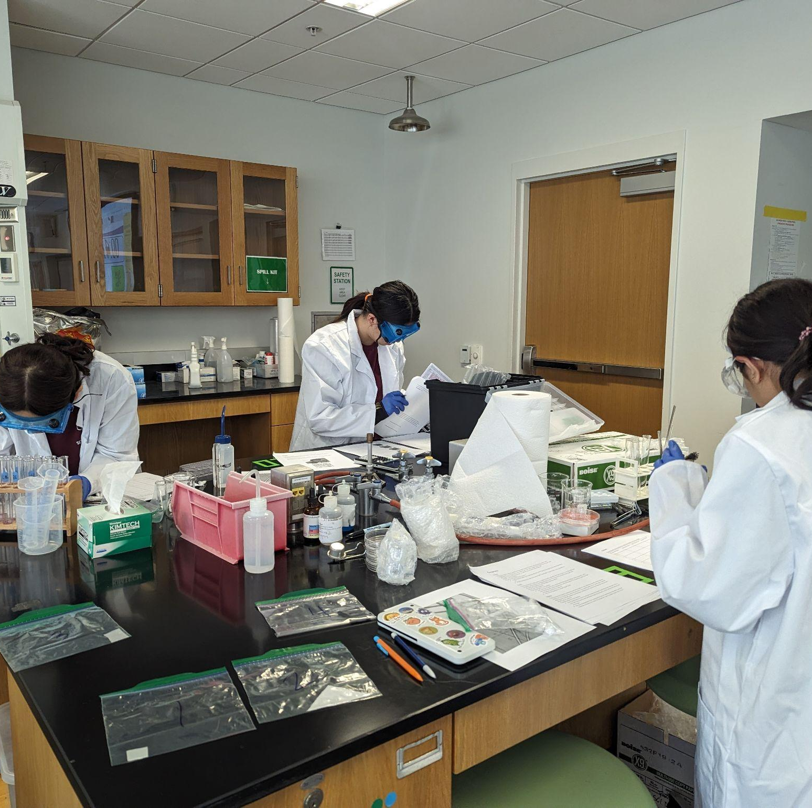
THANKS!
Notes:
(replace picture with a picture from one of our tournaments)

