Slide 1
Robot Tour
Division C
Georgia Tech Event Workshop Series 2024-25

Slide 2
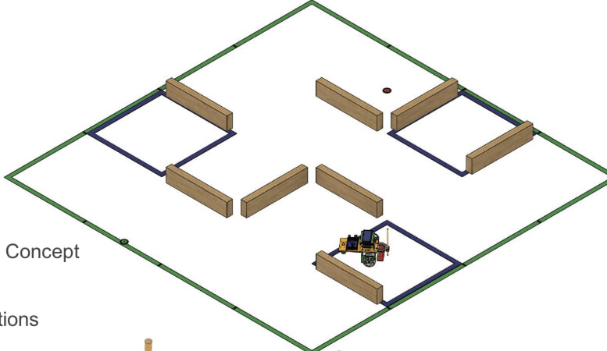
01
RULES SHEET
02
COMMON DESIGNS
[Event-Related Image]
03
NAVIGATION
04
COMMON ISSUES
05
OTHER FREE RESOURCES
Notes:
For Builds: Replace difficult topics with physical principles involved in the build and replace common questions with common designs

Slide 3
RULES
Notes:
This section should focus on topics that are more math-based (harder to self-teach), concepts that come only usually up in college level courses, or concepts that you struggled with when you competed in this event

Slide 4
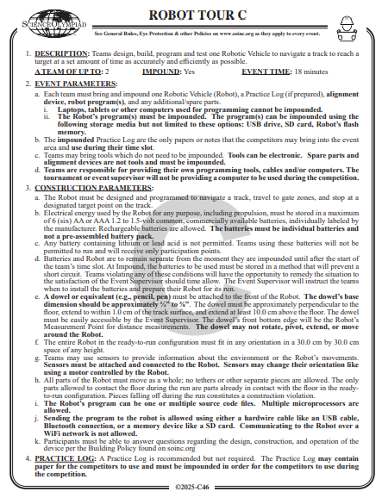
General Goal
Navigate a robot through a track avoiding obstacles and hitting as many gate zones as possible
Do so in an amount of time determined by the ES at start
Goal is to get as few points as possible
Notes:
Highlight key points from the rules sheet: DESIGN LOGS that basically grant free points, most tested-on topics, point distribution so that competitors know what to prioritize, allowed notes and equipment, etc.

Slide 5
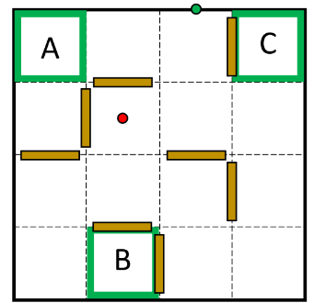
The Track
Made up of 50 cm squares
Up to 10 obstacles
+70 for hitting an obstacle
+50 for removing obstacles
-15 per gate, -45 for hitting the last gate

Slide 6
Design Specifications
MAKE SURE YOUR DOWEL IS CORRECT!
Dowel can be anything, even a pencil, but must be less than 1 cm above the ground and at least 10 cm above
As a general rule, always make sure your device fits well within standards (30x30 cm). ES’s might measure things differently, so make sure you give no room for error.
Don’t let things fall off your robot.

Slide 7
COMMON DESIGNS
Notes:
This section should focus on topics that are more math-based (harder to self-teach), concepts that come only usually up in college level courses, or concepts that you struggled with when you competed in this event

Slide 8
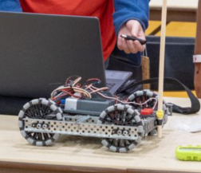
Ward’s Science
Science Olympiad™ 2024-2025 Robot Tour Kit | Ward's Science
$100 but is very reliable
Basic but sturdy and has a two motor-controller

Slide 9
Any Other Robot Online
Minestorms and other commercial robots work too!
This is unfortunately a pretty expensive event, but simpler kits are less expensive
Links to ones I’ve seen:
Smart Robot DIY Kit Intelligent Programmable Robot Kit with Arduino System Obstacle Avoidance Tracking STEM Wireless Vehicle Direction Control for Boys Girls Christmas Educational Gift - Walmart.com
https://www.amazon.com/Elecfreaks-Microbit-Smart-Cutebot-Micro/dp/B081ZSCZTV/ref=asc_df_B081ZSCZTV?tag=bingshoppinga-20&linkCode=df0&hvadid=80264440653340&hvnetw=o&hvqmt=e&hvbmt=be&hvdev=c&hvlocint=&hvlocphy=&hvtargid=pla-4583863987342616&psc=1
Amazon.com: FREENOVE Micro:Rover Kit for BBC Micro:bit (Not Included, Work with V1 & V2), Obstacle Avoidance, Light-tracing, Line-Tracking, Remote Control, Playing Melody, Colorful Lights, Blocks and Python Code : Toys & Games

Slide 10
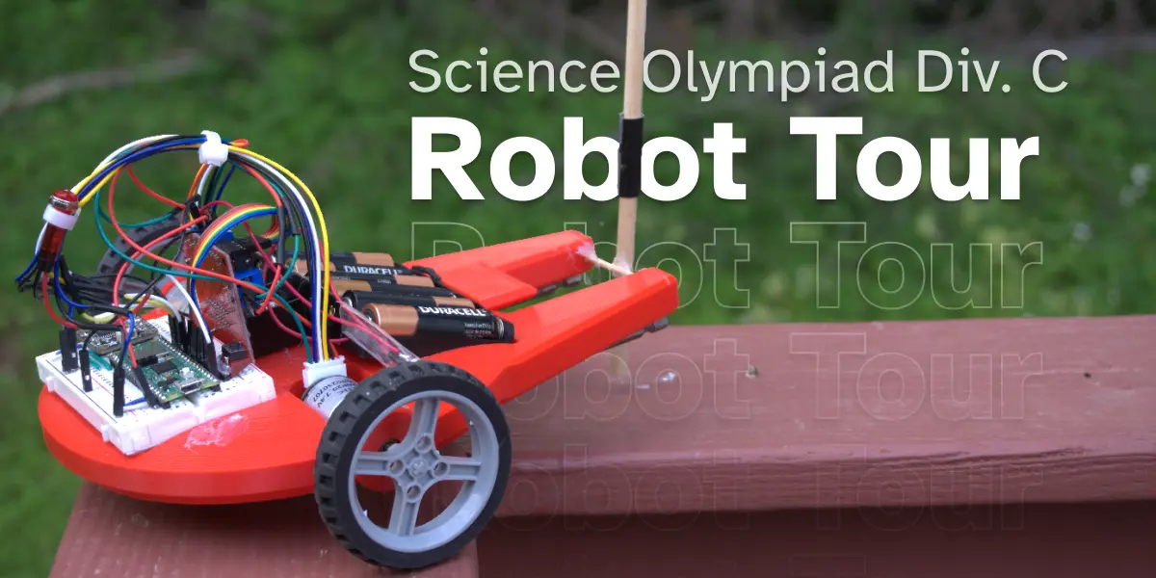
Build Your Own!!
Objectively more fun
A robot is basically 3 things: a body, controller, and motors
You can use any arduino for programming, which easily interface with most DC motor drivers
After that, you can build a body using simple tools and wood or cardboard.
Grippy wheels are a must!! You don’t know what material you will be navigating.
Notes:
Feel free to add more topics and make sure that there are plenty of pictures/diagrams!

Slide 11
NAVIGATION
Notes:
\

Slide 12
Should I use autonomous sensing?
No.
Autonomous sensing, from what I’ve seen, is hard to get right.
If you really want to use it, I recommend it as a fall back for in case you are about to hit an obstacle. It is very hard to use for true navigation.
Notes:
Pull some questions from exams on the scioly wiki test exchange, first give attendees a couple minutes to read over them/work through them, then walk them through the answers. Try to get a mix of multiple choice and short answer or matching

Slide 13
Coding
Use whatever software interfaces with your robot best, I’ve mostly seen scratch and Arduino
Make code blocks ahead of time
Ie “Move forward” and “turn left 90 degrees”
This allows for quick programming by creating sequences of code
Small code blocks are also easy to test lots! You can go over one chunk to make sure it turns exactly 90 degrees instead of 91
Notes:
Pull some questions from exams on the scioly wiki test exchange, first give attendees a couple minutes to read over them/work through them, then walk them through the answers

Slide 14
Timing
Slow down your wheels, as stalling is prohibited and it is hard to make a course that is exactly as long as you need.
The official term for this is PWM’ing your motors
This should follow about a linear relation to the voltage supplied to your motors
Put this graph in your impounded sheets and you can use it to backwards calculate what voltage to supply
Go over time, not under! Under is x2 points added to your score.
Notes:
Pull some questions from exams on the scioly wiki test exchange, first give attendees a couple minutes to read over them/work through them, then walk them through the answers

Slide 15
Common Issues
Improper Termination
Dowel Issues
SUBWAY STATIONS
Hitting too many Obstacles
Leaving the Track
Yes, Saturn is the ringed one. This planet is a gas giant, and it’s composed mostly of hydrogen and helium
Notes:
Here, you can link or mention any online or book resources that helped you in this event when you were a competitor. Try to avoid general resources like scioly wiki, because they probably already are familiar with it.

Slide 16
Additional Resources
Robot Tour | Science Olympiad
RobotTour24 SampRegTrackSetups.pdf - Google Drive
SUBWAY STATIONS
Robot Tour (T) (C) — Science Olympiad
Robot Tour - Wiki - Scioly.org
Yes, Saturn is the ringed one. This planet is a gas giant, and it’s composed mostly of hydrogen and helium
Notes:
Here, you can link or mention any online or book resources that helped you in this event when you were a competitor. Try to avoid general resources like scioly wiki, because they probably already are familiar with it.

Slide 17
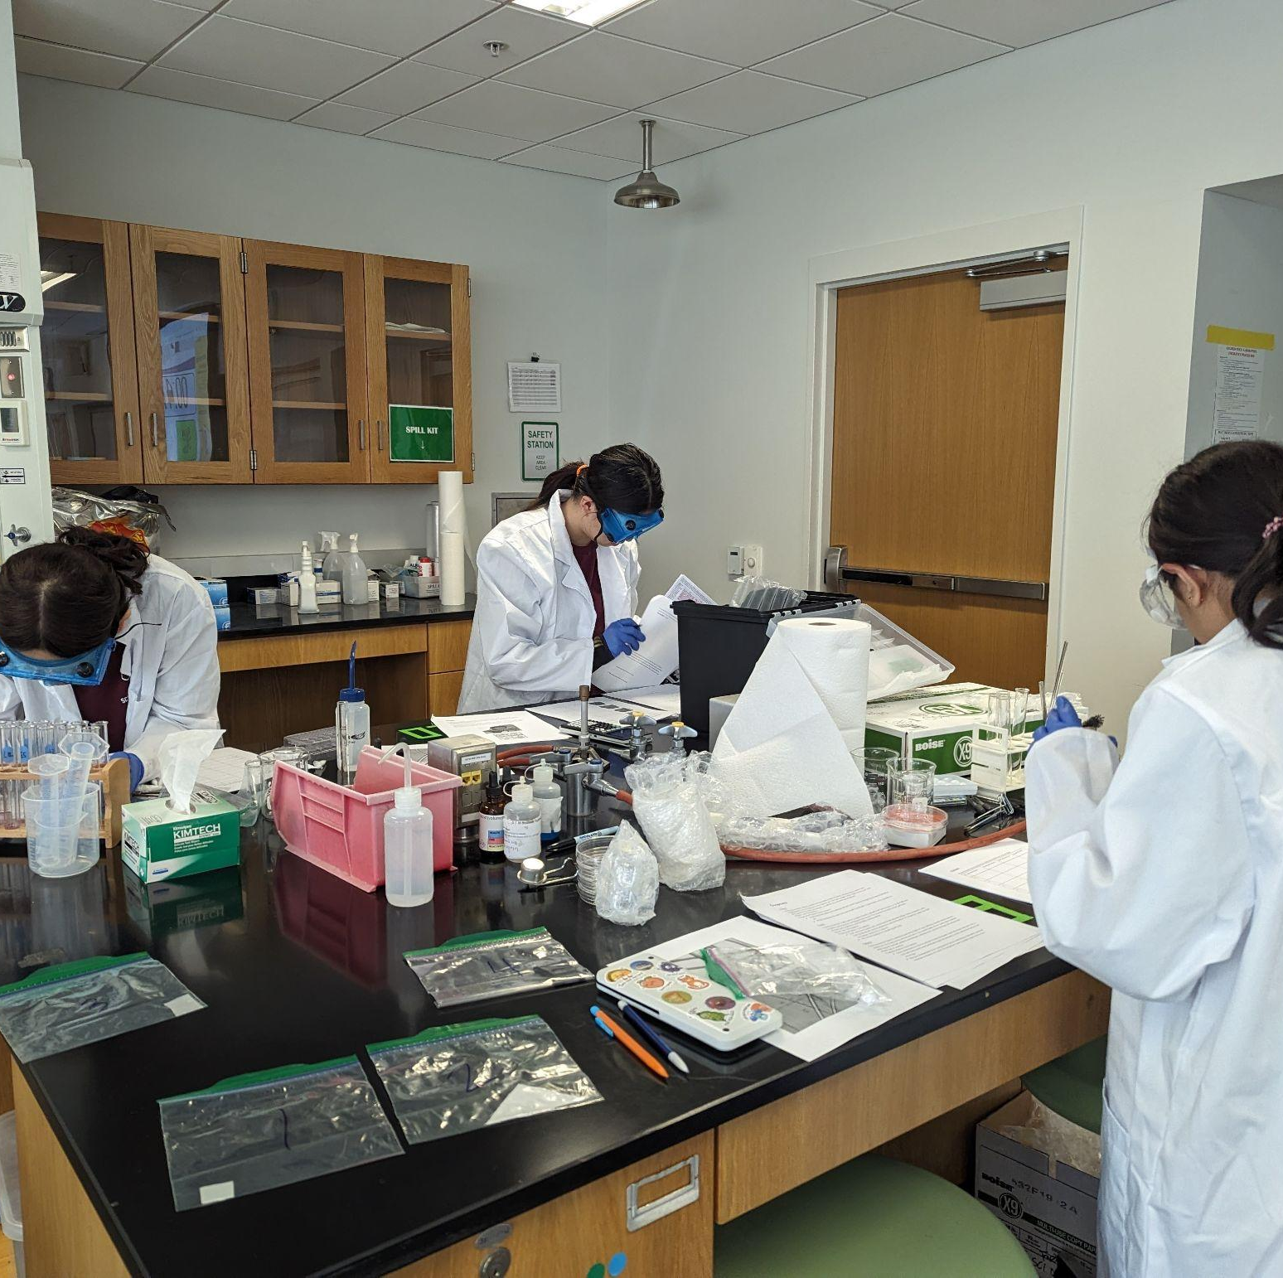
THANKS!
Notes:
(replace picture with a picture from one of our tournaments)

