Slide 1
Potions & Poisons
Division B
Georgia Tech Event Workshop Series 2024-25

Slide 2
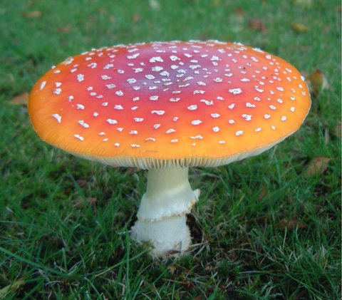
01
RULES SHEET
02
General Overview
03
COMMON QUESTIONS
04
TIPS FROM A VETERAN
05
OTHER FREE RESOURCES
Notes:
For Builds: Replace difficult topics with physical principles involved in the build and replace common questions with common designs

Slide 3
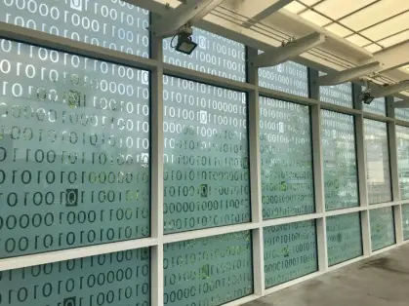
About Me
(Why you should trust me)

Slide 4
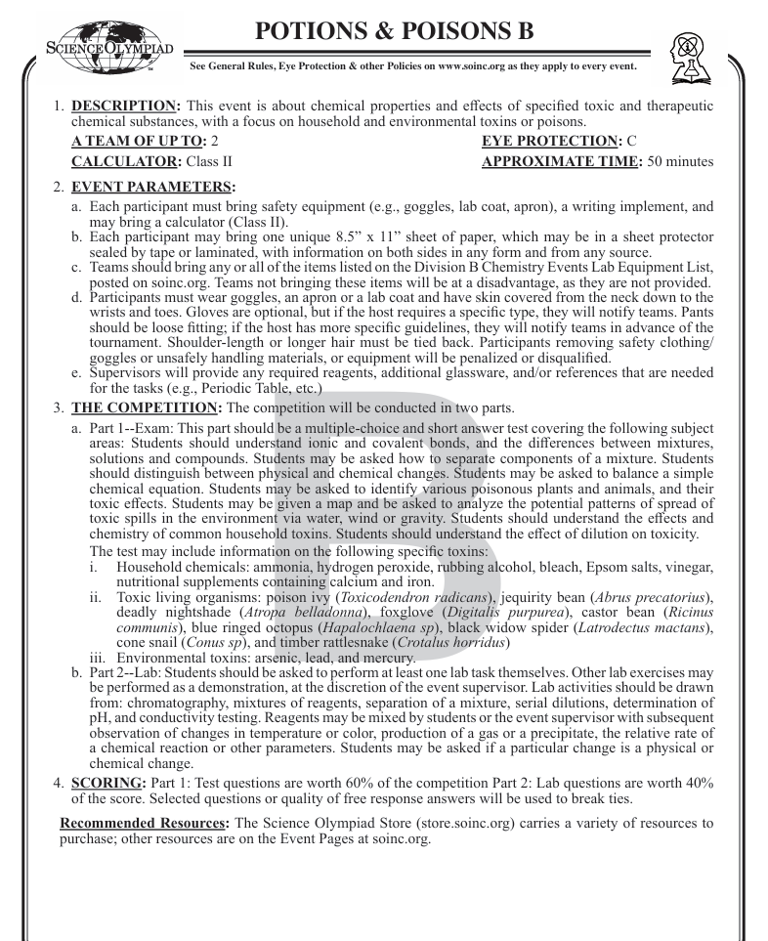
The Rules Sheet
Basic chemistry (bonds, mixtures vs. solutions, physical vs. chemical changes)
Lab skills (chromatography, pH testing, dilutions)
Environmental spread of toxins
Specific toxic organisms and household chemicals
Written Test: 60%
Lab Component: 40%
Safety
Notes:
Highlight key points from the rules sheet: DESIGN LOGS that basically grant free points, most tested-on topics, point distribution so that competitors know what to prioritize, allowed notes and equipment, etc.

Slide 5
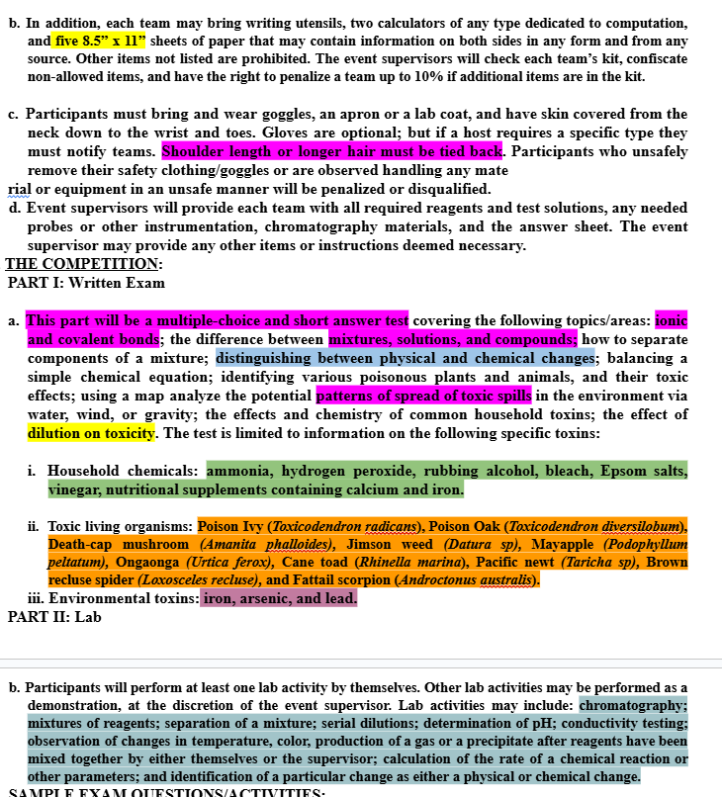
Annotate Your Sheet!
Notes:
Highlight key points from the rules sheet: DESIGN LOGS that basically grant free points, most tested-on topics, point distribution so that competitors know what to prioritize, allowed notes and equipment, etc.

Slide 6
DIFFICULT TOPICS
Notes:
This section should focus on topics that are more math-based (harder to self-teach), concepts that come only usually up in college level courses, or concepts that you struggled with when you competed in this event

Slide 7
Potions (Chemistry)
Need an extensive understanding of basic chemistry (HS level intro chem)
Ionic and covalent bonds
Mixtures, solutions, and compounds
Separation techniques
Physical vs. chemical changes
Basic equation balancing
Requires lots of practice
Great to be fast

Slide 8
Potions (Chem Lab)
Lab Safety is the most important part
Seen multiple teams DQ’d across all levels of competition.
Common Lab Topics
Chromatography
Working with reagent mixtures
Mixture separation
pH determination
Observation of chemical reactions:
Temperature changes
Color changes
Gas production
Precipitate formation
Reaction rate analysis
Notes:
Feel free to add more topics and make sure that there are plenty of pictures/diagrams!

Slide 9
Poisons (Toxins)
Extensive knowledge required here
Household Chemicals
Ammonia
Hydrogen peroxide
Rubbing alcohol
Bleach
Epsom salts
Vinegar
Calcium/iron supplements
Toxic Organisms
Environmental Toxins (and Cleanup)
Arsenic
Lead
Mercury

Slide 10
COMMON QUESTIONS
All of the following questions have been pulled from past YJI exams (which can be found on our website) or the Text Exchange on SciOly Wiki
Notes:
\

Slide 11
Question 1: Equation balancing
Notes:
Pull some questions from exams on the scioly wiki test exchange, first give attendees a couple minutes to read over them/work through them, then walk them through the answers. Try to get a mix of multiple choice and short answer or matching

Slide 12
Question 1: Equation balancing
Notes:
Pull some questions from exams on the scioly wiki test exchange, first give attendees a couple minutes to read over them/work through them, then walk them through the answers. Try to get a mix of multiple choice and short answer or matching

Slide 13
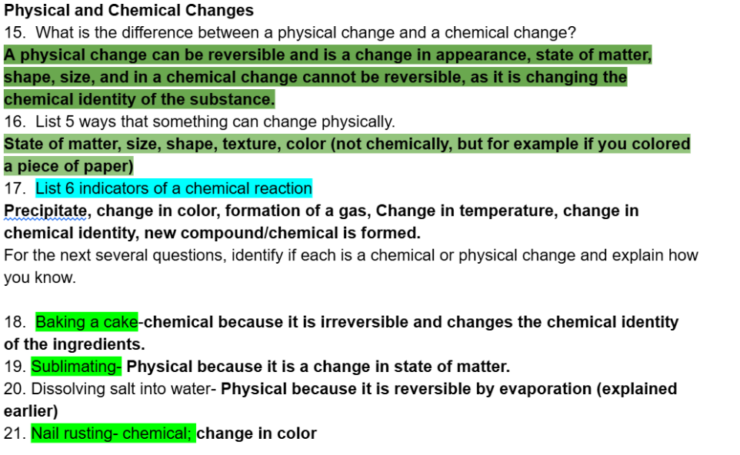
Question 2: Changes
Notes:
Pull some questions from exams on the scioly wiki test exchange, first give attendees a couple minutes to read over them/work through them, then walk them through the answers

Slide 14
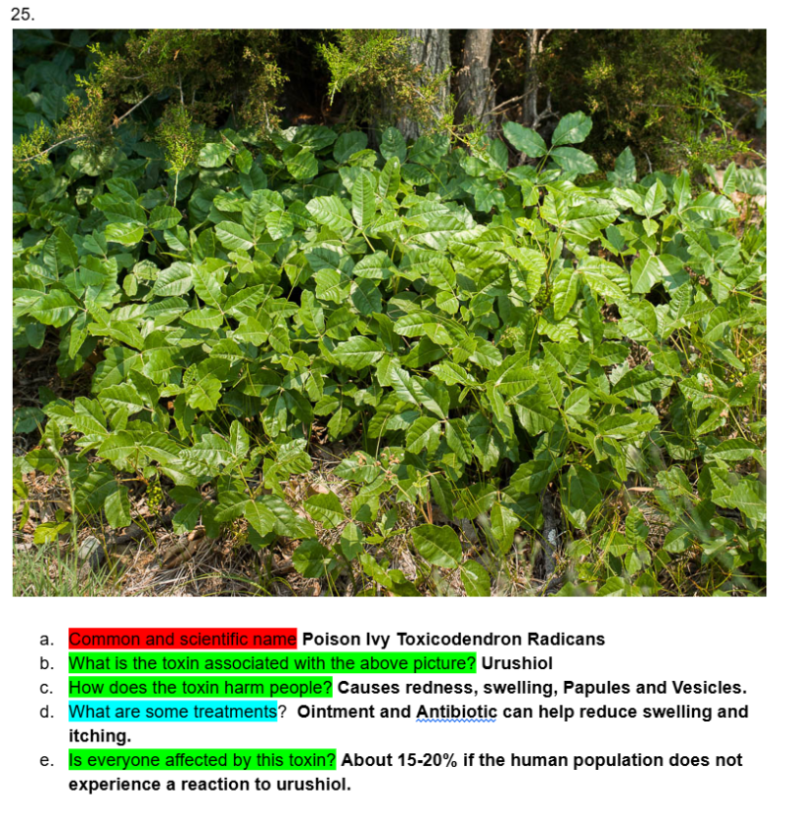
Question 3: Poisons
Notes:
Pull some questions from exams on the scioly wiki test exchange, first give attendees a couple minutes to read over them/work through them, then walk them through the answers

Slide 15
Question 4: Labs
Notes:
Pull some questions from exams on the scioly wiki test exchange, first give attendees a couple minutes to read over them/work through them, then walk them through the answers

Slide 16
Tips from a Veteran
Come up with a cheat-sheet divide ASAP
Create quick guides for common labs
In-depth information on toxins and organisms
Understand organizational involvement
Avoid having common chemistry things
Don’t depend on “provided reference materials”
Practice labs, many of the labs are easily accessible and can be practiced fairly easily at a school
Work well with your partner
Should one specialize in toxins vs chemistry?
How are y’all going to synchronize for labs?
Time Management
Notes:
Use this section to talk about any strategies you used to navigate the event when you competed. For example, how did you manage your time, how did you organize your notes, how did you split topics up between you and your partner, etc.?

Slide 17
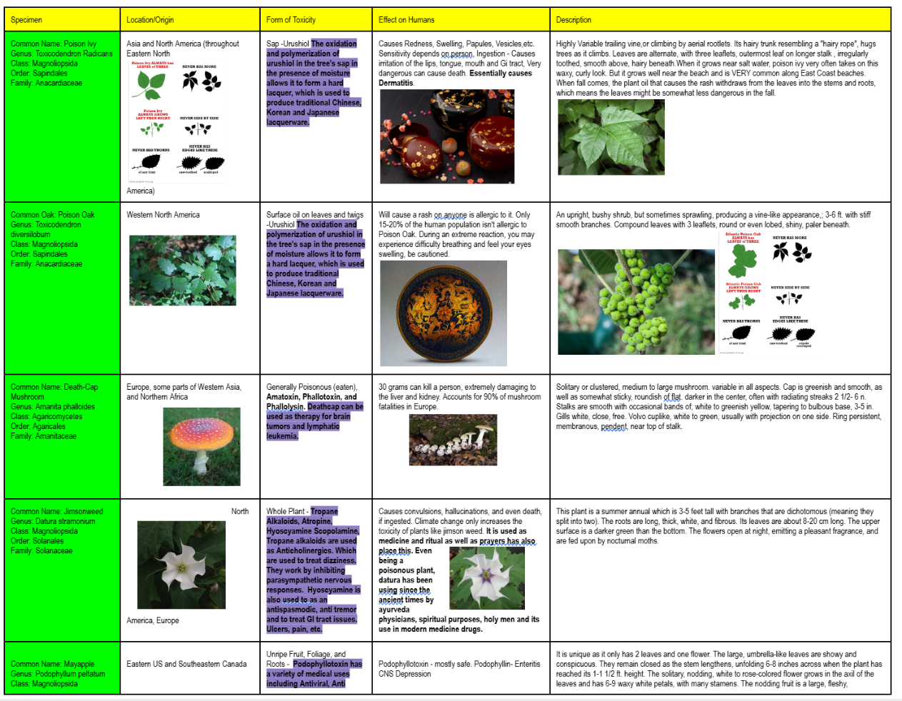
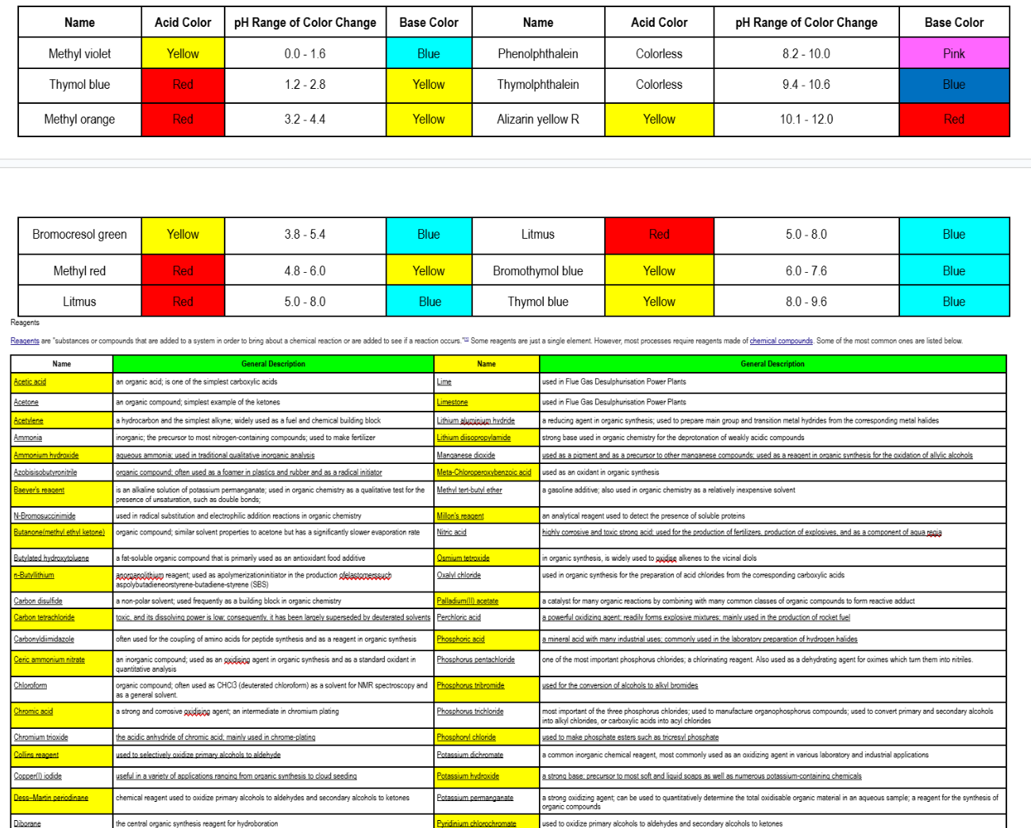
Cheat Sheet Tips
Notes:
Use this section to talk about any strategies you used to navigate the event when you competed. For example, how did you manage your time, how did you organize your notes, how did you split topics up between you and your partner, etc.?

Slide 18
Additional Resources
Government Agencies (EPA, CDC, NOAA, USDA ARS)
Khan Academy for basic Chem
SUBWAY STATIONS
PubChem / Toxnet
MIT OCW: Toxicology and Environmental Health
Yes, Saturn is the ringed one. This planet is a gas giant, and it’s composed mostly of hydrogen and helium
Notes:
Here, you can link or mention any online or book resources that helped you in this event when you were a competitor. Try to avoid general resources like scioly wiki, because they probably already are familiar with it.

Slide 19
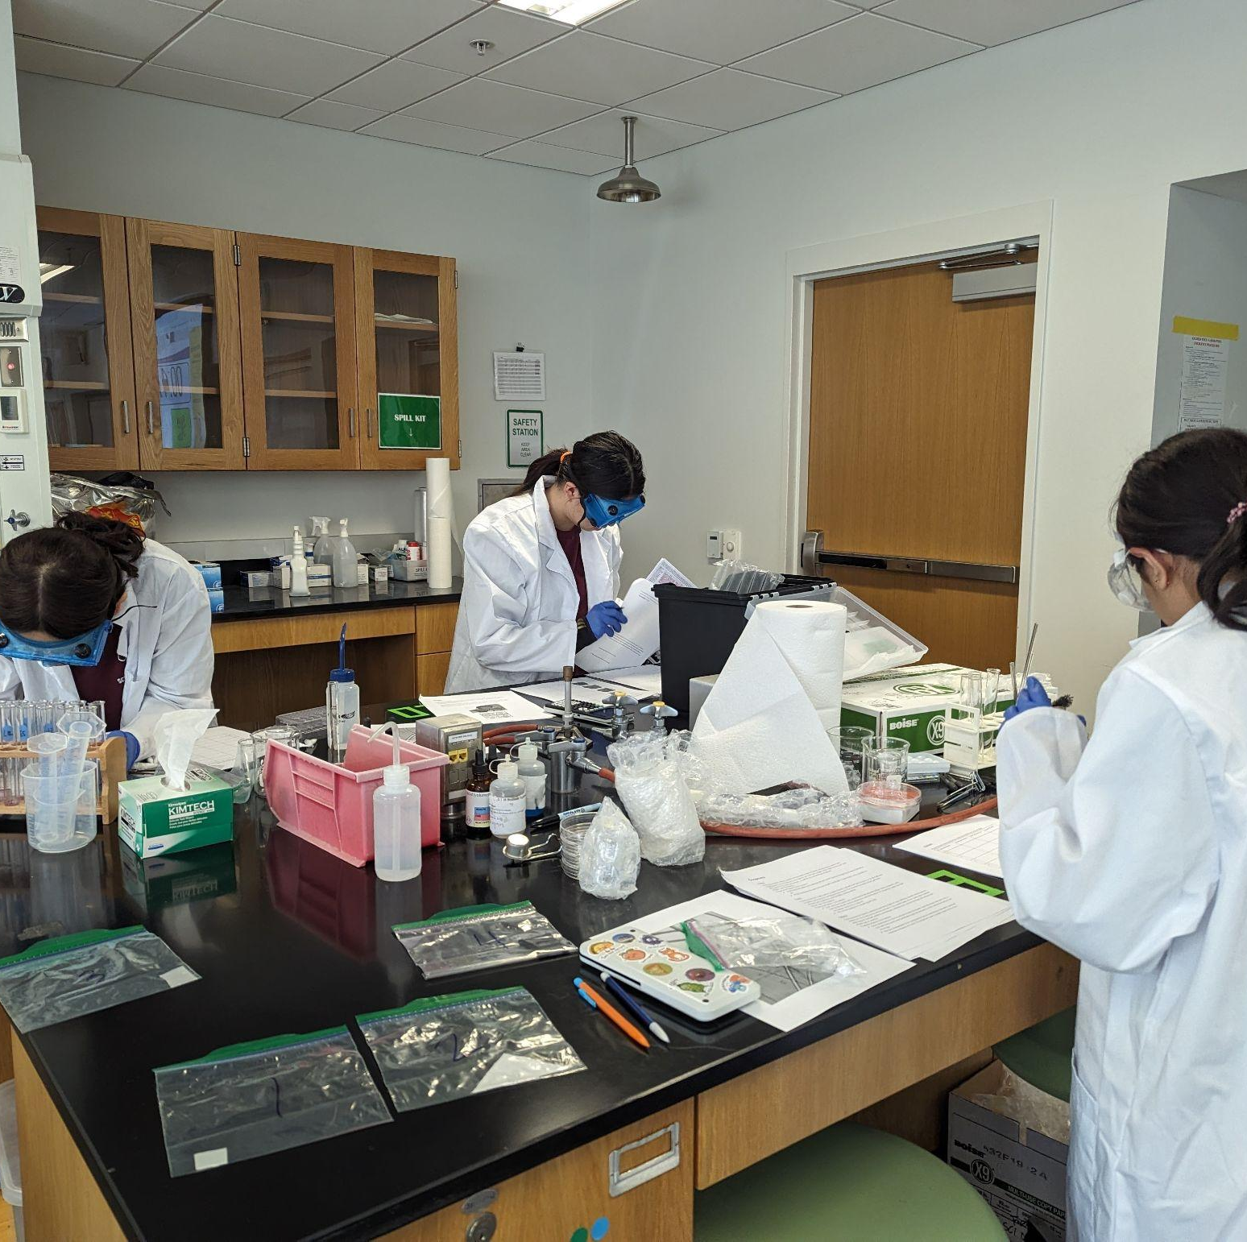
THANKS!
Notes:
(replace picture with a picture from one of our tournaments)

