Slide 1
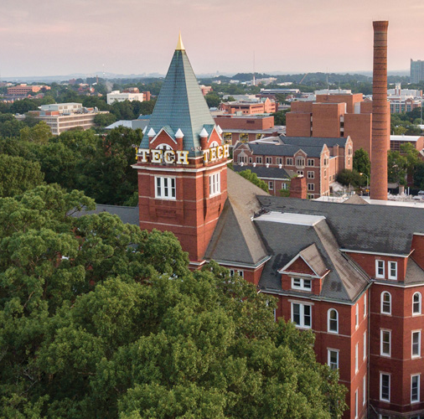
Optics
Division B/C
Georgia Tech Event Workshop Series 2024-25

Slide 2
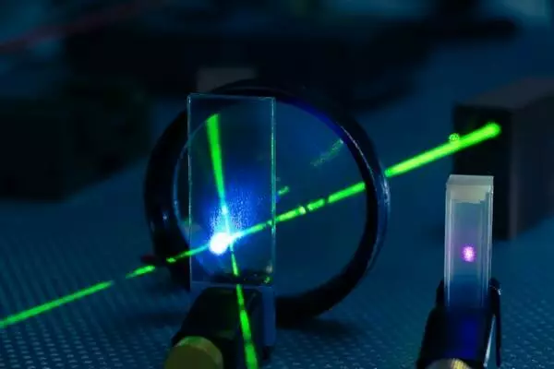
01
RULES SHEET
02
DIFFICULT TOPICS
03
COMMON QUESTIONS
04
TIPS FROM A VETERAN
05
OTHER FREE RESOURCES
Notes:
For Builds: Replace difficult topics with physical principles involved in the build and replace common questions with common designs

Slide 3
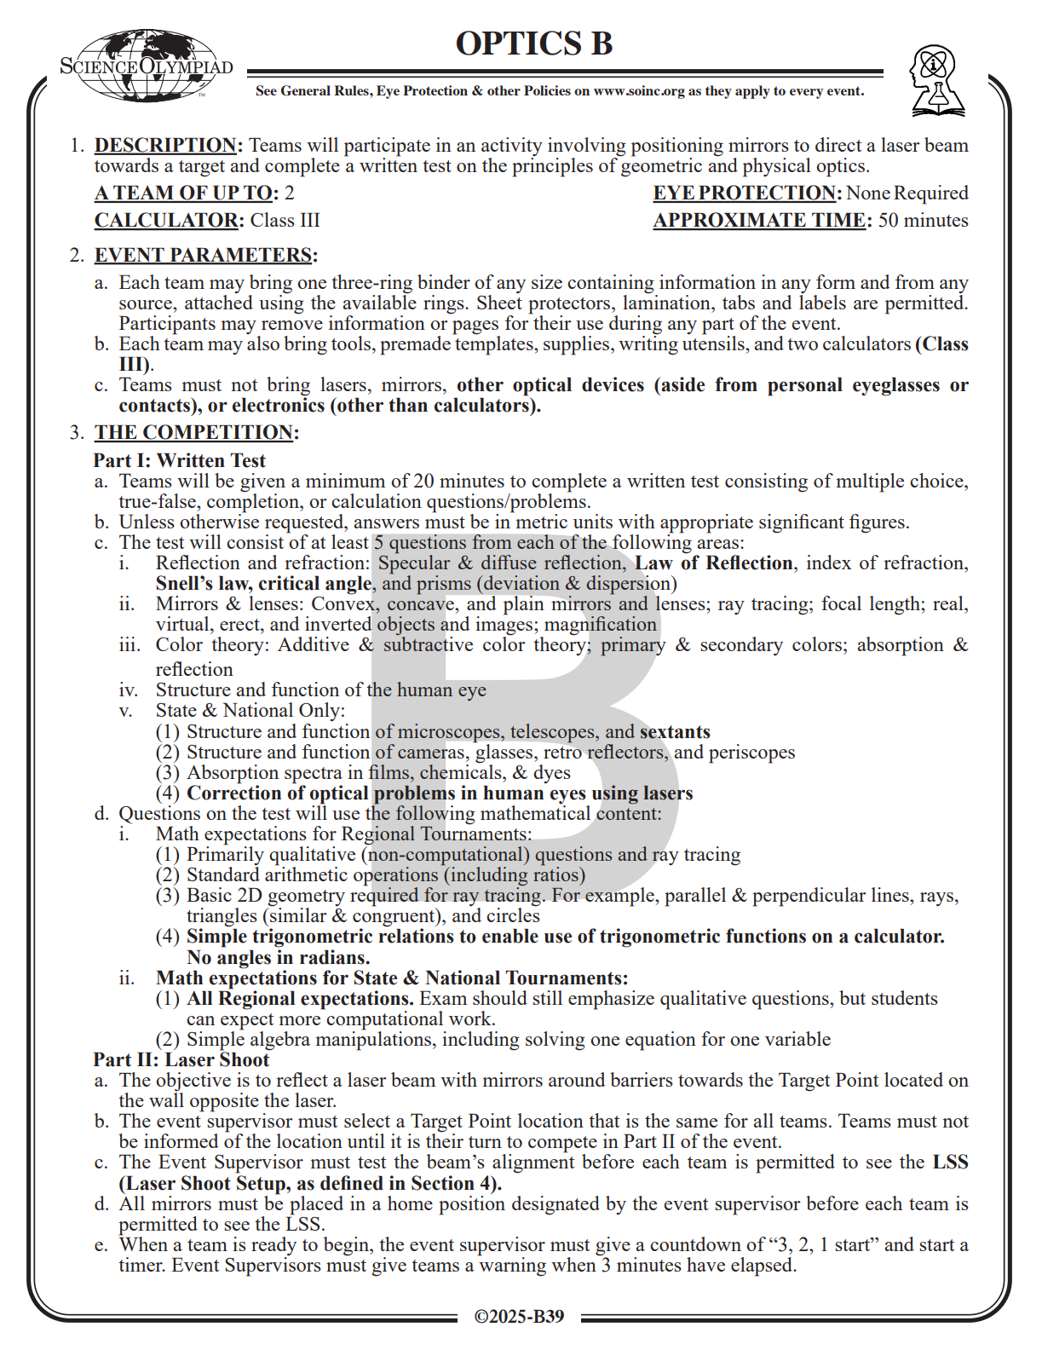
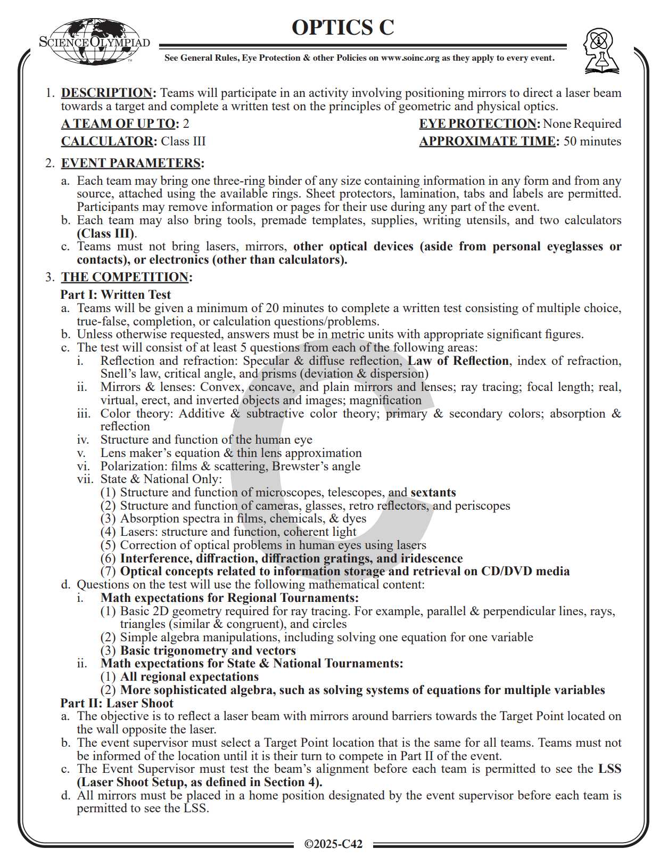
The Rules Sheet
Written Test
Important to know every topic at least on the surface level!
All supplement material can be in the binder
E.g., formulas and refractive indices
Laser Shoot
Practice with your partner!
You need to have ✨synergy✨
Think first, act last!! Even if you work slow
Make sure to stop on time
Move with care
Notes:
Highlight key points from the rules sheet: DESIGN LOGS that basically grant free points, most tested-on topics, point distribution so that competitors know what to prioritize, allowed notes and equipment, etc.

Slide 4
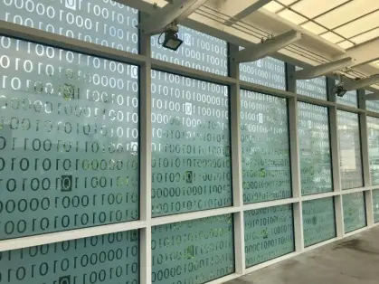
DIFFICULT TOPICS
Notes:
This section should focus on topics that are more math-based (harder to self-teach), concepts that come only usually up in college level courses, or concepts that you struggled with when you competed in this event

Slide 5
Topic 1: Reflection & Refraction
Law of Reflection
Angle of incidence = angle of reflection
Snell’s Law
n₁sin(θ₁) = n₂sin(θ₂)
Critical Angle
Angle of incidence where the angle of refraction is 90° (direct reflection)
θ = arcsin(nr/ni)
Index of Refraction
n = c/v
Understand what happens to v when light enters a different medium

Slide 6
Topic 2: Mirrors & Lenses
Mirrors
Convex: curves “out”
Concave: like an entrance to a cave, caves “in”
Lenses
Convex: middle thicker than edges
Concave: middle thinner than edges

Slide 7
Topic 2: Mirrors & Lenses
Watch out for naming!
Mirrors:
Concave: converging
Convex: diverging
Lenses:
Concave: diverging
Convex: converging
This is simply a reflection of how they interact with light

Slide 8
Topic 2: Mirrors & Lenses
Focal Length
1/f = 1/u + 1/v
u = object to lens
v = lens to image
Magnification
m = hi/ho = -di/do
i = image
o = object
All distances are measured from the mirror/lens
Often used in the context of vision correction
Important to measure all distances/heights correctly!

Slide 9
Topic 3: Color Theory
Additive Color Theory
RGB (human vision)
More light added = brighter & lighter resulting color
Subtractive Color Theory
CMY (pigments)
More color added = closer to black
Primary and Secondary Colors
RGB/CMY vs. colors resulting from their mixing
Absorption and Reflection
Which colors are absorbed/reflected when striked with, e.g., white light?
Notes:
Feel free to add more topics and make sure that there are plenty of pictures/diagrams!

Slide 10
COMMON QUESTIONS
All of the following questions have been pulled from past YJI exams (which can be found on our website) or the Text Exchange on SciOly Wiki
Notes:
\

Slide 11
Question 1
If a concave mirror forms a real image 45 cm from the mirror when the object is 30 cm from the mirror, what is the focal length of the mirror, in cm?
Notes:
Pull some questions from exams on the scioly wiki test exchange, first give attendees a couple minutes to read over them/work through them, then walk them through the answers. Try to get a mix of multiple choice and short answer or matching

Slide 12
Question 2
Light enters a diamond at an angle of 30◦ and bends to an angle of 22◦. Calculate the index of refraction of the diamond, to the nearest thousandth.
Notes:
Pull some questions from exams on the scioly wiki test exchange, first give attendees a couple minutes to read over them/work through them, then walk them through the answers

Slide 13
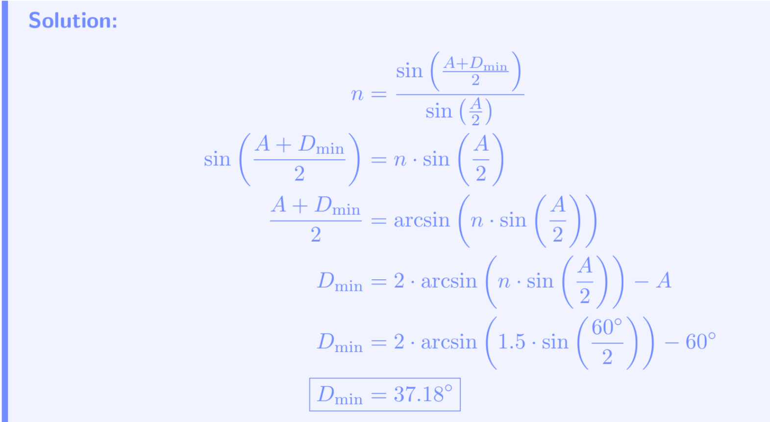
Question 3
A ray of light passes through a glass prism (n = 1.5) with an apex angle of 60◦. Calculate the angle of minimum deviation, to the nearest hundredth of a degree.
Notes:
Pull some questions from exams on the scioly wiki test exchange, first give attendees a couple minutes to read over them/work through them, then walk them through the answers

Slide 14
Tips from a Veteran
Teamwork is key
Specialize in separate topics, especially those that you enjoy more
A good split is anatomy/color/basics & mirrors/lenses
Organization of your binder is essential
Sort your binder in a logical manner
Sort it in a way you will remember on competition day
Less is more
A lot of people move mirrors in the perfect position before moving it away for their final run :(
Limit your overthinking
PRACTICE (nothing else to say)
Notes:
Use this section to talk about any strategies you used to navigate the event when you competed. For example, how did you manage your time, how did you organize your notes, how did you split topics up between you and your partner, etc.?

Slide 15
Additional Resources
Example tests
Tournament websites
SciOly test exchange
physicsclassroom.com
SUBWAY STATIONS
hyperphysics.phy-astr.gsu.edu !
phys.libretexts.org !
Yes, Saturn is the ringed one. This planet is a gas giant, and it’s composed mostly of hydrogen and helium
Notes:
Here, you can link or mention any online or book resources that helped you in this event when you were a competitor. Try to avoid general resources like scioly wiki, because they probably already are familiar with it.

Slide 16
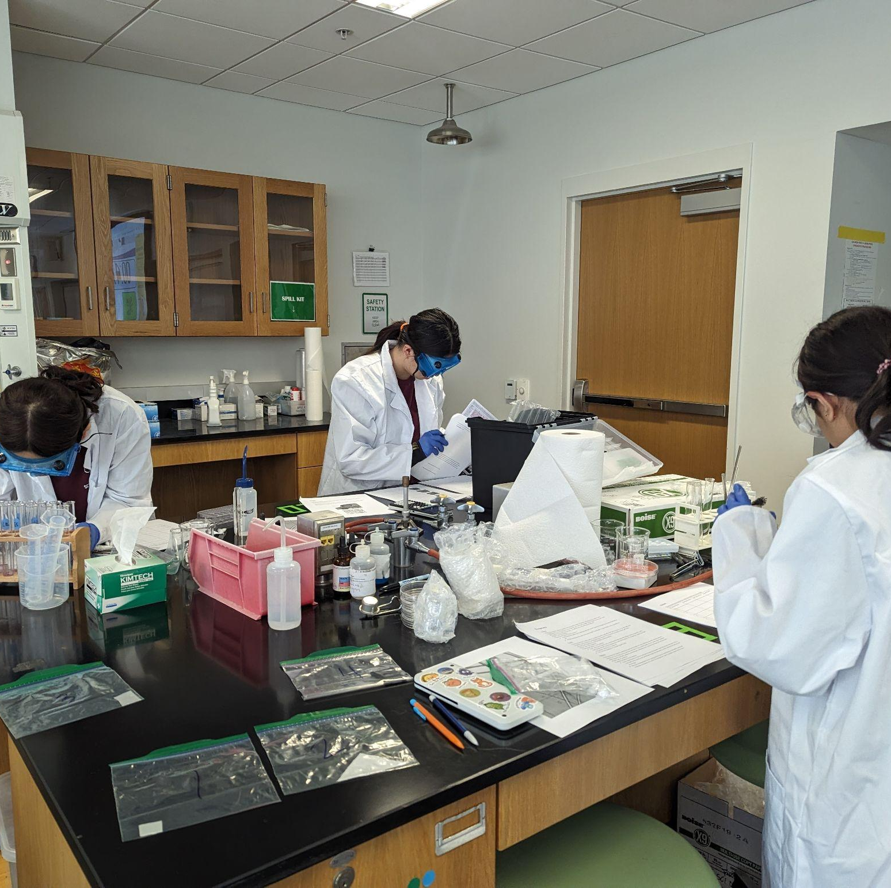
THANKS!
Notes:
(replace picture with a picture from one of our tournaments)

