Slide 1
Mission Possible
Division B
Georgia Tech Event Workshop Series 2024-25

Slide 2
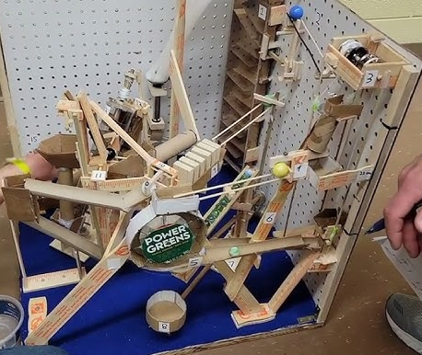
01
RULES SHEET
02
DIFFICULT TOPICS
[Event-Related Image]
03
COMMON PROBLEMS
04
TIPS FROM A VETERAN
05
OTHER FREE RESOURCES
Notes:
For Builds: Replace difficult topics with physical principles involved in the build and replace common questions with common designs

Slide 3
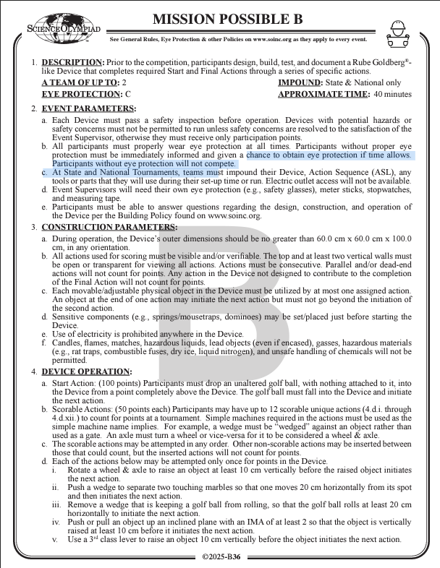
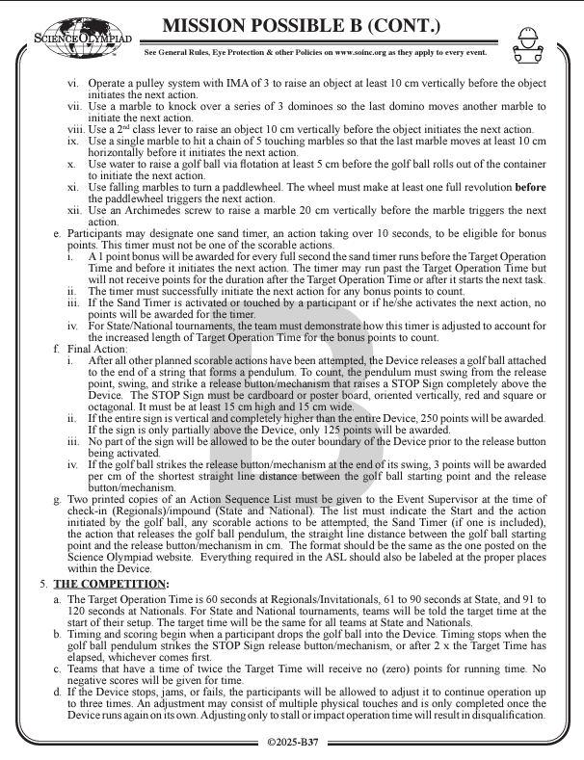
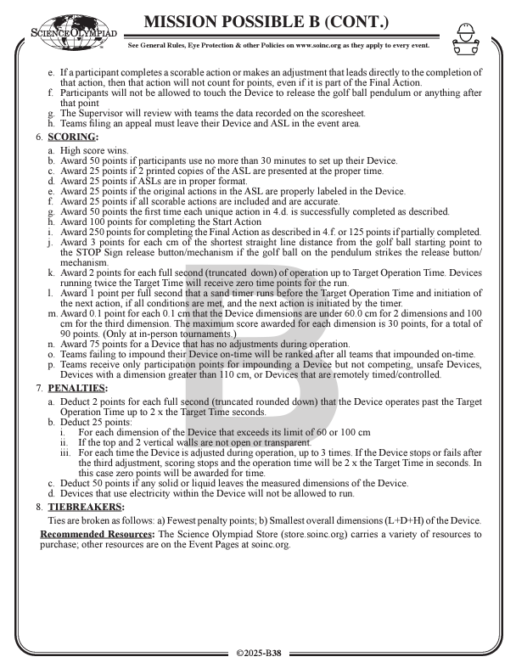
The Rules Sheet
What is Mission Possible
Students must design, build, test & document a Rube Goldberg-like device
Device made up of a series of actions
Device must run autonomously
Must complete a specific start and end task
What to bring to competition
Your device
Eye Protection
Action Sequence Log (ASL)
Any tools you need to setup or run the device
No outlet provided for power tools
Notes:
Highlight key points from the rules sheet: DESIGN LOGS that basically grant free points, most tested-on topics, point distribution so that competitors know what to prioritize, allowed notes and equipment, etc.

Slide 4
The Rules Sheet (Cont)
Important Construction Parameters
Must fit within a bounding box of 60 x 60 x 100 cm
All actions must be visible
Top and 2 walls visible (at least)
Only consecutive actions will be counted
Each moveable object can only be used by 1 action
If the object initiates another action it cannot go further after that
NO ELECTRICITY of an kind can be used
No hazardous items allowed
Nothing may leave the bounding box while the device is running except the final action stop sign
Notes:
Highlight key points from the rules sheet: DESIGN LOGS that basically grant free points, most tested-on topics, point distribution so that competitors know what to prioritize, allowed notes and equipment, etc.

Slide 5
The Rules Sheet (Cont)
Easy Points
50 points for setting up within 30 minutes
100 point for having 2 printed ASL’s in proper format with all actions included and actions labeled on the device
2 points for every second up to the target operation time.
If you go past the target time it starts deducting 2 points per second
0.1 points for every 0.1 cm under the bounding box dimensions
max 90 (30 for each dim)
75 points for not adjusting while device is running
Notes:
Highlight key points from the rules sheet: DESIGN LOGS that basically grant free points, most tested-on topics, point distribution so that competitors know what to prioritize, allowed notes and equipment, etc.

Slide 6
The Rules Sheet (Cont)
Scorable Actions
12 possible actions outlined in the rulebook
Each can only count for points once
All actions specifically listed on the ASL must contribute to the Final Action
Additional non scoring actions can be put in between scored actions
Must also be on ASL.
Actions can be in any order
Notes:
Highlight key points from the rules sheet: DESIGN LOGS that basically grant free points, most tested-on topics, point distribution so that competitors know what to prioritize, allowed notes and equipment, etc.

Slide 7
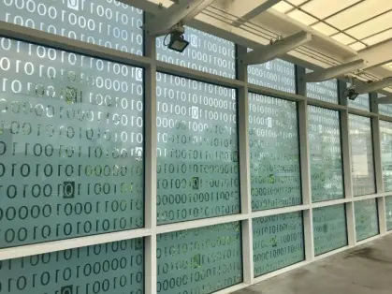
DIFFICULT TOPICS
Notes:
This section should focus on topics that are more math-based (harder to self-teach), concepts that come only usually up in college level courses, or concepts that you struggled with when you competed in this event

Slide 8
Topic 1: Initiating Action
Before triggering the next action, a scorable action must complete its own action. Meaning before making any contact with the trigger for the next action.
For example:
A lever raises a an object 10 cm vertically before initiating the next action.
If the object raised by the lever makes contact with the next action before moving 10 cm, then the lever does not count as a scorable action.

Slide 9
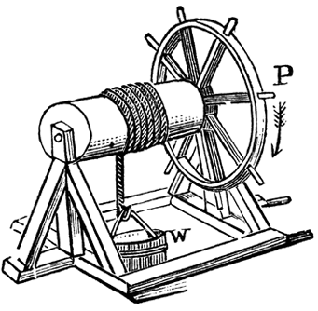
Topic 2: Wheel & Axle Action
Section 4.d.i.
Rotate a wheel & axle to raise an object at least 10 cm vertically before the raised object initiates the next action
More difficult than it looks
Vague description
Open to many different possibilities
Possible action:
Drop an object into a cup with a string to rotate the axel which in turn turns the wheel and can lift something on spokes.

Slide 10
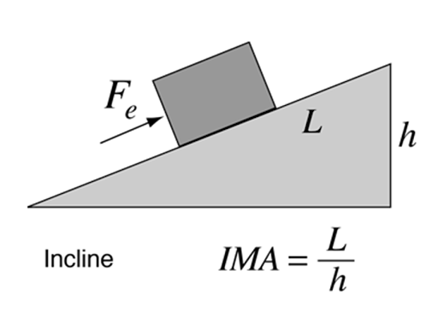
Topic 3: IMA of Inclined Plane
Section 4.d.iv
Push or pull an object up an inclined plane with an IMA of at least 2 so that the object is vertically raised at least 10 cm before it initiates the next action.
IMA stands for Ideal Mechanical Advantage
For an inclined plane it is the ratio between the length and vertical height that the incline raises the object. (IMA=L/h)
With an IMA of 2 we want the incline to provide twice the advantage in force. Meaning it will cut the required force to pull the object in half.
This means the incline must be at least 20 cm long and at an angle where it is 10 cm tall.
Notes:
Feel free to add more topics and make sure that there are plenty of pictures/diagrams!

Slide 11
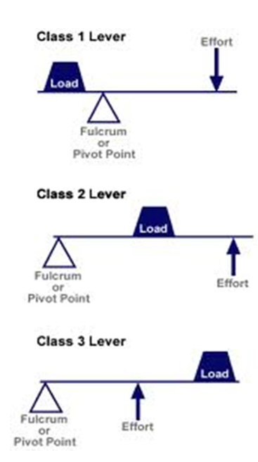
Topic 4: 2nd and 3rd Class Lever
Section 4.d.v and 4.d.viii
Use a 3rd/2nd class lever to raise an object 10 cm vertically before the object initiates the next action
On a third class lever the input is in the same direction as the output.
The effort is between the load and the fulcrum (pivot point)
Meaning a redirect or pulley will be required to carry out this action
On a second class lever the input is also in the direction of the output but the load is between the effort and fulcrum.
Redirect or pulley is still needed
If you use a pulley it will not count as a separate action.
Notes:
Feel free to add more topics and make sure that there are plenty of pictures/diagrams!

Slide 12
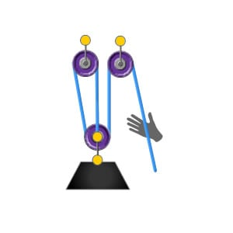
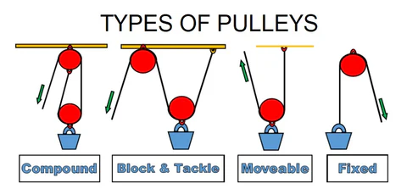
Topic 5: Pulley System
Section 4.d.vi
Operate a pulley system with IMA of 3 to raise an object at least 10 cm vertically before the object initiates the next action
IMA for a pulley system is determined by the number of ropes directly lifting the load.
An IMA of 3 implies there are 3 segments of rope
There are many types of pulley systems where you can get an IMA of 3.
Which one you choose depends on the application
Notes:
Feel free to add more topics and make sure that there are plenty of pictures/diagrams!

Slide 13
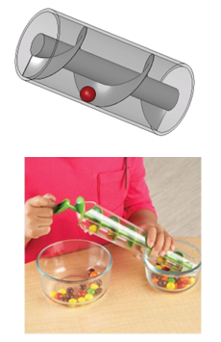
Topic 6: Archimedes Screw
Section 4.d.xii
Use an archimedes screw to raise a marble 20 cm vertically before the marble trigger the next action.
This can be done by rotating the screw in a cylindrical pipe.
The pipe needs to be angled so the marble doesn’t roll down the screw.
Note: The tighter the blades, the higher the angle the screw can be.
Good way to move an action from a lower height back to the top
Notes:
Feel free to add more topics and make sure that there are plenty of pictures/diagrams!

Slide 14
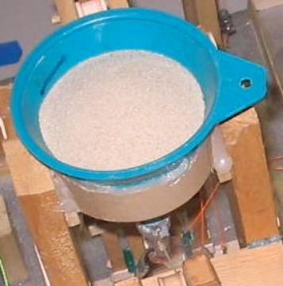
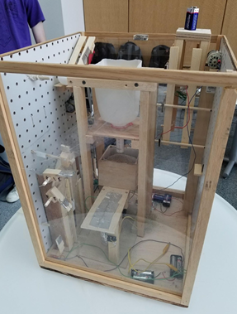
Topic 7: Sand TImer
The sand timer must not be a scorable action and must take at least 10 seconds for bonus points.
It must also initiate the next action in the sequence.
A 1 point bonus is awarded for every second the sand timer runs up to the Target Operation Time or until the next action is initiated.
If it runs past this time no additional points will be awarded.
Possible method
Have a funnel of sand fill a cup sitting on a lever.
Once a certain weight has been added into the cup the lever moves and initiates the next action
Can vary the timer by using counterweights or changing the amount of sand initially in the cup.
Notes:
Feel free to add more topics and make sure that there are plenty of pictures/diagrams!

Slide 15
COMMON PROBLEMS
Notes:
\

Slide 16
Connecting actions together
Connecting actions that don’t go together often results in the need for intermediate actions.
This is why it is imperative that once you figure out how you will do each of your actions, you plan out the order in which to execute them.
More than likely you can't avoid using some intermediate actions but you can make the job much simpler if you have less of them.
Notes:
Pull some questions from exams on the scioly wiki test exchange, first give attendees a couple minutes to read over them/work through them, then walk them through the answers. Try to get a mix of multiple choice and short answer or matching

Slide 17
Designing an Action
It may seem difficult to design an action from scratch.
The key to success is to take inspiration from others.
People have been making Rube Goldberg-like device for a long time and chances are someone has already made exactly what you're looking for.
Do your research and find the method that best suits your needs.
Don’t forget to keep it simple.
Notes:
Pull some questions from exams on the scioly wiki test exchange, first give attendees a couple minutes to read over them/work through them, then walk them through the answers. Try to get a mix of multiple choice and short answer or matching

Slide 18
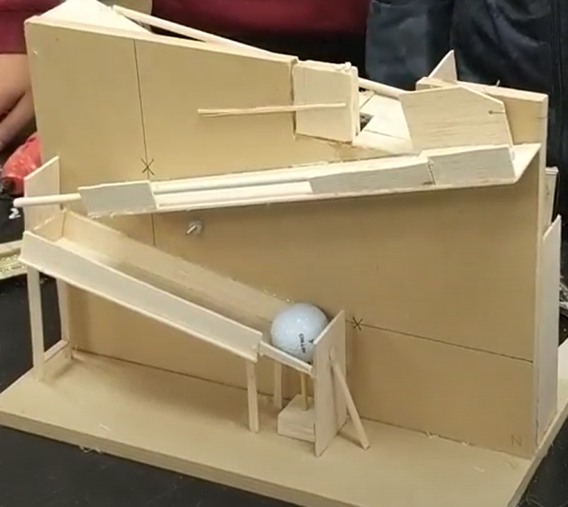
Tips from a Veteran
https://www.youtube.com/watch?v=dQganlHJyBk
ALWAYS go for reliability over looks
Consistency is key
Make every action run as smoothly as possible
Make a highly reliable, consistent sand timer
Make all distances easy to measure!
Go a little long, don’t cut it too close.
Go back and check the rules often
Don’t want to get penalized or disqualified for a small error.
When designing an action, plan out and experiment with the action first. Then implement it into your build.
Notes:
Use this section to talk about any strategies you used to navigate the event when you competed. For example, how did you manage your time, how did you organize your notes, how did you split topics up between you and your partner, etc.?
The link is a good example mission possible. Very simplistic design that is easy to follow and fulfills all the actions.

Slide 19
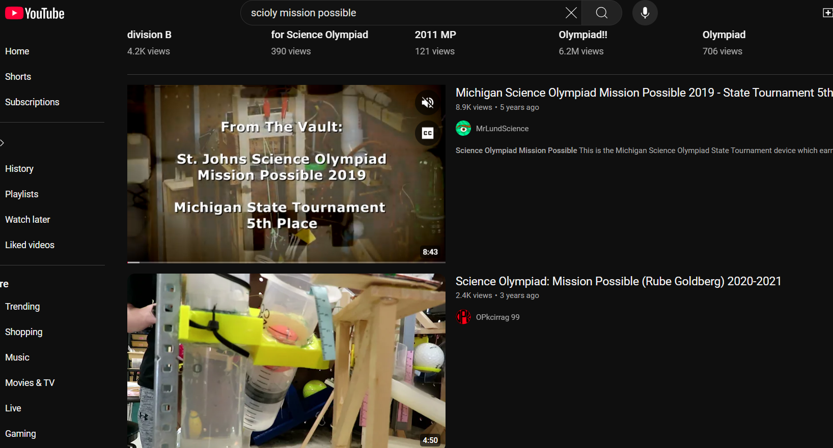
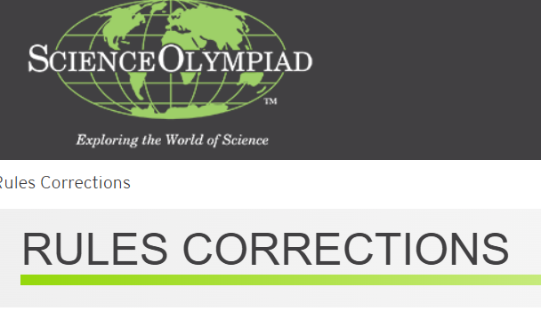
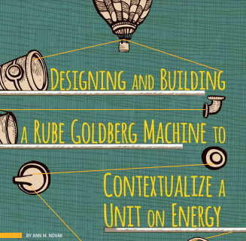
Additional Resources
https://www.youtube.com/results?search_query=scioly+mission+possible
https://www.soinc.org/mission-possible-b
SUBWAY STATIONS
https://www.soinc.org/events/rules-corrections
https://www.proquest.com/scholarly-journals/designing-building-rube-goldberg-machine/docview/1844174852/se-2?accountid=11107
Yes, Saturn is the ringed one. This planet is a gas giant, and it’s composed mostly of hydrogen and helium
Notes:
Here, you can link or mention any online or book resources that helped you in this event when you were a competitor. Try to avoid general resources like scioly wiki, because they probably already are familiar with it.

Slide 20
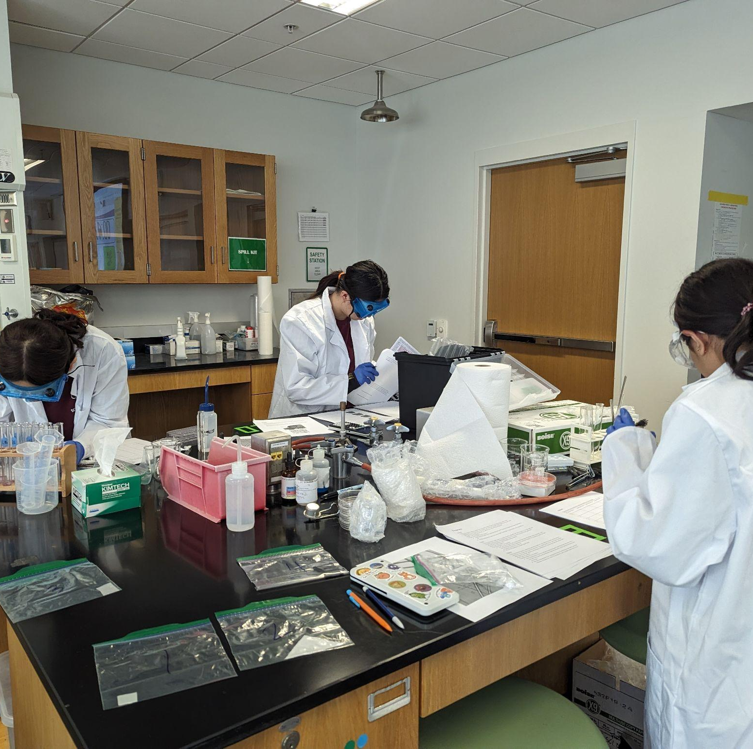
THANKS!
Notes:
(replace picture with a picture from one of our tournaments)

