Slide 1
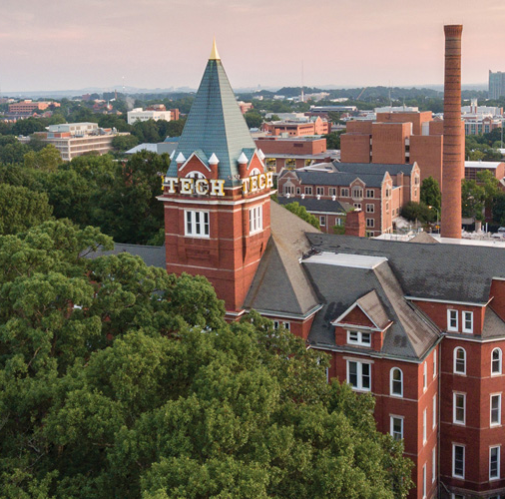
Microbe Mission
Division B/C
Georgia Tech Event Workshop Series 2024-25

Slide 2
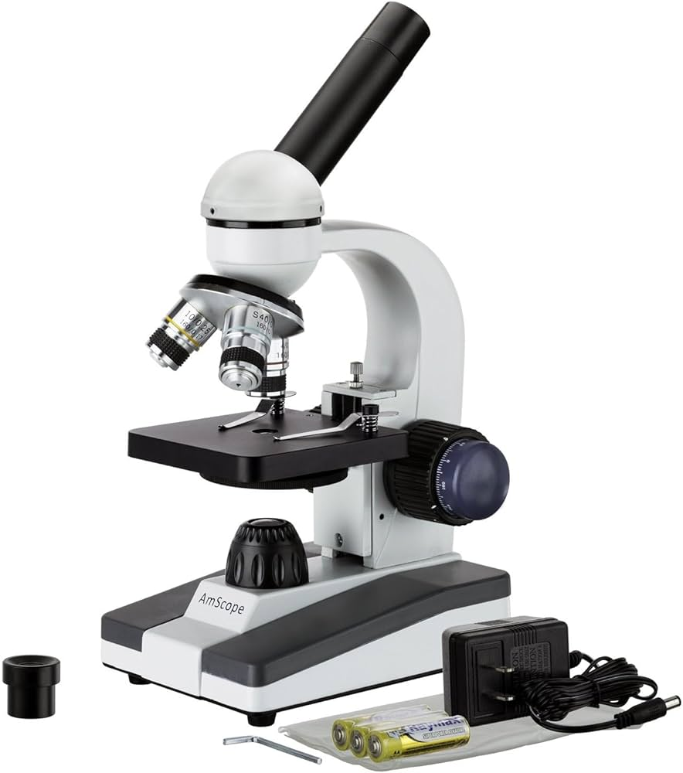
01
RULES SHEET
02
DIFFICULT TOPICS
03
COMMON QUESTIONS
04
TIPS FROM A VETERAN
05
OTHER FREE RESOURCES
Notes:
For Builds: Replace difficult topics with physical principles involved in the build and replace common questions with common designs

Slide 3
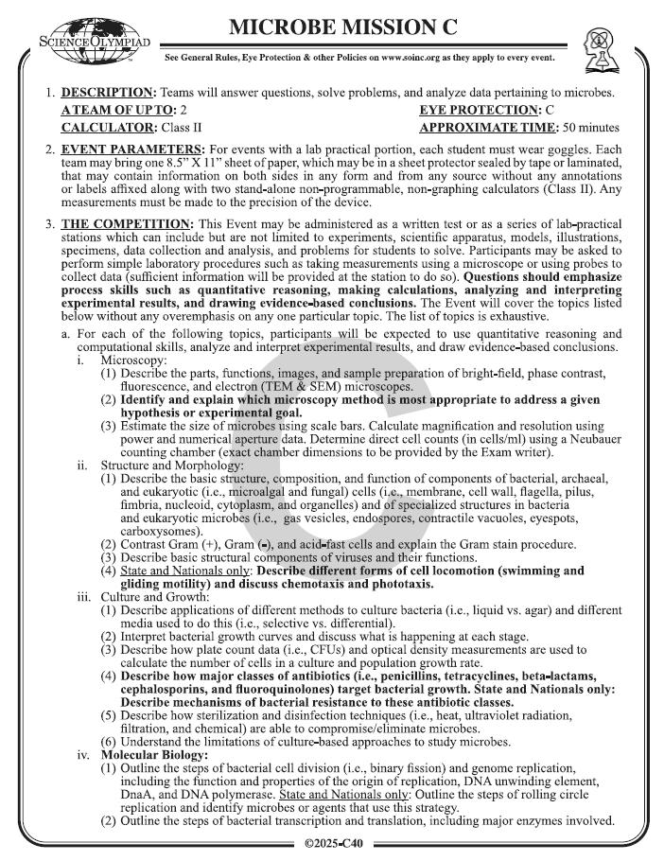
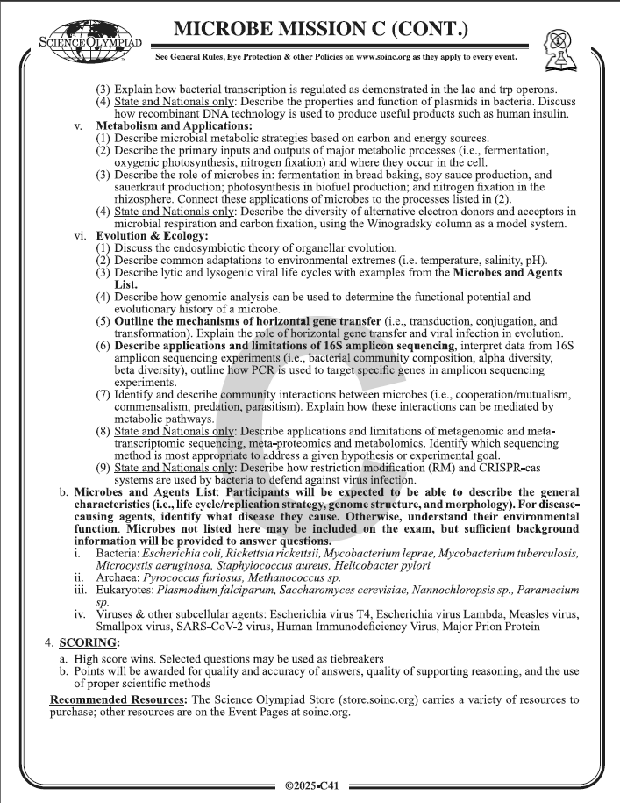
The Rules Sheet
May bring 1 8.5” by 11” sheet of paper, both sides
No additions on top of the paper
Can be in a a sheet protector sealed with tape or laminated
2 non-programmable, non-graphing calculators allowed
Make sure that you and your teammate know every topic at least a surface level.
Either as lab-practical stations or an exam
Notes:
Highlight key points from the rules sheet: DESIGN LOGS that basically grant free points, most tested-on topics, point distribution so that competitors know what to prioritize, allowed notes and equipment, etc.

Slide 4
Fundamental Topics
Microscopy
Structures of Bacteria, Archaea, Eukarya, and Viruses.
Gram Staining.
Molecular Biology of Bacteria*
Metabolic Pathways
Evolution & Ecology
Notes:
Highlight key points from the rules sheet: DESIGN LOGS that basically grant free points, most tested-on topics, point distribution so that competitors know what to prioritize, allowed notes and equipment, etc.

Slide 5
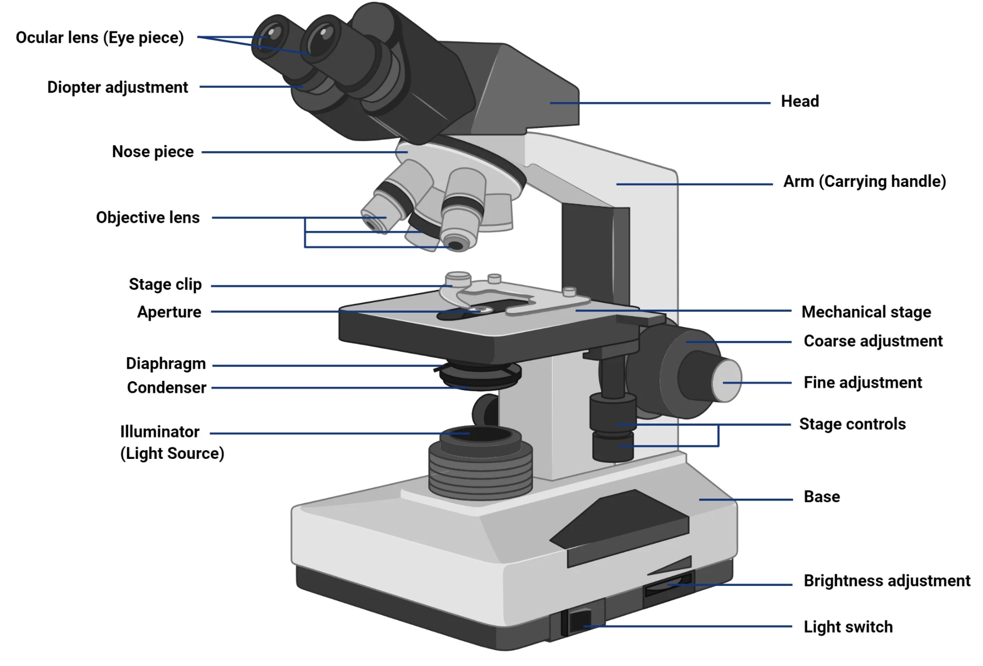
Topic 1: Microscopy
The anatomy of bright-field microscopy
Know the functions and its limits as well.
Know the appropriate formulas for resolution
Abbe’s Equation:
The purpose of dark-field microscopy.
Living & unstained microbes
Fluorescence Microscopy
SEM & TEM
Differences and use

Slide 6
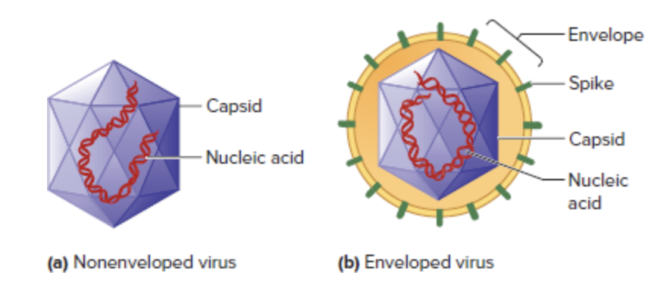
Topic 2: Structures
Common bacterial and archaeal internal structures and their functions.
Carboxysomes, (CO2 Fixation); Storage Inclusions (PHB)
Compare and contrast the differences of cell membranes & wall’s of archaea, eukarya, and bacteria.
Ether-linkage vs. ester-linkages
Compare and contrast Gram (+) and Gram (-).
What about the atypical bacteria? Why?
Noneveloped vs. enveloped viruses.

Slide 7
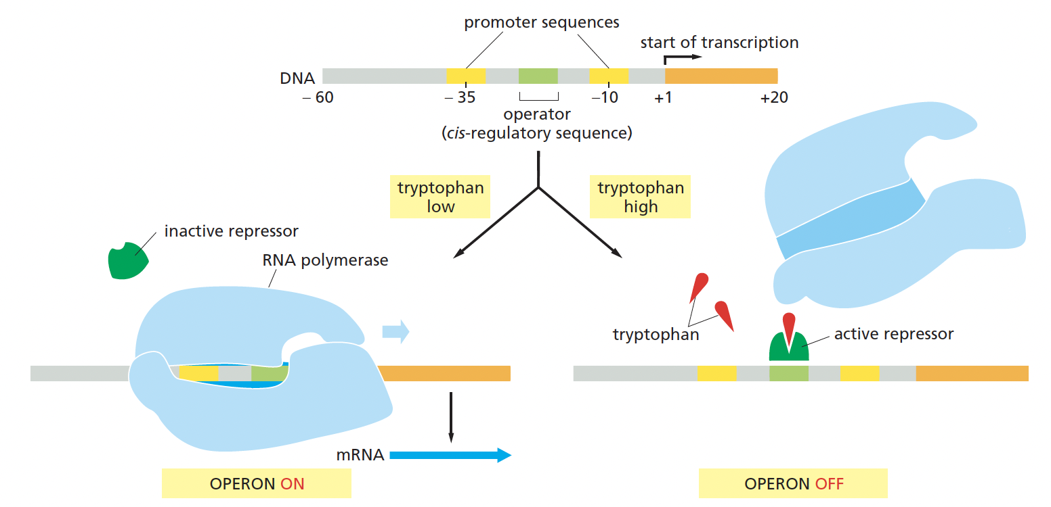
Topic 3: Molecular Bio
Rule sheet limits the molecular biology aspect to bacteria.
Model bacteria is E.coli.
Know the functions of each commonly asked proteins:
DnaA (initiator of replication)
DNA Pol I & III
DNA Ligase
Lac and Trp Operons
Bacterial Translation
Shine-Dalgarno Sequence?

Slide 8
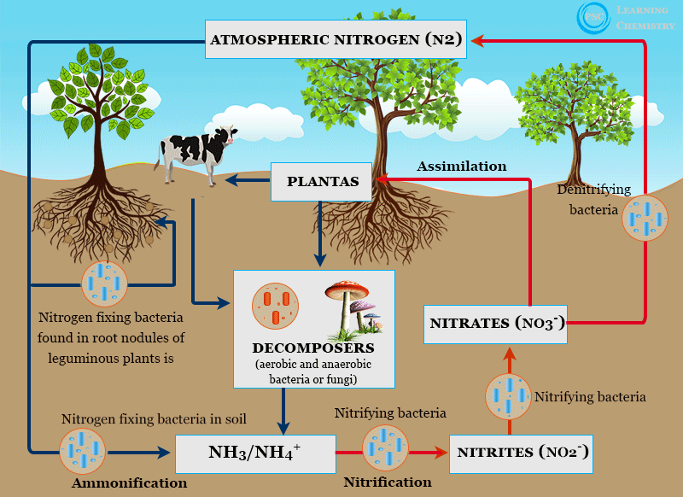
Topic 4: Metabolic Pathways
Cheat Sheet!
Understand difference between catabolism and anabolism.
Know the general concepts of common pathways: Glycolysis, TCA, and ETC.
Then, known the more specialized pathways:
ED-Pathways: Gram-negative, mostly soil-bacteria
ETCs of E.coli (bo and bd? )
Different types of fermentation.
Lactic Acid
Ethanol
Nitrogen Fixation

Slide 9
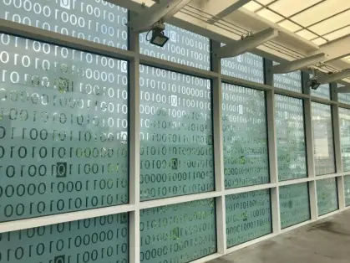
DIFFICULT TOPICS
Notes:
This section should focus on topics that are more math-based (harder to self-teach), concepts that come only usually up in college level courses, or concepts that you struggled with when you competed in this event

Slide 10
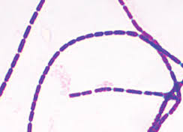
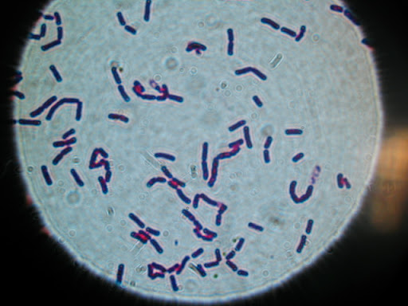
Topic 1: Identification
Notes:
There is a high likelihood that the exam will likely involve you identifying slides of bacteria, fungi, or other microorganisms, and these tend to cause the most difficulty for students, especially because identifying microbes by observable phenotypes is quite difficult on its own. For example, the two bacteria shown here are two completely different species, Bacillus anthracis on the left and Bacillus cereus on the right, each with their own unique characteristics and they both cause completely unique diseases in humans.
Therefore, it’s important to familiarize yourselves on some unique identifying traits for some common bacteria. With these bacteria, even they both are purple in color from staining and appear rod-shaped, you can see that Bacillus anthracis forms these filamentous colonies, with each one after the other, while Bacillus cereus doesn’t show this phenotype.

Slide 11
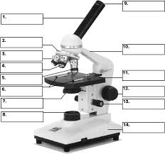
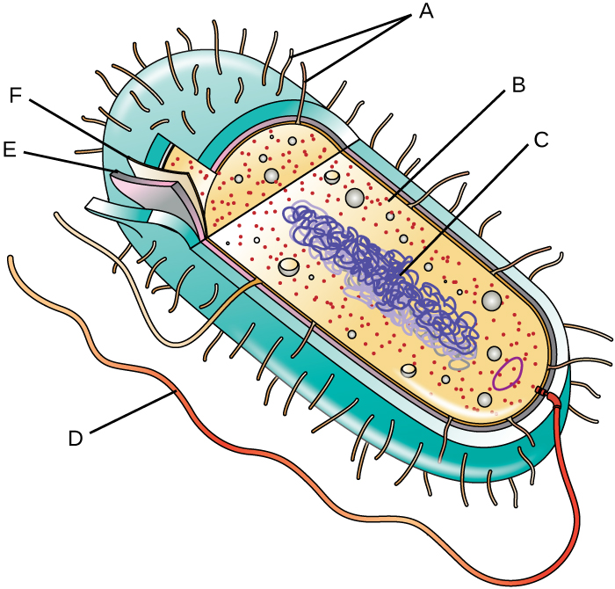
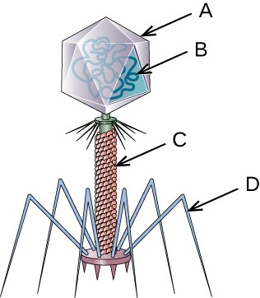
Topic 2: Specific Naming

Slide 12
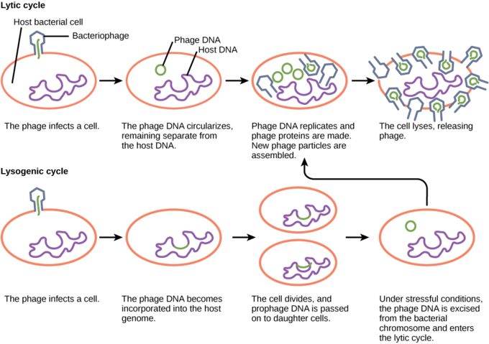
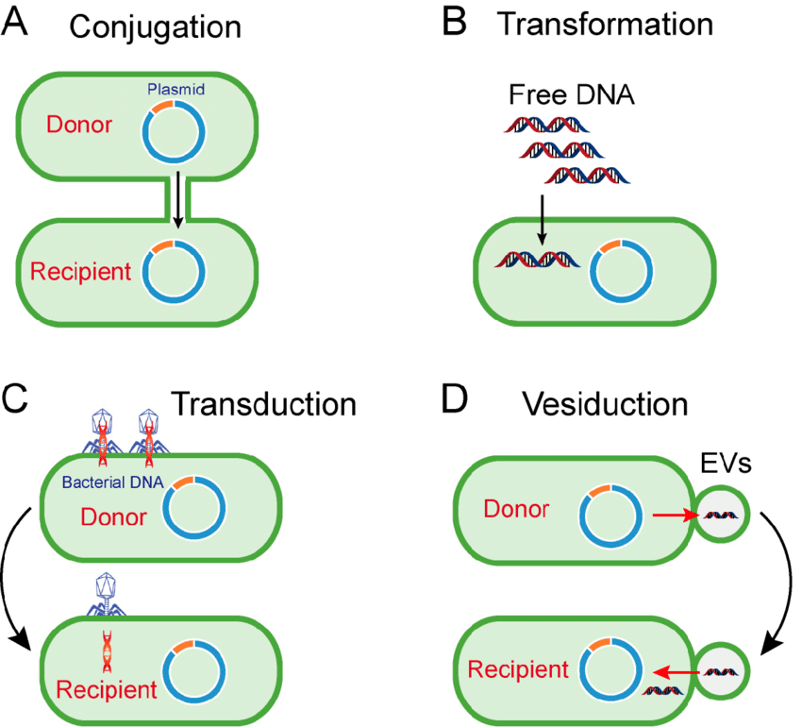
Topic 3: Processes
Notes:
Feel free to add more topics and make sure that there are plenty of pictures/diagrams!

Slide 13
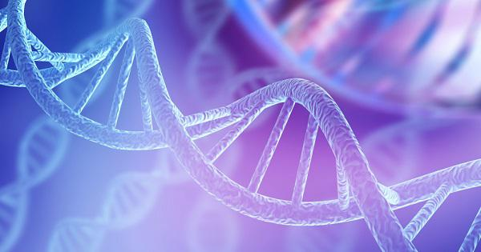
COMMON QUESTIONS
All of the following questions have been pulled from past YJI exams (which can be found on our website) or the Text Exchange on SciOly Wiki
Notes:
\

Slide 14
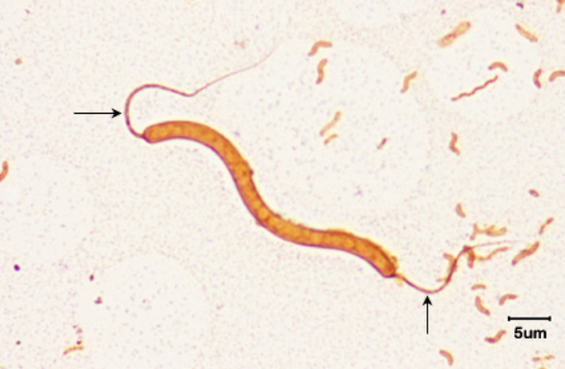
Question 1
Name this type of flagellar arrangement.
Monotrichous
Amphitrichous
Lophotrichous
Peritrichous
Notes:
Pull some questions from exams on the scioly wiki test exchange, first give attendees a couple minutes to read over them/work through them, then walk them through the answers. Try to get a mix of multiple choice and short answer or matching

Slide 15
Question 1
Name this type of flagellar arrangement.
Monotrichous
Amphitrichous
Lophotrichous
Peritrichous
Amphitrichous bacteria have flagella on both ends of their body.
Notes:
Pull some questions from exams on the scioly wiki test exchange, first give attendees a couple minutes to read over them/work through them, then walk them through the answers. Try to get a mix of multiple choice and short answer or matching

Slide 16
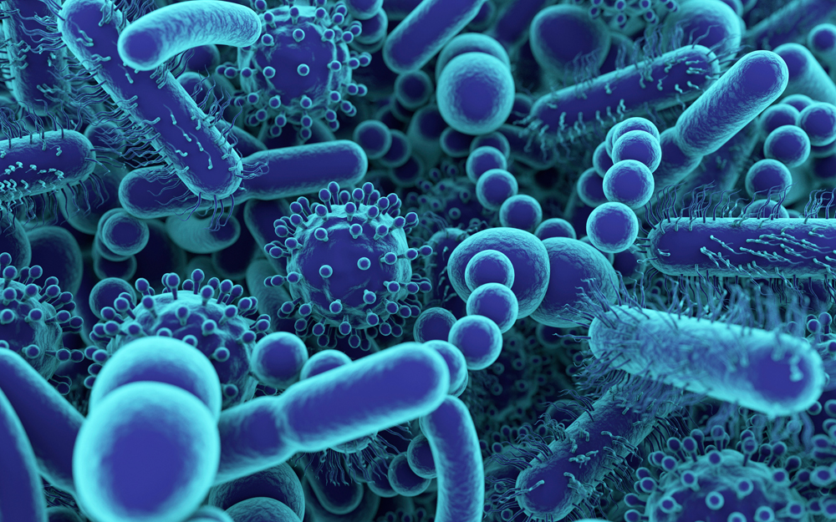
Question 2
Which of the following is NOT a viral disease?
AIDS
Measles
Anthrax
Rubella
Notes:
Pull some questions from exams on the scioly wiki test exchange, first give attendees a couple minutes to read over them/work through them, then walk them through the answers

Slide 17
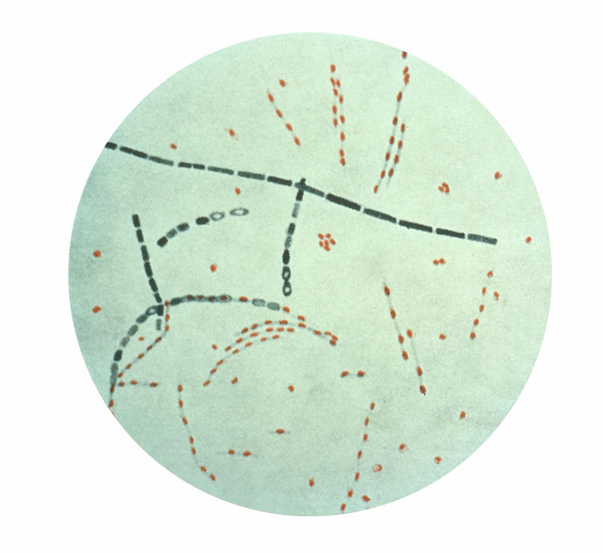
Question 2
Which of the following is NOT a viral disease?
AIDS - caused by the human immunodeficiency virus (HIV)
Measles - caused by Morbillivirus hominis
Anthrax - caused by Bacillus anthracis
Rubella - caused by Rubivirus rubellae
Notes:
Pull some questions from exams on the scioly wiki test exchange, first give attendees a couple minutes to read over them/work through them, then walk them through the answers

Slide 18
Question 3
Which of the following types of microscopy would most likely be used to view the insides of organelles?
Darkfield
Scanning Electron
Transmission Electron
X-Ray
Phase Contrast
Differential Interference Contrast
Notes:
Pull some questions from exams on the scioly wiki test exchange, first give attendees a couple minutes to read over them/work through them, then walk them through the answers

Slide 19
Question 3
Which of the following types of microscopy would most likely be used to view the insides of organelles?
Answer: Transmission Electron
Electron microscopy - High Resolution at High Magnification
Scanning Electron - Sees structure surface by reflecting electrons
Transmission Electron - Electrons pass through structures, visualizing internal structure
Notes:
Pull some questions from exams on the scioly wiki test exchange, first give attendees a couple minutes to read over them/work through them, then walk them through the answers

Slide 20
Question 4
Given a stock protein solution with a concentration of 15 mg/ml, determine the protein concentration (in mg/ml) of a solution made by mixing 2 μL of the stock with 8 μL of a buffer.
Notes:
Pull some questions from exams on the scioly wiki test exchange, first give attendees a couple minutes to read over them/work through them, then walk them through the answers

Slide 21
Question 4
Given a stock protein solution with a concentration of 15 mg/ml, determine the protein concentration (in mg/ml) of a solution made by mixing 2 μL of the stock with 8 μL of a buffer.
Answer: 3 mg/mL
V1 * M1 = V2 * M2
(2 μL) * (15 mg/mL) = (10 μL) * (M2)
30 = 10 * M2
M2 = 3 mg/mL
Notes:
Pull some questions from exams on the scioly wiki test exchange, first give attendees a couple minutes to read over them/work through them, then walk them through the answers

Slide 22
More Example Q’s
If you want to find more example questions, head to the Scioly Wiki Test Exchange located at https://scioly.org/tests/.
Notes:
Pull some questions from exams on the scioly wiki test exchange, first give attendees a couple minutes to read over them/work through them, then walk them through the answers

Slide 23
Tips from a Veteran
Prepare well beforehand. Don’t cram the information.
Only include information on your notes sheet that you are sure you can’t remember. The limited space is valuable!
Include images over words.
Be sure to practice several tests to learn how questions are asked.
Tests v. Stations
Study the classic microbiology textbooks - many questions are usually based on the contents found in these books.
Notes:
Use this section to talk about any strategies you used to navigate the event when you competed. For example, how did you manage your time, how did you organize your notes, how did you split topics up between you and your partner, etc.?

Slide 24
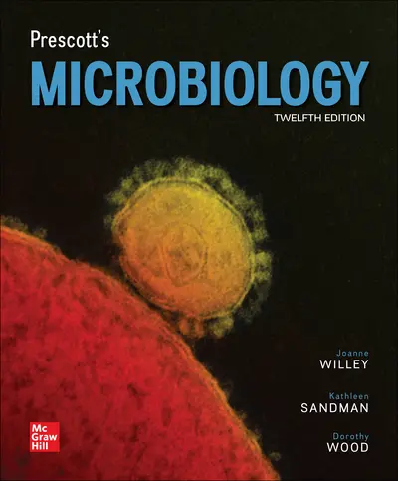
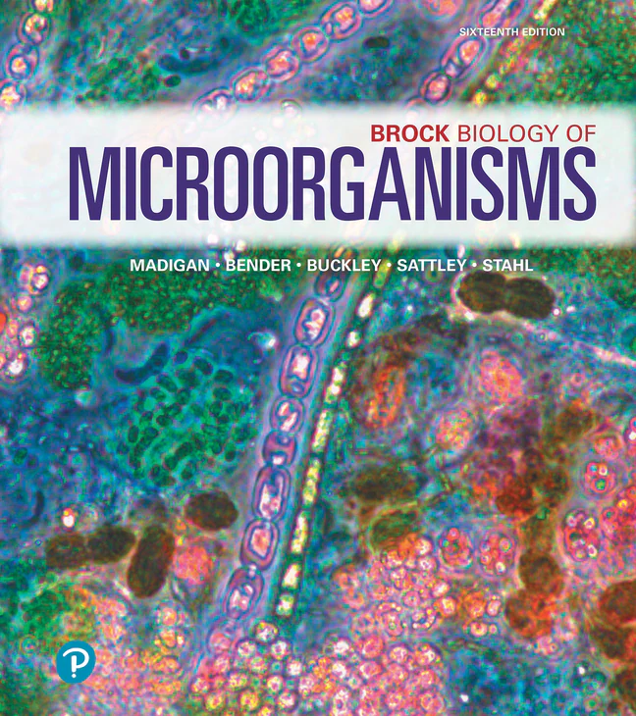
Additional Resources
Prescott’s Microbiology
Brock’s Biology of Microorganisms
SUBWAY STATIONS
OpenStax Microbiology
Your Teachers!
Yes, Saturn is the ringed one. This planet is a gas giant, and it’s composed mostly of hydrogen and helium
Notes:
Here, you can link or mention any online or book resources that helped you in this event when you were a competitor. Try to avoid general resources like scioly wiki, because they probably already are familiar with it.

Slide 25
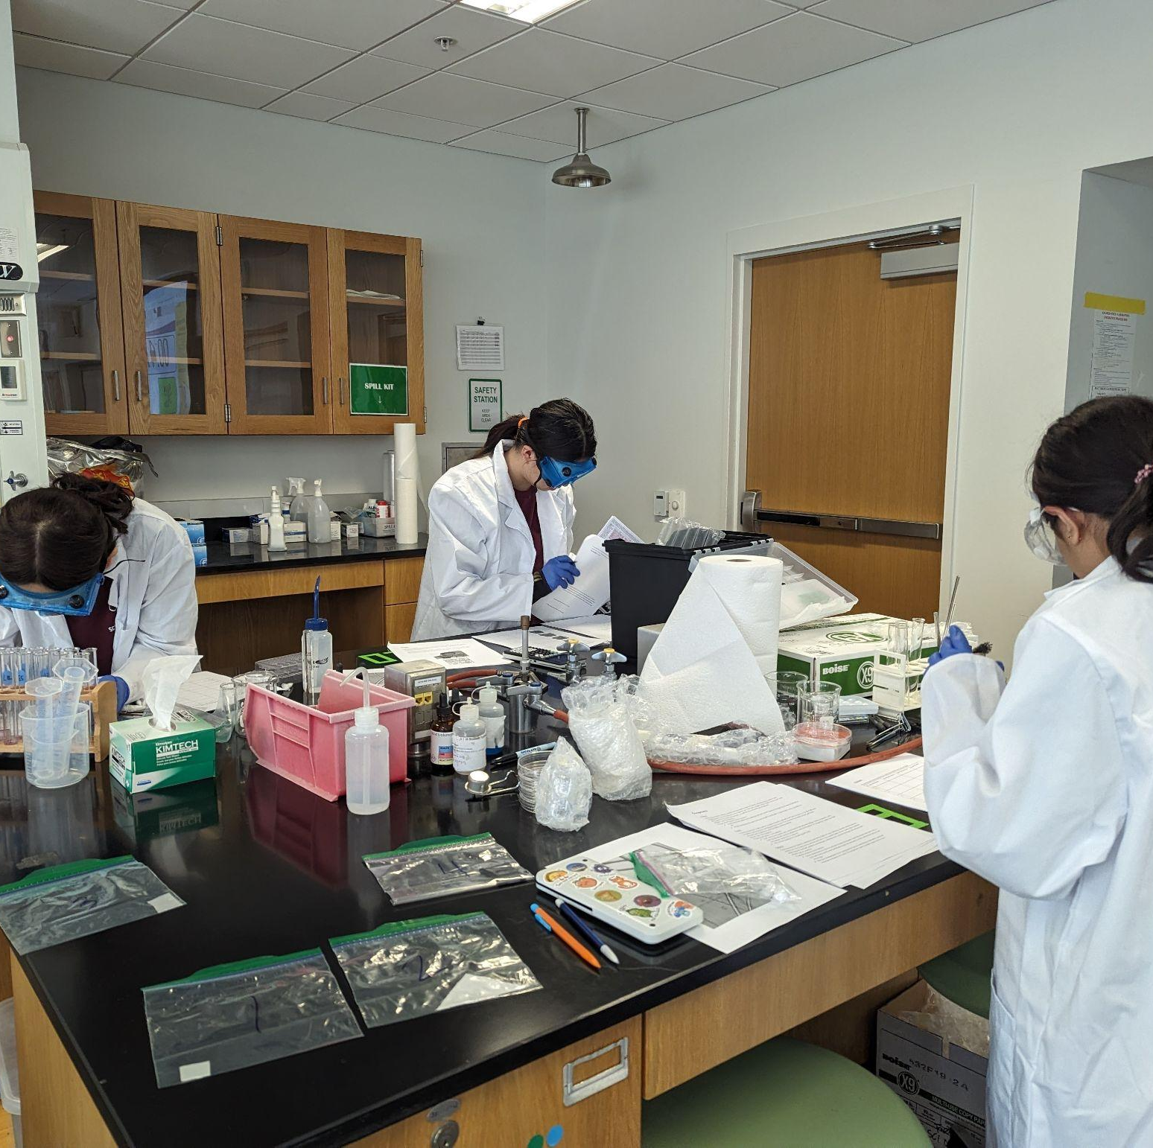
THANKS!
Notes:
(replace picture with a picture from one of our tournaments)

