Slide 1
Metric
Mastery
Division B
Georgia Tech Event Workshop Series 2024-25

Slide 2
01
RULES SHEET
02
DIFFICULT TOPICS
03
COMMON QUESTIONS
04
TIPS FROM A VETERAN
05
OTHER FREE RESOURCES
Notes:
For Builds: Replace difficult topics with physical principles involved in the build and replace common questions with common designs

Slide 3
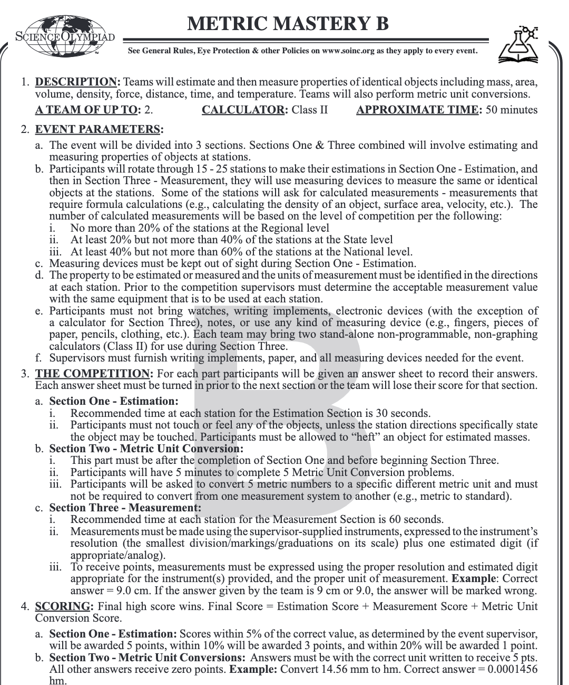
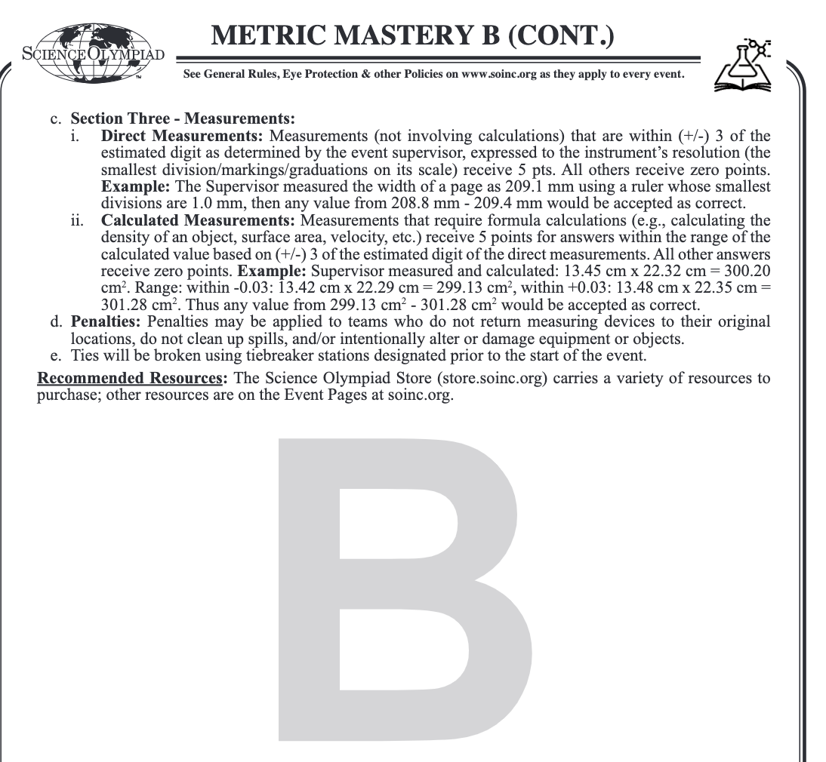
The Rules Sheet
Event has 3 parts:
Estimation: Have 30 seconds at 15-25 stations to estimate measurements of objects
Metric Unit Conversion: Have 5 minutes to convert 5 numbers to different units
Measurement: Have 60 seconds at 15-25 stations to actually calculate measurements of objects
What is a measurement? Density, surface area, velocity, ect…
Notes:
Highlight key points from the rules sheet: DESIGN LOGS that basically grant free points, most tested-on topics, point distribution so that competitors know what to prioritize, allowed notes and equipment, etc.

Slide 4
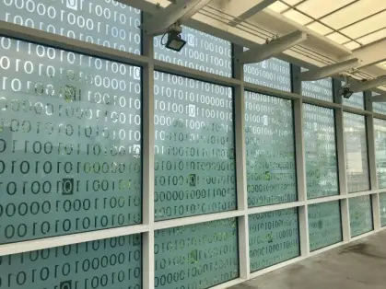
DIFFICULT TOPICS
Notes:
This section should focus on topics that are more math-based (harder to self-teach), concepts that come only usually up in college level courses, or concepts that you struggled with when you competed in this event

Slide 5
Topic 1: How to use…
Calipers - Wikihow
Micrometers - Home Depot Guide
Pipettes - Youtube Video
Double Pan Balance - Website Guide
Tare Mass - EUREKA!
Ruler
Stopwatch
Spring Scale
Graduated Cylinder - Read the Meniscus
Thermometer
MEASURE the SMALLEST graduation or markings on the instrument plus one estimated digit

Slide 6
Topic 2: How to estimate?
Use reference points and logic!
Boiling, freezing, room temperature
Per rules:
What are “things” that you can visually see and “secretly” use as reference points?
Size of letter paper
Sizes of tables and chairs

Slide 7
Topic 3: Doing Math
Converting metric unit to metric unit
Use Dimensional Analysis
Write the units as fractions
Cancel same units
Keep remaining units in final solution
Notes:
Feel free to add more topics and make sure that there are plenty of pictures/diagrams!

Slide 8
COMMON QUESTIONS
All of the following questions have been pulled from past YJI exams (which can be found on our website) or the Text Exchange on SciOly Wiki
Notes:
\

Slide 9
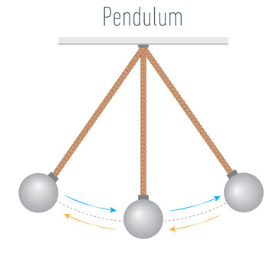
Question 1
Measure the period of the pendulum
Notes:
Pull some questions from exams on the scioly wiki test exchange, first give attendees a couple minutes to read over them/work through them, then walk them through the answers. Try to get a mix of multiple choice and short answer or matching

Slide 10
Question 2
Measure the mass of the Godzilla figure
Notes:
Pull some questions from exams on the scioly wiki test exchange, first give attendees a couple minutes to read over them/work through them, then walk them through the answers

Slide 11
Question 3
Area of a notecard in giga meters²
Notes:
Pull some questions from exams on the scioly wiki test exchange, first give attendees a couple minutes to read over them/work through them, then walk them through the answers

Slide 12
Tips from a Veteran
Make quizlets to study and test your partner!
What are things you need to memorize? (Metric prefixes, formulas)
What are things you need to practice? (Getting a feel for estimations)
Go through “practice rounds” of the event
How will you and your partner work together?
Could you work more efficiently is one person was responsible for measuring, while the other for doing math?
Who will study for which topic?
Precision is key!
Notes:
Use this section to talk about any strategies you used to navigate the event when you competed. For example, how did you manage your time, how did you organize your notes, how did you split topics up between you and your partner, etc.?

Slide 13
Additional Resources
Sci Oly Metric Mastery Wiki
Metric Units of Measurement
CueMath Website on Metric System
SUBWAY STATIONS
Example Metric Mastery Quizlet
Example Metric Mastery Exam
Formulas
Yes, Saturn is the ringed one. This planet is a gas giant, and it’s composed mostly of hydrogen and helium
Notes:
Here, you can link or mention any online or book resources that helped you in this event when you were a competitor. Try to avoid general resources like scioly wiki, because they probably already are familiar with it.

Slide 14
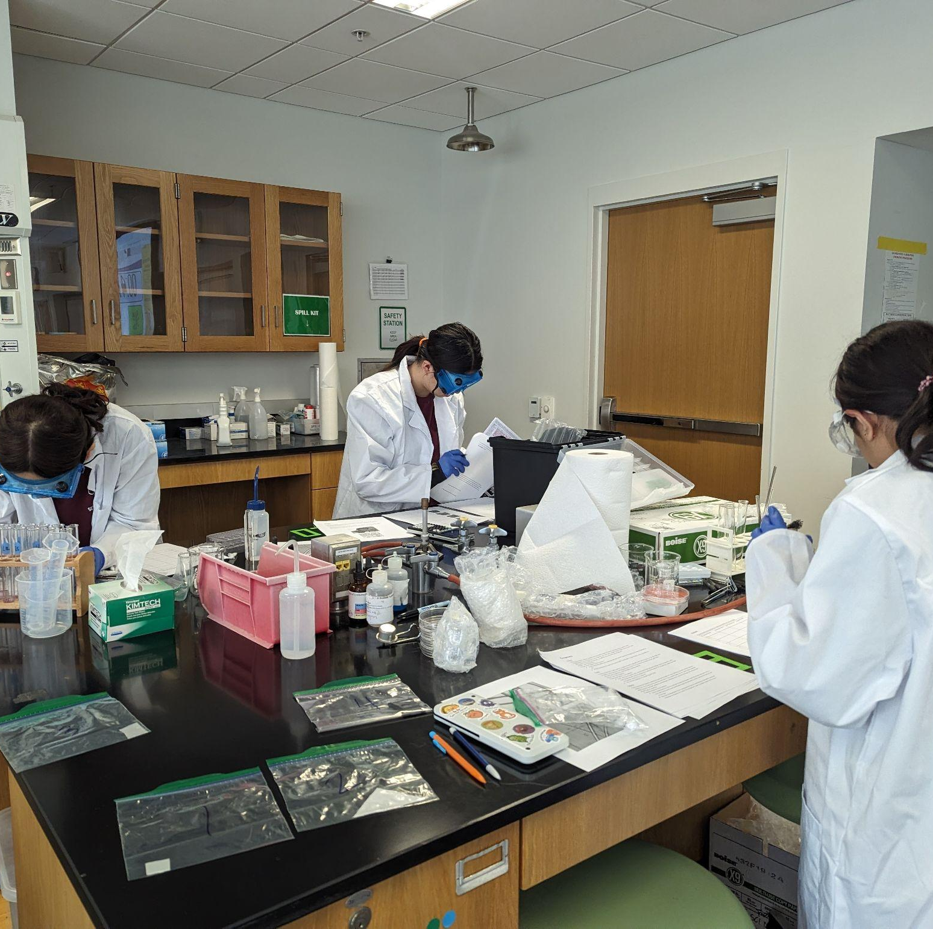
THANKS!
Notes:
(replace picture with a picture from one of our tournaments)

