Slide 1
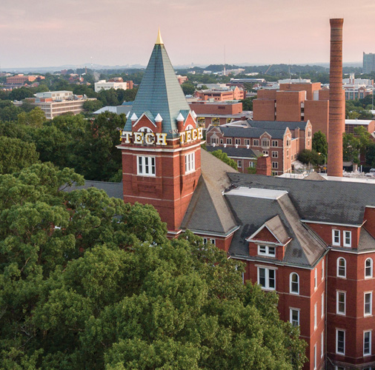
How to Fund a Team
Division B/C
Georgia Tech Event Workshop Series 2024-25
Presenter: Rebecca Xiong

Slide 2
01
SOURCES OF FUNDING
02
BUILDING UP NEW TEAMS AND SMALLER SCHOOLS
[Event-Related Image]
03
MANAGING CLUB FINANCIALS
04
ADVICE FROM COACHES
05
RESOURCES & CONTACTS

Slide 3
Sources of Funding
County/School District Science Office
Student Fundraising Campaigns
GA Science Olympiad and GA Department of Education
School-Specific Funding
Corporate Sponsors
Community Groups
National/Philanthropic Grants
PTA
Div A/Elementary-Specific: Georgia Science Teachers Organization (GSTA)
Notes:
Highlight key points from the rules sheet: DESIGN LOGS that basically grant free points, most tested-on topics, point distribution so that competitors know what to prioritize, allowed notes and equipment, etc.

Slide 4
Letter Campaign
Click for link to Template Letter
Each student brings in 10 mailing addresses
Small local businesses, family members, friends of family
Previous success has been found with these businesses: dental/medical offices, law offices, restaurants, UPS, etc.
Personal connections are best
No peers/classmates
Option for partial contribution to individual student’s account or general club expenses
Different donation level incentives/recognitions
Donation webpage, QR code
Maintain good donor relations by sending out annual/biannual/periodic newsletter updates highlighting your team’s achievements
This will encourage recurring donations

Slide 5
Corporate Sponsors
Hard to get but very impactful source of funding
Employers of parents of students
Previous example: 3M sponsorship at Brookwood from student’s parent
Sponsorship for hosting home tournaments
Offer advertising incentives
Philanthropic foundations/organizations
Timing: If having issue getting responses for donations, try to spread out donation request campaigns near end of school year to prep in advance for next school year (spring), or before the start of the new school year (early summer - fall)
Notes:
3M example from BHS

Slide 6
Other Fundraising Ideas
Bake sale
Car wash
Crafts/handmade goods
Social media posts
Donation bingo board
Creative challenges for hitting donation targets: pie a coach in the face, Scioly team flashmob in cafeteria, TikTok challenges/dances, etc.
Restaurant Partnerships
Chipotle: 15% of sales made during an event goes towards the organization

Slide 7
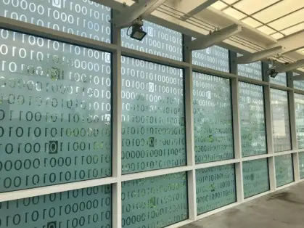
Building Up New Teams and Smaller Schools
Notes:
This section should focus on topics that are more math-based (harder to self-teach), concepts that come only usually up in college level courses, or concepts that you struggled with when you competed in this event

Slide 8
Starting Small and Saving Big
Maintain low club dues to remain accessible and build team membership
Don’t raise dues – try to lower expenses
Don’t have to compete in all events to start – choose the ones that are low-cost
Prioritize study events over build events
Some builds are cheaper (e.g. Balsa wood is very expensive; Robot Tour and Flight are expensive; Bungee Drop is low-cost)
Compete in online invitationals
Partner with local high schools and have student volunteers run your invitational
Create your own build kits by replicating parts from big science distributors
Contact local sales rep for the distributors, potential discounts/promos
Source electronic components by dismantling old electronics from Goodwill/used goods stores

Slide 9
Accounting
If you have multiple coaches, it’s ideal to have one coach be in charge of the financials
Become familiar with your school’s bookkeeper, especially if you are a solo coach
School administrators
School district financial office

Slide 10
MANAGING CLUB FINANCIALS
Planning a Budget
Notes:
\

Slide 11
Major Budget Categories
Revenue sources:
Club Dues
Donations/Grants
Main expenditures:
1. State Tournament Registration
2. Regional Tournament Registration
3. Invitational(s) Registration
4. Materials
5. Transportation
6. Food
7. Team T-shirts
Notes:
Pull some questions from exams on the scioly wiki test exchange, first give attendees a couple minutes to read over them/work through them, then walk them through the answers. Try to get a mix of multiple choice and short answer or matching

Slide 12
Advice from Coaches
Invest in materials/resources that can be reused
Building up inventory of reusable materials will decrease further expenses down the line
Seek the help of parents for donating tools and materials
Utilize parent volunteers for transportation
Online invitationals to break in – set up a mock tournament environment in your school in different rooms
DIY Team T-shirts – e.g. customize with materials from Michael’s

Slide 13
Additional Contacts
GA Department of Education
Keith Crandall, Science Program Manager​
Phone: 470-607-0442
Email: kcrandall@doe.k12.ga.us​
Brookwood High School Coaches
Justin Harvey (Justin.Harvey@gcpsk12.org)
Matthew Meek (Matthew.Meek@gcpsk12.org)
Presenter
Rebecca Xiong (rebeccaxiong01@gmail.com)
Ex-Brookwood HS competitor, Ex-President of UChicago SO, state and regional ES for IL, VA, MI, NY
Feel free to reach out if you’d like me to connect you to others/ask questions!

Slide 14
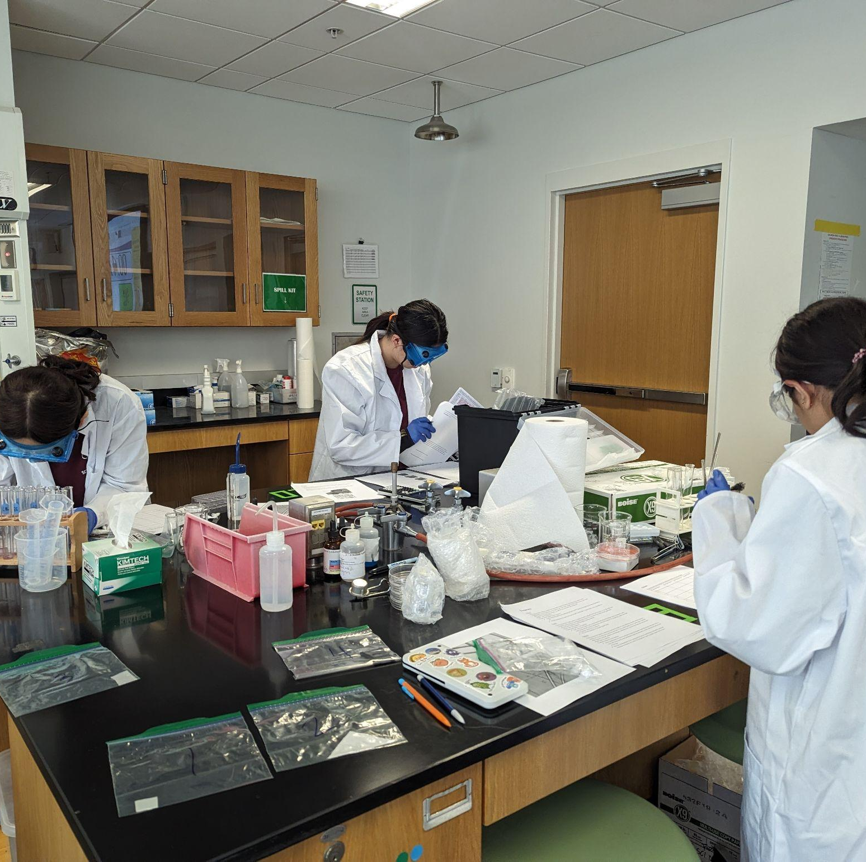
THANKS!
Notes:
(replace picture with a picture from one of our tournaments)

