Slide 1
Helicopters
Division B/C
Georgia Tech Event Workshop Series 2024-25

Slide 2
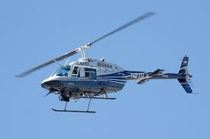
01
RULES SHEET
02
DIFFICULT TOPICS
03
COMMON QUESTIONS
04
TIPS FROM A VETERAN
05
OTHER FREE RESOURCES
Notes:
For Builds: Replace difficult topics with physical principles involved in the build and replace common questions with common designs

Slide 3
The Rules Sheet
Build parameters
Fit in a 32 cm x 24 cm x 47 cm box
Up to 3 fixed pitch rotors
Mass must be 4 g or more (excluding rubber motor)
Rubber motors can be of any mass or length
Flight Log: 6 parameters
Required: Motor size, number of turns or torque of motor before launch, flight time
Examples of more parameters: number of winds remaining on motor, propeller pitch, estimated peak flight altitude, etc.
Competition
10 minute flight period
2 official flights
As many unofficial flights as you want
Notes:
Highlight key points from the rules sheet: DESIGN LOGS that basically grant free points, most tested-on topics, point distribution so that competitors know what to prioritize, allowed notes and equipment, etc.

Slide 4
DIFFICULT TOPICS
Notes:
This section should focus on topics that are more math-based (harder to self-teach), concepts that come only usually up in college level courses, or concepts that you struggled with when you competed in this event

Slide 5
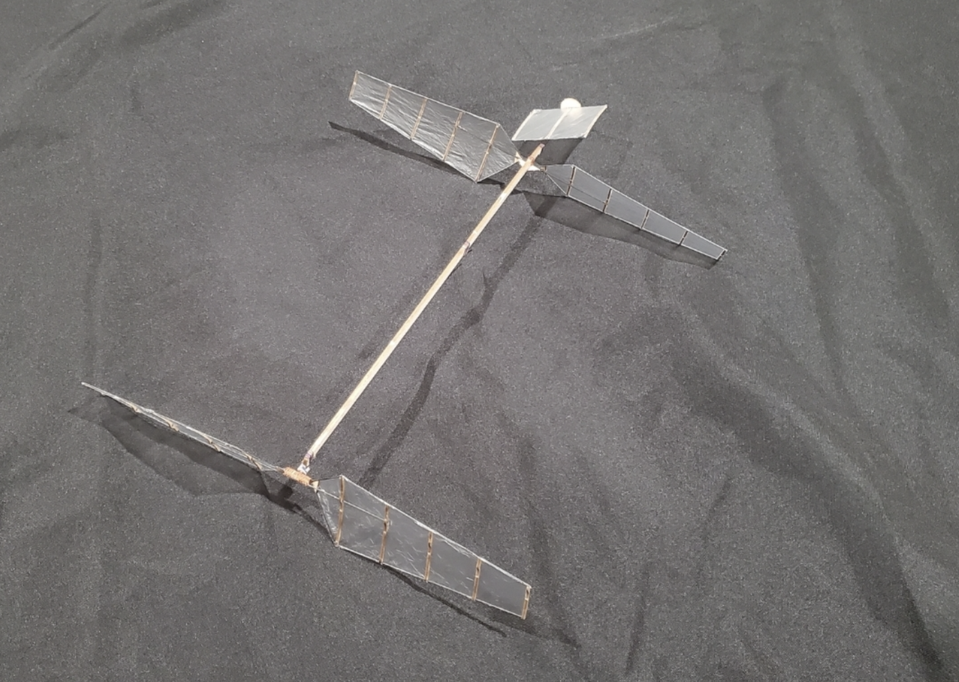
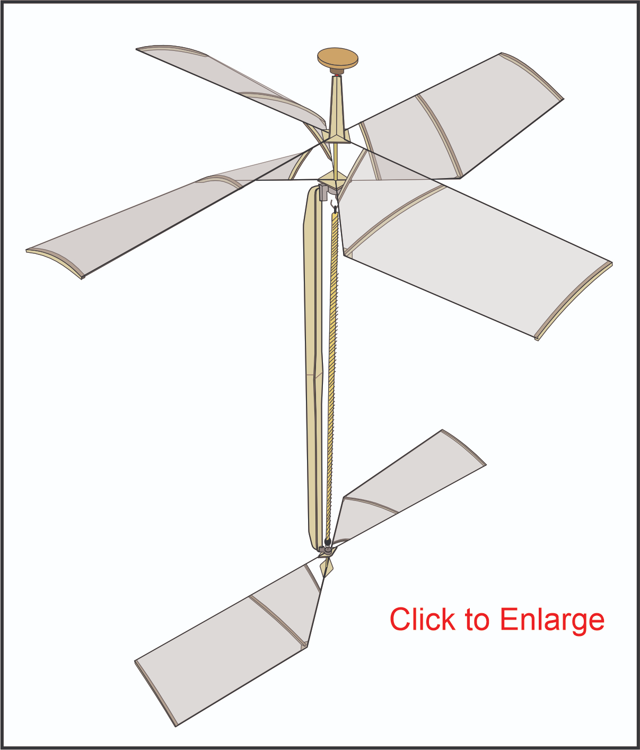
Topic 1: Getting Started
What design should I choose?
What materials are good for a helicopter?
The lightest (least dense) balsa wood
The thinnest plastic bags (or even mylar)
You want to save weight!!!
Where do I get the rubber for the motor?
Many suppliers (linked later in the presentation)

Slide 6
Topic 2: Testing
Where should I test?
Any open room that has minimal obstructions on the ceiling (ideally a flat ceiling if possible)
Height of the room does not matter as much for this event
What should I expect out of my first tests?
Unstable flights
You are just trying to see if your helicopter can even get airborne
What data should I collect?
Weight of the motor [required]
Length of the motor (rubber band)
How many winds you put into the motor/torque [required]
Flight time [required]
Any interesting characteristics of the flight (did the helicopter drift in one direction, did the helicopter vibrate, etc.

Slide 7
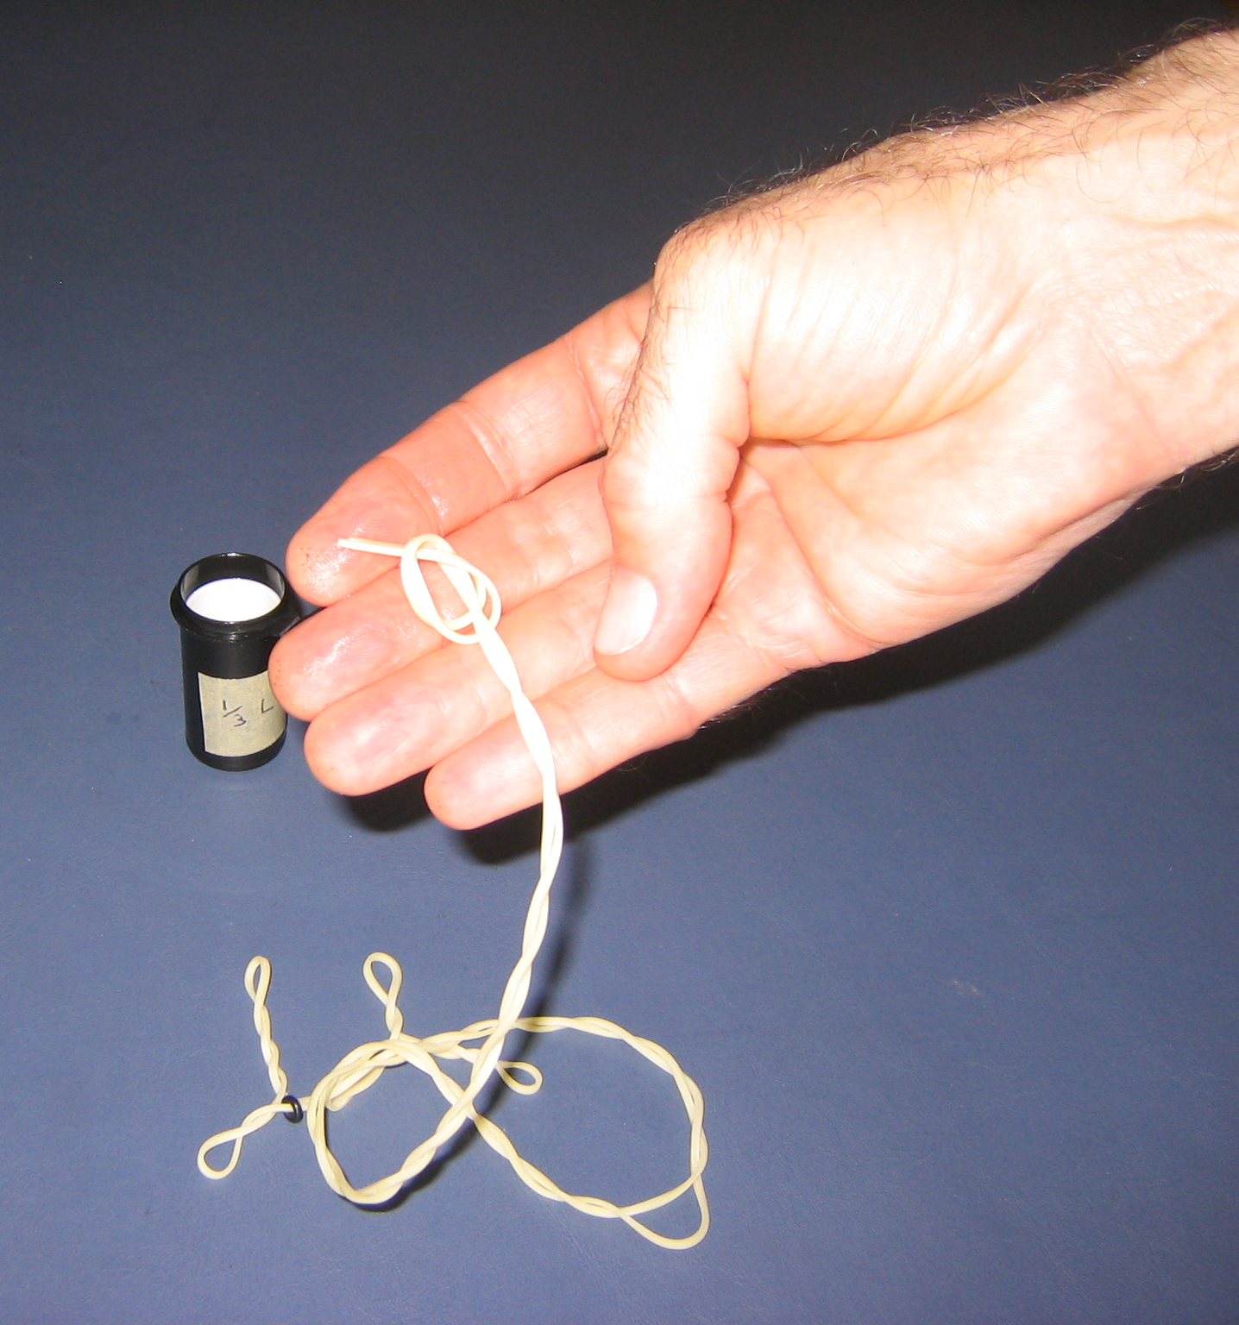
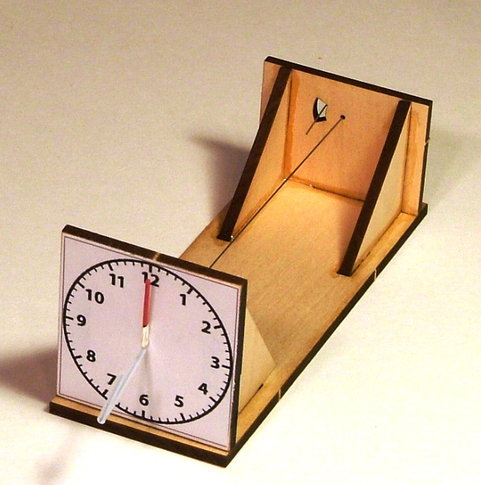
Topic 3: Optimization
How do I use the data I collect to improve my flight times?
Check if changing a characteristic of the
Changing the rubber band I use?
New rubber thickness
Thicker bands will release their energy must faster, so they may not be good for long flight times
Changing the length of the motor?
Longer bands can hold more energy overall, so we could get longer flight times, but there is a breaking point where the longer rubber band adds more weight to the helicopter than its worth
Notes:
Feel free to add more topics and make sure that there are plenty of pictures/diagrams!

Slide 8
Tips from a Veteran
TEST, TEST, TEST!!!!
Don’t be afraid to test at home
Things break, just fix them
Look for any changes in flight characteristics before and after the repair
Play with the rubber motor sizes
Including thickness and length of the rubber band
Make sure to use some sort of lubricant on the rubber band
Armorall (car seat cleaner)
Helps with the rubber band releasing as much energy as possible before it is out of winds
Notes:
Use this section to talk about any strategies you used to navigate the event when you competed. For example, how did you manage your time, how did you organize your notes, how did you split topics up between you and your partner, etc.?

Slide 9
Additional Resources
https://freedomflightmodels.com/kits.php
https://jhaerospace.com/product/tornado2025/
SUBWAY STATIONS
https://www.faimodelsupply.com/
https://www.lasercutplanes.com/product/dirt-cheap-torque-meter/
Yes, Saturn is the ringed one. This planet is a gas giant, and it’s composed mostly of hydrogen and helium
Notes:
Here, you can link or mention any online or book resources that helped you in this event when you were a competitor. Try to avoid general resources like scioly wiki, because they probably already are familiar with it.

Slide 10
Additional Resources
https://www.endlesslift.com/making-a-rubber-motor/
SUBWAY STATIONS
Yes, Saturn is the ringed one. This planet is a gas giant, and it’s composed mostly of hydrogen and helium
Notes:
Here, you can link or mention any online or book resources that helped you in this event when you were a competitor. Try to avoid general resources like scioly wiki, because they probably already are familiar with it.

Slide 11
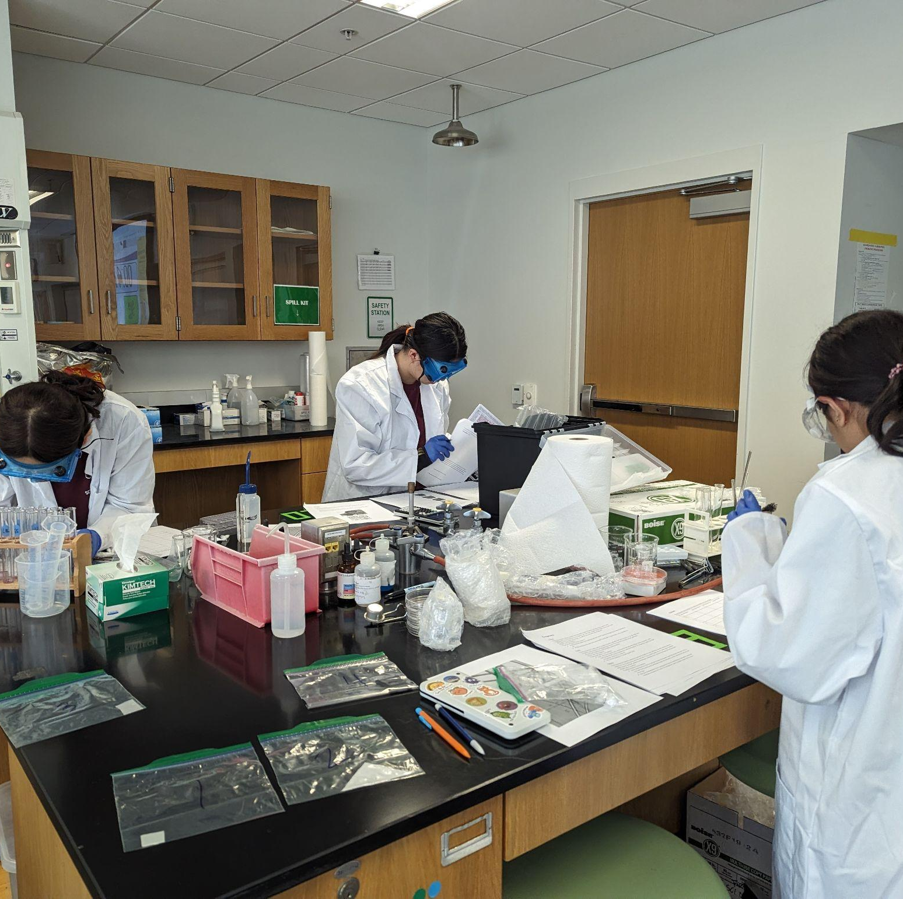
THANKS!
Notes:
(replace picture with a picture from one of our tournaments)

