Slide 1
Fossils
B/C
Georgia Tech Event Workshop Series 2024-25

Slide 2
Introductions
Notes:
This section should focus on topics that are more math-based (harder to self-teach), concepts that come only usually up in college level courses, or concepts that you struggled with when you competed in this event

Slide 3
Akul Rana
The Westminster Schools
Emory BS and BBA ‘28
Scioly for 4 years
USESO ‘23 National Camper
Educator at natural history museum in Georgia
2nd GA States in Fossils
Notes:
Highlight key points from the rules sheet: DESIGN LOGS that basically grant free points, most tested-on topics, point distribution so that competitors know what to prioritize, allowed notes and equipment, etc.

Slide 4
Victor Hesu
The Westminster Schools
Georgia Tech BSME ‘26
Scioly for 4 years
Helped with 20+ tournaments
2nd GA States in Fossils
Notes:
Highlight key points from the rules sheet: DESIGN LOGS that basically grant free points, most tested-on topics, point distribution so that competitors know what to prioritize, allowed notes and equipment, etc.

Slide 5
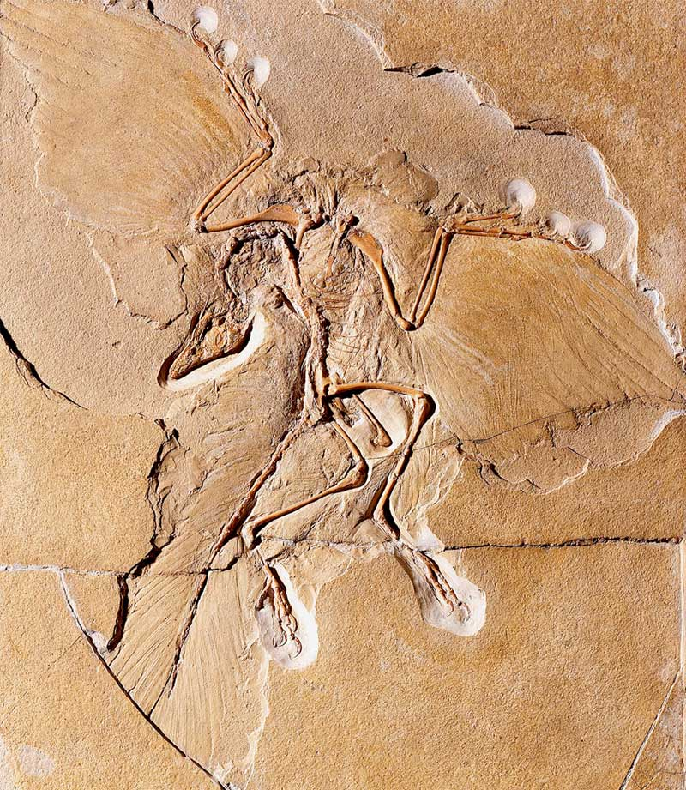
01
RULES SHEET
02
DIFFICULT TOPICS
[Event-Related Image]
03
COMMON QUESTIONS
04
TIPS FROM A VETERAN
05
OTHER FREE RESOURCES
Notes:
For Builds: Replace difficult topics with physical principles involved in the build and replace common questions with common designs

Slide 6
The Rules Sheet
Common Topics
Identify the fossil and be able to determine mode of preservation
Determine past environments and ecosystems
Determine the age of assemblages and fossils with relative and absolute dating
Major evolutionary trends and events
What's allowed
1 three ring binder of any size
Magnifying glass
Annotated and labeled field guide
1 individual copy of the official list outside of binder
Notes:
Highlight key points from the rules sheet: DESIGN LOGS that basically grant free points, most tested-on topics, point distribution so that competitors know what to prioritize, allowed notes and equipment, etc.

Slide 7
DIFFICULT TOPICS
Notes:
This section should focus on topics that are more math-based (harder to self-teach), concepts that come only usually up in college level courses, or concepts that you struggled with when you competed in this event

Slide 8
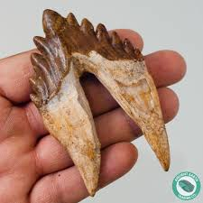
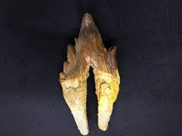
Topic 1: Teeth
Basilosaurus

Slide 9
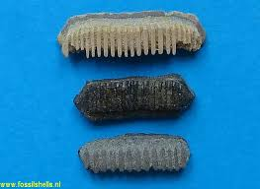
Topic 1: Teeth
Batoidea

Slide 10
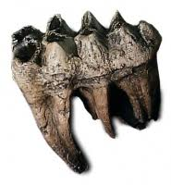
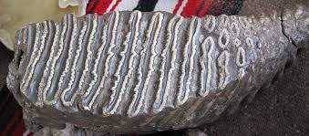
Topic 1: Teeth
Mammoth vs Mastodon

Slide 11
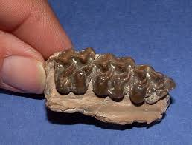
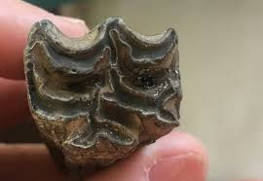
Topic 1: Teeth
Equus vs Mesohippus

Slide 12
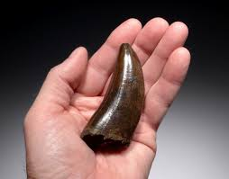
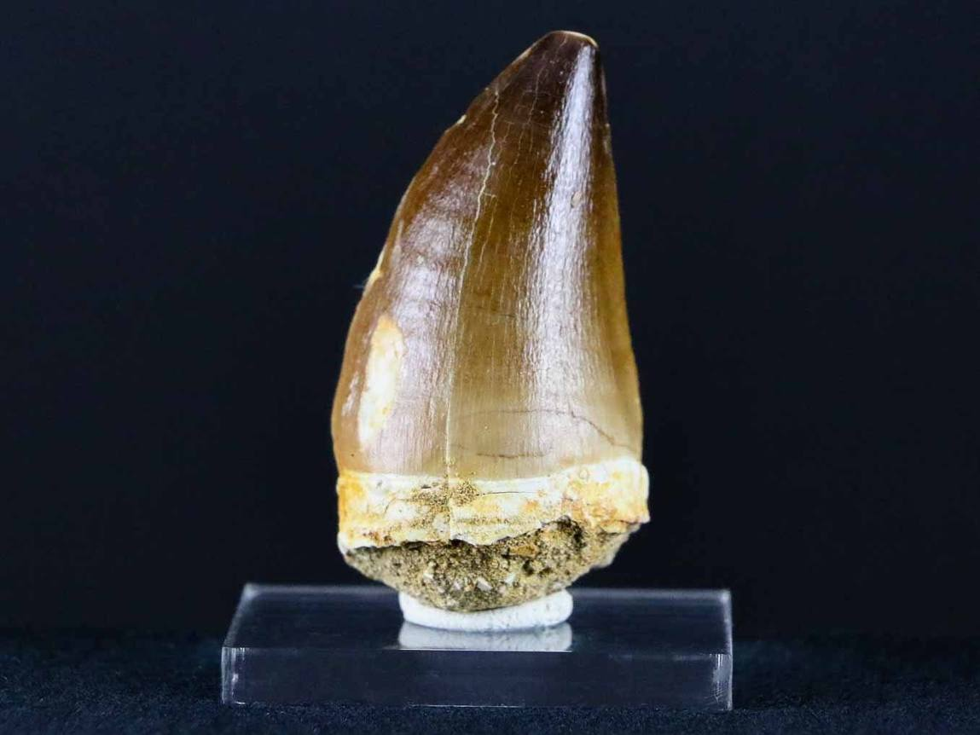
Topic 1: Teeth
Mosasaurus vs T. Rex

Slide 13
Topic 2: Evolution and Geologic History
First life on earth is debated
Oldest evidence of life in total is a debated graphite grain inside Australian Zircon
Jack Hills formation
Oldest large scale stratigraphic evidence is in a Greenland metasedimentary layer
Isua Supracrustal Belt
THE EARLIEST KNOWN DIRECT LIFE(not earliest life) are stromatolites
Dresser Formation of the Pilbara Craton of Western Australia

Slide 14
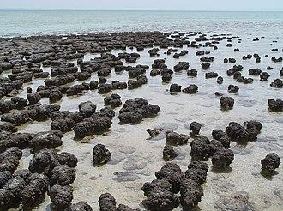
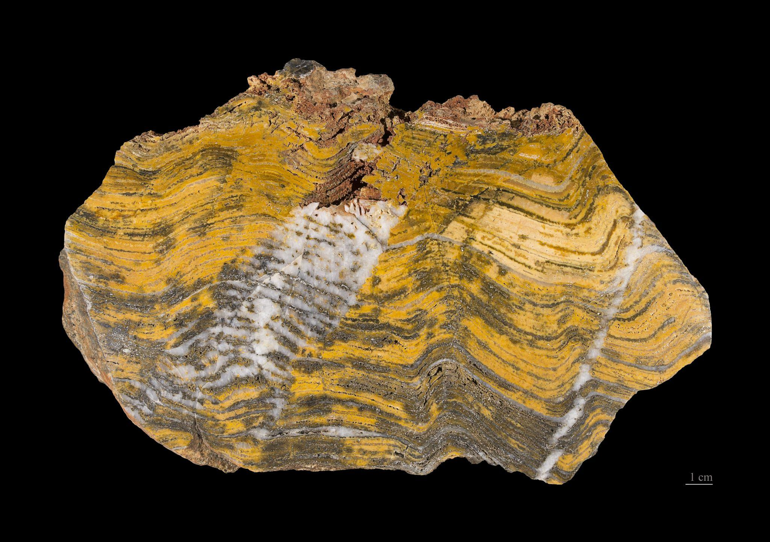
Topic 2: Evolution and Geologic History
Stromatolites are like microbial mats that mixed with sediment and ended up getting preserved in Geyserite
Hypersaline environments

Slide 15
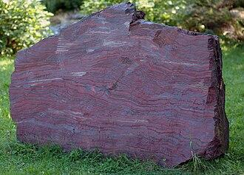
Topic 2: Evolution and Geologic History
Banded Iron Formations (BIF’s) also display the effects of cyanobacteria

Slide 16
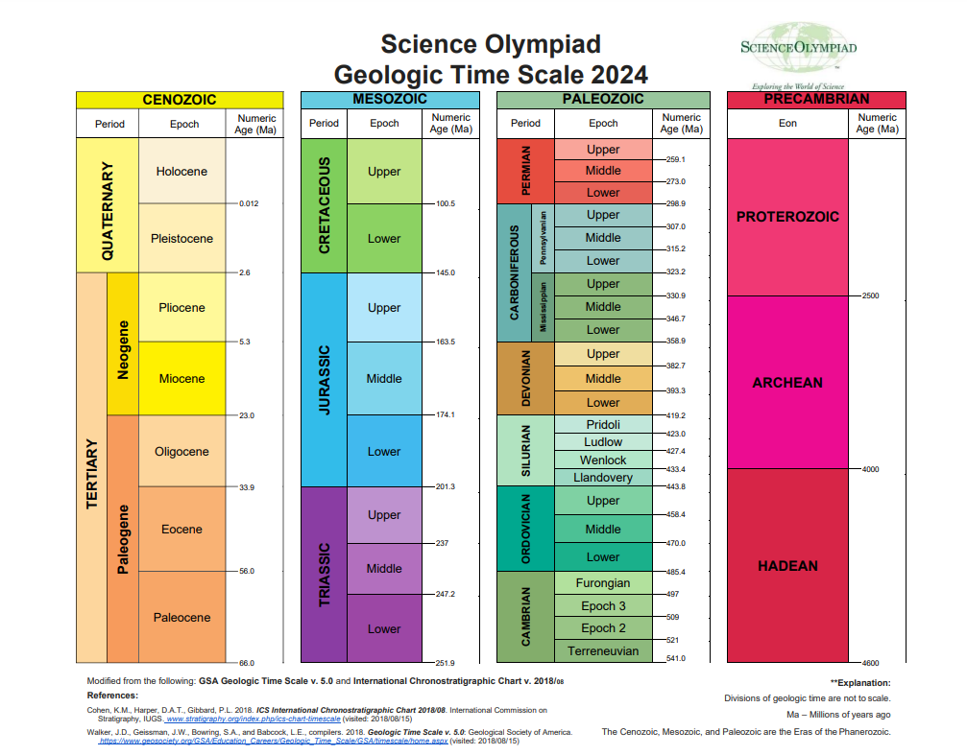
Topic 2: Evolution and Geologic History

Slide 17
Topic 2: Evolution and Geologic History: Precambrian
Hadean
Not much life stuff, earth was very hot; Defined by lack of life
Archean
4100 MYA: Jack Hills Graphite
3800 MYA: Bacteria and Archaea’s last common ancestor
3000 MYA: Cyanobacteria creating free oxygens into environment
Proterozoic Eon
2500 MYA: Great Oxygenation (defines start of the Proterozoic)
By 1850 MYA: Eukaryotes and Viruses soon after
750 MYA: Animalia gets on stage
600 MYA: Ozone
580 MYA: Start of the Cambrian explosion(mostly coral and jellies
Phanerozoic is defined by the diversification of Life

Slide 18
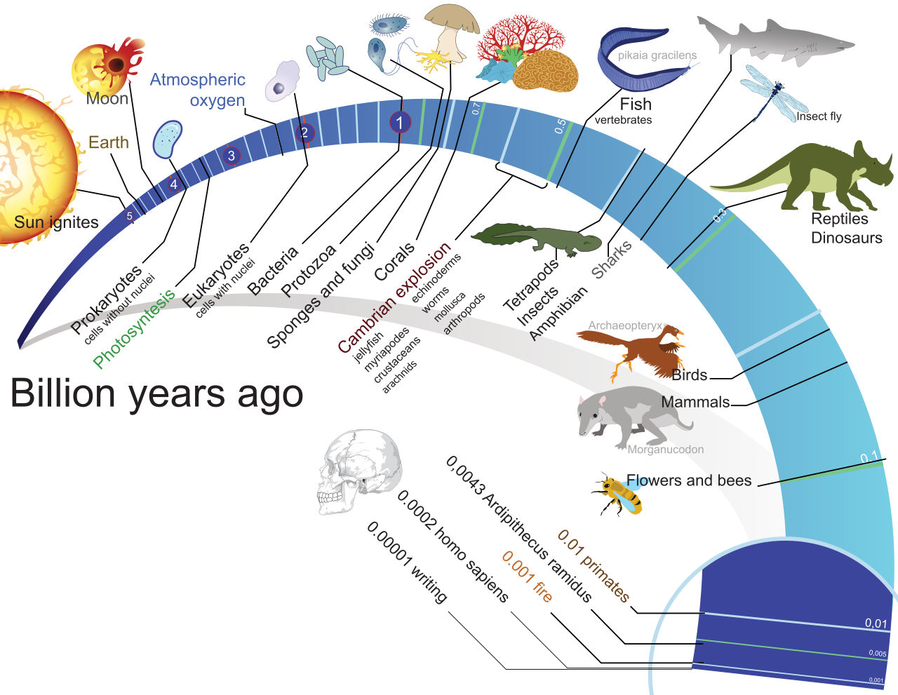
Topic 2: Evolution and Geologic History: Life

Slide 19
Topic 2: Evolution and Geologic History: Extinction
Ordovician–Silurian extinction events (End Ordovician or O–S): 450–440 Ma at the Ordovician–Silurian transition. Two events occurred that killed off 27% of all families, 57% of all genera and 60% to 70% of all species.
Late Devonian extinction: 375–360 Ma near the Devonian–Carboniferous transition. At the end of the Frasnian Age in the later part(s) of the Devonian Period, a prolonged series of extinctions eliminated about 19% of all families, 50% of all genera and at least 70% of all species.
Permian–Triassic extinction AKA “The Great Dying” event (End Permian): 252 Ma at the Permian–Triassic transition. Earth's largest extinction killed 57% of all families, 83% of all genera and 90% to 96% of all species (53% of marine families, 84% of marine genera, about 96% of all marine species and an estimated 70% of land species, including insects).
Triassic–Jurassic extinction event (End Triassic): 201.3 Ma at the Triassic–Jurassic transition. About 23% of all families, 48% of all genera (20% of marine families and 55% of marine genera) and 70% to 75% of all species became extinct.
Cretaceous–Paleogene extinction event (End Cretaceous, K–Pg extinction, or formerly K–T extinction): 66 Ma at the Cretaceous (Maastrichtian) – Paleogene (Danian) transition interval. About 17% of all families, 50% of all genera and 75% of all species became extinct.

Slide 20
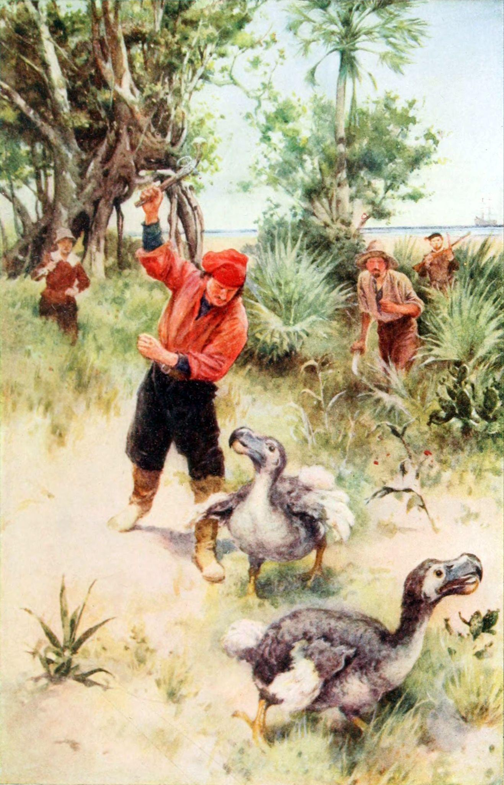
Topic 2: Evolution and Geologic History: 6th Extinction
Holocene extinction: Currently ongoing. Extinctions have occurred at over 1000 times the background extinction rate since 1900. The mass extinction is a result of human activity, driven by population growth and overconsumption of the earth's natural resources. The 2019 global biodiversity assessment by IPBES asserts that out of an estimated 8 million species, 1 million plant and animal species are currently threatened with extinction. 50 times higher is the rate of extinction of the Pleistocene-Holocene extinction than that of any other major mass extinction.

Slide 21
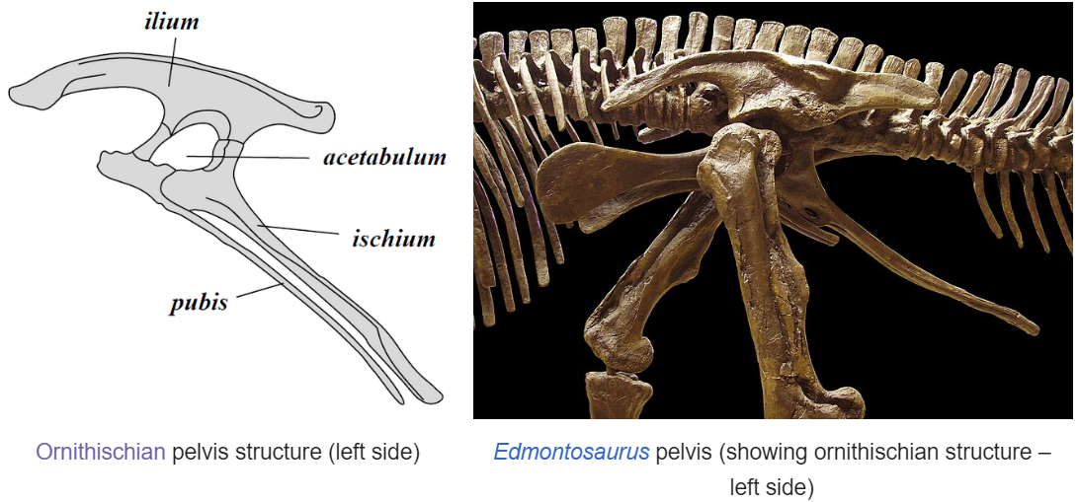
Topic 3: Bird or Reptile?: Ornithischians

Slide 22
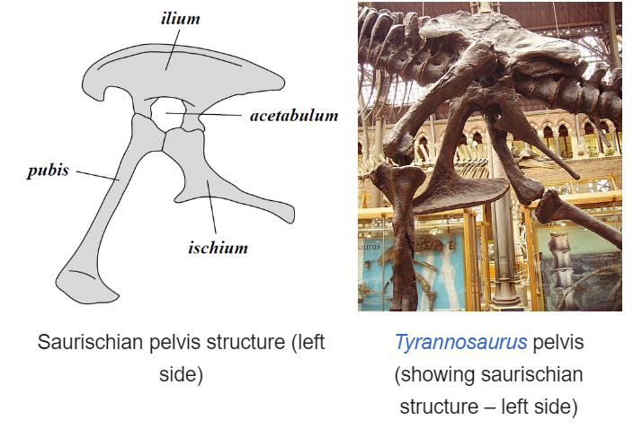
Topic 3: Bird or Reptile?: Ornithischians

Slide 23
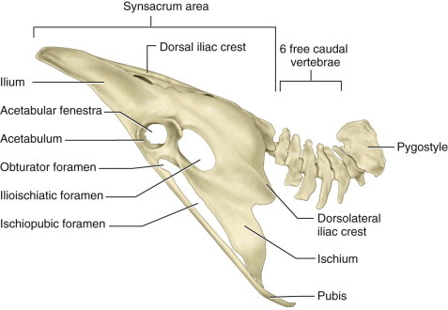
Topic 3: Bird or Reptile?: Ornithischians and Birds → Convergent
Birds actually evolved from Saurischian (not bird hips) carnivorous dinosaurs
The Ischium rotation had evolutionary twice

Slide 24
Topic 2: Evolution and Geologic History: Paleozoic
Paleozoic
535 MYA: Crazy diversification of invertebrates
485 MYA: Vertebrates
430 MYA: First agnathan fishes (IN LIST)
420 MYA: First ray finned fish and land invertebrates
410 MYA: First fish with teeth and nautilida
395 MYA: Zachelmie Trackways: oldest terrestrial prints
375-365 MYA: Tiktaalik and Acanthostega fossils were found
360 MYA: First firns, and seed ferns dominate land plants
350 MYA: Diversification of Amphibians
Notes:
Feel free to add more topics and make sure that there are plenty of pictures/diagrams!

Slide 25
COMMON QUESTIONS
All of the following questions have been pulled from past YJI exams (which can be found on our website) or the Text Exchange on SciOly Wiki
Notes:
\

Slide 26
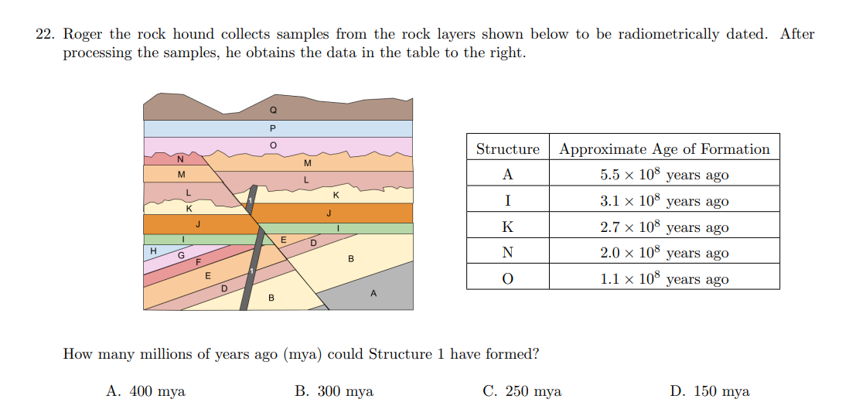
Question 1
Notes:
Pull some questions from exams on the scioly wiki test exchange, first give attendees a couple minutes to read over them/work through them, then walk them through the answers. Try to get a mix of multiple choice and short answer or matching

Slide 27
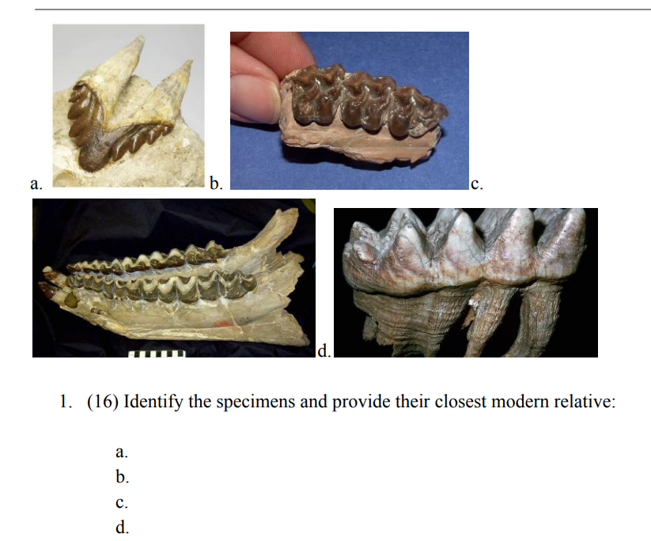
Question 2
Notes:
Pull some questions from exams on the scioly wiki test exchange, first give attendees a couple minutes to read over them/work through them, then walk them through the answers

Slide 28
Question 3
Notes:
Pull some questions from exams on the scioly wiki test exchange, first give attendees a couple minutes to read over them/work through them, then walk them through the answers

Slide 29
Question 4
Notes:
Pull some questions from exams on the scioly wiki test exchange, first give attendees a couple minutes to read over them/work through them, then walk them through the answers

Slide 30
Tips from a Veteran
ID, ID, ID
You shouldn’t be having to flip through your binder to identify something
Make your own binder
Allows you to make your own system that is most efficient for YOU
Practice tests!!!
Since fossils covers so many topics, you can use practice tests to patch up cracks
Notes:
Use this section to talk about any strategies you used to navigate the event when you competed. For example, how did you manage your time, how did you organize your notes, how did you split topics up between you and your partner, etc.?

Slide 31
Additional Resources
Sci Oly Wiki
Wikipedia
SUBWAY STATIONS
Tarbuck Earth Science
ID bot on Discord
Yes, Saturn is the ringed one. This planet is a gas giant, and it’s composed mostly of hydrogen and helium
Notes:
Here, you can link or mention any online or book resources that helped you in this event when you were a competitor. Try to avoid general resources like scioly wiki, because they probably already are familiar with it.

Slide 32
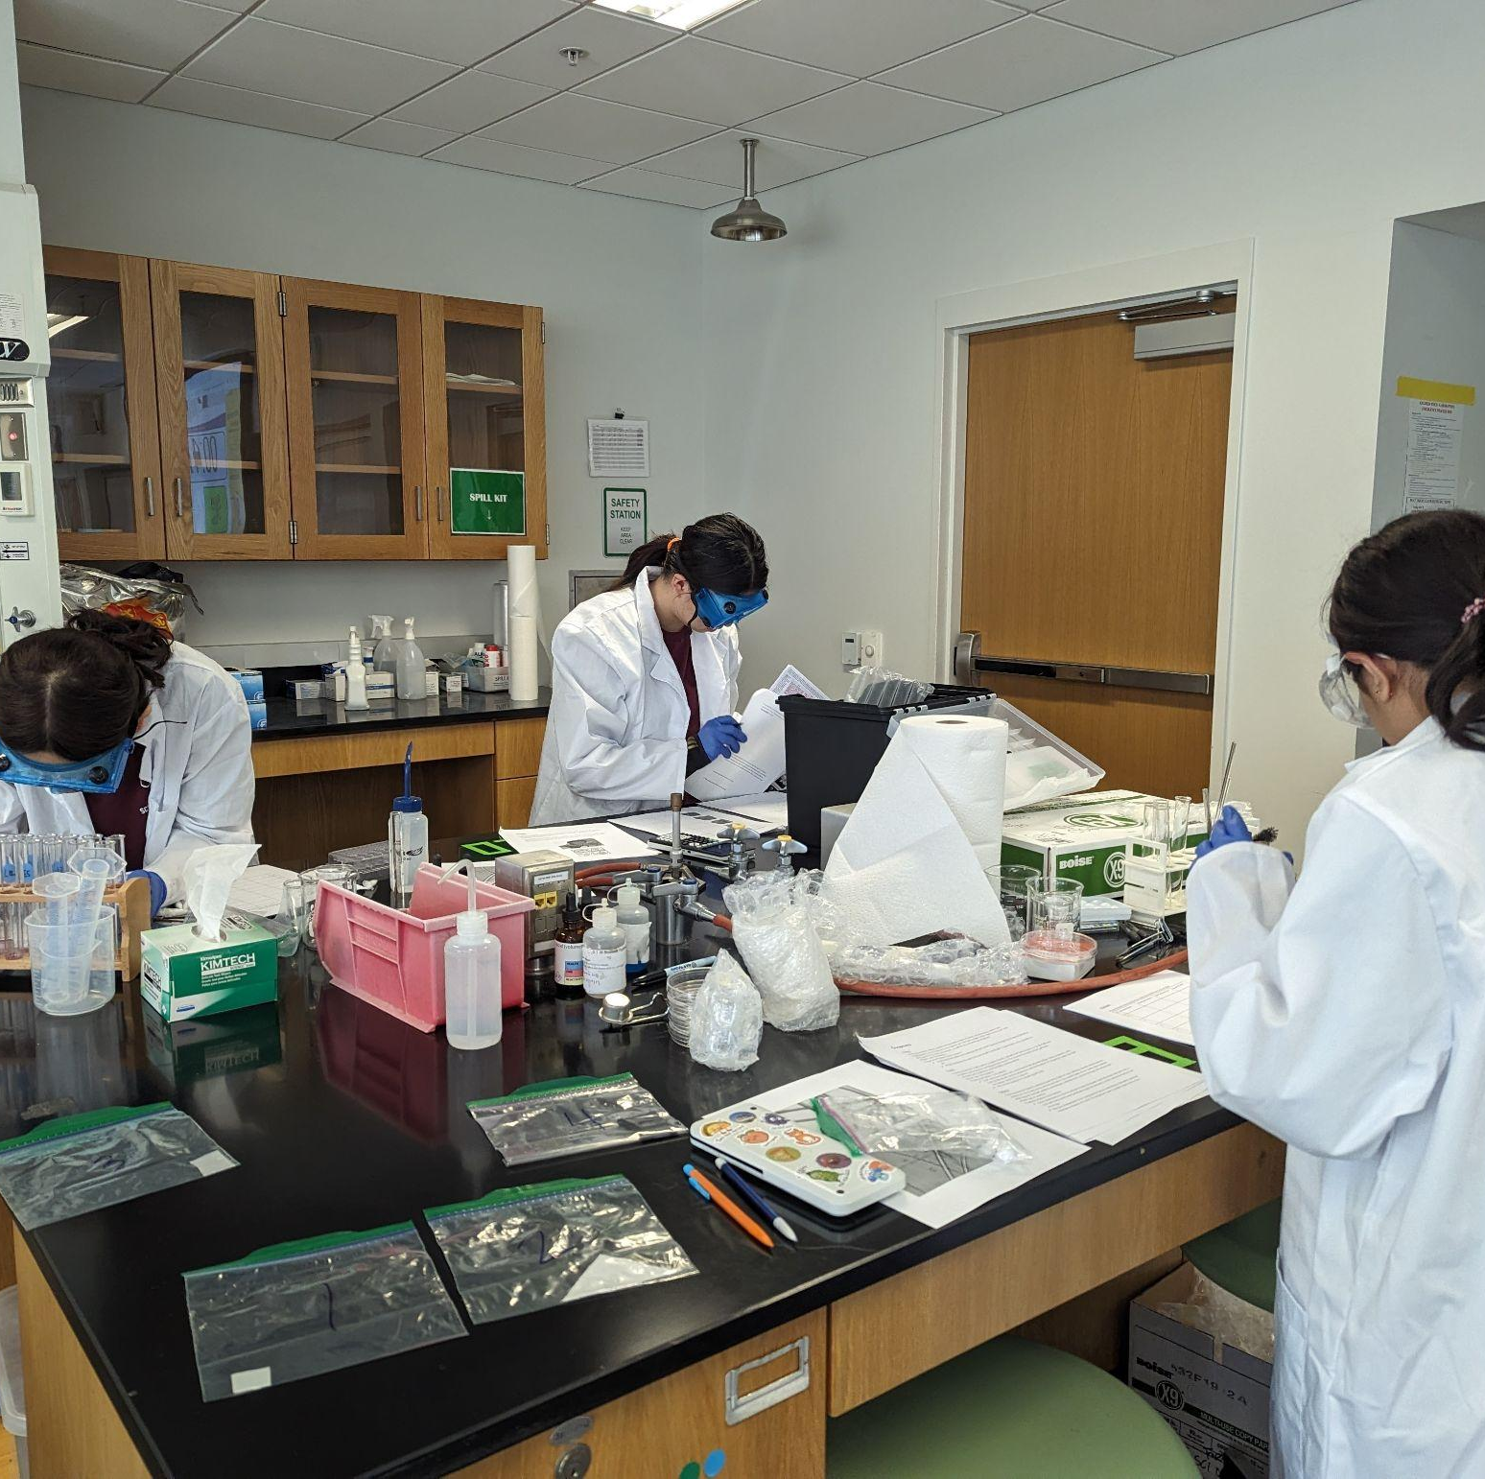
THANKS!
Notes:
(replace picture with a picture from one of our tournaments)

