Slide 1
Experimental Design
Division B/C
Georgia Tech Event Workshop Series 2024-25

Slide 2
01
RULES SHEET
02
DIFFICULT TOPICS
03
COMMON QUESTIONS
04
TIPS FROM A VETERAN
05
OTHER FREE RESOURCES
Notes:
For Builds: Replace difficult topics with physical principles involved in the build and replace common questions with common designs

Slide 3
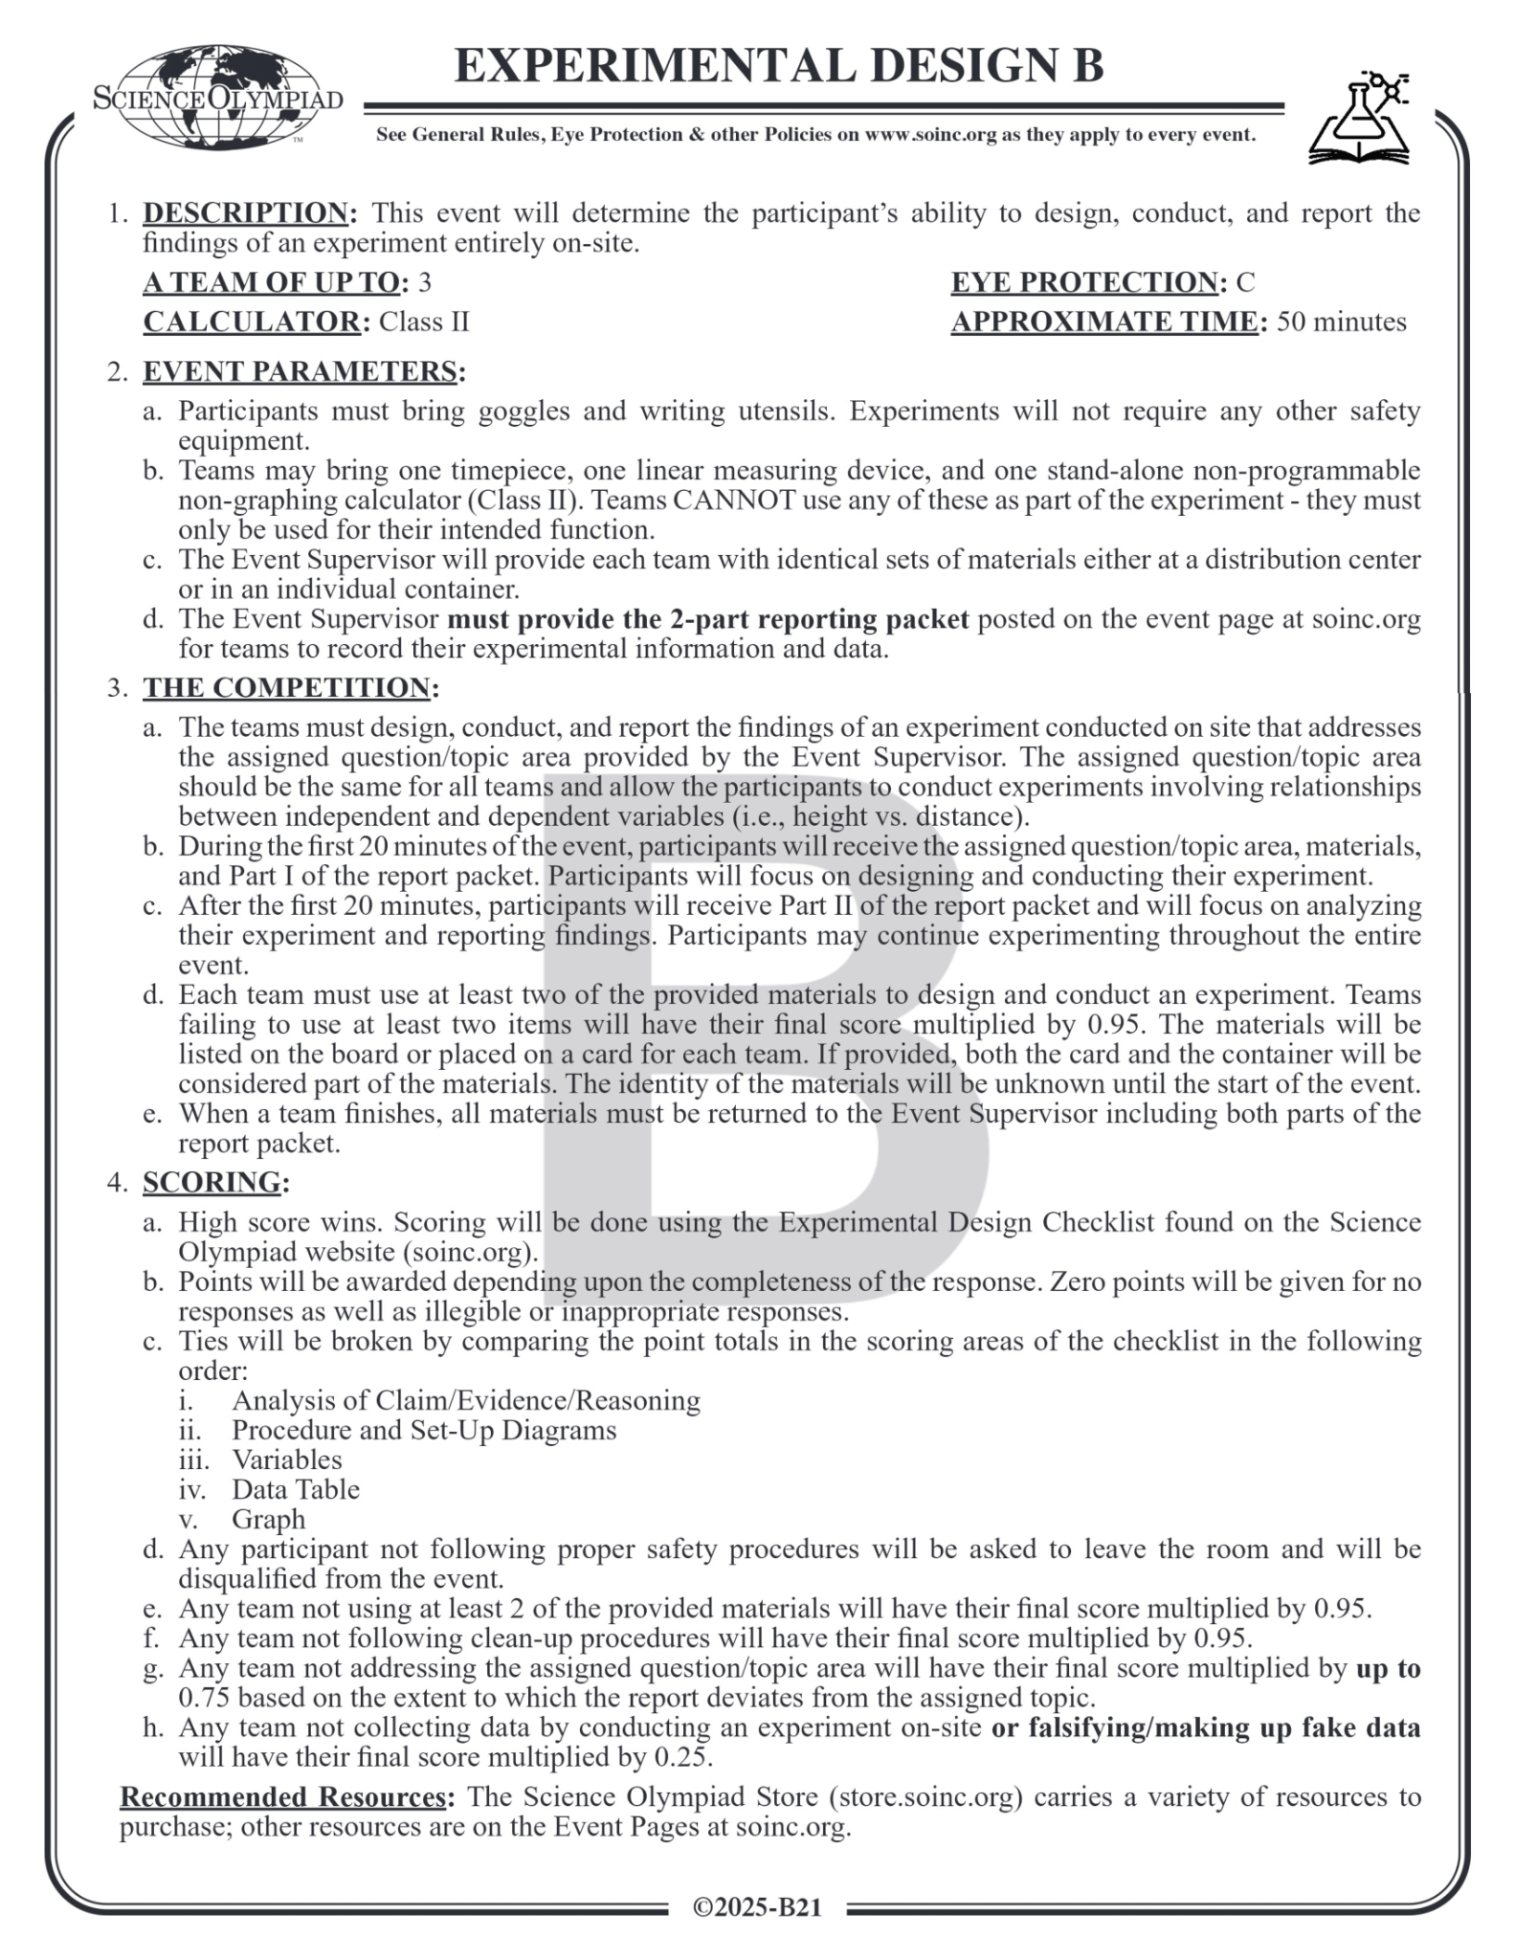
The Rules Sheet
Short/Basic Description: make a science fair project in 50 minutes
Differences between Div B and C:
Standard Of Comparison
3 vs 4 levels of IV
Sig Figs
Abstract
NEW: “Any team not collecting data by conducting an experiment on-site or falsifying/making up fake data will have their final score multiplied by 0.25”
Notes:
Highlight key points from the rules sheet: DESIGN LOGS that basically grant free points, most tested-on topics, point distribution so that competitors know what to prioritize, allowed notes and equipment, etc.

Slide 4
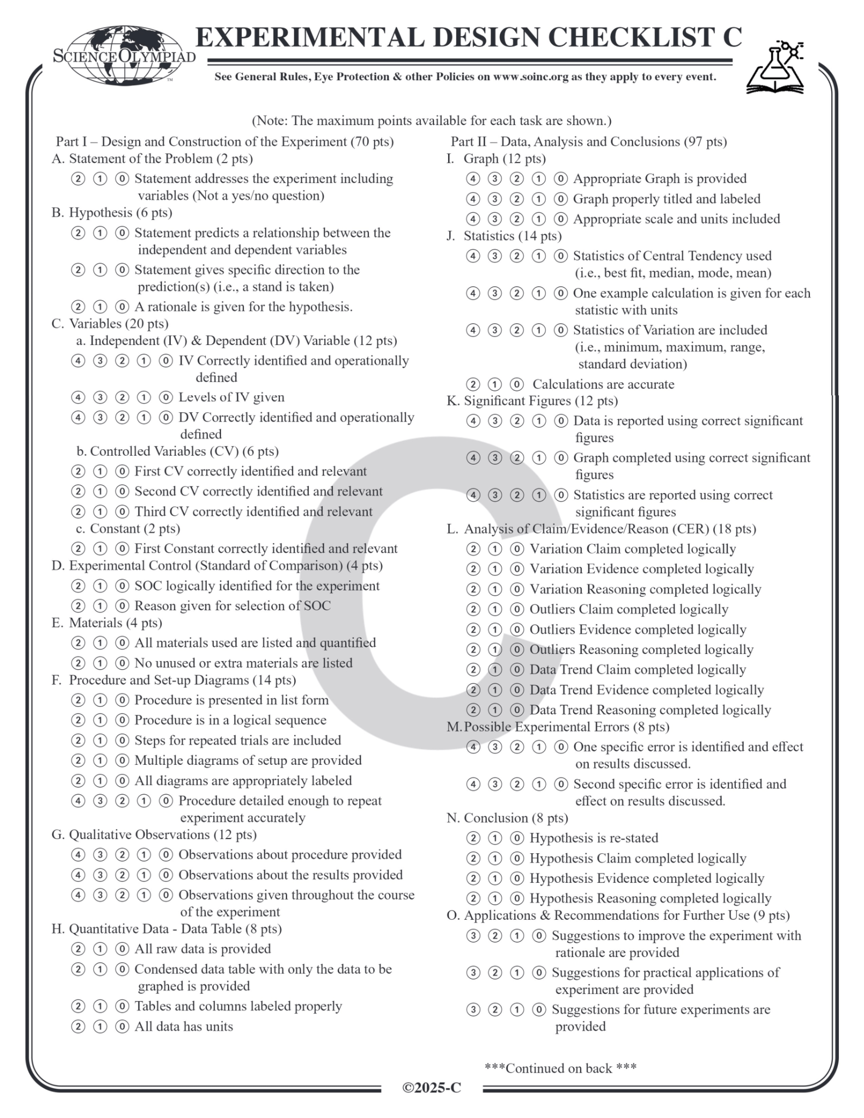
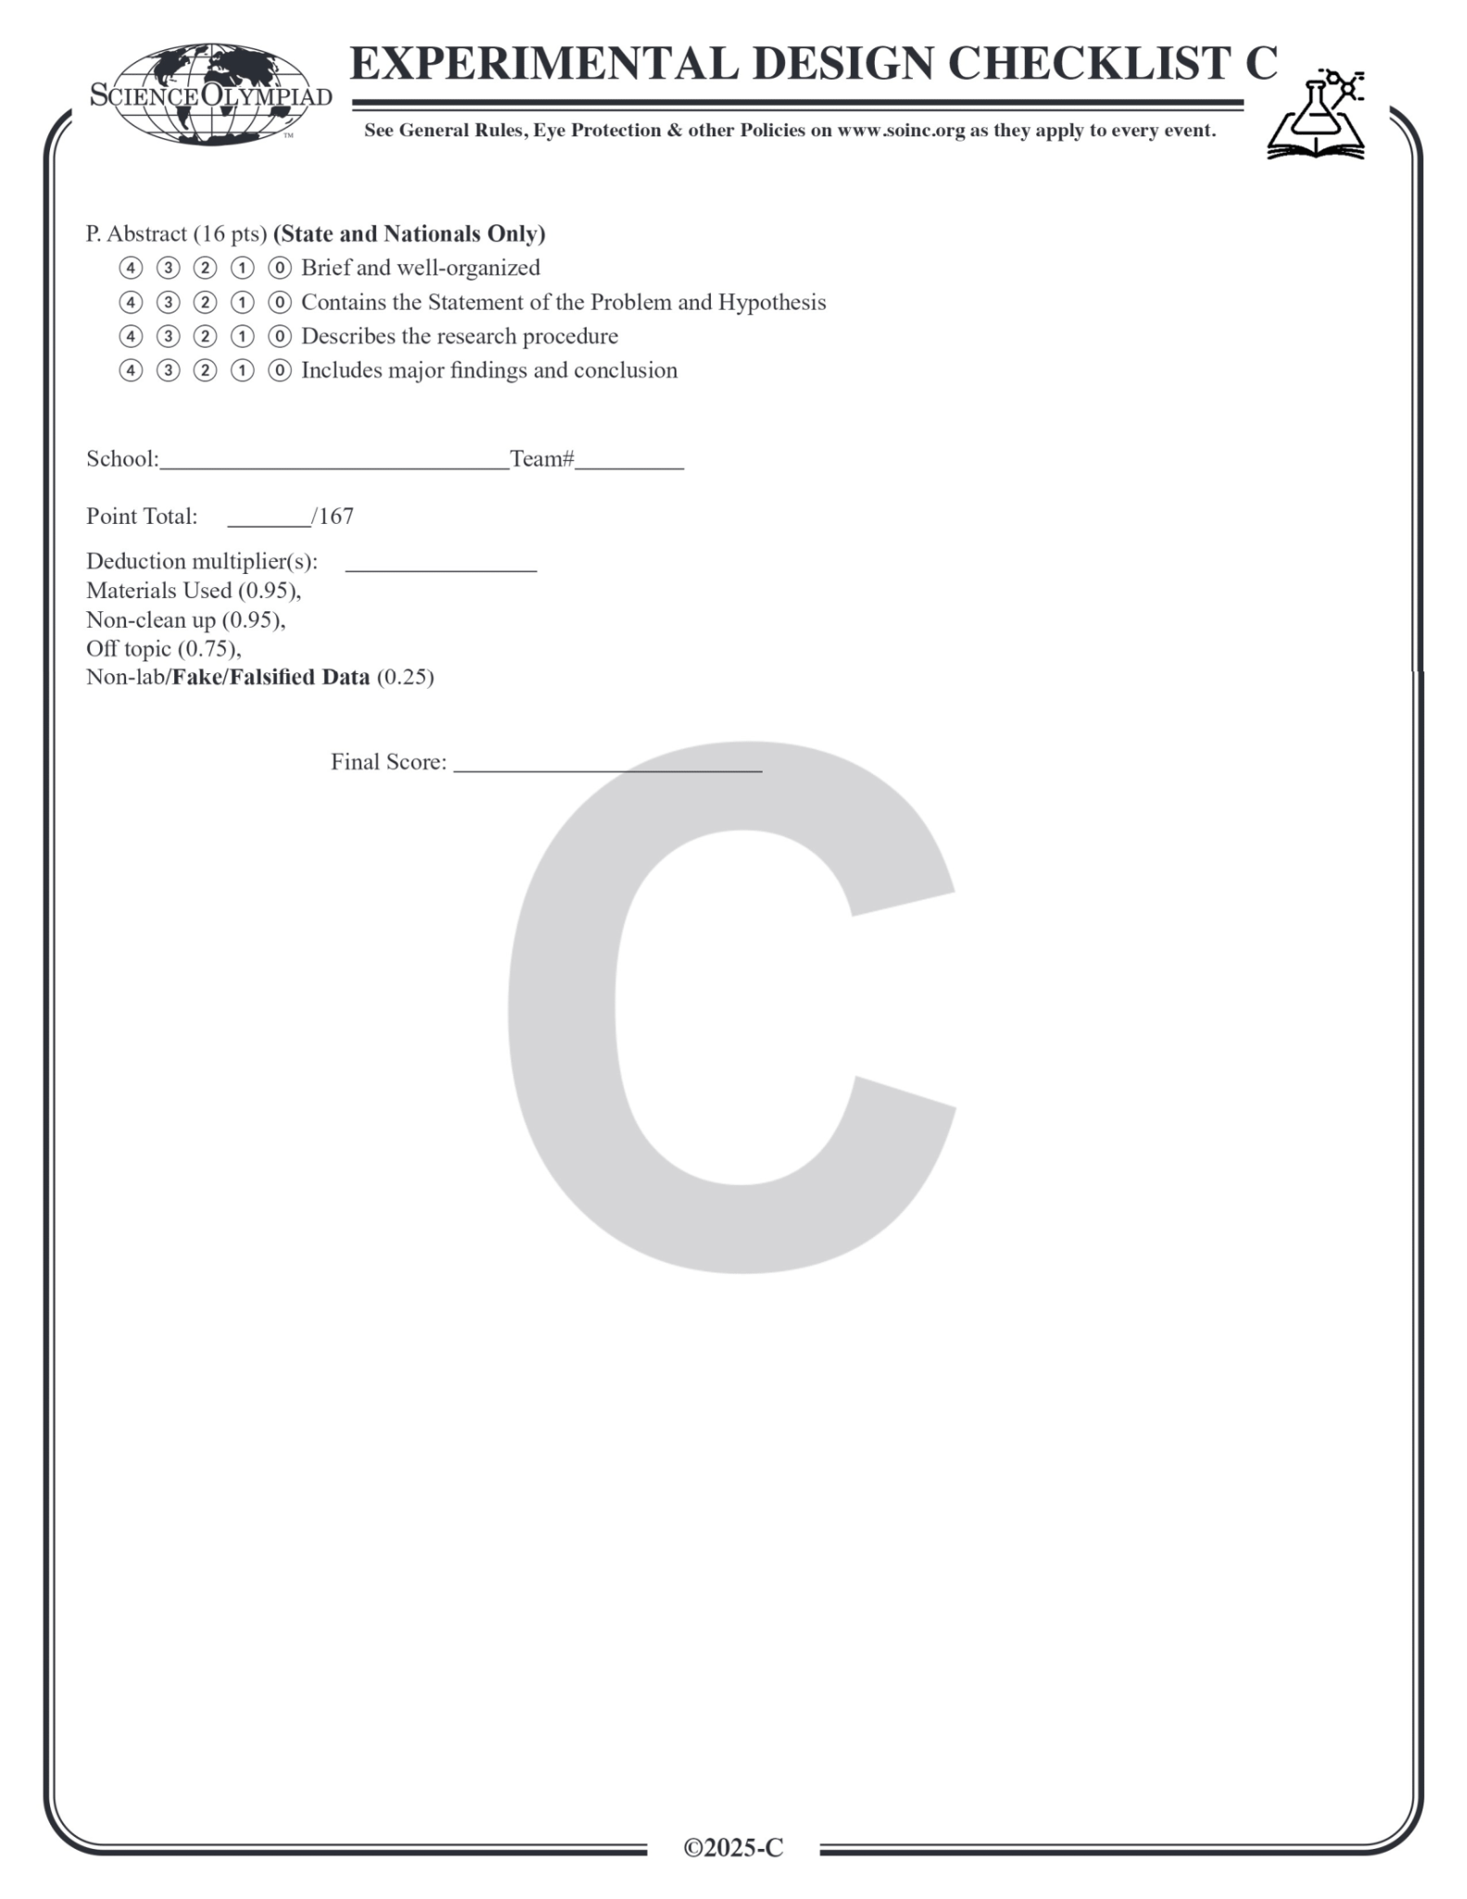

Slide 5
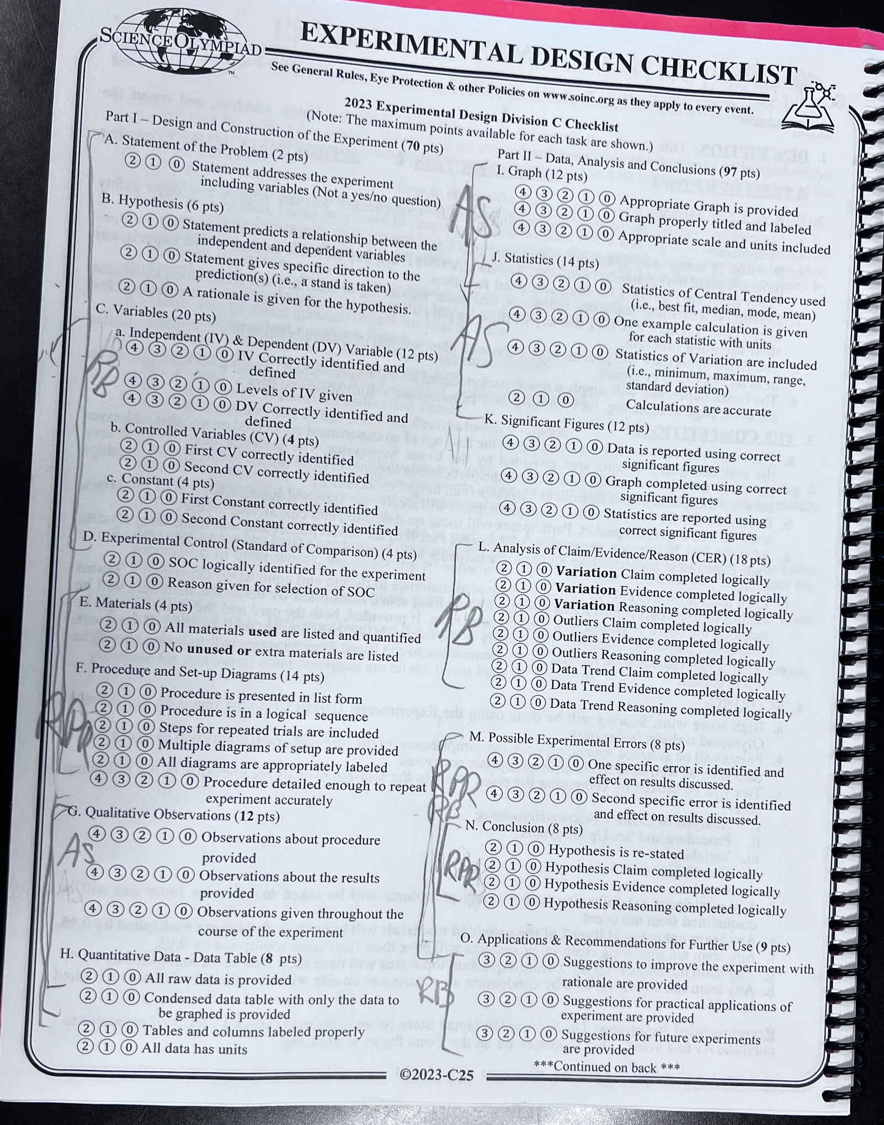

Slide 6
DIFFICULT TOPICS
Notes:
This section should focus on topics that are more math-based (harder to self-teach), concepts that come only usually up in college level courses, or concepts that you struggled with when you competed in this event

Slide 7
Topic 1: Terminology
Hypothesis: an educated guess or prediction about the relationship between the independent and dependent variables in an experiment (if… , then… , because…)
Independent Variable: the variable that you purposely change in an experiment to test its effects
Dependent Variable: the variable that is measured in response to changes in the independent variable
Controlled Variable: variables that are kept the same throughout the experiment to make sure that any changes in the dependent variable are due to the independent variable, not other factors.
Standard of Comparison (Control): The baseline condition in an experiment that serves as a reference point to compare the effects of the independent variable on the dependent variable.
Constant: any factor in an experiment that remains unchanged and is IMPOSSIBLE for the experimenter to change (ex: g = 9.8 m/s^2)

Slide 8
Topic 2: Significant Figures
https://scioly.org/wiki/index.php/Significant_Figures
Reading the number of significant figures in other people's measurements:
All non-zero numbers count as significant figures.
Zeroes placed between significant figures are always significant; 4009 kg has four significant figures.
Zeroes placed after a decimal point and a non-zero number are significant; 4.00 kg has three significant figures and 0.0400 has three significant figures.
All other digits are insignificant. So the 0 in 0.493 is insignificant and 0.493 has 3 sig figs.
Pure Numbers: Pure numbers have infinite significant figures, meaning they are exact. If you have 12 eggs, then 12 is a pure number. You don't have 12.01 eggs, or 11.9 eggs. Do NOT put decimals for pure numbers.

Slide 9
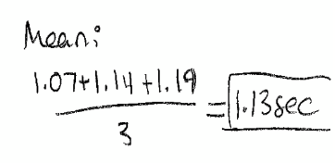
Topic 2: Significant Figures
https://scioly.org/wiki/index.php/Significant_Figures
Addition and Subtraction: your answer will have as many decimal places as the number with the least decimal places.
Ex: 4.1 - 3.456 + 44.4 - 2.35 = 42.694 -> 42.7
Multiplication and Division: When multiplying or dividing two physical numbers, the answer will have the same number of significant figures as the number with the least number of significant figures
Ex: 2.10 * 3.607 = 7.5747 -> 7.57
From the EXD “Scoring Explanation Doc”:

Slide 10
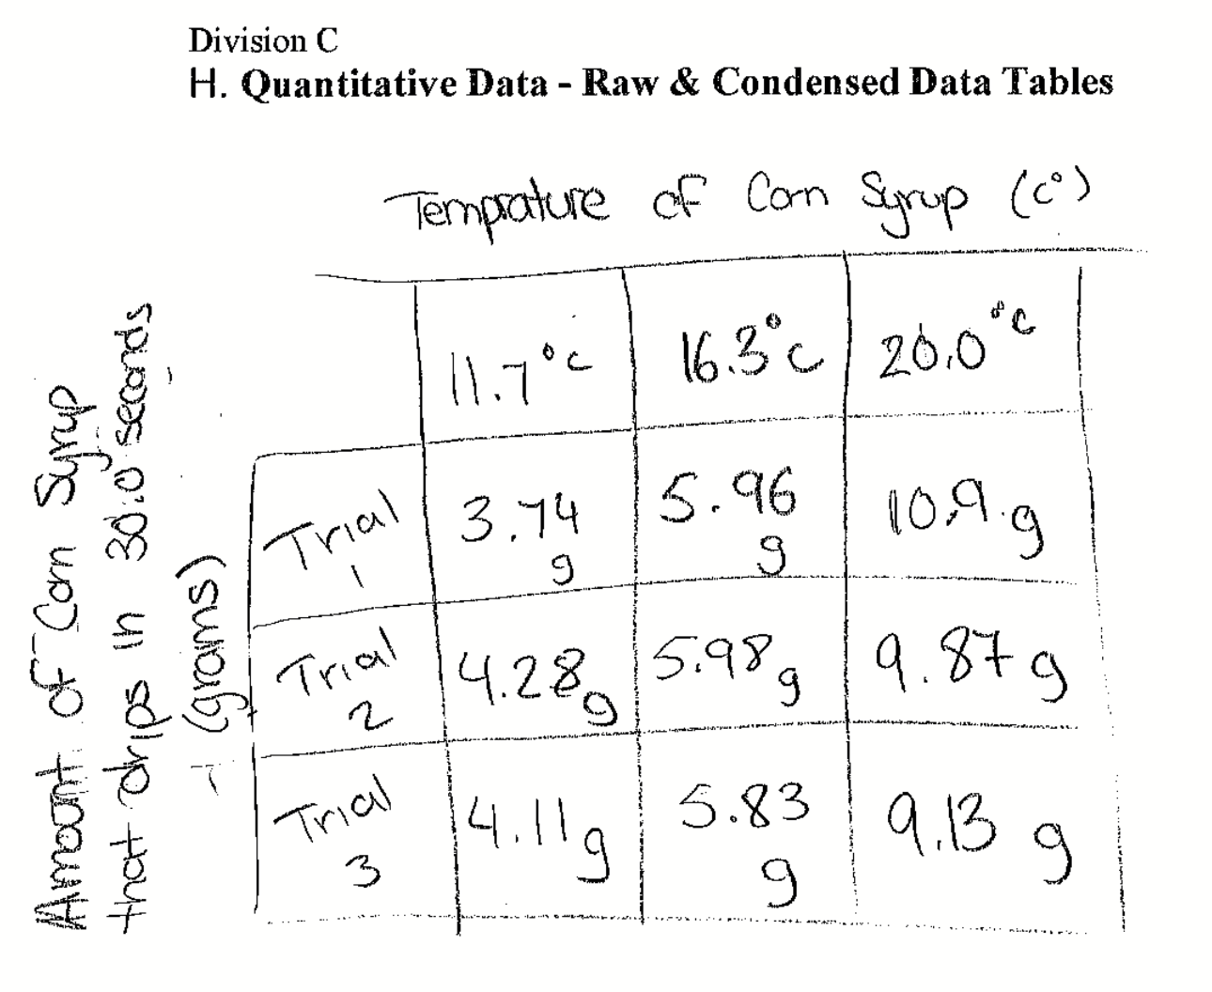
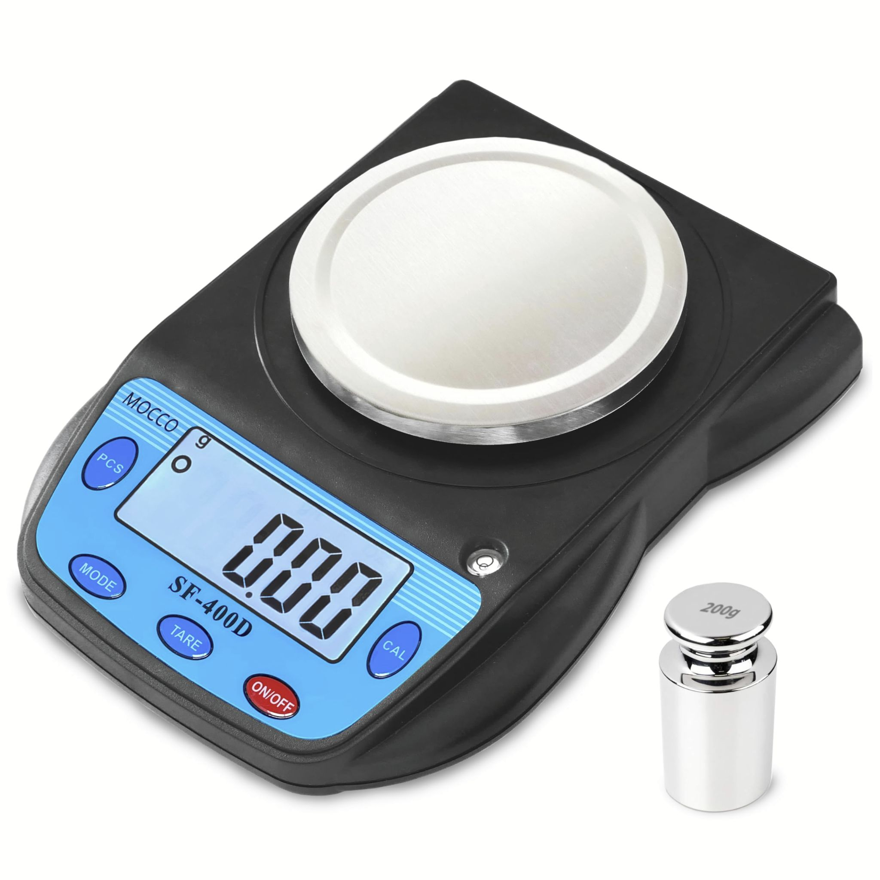
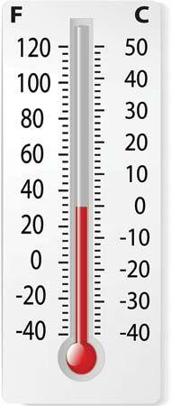
Topic 2: Significant Figures
Common Mistakes

Slide 11
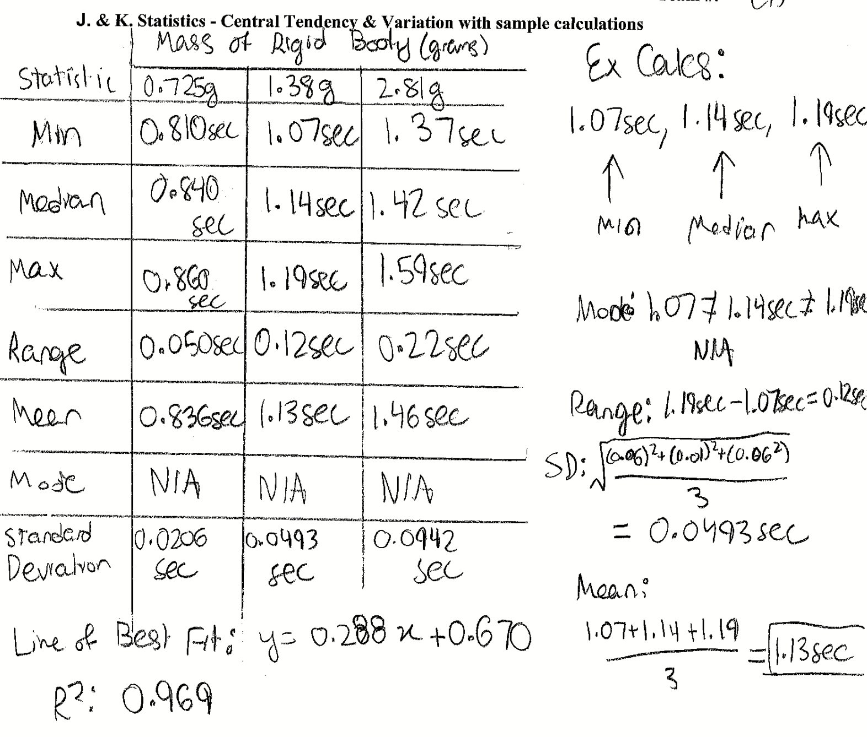
Topic 2: Significant Figures
Common Mistakes

Slide 12
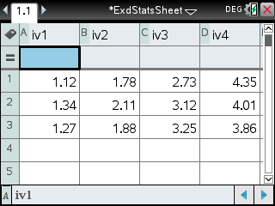
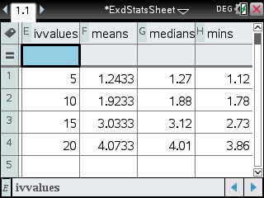
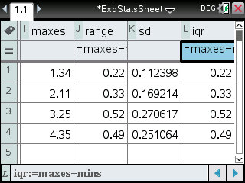
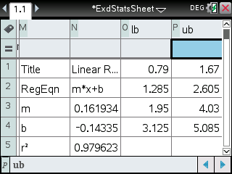

Slide 13
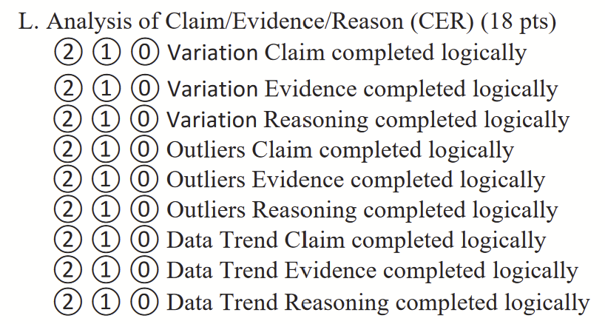
Topic 3: CER Template
Variation:
Claim: As the [Insert IV] increased, the variation of the dataset for each IV level [increased/decreased].
Evidence: The standard deviation for [Insert IV level #1] is [Insert SD for IV level #1]. The standard deviation for [Insert IV level #2] is [Insert SD for IV level #2]. The standard deviation for [Insert IV level #3] is [Insert SD for IV level #3]. The standard deviation for [Insert IV level #4] is [Insert SD for IV level #4].
Reasoning: The standard deviation of each dataset increases as the [insert IV] increases. Since standard deviation indicates how far data points are typically from the mean, this increase in standard deviation indicates that the data points are becoming more spread out. Therefore, the increase in [Insert IV] is increasing the variability of each dataset.
Notes:
Feel free to add more topics and make sure that there are plenty of pictures/diagrams!

Slide 14
Topic 3: CER Template
Outliers:
Claim: There are [insert # of outliers] outliers in the data.
Evidence: Create a table with the header as “1.5 IQR Rule.” In the table make the columns labeled as “IV Levels,” “lower bound,” and “upper bound” (remember units). Also, below the table, write down the following formulas…
Lower Bound = Q₁ - 1.5*IQR
Upper Bound = Q₃ - 1.5*IQR
Reasoning:
If there are no outliers: Since all of the data points fall within the range of the lower and upper bound for each IV level, there are no outliers in the data based on the 1.5 IQR rule.
If there are outliers: Since the [1st/2nd/3rd] trial of the [insert IV level] IV level, which has a value of [insert value], [is greater/less than the upper/lower bound], which has a value of [insert lower/upper bound], that value is an outlier.
Notes:
Feel free to add more topics and make sure that there are plenty of pictures/diagrams!

Slide 15
Topic 3: CER Template
Data Trend:
Claim: There is a [positive/negative] correlation between [insert DV] and
[insert IV].
Evidence: The line of best fit when plotting the mean for each IV level against the value of each IV level is
y = [insert m]*x + [insert b].
Reasoning: Since the slope of the line of best fit is [insert m], which is [positive/negative], the [insert DV] [increases/decreases] as the [insert IV] increases. Therefore, there is a [positive/negative] correlation between [insert DV] and [insert IV].
Notes:
Feel free to add more topics and make sure that there are plenty of pictures/diagrams!

Slide 16
COMMON EXPERIMENT
All of the following experiments have been pulled from past YJI exams (which can be found on our website) or the Text Exchange on SciOly Wiki
Notes:
\

Slide 17
Sample Experiment
Topic: Oscillation of a Pendulum
Materials (you do not have to use all materials):
2 meters length of string
5 hooked masses
10 gram mass
20 gram mass
30 gram mass
40 gram mass
50 gram mass
Meter stick
Protractor
Digital scale
Masking tape (unlimited)
Stopwatch
Lab table
Scissors
Notes:
Pull some questions from exams on the scioly wiki test exchange, first give attendees a couple minutes to read over them/work through them, then walk them through the answers. Try to get a mix of multiple choice and short answer or matching

Slide 18
Sample Experiment
Topic: Oscillation of a Pendulum
Sample Experiment:
Problem: How does the length of a pendulum affect its period?
IV: Length of the pendulum measured from the axis of rotation to the bottom of the hooked mass attached to the string
Units: meters (measured using meter stick)
IV #1 (SOC): 0.10 meters
IV #2: 0.20 meters
IV#3: 0.30 meters
IV#4: 0.40 meters
DV: the average period of a pendulum or the time it takes for the pendulum to oscillate back and forth once
Units: seconds (measured using stopwatch)
In order to increase precision, for each trial, the pendulum will be timed for 10 periods and the average period will be determined by dividing that raw value by 10
Calculuation: average period (in seconds) = (time for 10 periods of pendulum) / 10
Notes:
Pull some questions from exams on the scioly wiki test exchange, first give attendees a couple minutes to read over them/work through them, then walk them through the answers. Try to get a mix of multiple choice and short answer or matching

Slide 19
Sample Experiment
Topic: Oscillation of a Pendulum
Sample Experiment:
Controlled Variables:
Angle that the pendulum is released from relative to its resting position (45°)
Mass of the object that is attached to the pendulum (50g hooked mass)
Thickness of the string that the hooked mass is attached to
Constant: gravity (9.8 m/s²)
Hypothesis: If the length of a pendulum (in meters) increases, the average period or time for one oscillation of the pendulum (in seconds) would increase because the period of a pendulum is determined by the formula T = 2π*sqrt(L/g) and increasing L (length of the pendulum) would also lead to an increase in T (the period).
SOC: The standard of comparison is the 0.10 meter pendulum length because every other IV level (0.2m, 0.3m, 0.4m) is a multiple of that value. Therefore, by using 0.10 meters as the baseline, it will be easier to observe how proportional increases in the length of the pendulum affect the period of oscillation and recognize the exact type of trend of the data.
Notes:
Pull some questions from exams on the scioly wiki test exchange, first give attendees a couple minutes to read over them/work through them, then walk them through the answers. Try to get a mix of multiple choice and short answer or matching

Slide 20
Common EXD Topics
Chemistry
Diffusion
Reaction Rates
PH Reaction
Polarity
Density / Viscosity
Physics
Pendulum
Tension and Elasticity
Hooke’s Law / Springs
Buoyancy
Aerodynamics / Air Resistance
Projectile Motion
Circular Motion / Centripetal Force
Simple Machines: lever, inclined plane, etc
Optics
Magnetism
Miscellaneous
Probability
Memory
Notes:
Pull some questions from exams on the scioly wiki test exchange, first give attendees a couple minutes to read over them/work through them, then walk them through the answers. Try to get a mix of multiple choice and short answer or matching

Slide 21
Tips from a Veteran
Remember to bring your own ruler, stopwatch, and goggles to the event
Automated Statistics
Keep the experiment simple to save time
Remember that you do NOT need to use all of the materials (unless specified by the event supervisor)
Make sure your IV is quantifiable
If you want to medal in EXD, you have to fill out the whole packet
For data, do 3 trials for each IV level
For Div C: Don’t do 4 IV Levels if the experiment is time consuming
Notes:
Use this section to talk about any strategies you used to navigate the event when you competed. For example, how did you manage your time, how did you organize your notes, how did you split topics up between you and your partner, etc.?

Slide 22
Additional Resources
Scioly Wiki: https://scioly.org/wiki/index.php/Experimental_Design
SOINC:
https://www.soinc.org/experimental-design-b
https://www.soinc.org/experimental-design-c
SUBWAY STATIONS
Scioly Test Exchange: https://scioly.org/tests/
Calculator Automation:
https://drive.google.com/file/d/14pS56pYiemFTe2BhSUXgk_BtP_aEoWHH/view?usp=sharing
Yes, Saturn is the ringed one. This planet is a gas giant, and it’s composed mostly of hydrogen and helium
Notes:
Here, you can link or mention any online or book resources that helped you in this event when you were a competitor. Try to avoid general resources like scioly wiki, because they probably already are familiar with it.

Slide 23
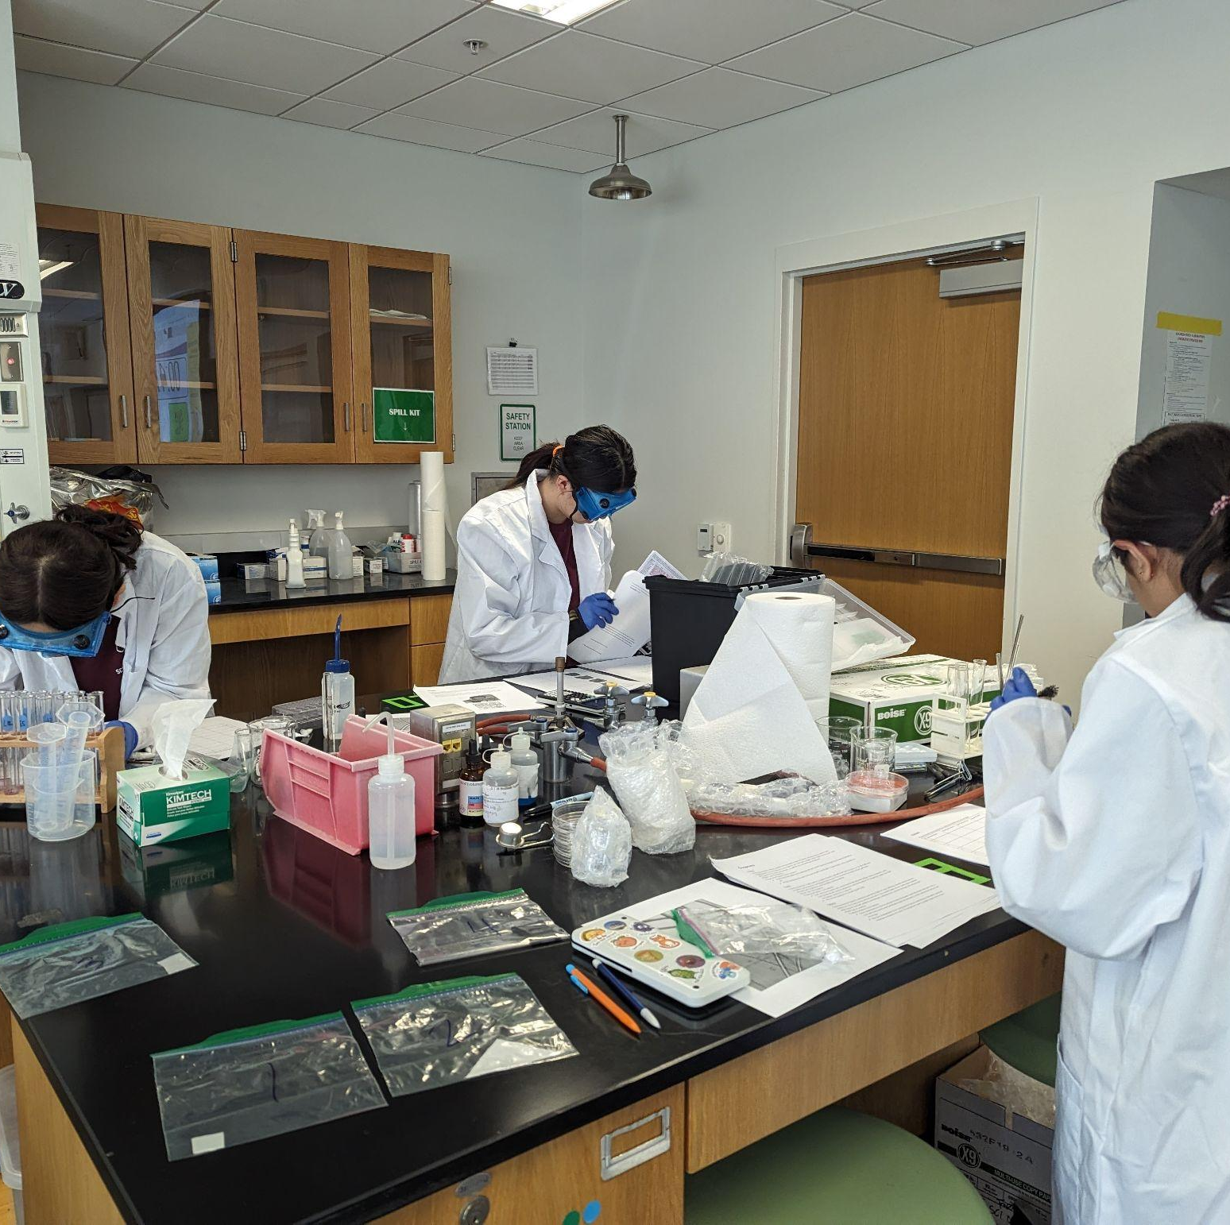
THANKS!
Notes:
(replace picture with a picture from one of our tournaments)

