Slide 1
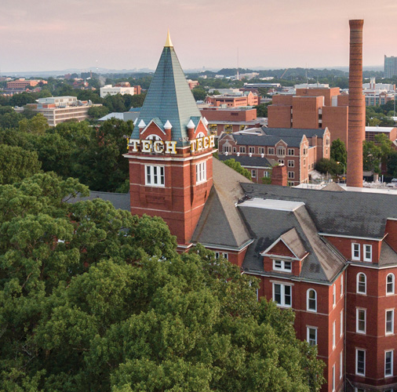
Entomology
Division C
Georgia Tech Event Workshop Series 2024-25

Slide 2
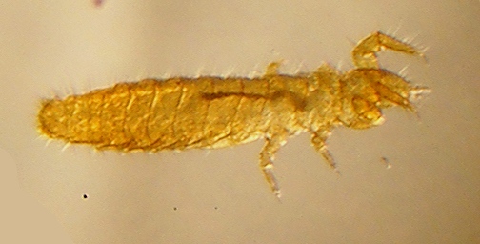
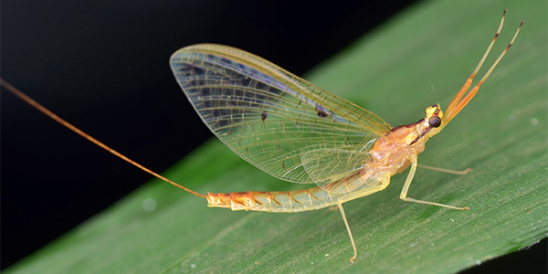
01
RULES SHEET
02
DIFFICULT TOPICS
03
COMMON QUESTIONS
04
TIPS FROM A VETERAN
05
OTHER FREE RESOURCES
Notes:
For Builds: Replace difficult topics with physical principles involved in the build and replace common questions with common designs

Slide 3
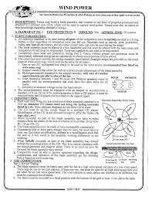
The Rules Sheet
Rules Sheet for Event
2” 3-ring binder, Field Guide, magnifying glass
Memorize appearances, key features, Class, Order, Family, Common Name
Very knowledge/rote memorization based!
Notes:
Highlight key points from the rules sheet: DESIGN LOGS that basically grant free points, most tested-on topics, point distribution so that competitors know what to prioritize, allowed notes and equipment, etc.

Slide 4
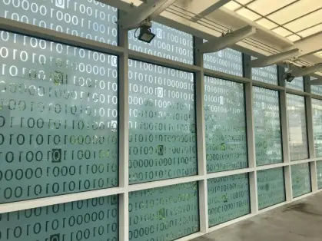
Important things to think about!
Notes:
This section should focus on topics that are more math-based (harder to self-teach), concepts that come only usually up in college level courses, or concepts that you struggled with when you competed in this event

Slide 5
Topic 1: Organizing a Binder!
Figuring out what kind of format works for you!
Images + Info
Just Images
Just Info
Charts are your best friend
Anatomy diagrams
Body part adaptations
Morphogenesis

Slide 6
Topic 2: Human Impact
Important to build intuition for how insects relate to human life
Positive: food, pollination, control populations of harmful insects
Negative: vectors for disease, damage crops and buildings
Notes:
Feel free to add more topics and make sure that there are plenty of pictures/diagrams!

Slide 7
Practice!
All of the following questions have been pulled from past YJI exams (which can be found on our website) or the Text Exchange on SciOly Wiki
Notes:
\

Slide 8
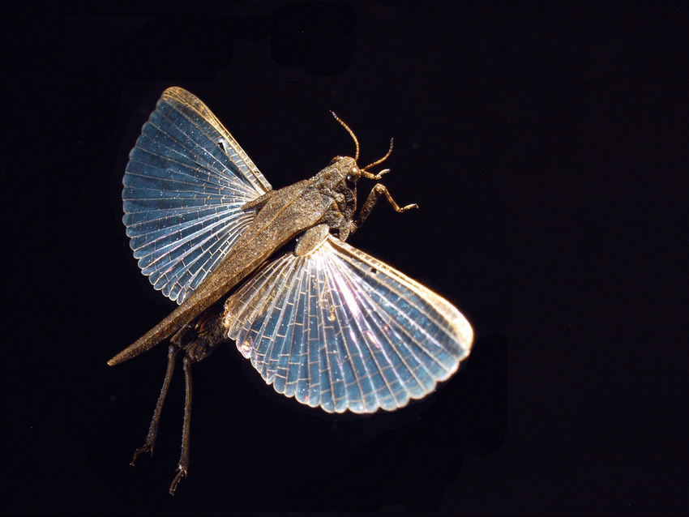
Question 1: ID
Identify the order, family, and common name of the specimen.
In what kind of environment is this family of insect usually found?
Notes:
Pull some questions from exams on the scioly wiki test exchange, first give attendees a couple minutes to read over them/work through them, then walk them through the answers. Try to get a mix of multiple choice and short answer or matching

Slide 9
Question 1: ID
Order Orthoptera, Family Tetrigidae, Pygmy Grasshopper (awl-shaped pygmy grasshopper)
Most reside in rainforests! But this particular species is found in moist grasslands near streams, riverbanks and mudflats.
Notes:
Pull some questions from exams on the scioly wiki test exchange, first give attendees a couple minutes to read over them/work through them, then walk them through the answers. Try to get a mix of multiple choice and short answer or matching

Slide 10
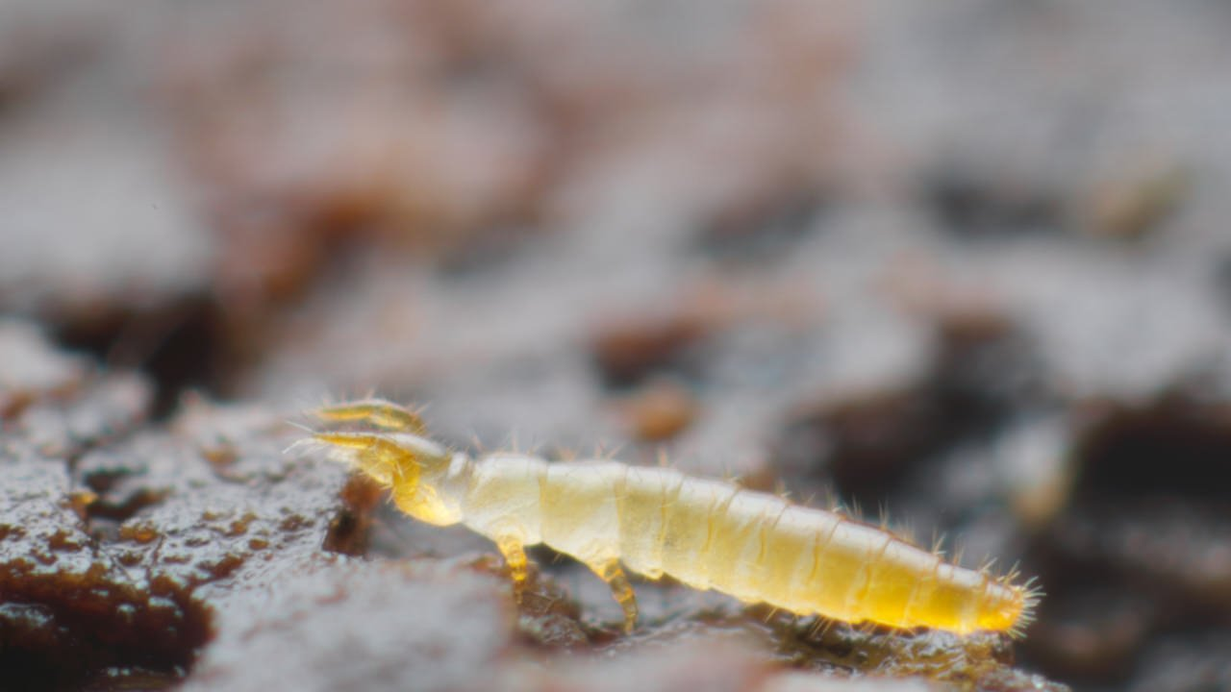
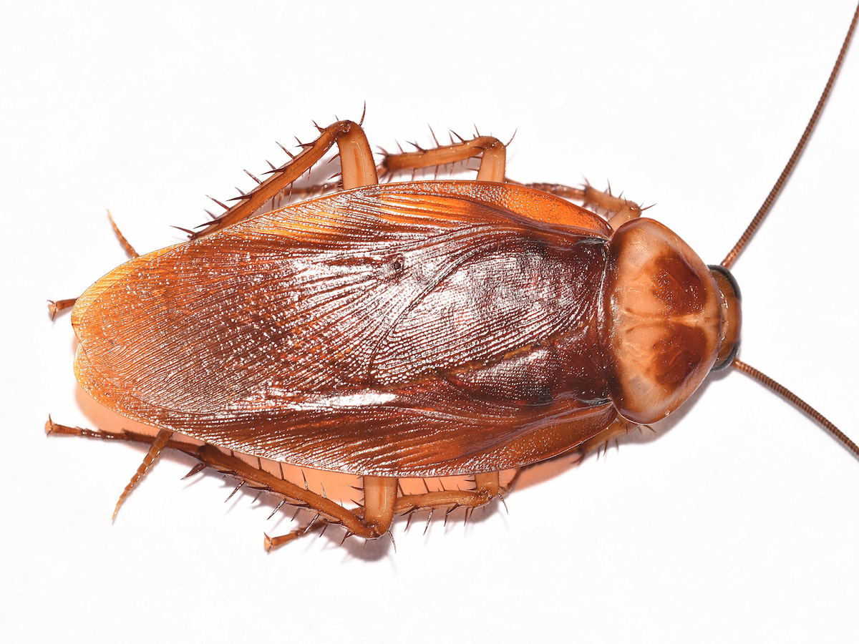
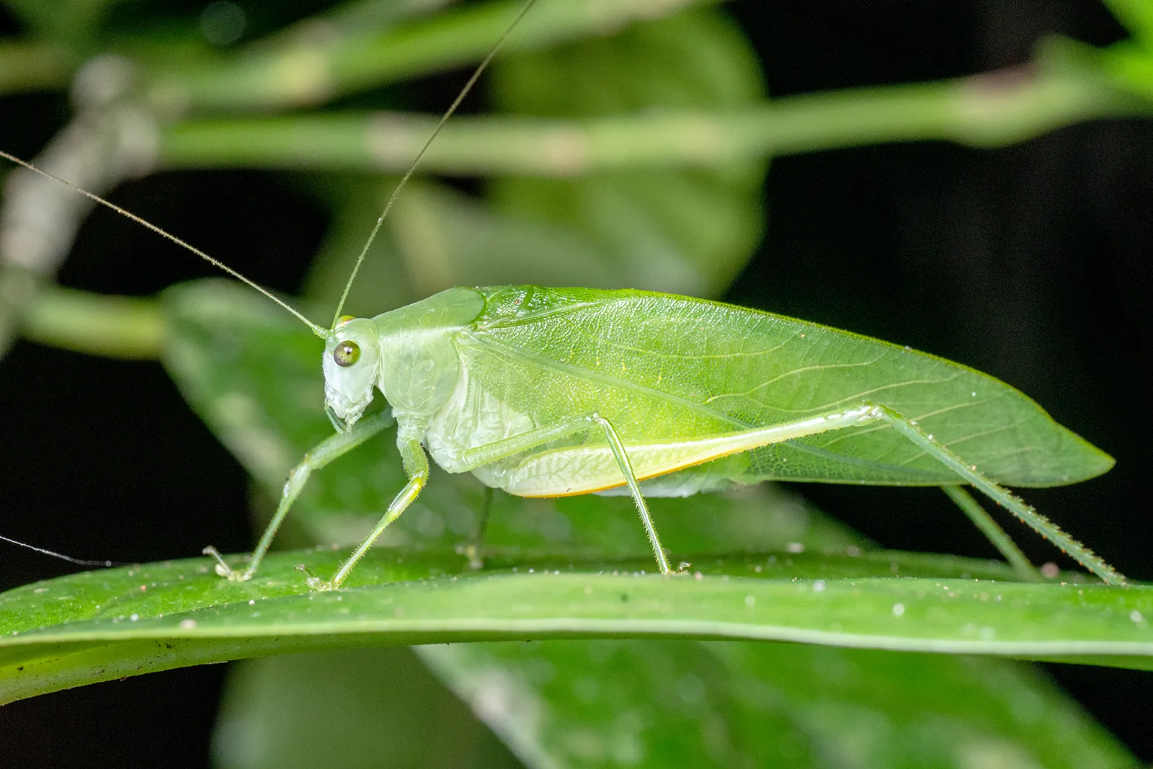
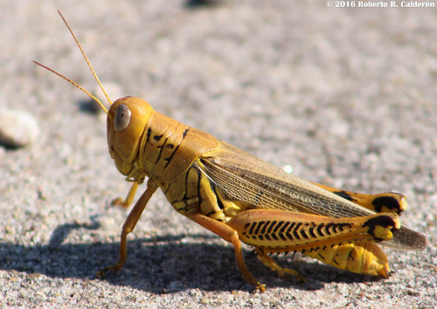
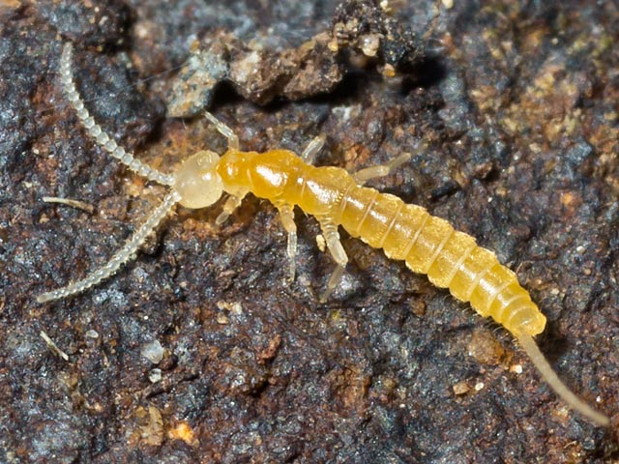
Question 2: Dichotomous Key
Make a Dichotomous Key for these 5 Insects:
Notes:
Pull some questions from exams on the scioly wiki test exchange, first give attendees a couple minutes to read over them/work through them, then walk them through the answers

Slide 11
Question 2: Dichotomous Key
Make a Dichotomous Key for These 5 Insects (always one step less than # of specimens)!
Concealed mouthparts → 2
Exposed mouthparts → 3
Have multi-segmented antennae → Diplurans
No antennae → Proturans
Large, well developed back legs → 4
Smaller back legs →Blattodea (cockroach)
Long antennae →Tettigoniidae (katydids)
Short antennae → Acrididae (short-horned)
Notes:
Pull some questions from exams on the scioly wiki test exchange, first give attendees a couple minutes to read over them/work through them, then walk them through the answers

Slide 12
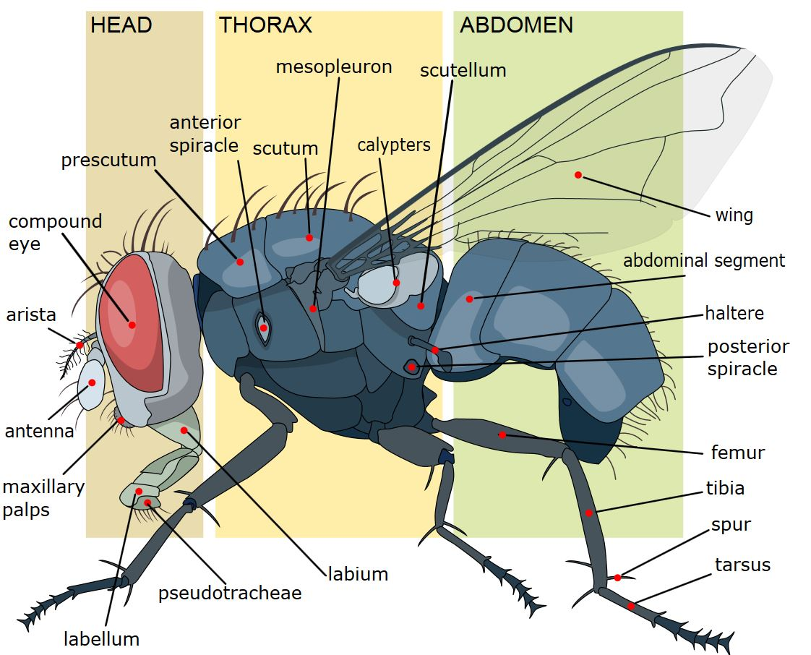
Question 3: Label!
Word Bank:
Compound Eye
Antenna
Prescutum
Scutum
Scutellum
Wing
Abdominal Segment
Femur
Notes:
Pull some questions from exams on the scioly wiki test exchange, first give attendees a couple minutes to read over them/work through them, then walk them through the answers

Slide 13
Question 3: Label!
Notes:
Pull some questions from exams on the scioly wiki test exchange, first give attendees a couple minutes to read over them/work through them, then walk them through the answers

Slide 14
Tips from a Veteran
Assemble a rudimentary binder ASAP so that you can spend the rest of the year adding to it and memorizing key information!
Make a Quizlet multiple images of each specimen so you can get used to looking at different angles for different things.
Practice tests! You unfortunately don’t have many of these, so I would use other people’s Quizlets or test each other with the field guide.
Speed IDing is key!
Notes:
Use this section to talk about any strategies you used to navigate the event when you competed. For example, how did you manage your time, how did you organize your notes, how did you split topics up between you and your partner, etc.?

Slide 15
Resources
Entomology ID List
Practice Test 1
Practice Test 2
Practice Test 3
SUBWAY STATIONS
Wiki!!
Field Guide
Yes, Saturn is the ringed one. This planet is a gas giant, and it’s composed mostly of hydrogen and helium
Notes:
Here, you can link or mention any online or book resources that helped you in this event when you were a competitor. Try to avoid general resources like scioly wiki, because they probably already are familiar with it.

Slide 16
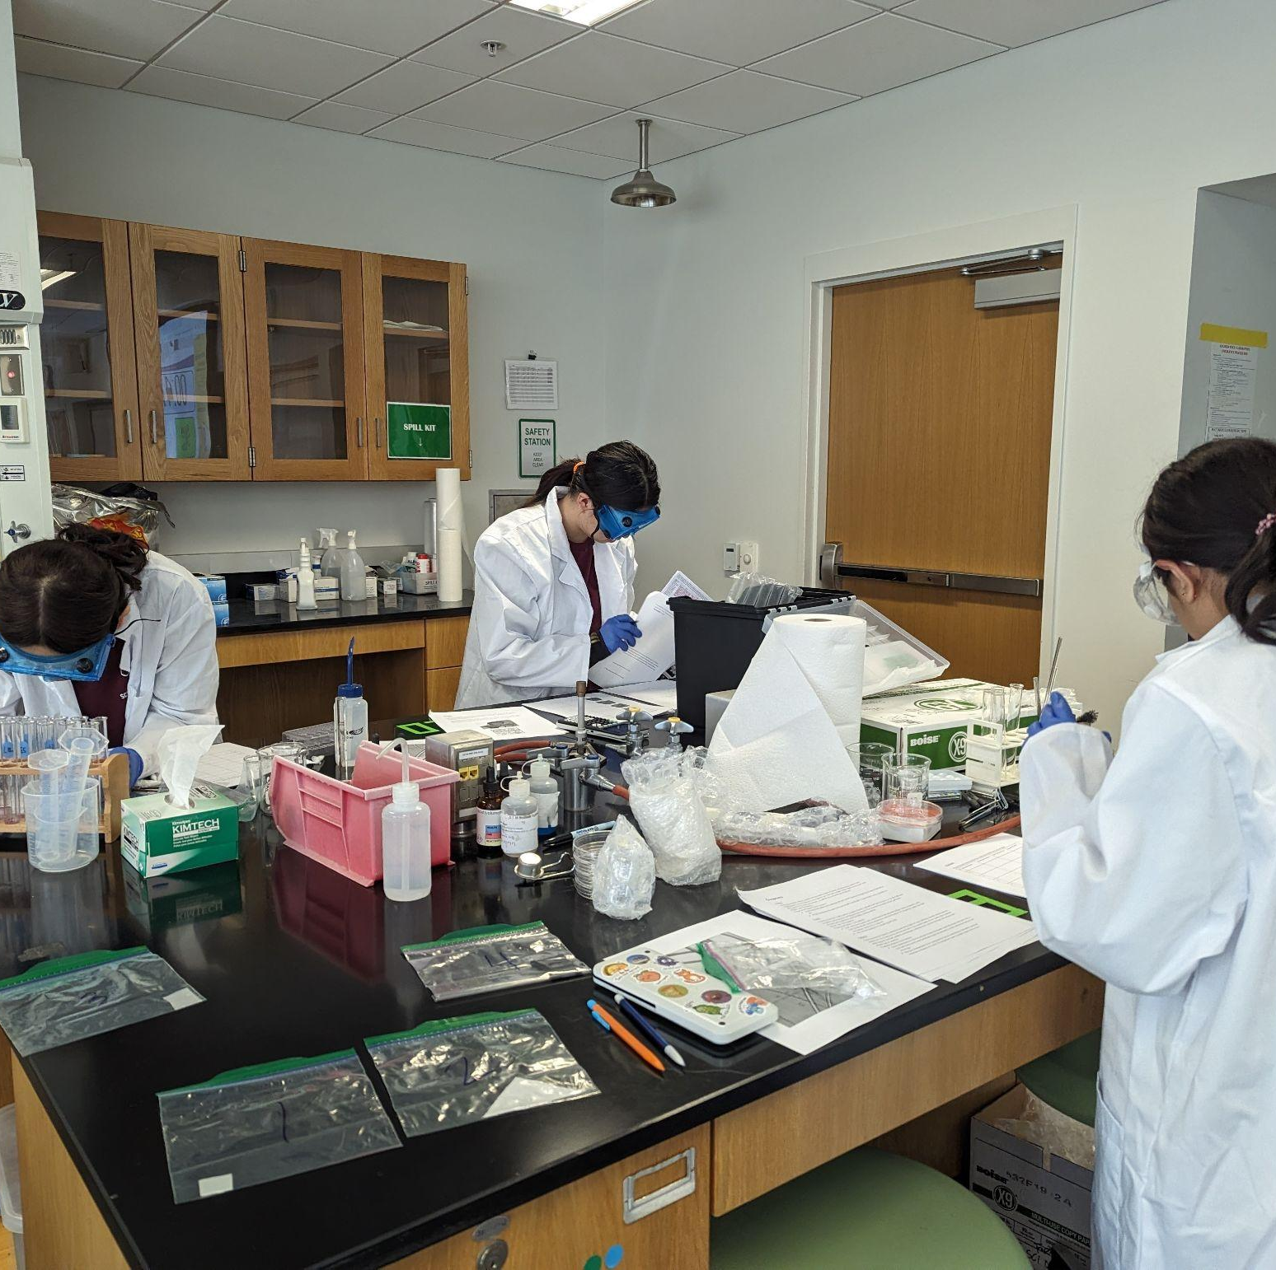
THANKS!
Notes:
(replace picture with a picture from one of our tournaments)

