Slide 1
Ecology
Division B/C
Georgia Tech Event Workshop Series 2024-25

Slide 2
Agenda
Event Overview
Topic Areas
Quantitative Tips
Note Sheet Tips
How to Prepare

Slide 3
Event Overview
Students will answer questions involving content knowledge and process skills in the area of ecology and adaptations in featured North American biomes.
Each team may bring only one 8.5” x 11” sheet of paper, which may be in a sheet protector sealed by tape or laminated, that may contain information on both sides in any form from any source without annotations or labels affixed along with two stand-alone non-programmable, nongraphing calculators (Class II).

Slide 4
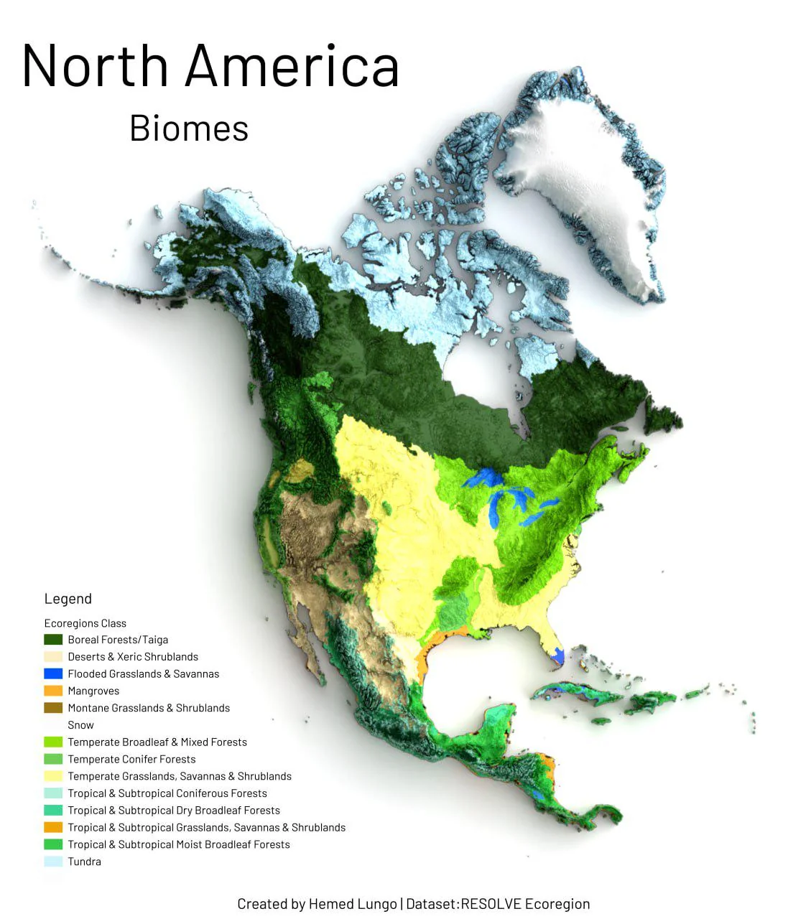
North American Biomes
Temperate deciduous forest
Coniferous forest
Grasslands/Prairie
Desert
Taiga
Tundra

Slide 5
Topic Areas
01
Part 1: Review of the General Principles of Ecology
02
Part 2: Terrestrial Ecosystems
03
Part 3: Human Impact on Ecosystems

Slide 6
Part 1: Review of the General Principles of Ecology
Food webs and trophic pyramids, nutrient cycling, community interactions, population dynamics (including density dependent/independent limiting factors, carrying capacity, doubling time, exponential/logistical growth and how to calculate population growth), extinction, selection, and migration. At the regional and state level, the general ecological principles should focus on local and regional ecology.

Slide 7
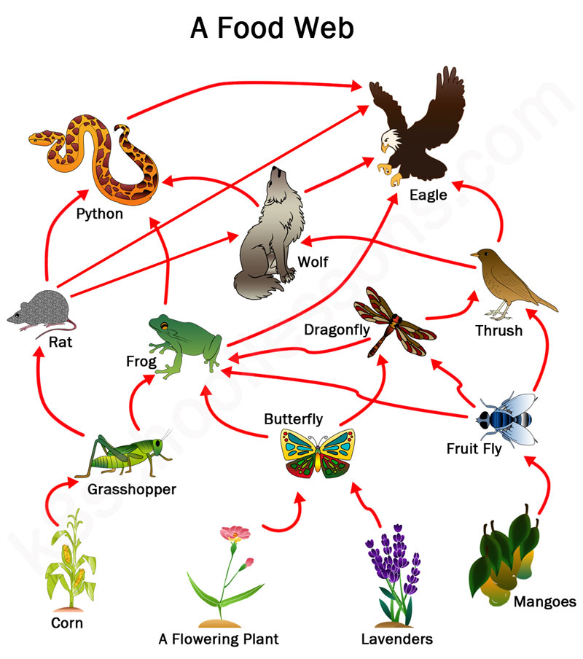
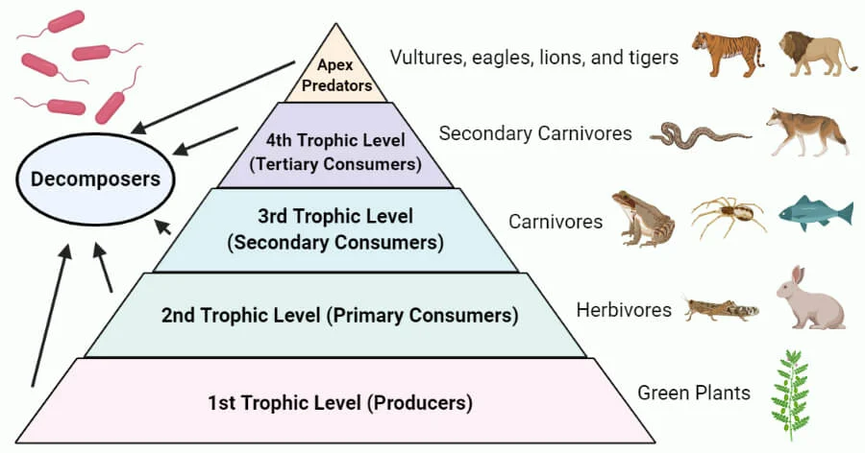
Food webs and trophic pyramids

Slide 8
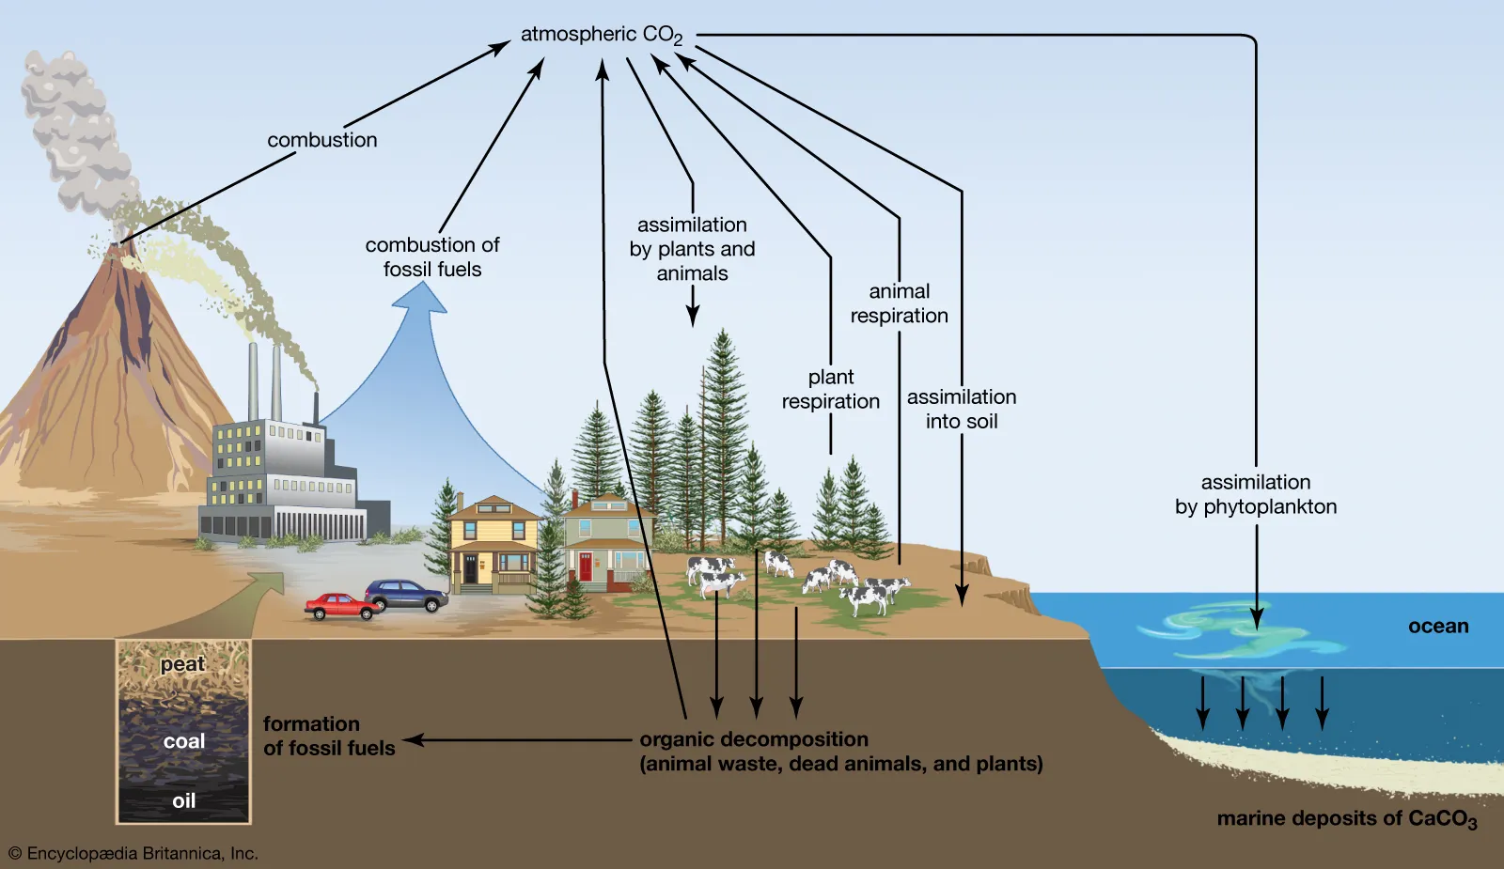
Nutrient Cycling - Carbon

Slide 9
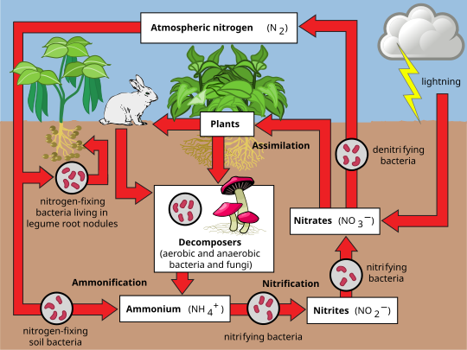
Nutrient Cycling - Nitrogen

Slide 10
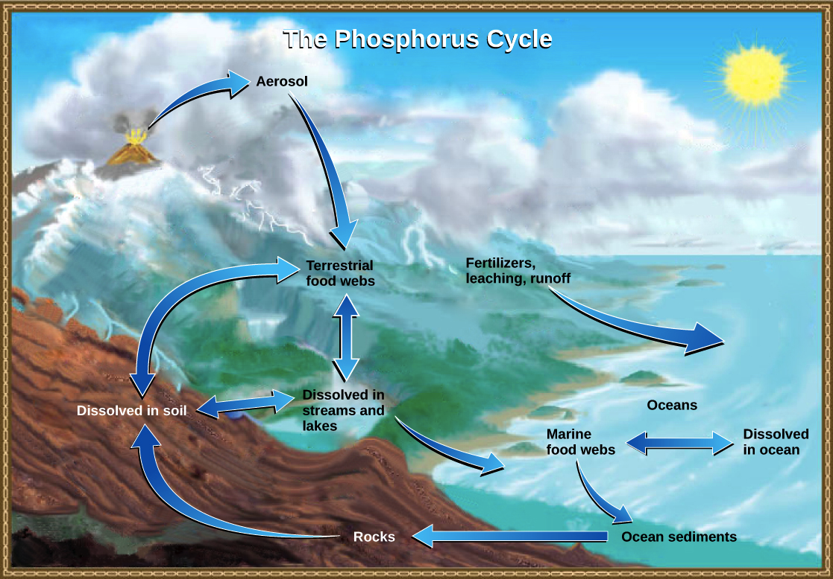
Nutrient Cycling - Phosphorus

Slide 11
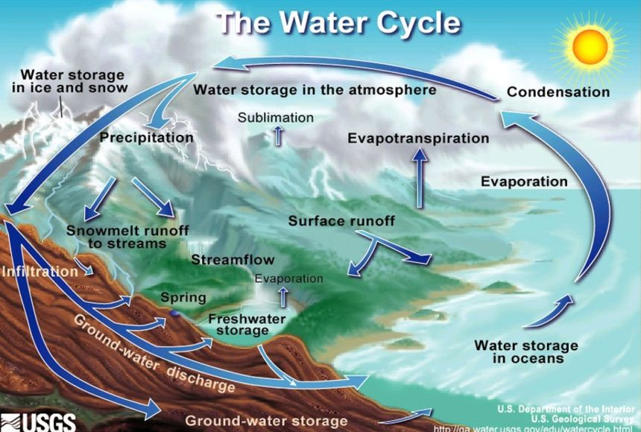
Water (Hydrologic) Cycle

Slide 12
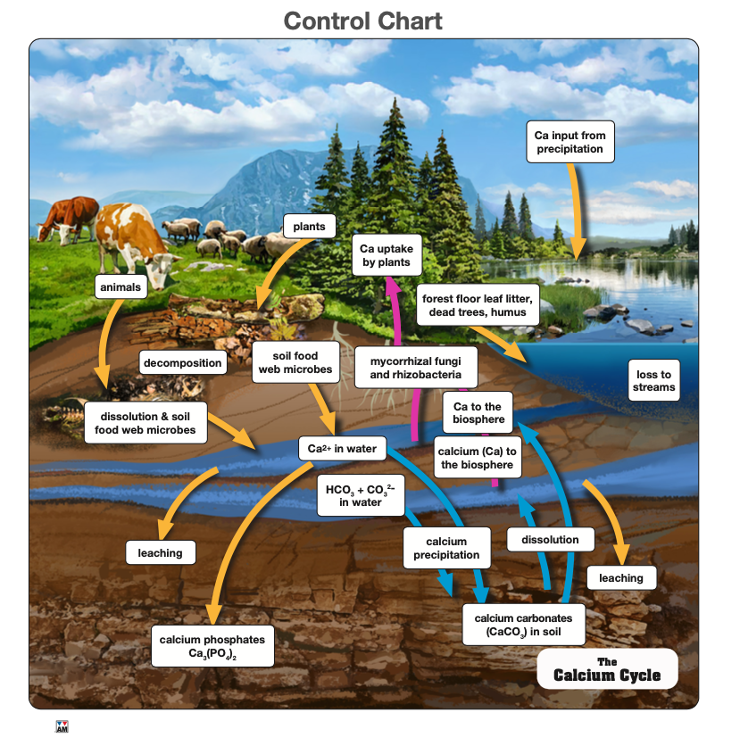
Nutrient Cycling - Calcium

Slide 13
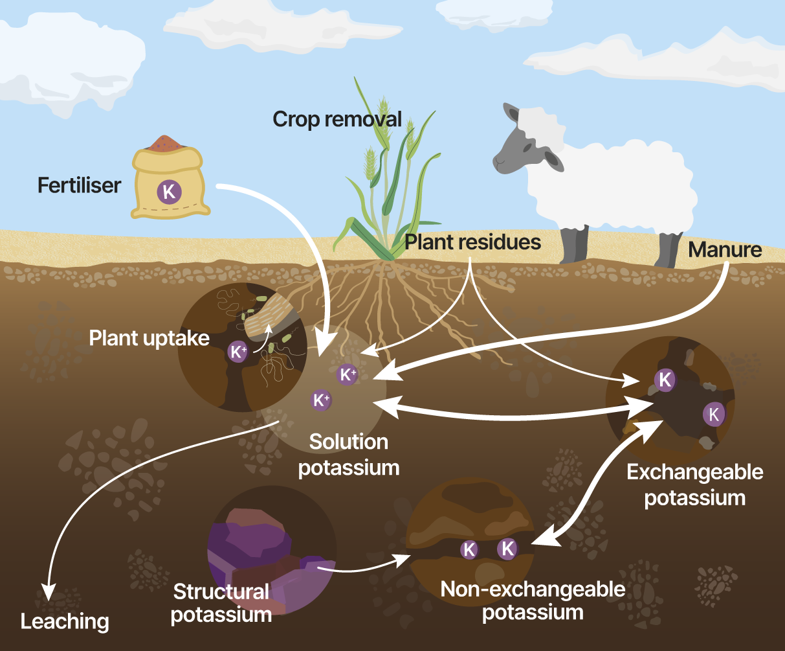
Nutrient Cycling - Potassium

Slide 14
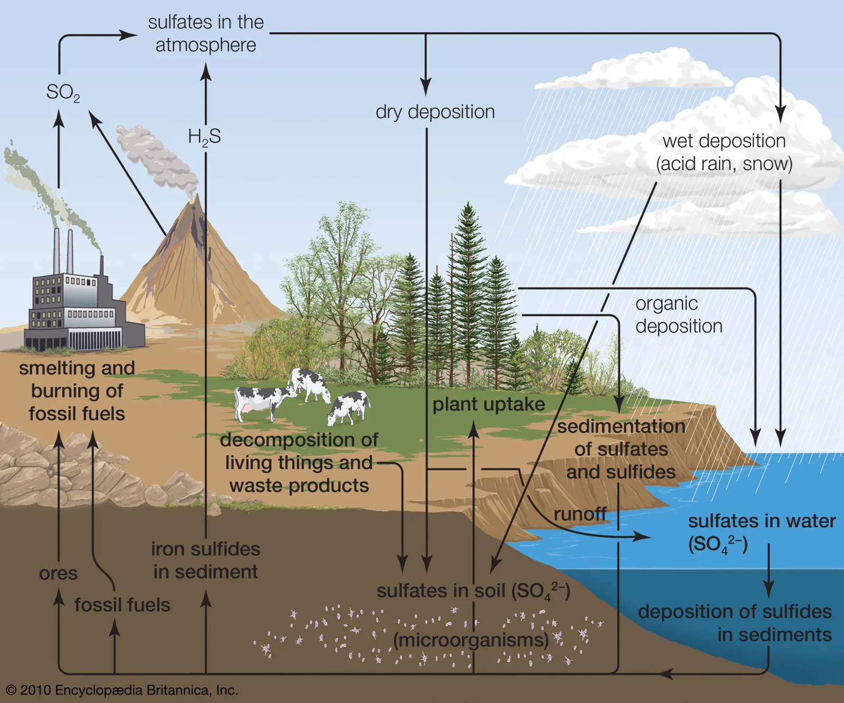
Nutrient Cycling - Sulfur

Slide 15
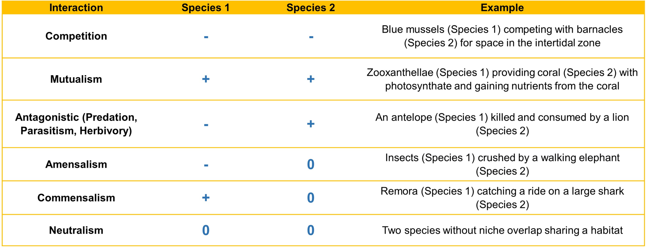
Community Interactions - Interspecific

Slide 16
Competition
Gause’s Competitive Exclusion Principle
Niche Partitioning
Interference Competition
Exploitative Competition
Apparent Competition

Slide 17
Limiting Factors
Density Dependent
Disease/parasitism
Competition
Predation
Resource Availability
Density Independent
Climate and weather events/seasonal cycles (monsoons)
Catastrophic events (fires, hurricanes, etc.)
Habitat alteration and destruction
Pollution

Slide 18
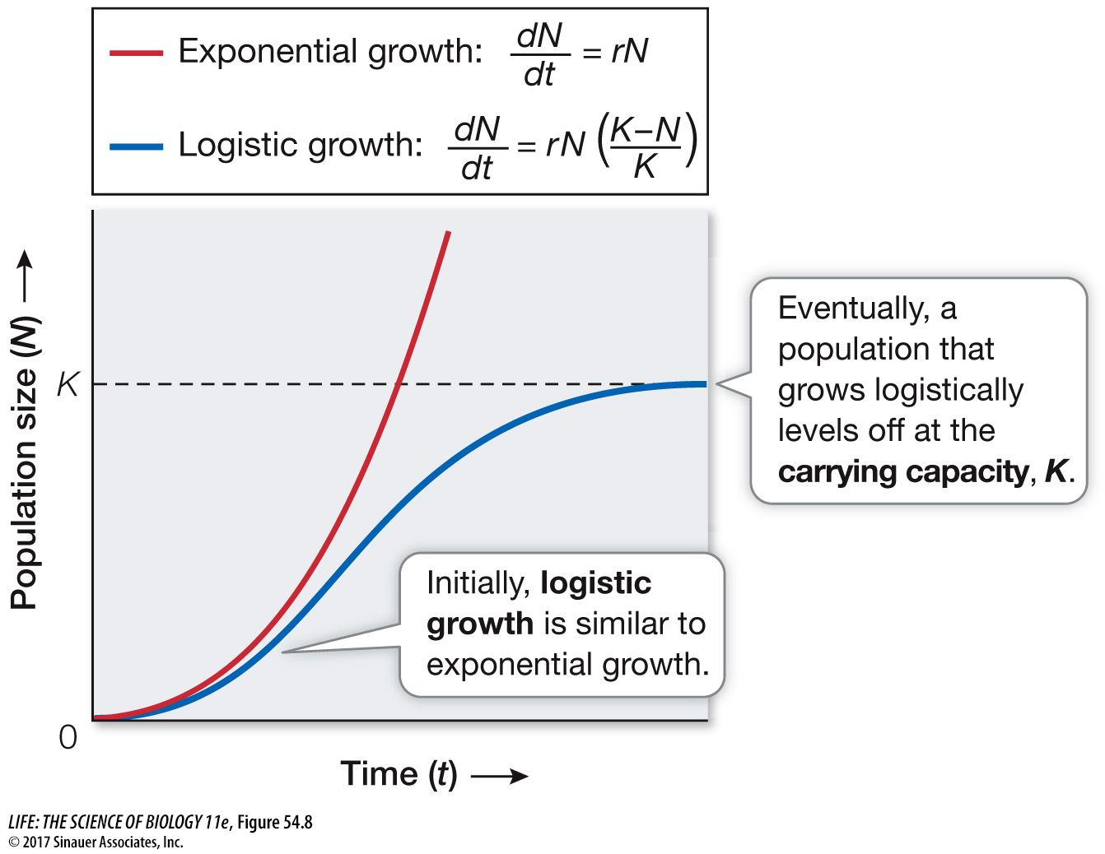
Population Growth

Slide 19
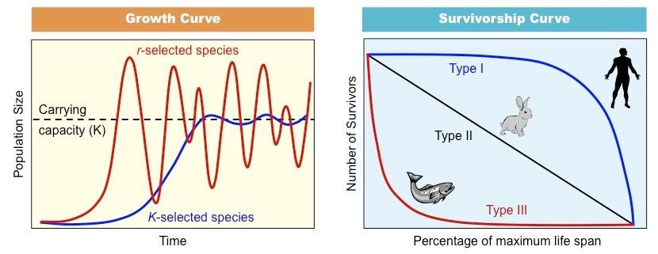
r/K Selection Theory
Verhulst equation of population dynamics

Slide 20
Population Doubling
Rule of 70: Doubling Time = 70/rate of growth
T(double) = ln(2)/k

Slide 21
Predation
Trophic Cascade

Slide 22
Selection
Natural selection
Variation
Differential Reproductive Success
Adaptation
Mimicry
Speciation
Prezygotic barriers
Postzygotic barriers
Allopatric speciation
Sympatric Speciation
Adaptive Radiation
Character displacement
Mutation
Evolution

Slide 23
Regional Ecology
Southeast Region
Understand specific keystone species, common species, endangered species
Flora and fauna
Regional climate trends
Agricultural impacts
Know case studies

Slide 24
Part 2: Terrestrial Ecosystems
Ecology of the Tundra, Taiga and Deciduous Forests
Understand basic concepts of biodiversity (e.g., importance, different types)
Div. C State and Nationals only: Be able to apply knowledge of biodiversity (plot maps, simulations of selection effects on populations)
Div. C Nationals only: Understand terminology and be able to calculate biodiversity of sample data (species richness, Simpson index, Shannon-Wiener index)

Slide 25
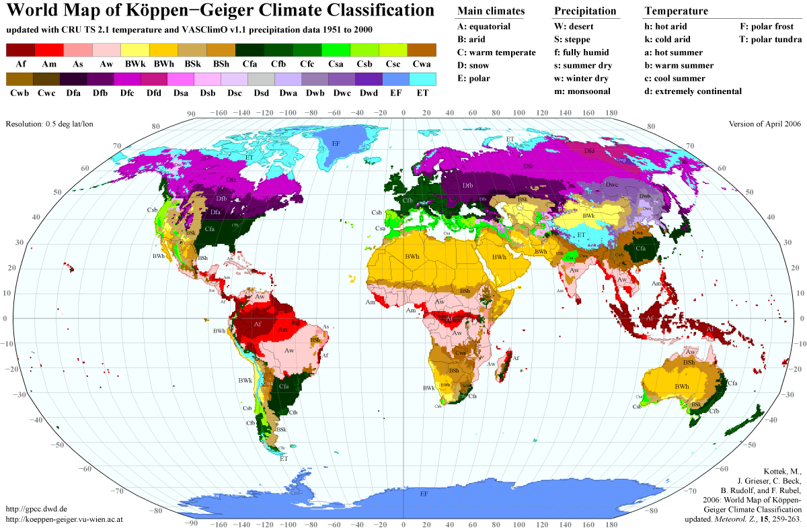
Koppen Climate Classification System

Slide 26
Soil Classification Systems
USDA Soil Taxonomy
Unified Soil Classification
Soil texture triangle
Biome-specific soil profiles
Impact on agriculture

Slide 27
Part 3: Part 3: Human Impact on Ecosystems
Topics such as climate change, invasive species, acid deposition (including acid rain), erosion, and chemical contamination (pollution)
The pros and cons of using alternative energy and its effect on the environment
Understand the goals of conservation biology and how they can be obtained
Reclamation of disturbed areas versus reintroduction of species
Division C State and Nationals only: Be able to answer questions as they pertain to case studies
Division C only: adding indigenous knowledge or traditional ecological knowledge (TEK) to our “toolkit”

Slide 28
Threats to the Tundra
Climate Change
Air Pollution
Industrial Activity
Invasive and Migrating Species

Slide 29
Threats to the Taiga
Deforestation
Commercial Activity
Acid Rain

Slide 30
Threats to the Deciduous Forest
Forest fragmentation
Overpopulation
Invasive species
Pollution
Fire Suppression
Acid rain and other changes in atmospheric chemistry
Human-induced climate change

Slide 31
Agricultural Impacts
Issues relating to crops that are frequently grown in your region/state
CAFOs and animal waste
Climate change impacts on crop viability and seasonality
GMO crops
Fertilizer and runoff

Slide 32
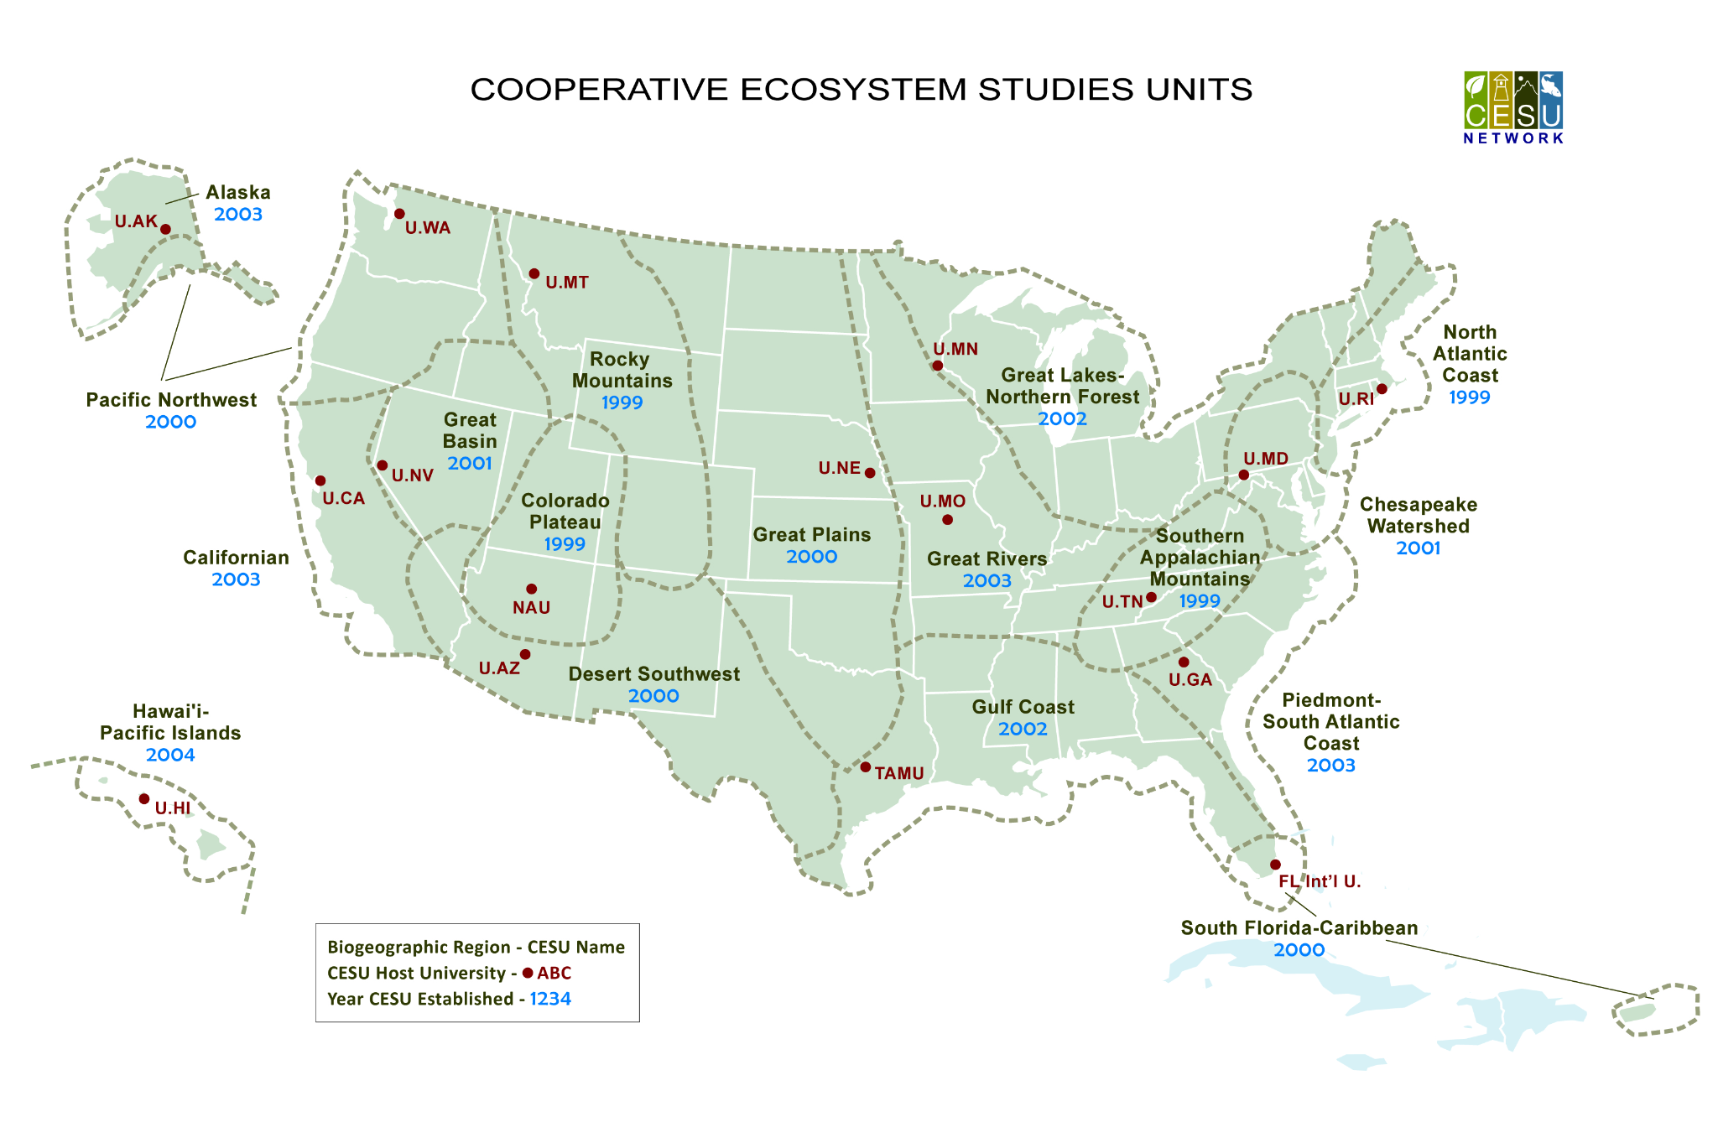
Traditional Ecological Knowledge

Slide 33
Quantitative Tips
Write all formulas down in your note sheet
Make sure you know what each variable stands for
Write an example of how to use the numbers in a solved problem
If you encounter a graph/plot you’ve never seen before – decipher it by looking at the axes, read the context

Slide 34
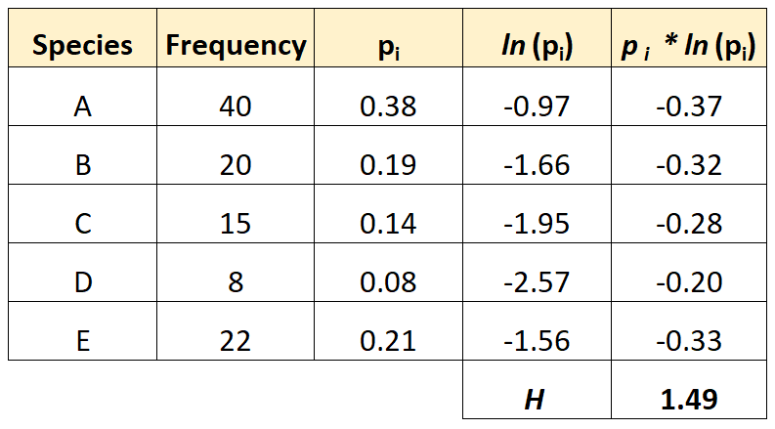
Shannon Index

Slide 35
Note Sheet Tips
Organize the note sheet by the 3 parts and topic areas
Landscape orientation
Use 3 columns
Small size font, sans serif
Minimize margins
Include common diagrams/graphs/charts
Print in color
Front and back – fill all the empty space
Can hand write into the empty space

Slide 36
How to Prepare
Gaining Knowledge and Preparing Note Sheet
Textbooks
YouTube/Khan Academy
AP Biology class
Practice Tests and Test Releases
Test trading with other schools
Invitational test releases
Past archives
AP Biology ecology practice questions

Slide 37
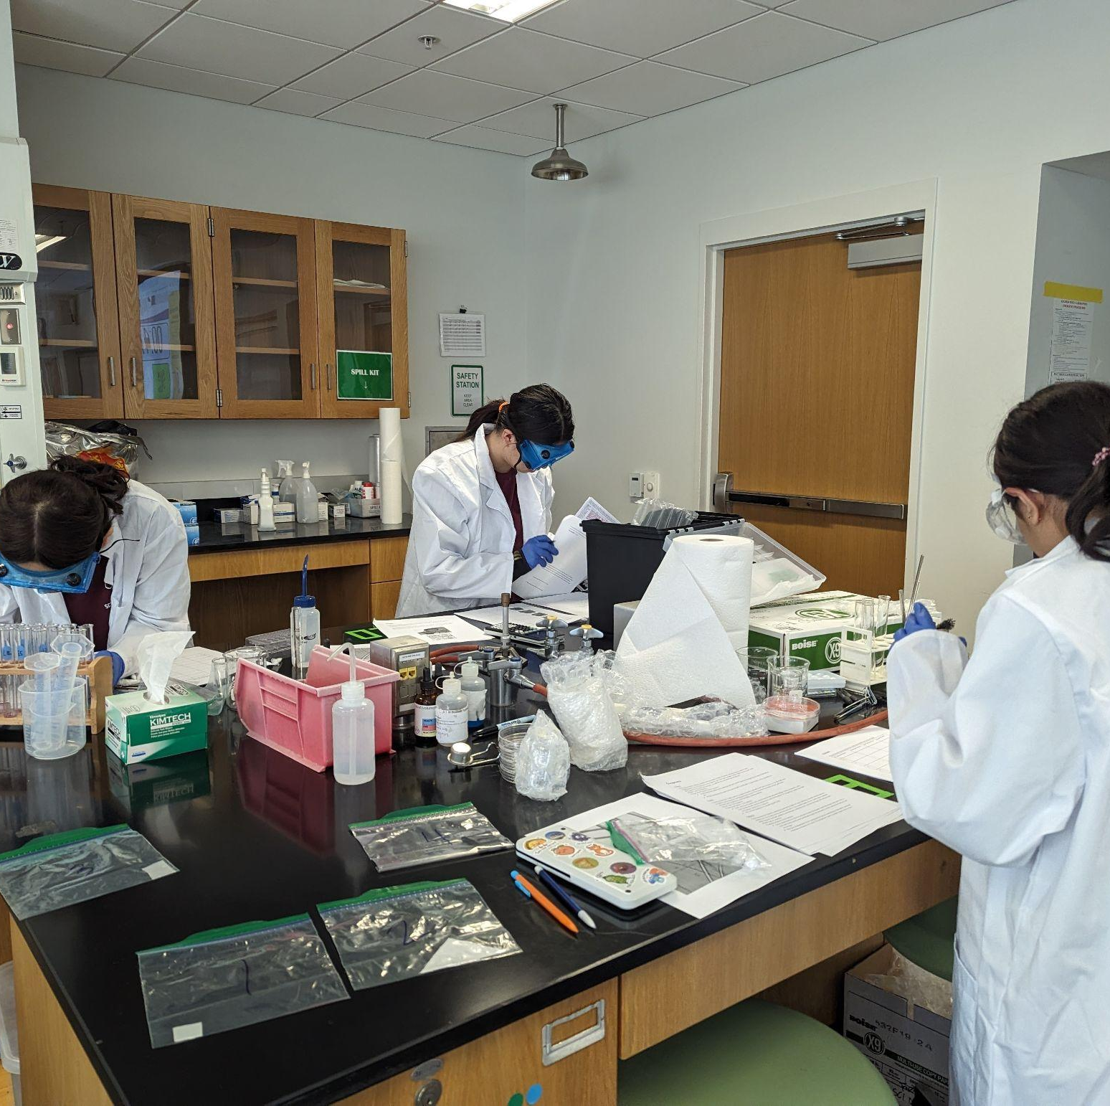
THANKS!
Rebecca Xiong
Email: rebeccaxiong01@gmail.com
Ex-Brookwood HS competitor, Ex-President of UChicago SO, state and regional ES for IL, VA, MI, NY
Feel free to reach out if you have any questions!
Notes:
(replace picture with a picture from one of our tournaments)

