Slide 1
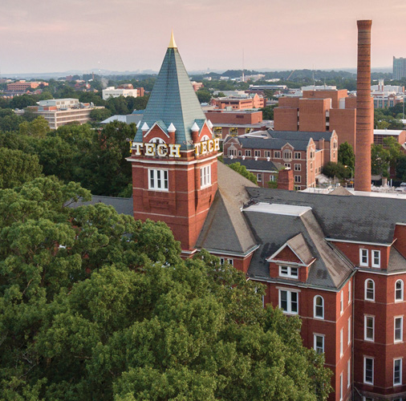
Dynamic Planet
Division B & C
Georgia Tech Event Workshop Series 2024-25

Slide 2
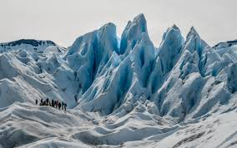
01
RULES SHEET
02
DIFFICULT TOPICS
[Event-Related Image]
03
COMMON QUESTIONS
04
TIPS FROM A VETERAN
05
OTHER FREE RESOURCES
Notes:
For Builds: Replace difficult topics with physical principles involved in the build and replace common questions with common designs

Slide 3
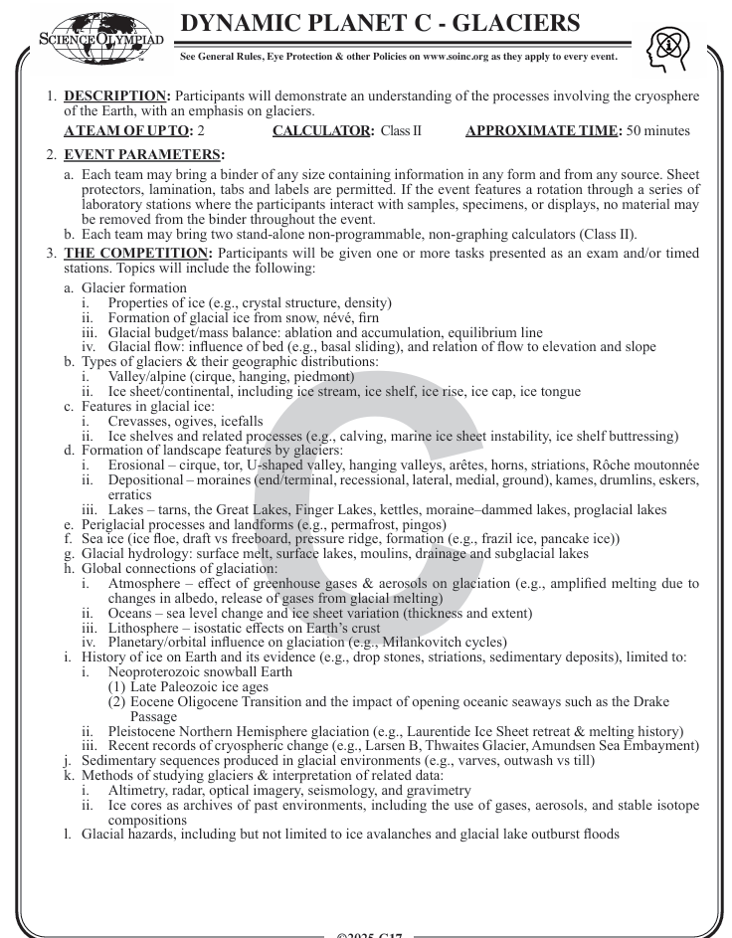
The Rules Sheet
Rules Sheet for Event
Binder Event: All Notes/Material must be hole-punched and placed in the binder rings
Having material outside the binder rings (loose sheets, etc. is not acceptable)
Please have all material ready the night before the competition as generally hole-punchers are rare at the competition site.
Non-Graphing Calculators Allowed
Topic of the Year: Glaciers
Notes:
Highlight key points from the rules sheet: DESIGN LOGS that basically grant free points, most tested-on topics, point distribution so that competitors know what to prioritize, allowed notes and equipment, etc.

Slide 4
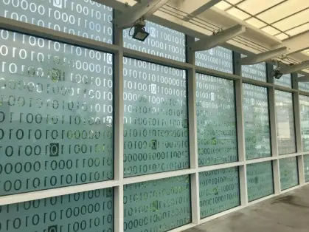
Important Tips
Notes:
This section should focus on topics that are more math-based (harder to self-teach), concepts that come only usually up in college level courses, or concepts that you struggled with when you competed in this event

Slide 5
Binder Organization
Organization and Formatting is Key to a Successful Binder
Images
Avoid Walls of Text, try to summarize notes in bullet points
Base Chapter off of Guidelines Headings and expand upon those sections
Don’t just copy information off the wiki → Okay as a starting point, but please ensure that you are familiar with the topics as you are adding them into the binder.
Common Mistake: Not knowing the information behind the binder
Binders should be used as a reference not as a textbook that you only start looking at the morning of the exam.
Should have a good enough familiarity with the topics to reference certain pages on a minute’s notice

Slide 6
Source Material
Content Review:
SciOLY Wiki – #1 resource for basic event overview & topics to know
Practice Questions → Main way to Prepare
Approach to Studying:
Look at a Question → See if you can answer it without having to reference notes
Research that topic in detail → Wikipedia, Britannica, USGS, Videos, GPT4o
Learn the content
Place Images, materials that you find into your find under your chapter headers using your own words

Slide 7
QUESTION REVIEW
All of the following questions have been pulled from past YJI exams (which can be found on our website) or the Text Exchange on SciOly Wiki
Notes:
\

Slide 8
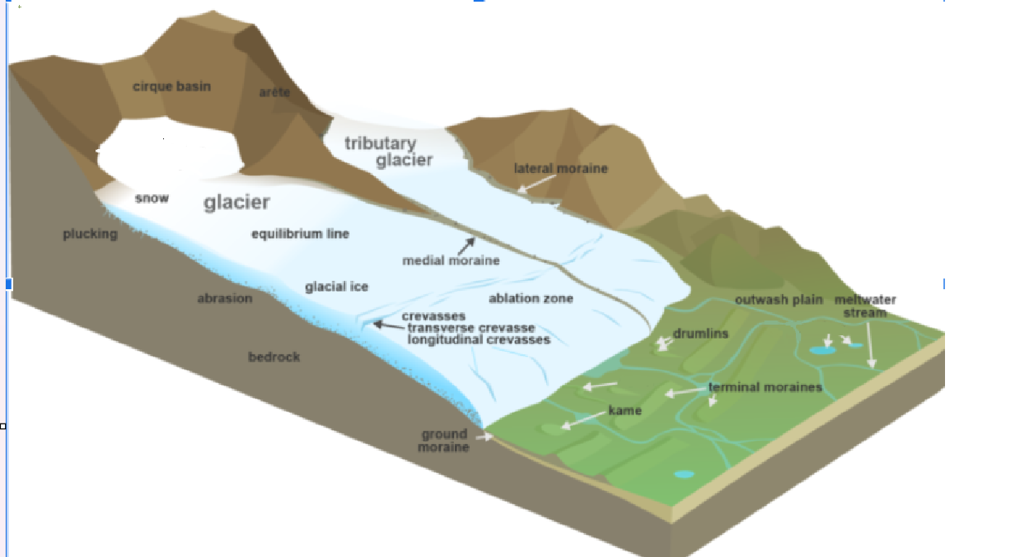
Question 1: Simple Recall
A
C
B

Slide 9
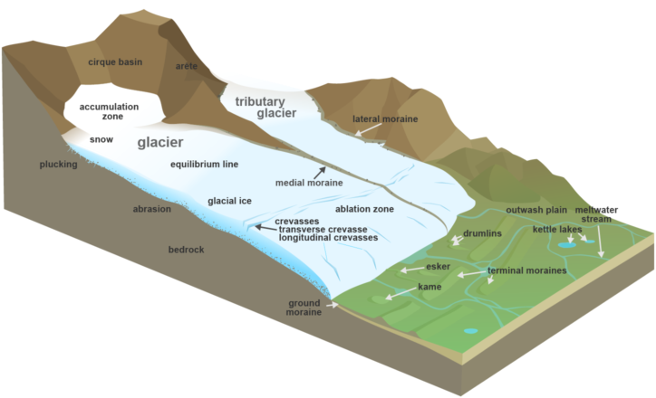
Question 1: Simple Recall

Slide 10
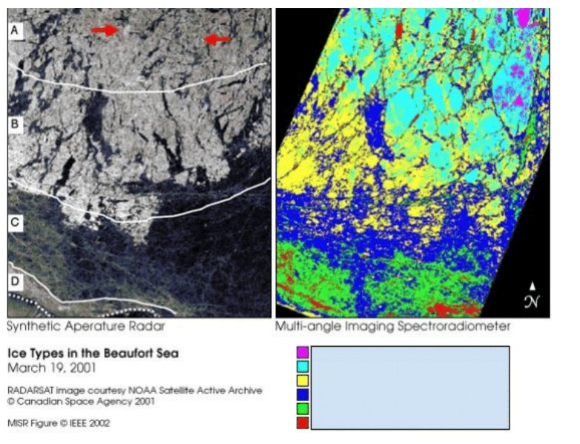
Question 2: Qualitative Analysis
The following questions refer to Fig. 1.
The left image was created by Synthetic Aperture Radar (SAR) and the right image was created by Multi-angle Imaging SpectroRadiometer(MISR).
Both images are of ice in the Beaufort Sea, Alaska.
Ice classification in this image is based on what two values? So then, why is section C of the left image nearly black though it is still ice?
What type of ice does the turquoise blue color represent?
<Princeton Science Olympiad Invitational — 2019>
Notes:
Pull some questions from exams on the scioly wiki test exchange, first give attendees a couple minutes to read over them/work through them, then walk them through the answers

Slide 11
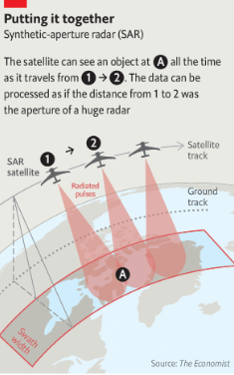
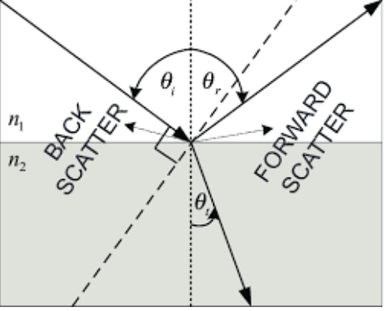

Slide 12
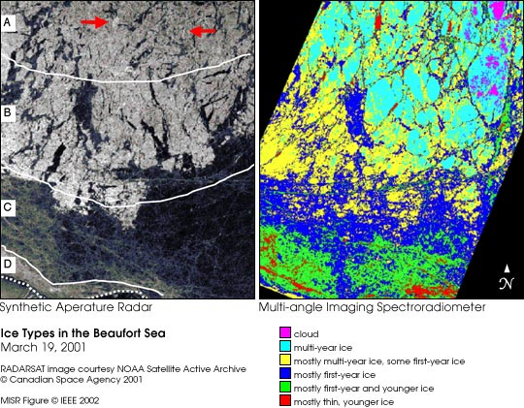
Question 2: Qualitative Analysis
SAR is sensitive to the physical texture of the ice, detecting ridges, cracks, and deformations.
MISR detects how much sunlight is reflected, influenced by surface composition and the presence of snow or melt ponds.
Ice classification in this image is based on what two values? So then, why is section C of the left image nearly black though it is still ice?
Forward scatter and backscatter; younger ice predominately forward scatters light,resulting in little to no signal being reflected back to the sensor, which makes the region nearly black to the sensor
What type of ice does the turquoise blue color represent?
Multi-Year Ice
Notes:
Pull some questions from exams on the scioly wiki test exchange, first give attendees a couple minutes to read over them/work through them, then walk them through the answers

Slide 13
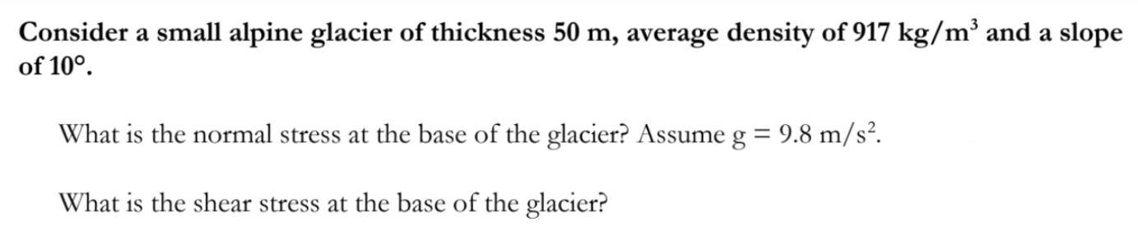
Question 3: Quantitative Analysis
<MIT Invitational 2019>
Notes:
Pull some questions from exams on the scioly wiki test exchange, first give attendees a couple minutes to read over them/work through them, then walk them through the answers

Slide 14
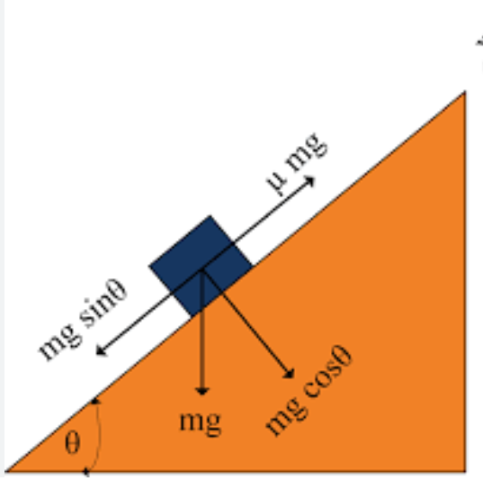
Question 3: Quantitative Analysis
normal stress = density * height * g * cos(angle) = 917 * 50 * 9.8 * cos(10) = 442.5 kPa
shear stress = density * height * g * sin(angle) = 917 * 50 * 9.8 * sin(10) = 78 kPa
Notes:
Pull some questions from exams on the scioly wiki test exchange, first give attendees a couple minutes to read over them/work through them, then walk them through the answers

Slide 15
Tips from a Veteran
Don’t blindly copy content into your binder → Learn & Understand it
Start with Fundamentals by learning through SciOly Wiki → Proceed to harder topics by researching each topic online and writing your own notes for it
If you come across a question, which you may be unfamiliar, make an educated guess based on what the problem gives you and based on what you know
Practice: Look at all tests from prior year (DP Changes topics but look at priori years with similar topics:
Glaciers: 2019, 2014, 2013, 2006, 2005
Have Fun! Science Olympiad Competitions are a great way to interact with students from other High/Middle Schools and explore several fun events, most importantly enjoy the material, and don’t stress too much about fitting every little fact into your binder.
Notes:
Use this section to talk about any strategies you used to navigate the event when you competed. For example, how did you manage your time, how did you organize your notes, how did you split topics up between you and your partner, etc.?

Slide 16
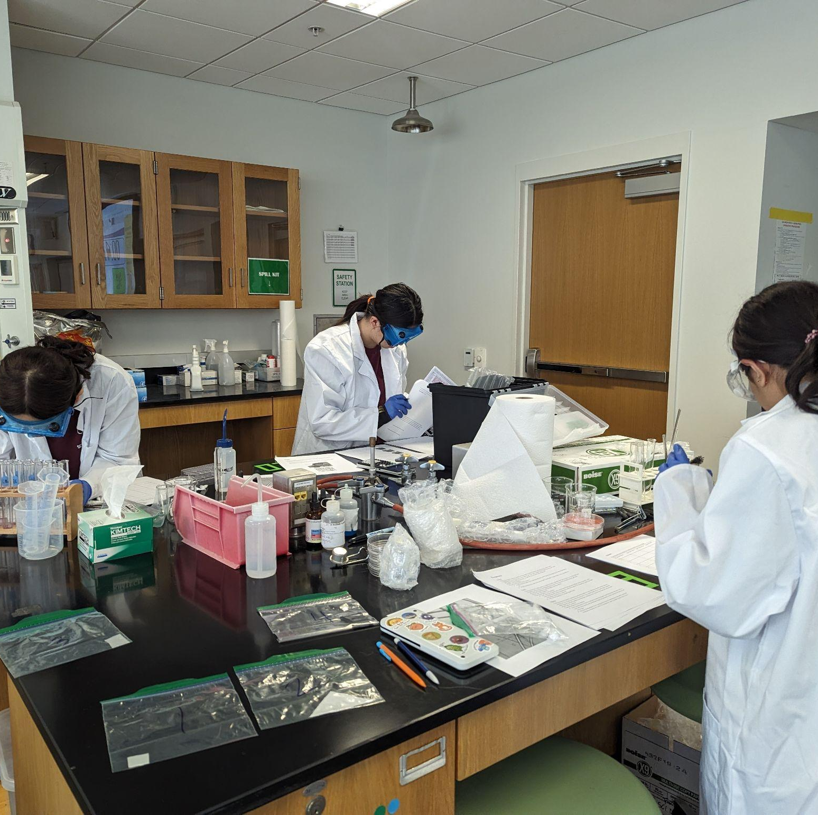
THANKS!
Notes:
(replace picture with a picture from one of our tournaments)

