Slide 1
Disease Detectives
Division B/C
Georgia Tech Event Workshop Series 2024-25

Slide 2
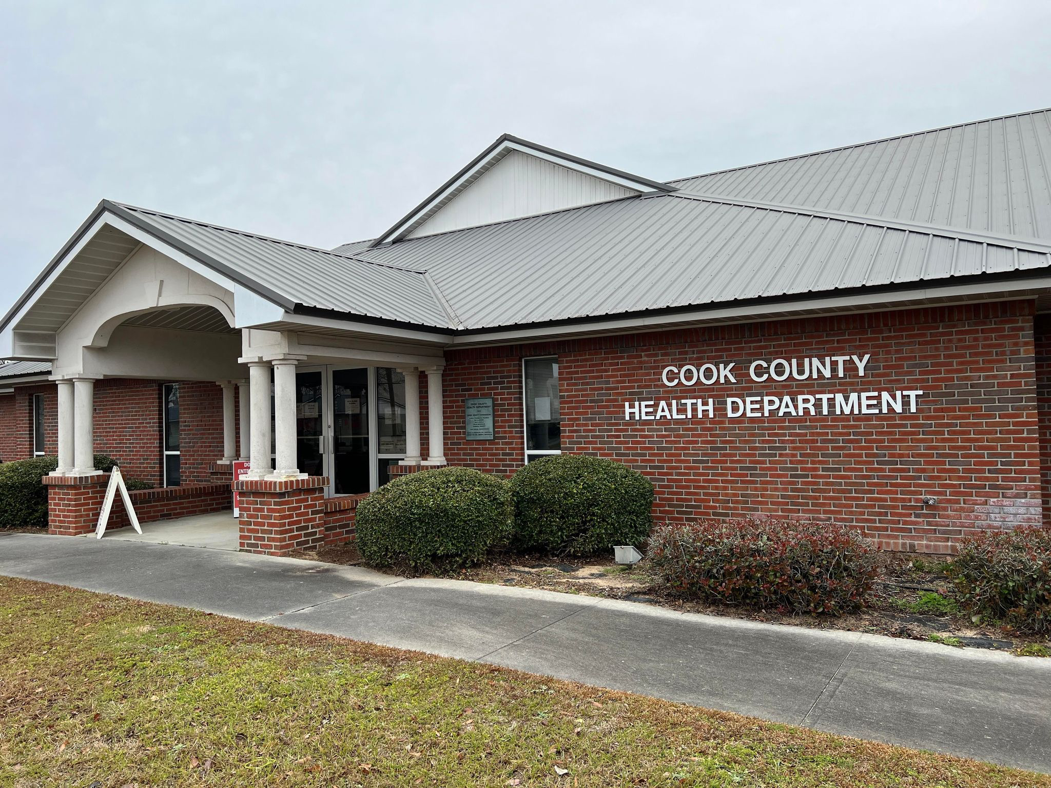
01
RULES SHEET
02
DIFFICULT TOPICS
03
COMMON QUESTIONS
04
TIPS FROM A VETERAN
05
OTHER FREE RESOURCES
Notes:
For Builds: Replace difficult topics with physical principles involved in the build and replace common questions with common designs

Slide 3
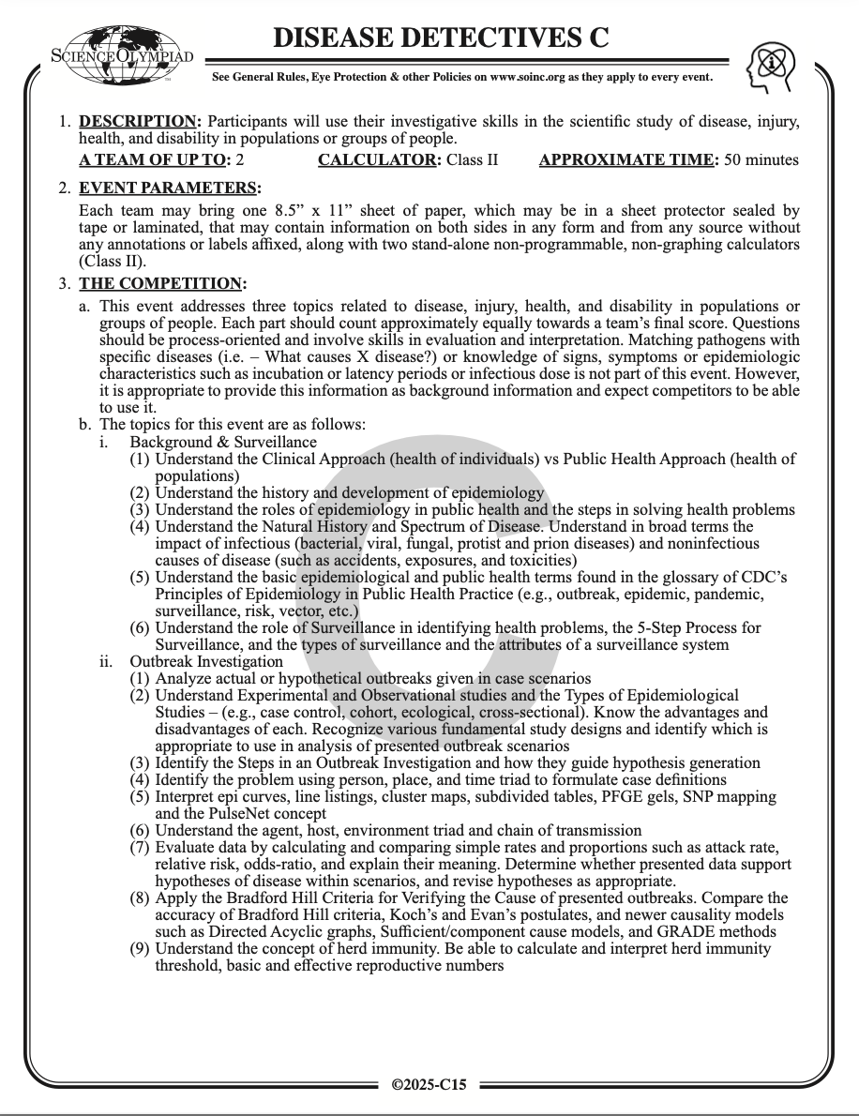
The Rules Sheet
No significant changes in nearly 6 years…
3 main sections
Background and Surveillance
Free points!
Outbreak investigation
Use science to solve an outbreak
Patterns, controls, and prevention
Math and graphs
Very little about this event is conceptually difficult!
Challenge is in being able to apply it to nuanced situations
Notes:
Highlight key points from the rules sheet: DESIGN LOGS that basically grant free points, most tested-on topics, point distribution so that competitors know what to prioritize, allowed notes and equipment, etc.

Slide 4
DIFFICULT TOPICS
Notes:
This section should focus on topics that are more math-based (harder to self-teach), concepts that come only usually up in college level courses, or concepts that you struggled with when you competed in this event

Slide 5
Topic 1: Studies B/C
Foodborne illness case study
Caused by undercooked eggs

Slide 6
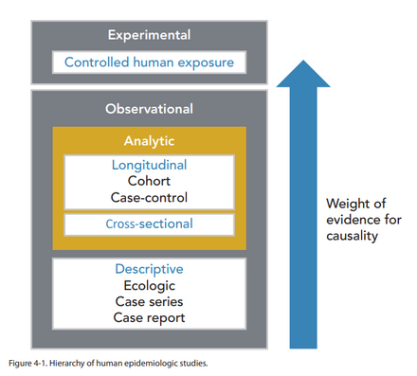
Topic 1: Studies B/C
Case studies are the heart of most Disease Detectives tests
Often you are given a situation then asked to apply principles from all 3 sections to it
For this, you need to use a study
But what study to use? And what’s the difference between them anyways?

Slide 7
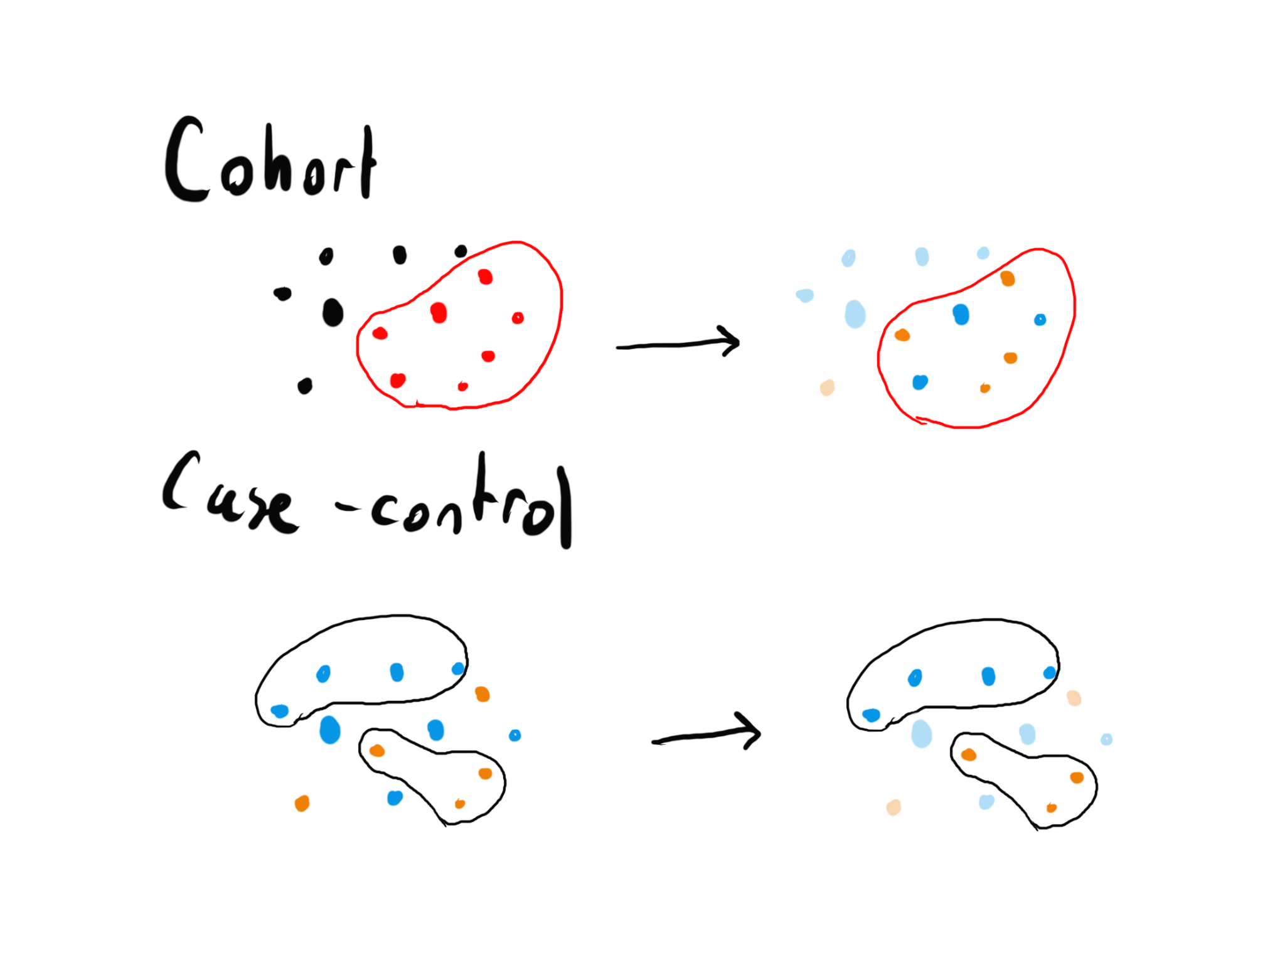
Topic 1: Studies B/C
Cohort
Sample a group, some will be exposed and some will not, see who develops outcome
Case control
Sample a group with disease and a group without disease
Increasing controls increases power (ability of study to find association if it exists)

Slide 8
Topic 1: Studies B/C
Study types
You will have to either choose a study type for the outbreak or identify the study type used
Cohort vs Case Control
If the population involved is well defined (ie people at a family potluck), it will almost certainly be a cohort study
If it is impossible to identify everyone exposed to the agent (ie people who visit the park begin falling ill), only a case control is possible

Slide 9
Topic 1: Studies B/C
Variations of Cohort
Prospective
Collect participants before outcomes occur
Attrition bias - people may drop out
Participants must not have outcome at time of data collection, but must be at risk of developing outcome
Retrospective
Collect participants after outcomes occur, use records to determine exposure status
More risk of bias, but cheaper and easier
May not have proof of exposure status
Notes:
https://pmc.ncbi.nlm.nih.gov/articles/PMC4763690/#sec1-4

Slide 10
Topic 1: Studies B/C
Variations of Case-control
Matched / matched-pair
Used to control for 1 factor of confounding
For each case, choose 1 or more controls with the same condition (ie age)
Nested case-control
Take cases/controls from a cohort
Used when looking at everyone in the cohort would be unreasonable - ie running expensive genetic tests to see association between gene and cancer
Case-cohort
After a cohort study ends, compare people with outcome to random sample (control group) of people in the cohort
Control group can include cases!

Slide 11
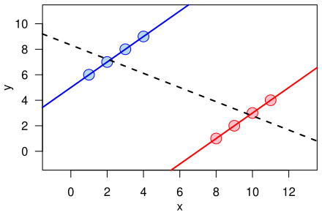
Topic 1: Studies B/C
Biases
Confounding
Something is associated with both the cause and effect you are trying to study
Sampling bias
Selection bias
Incidence bias - people who have mild/severe cases of disease are excluded
Berkson’s bias / Berksonian bias
Simpson’s paradox

Slide 12
Topic 1: Studies B/C
Biases
Immortal time bias - A type of misclassification - assigning a patient to exposed group before they have been exposed
Recall / response bias - recall is when patient remembers incorrectly, response is when patient lies
Length time - Increase time patient is aware of disease without really improving prognosis
Lead time bias - Patients with mild/serious disease not caught by screening

Slide 13
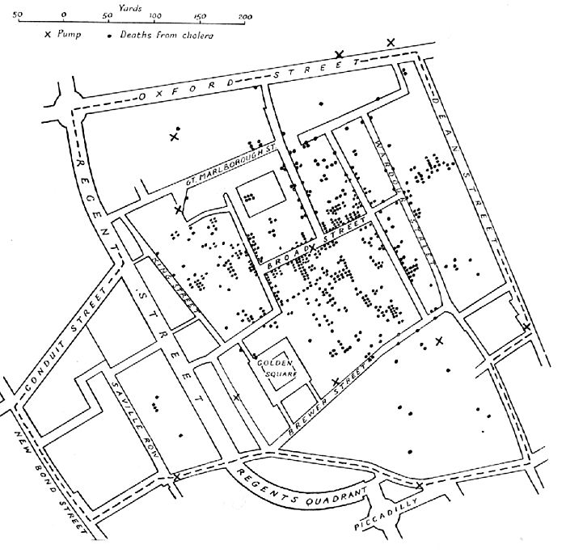
Topic 1: Studies B/C
Less common study types
Cross-sectional study
Ecological study
John Snow’s cholera study
Ecological fallacy
Time series
Case series
Quasi-experimental
Experimental
Only experimental studies can find causation! All others can only find correlation.

Slide 14
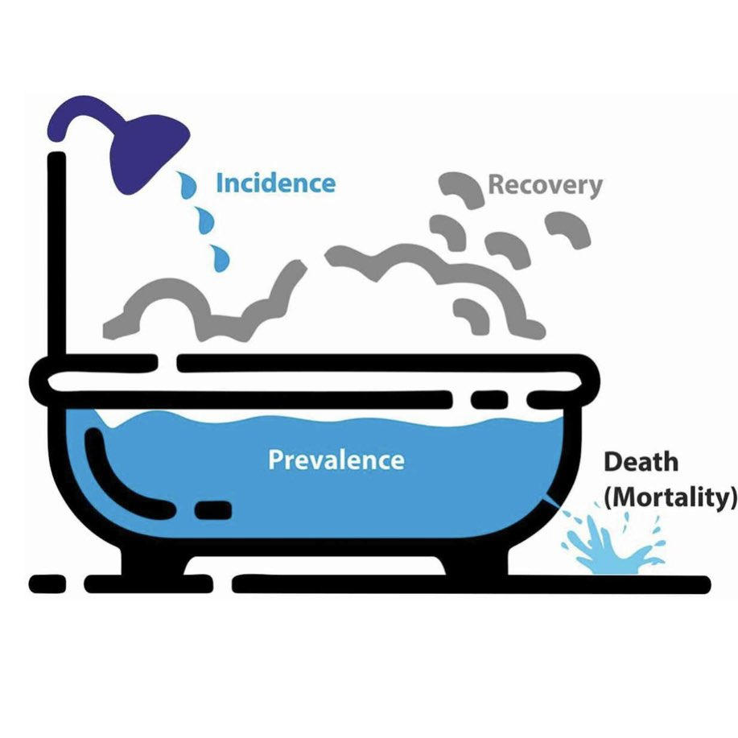
Topic 2: Math B/C
Measures of disease spread/virulence
Prevalence vs incidence
Mortality vs morbidity
Can be proportions (0.0003) or ratios (3 per 10,000 people)
Notes:
Feel free to add more topics and make sure that there are plenty of pictures/diagrams!

Slide 15
Topic 2: Math B/C
Measures of correlation in cohort studies
Risk and relative risk
 | Listeria + | Listeria -
Ate deli meat | 5 | 30
Did not eat deli meat | 1 | 45
35
46
6 75 81
Risk (ate deli meat) Risk (did not eat deli meat)
5/35=0.143 1/46=0.022
Relative risk: 0.143/0.022=6.5; Those who ate deli meat were 6.5 times more likely to develop listeria
Notes:
Feel free to add more topics and make sure that there are plenty of pictures/diagrams!

Slide 16
Topic 2: Math B/C
Measures of correlation in case-control studies
Odds ratio
 | Listeria + | Listeria -
Ate deli meat | 5 | 30
Did not eat deli meat | 1 | 45
35
46
6 75 81
Odds (ate deli meat) Odds (did not eat deli meat)
5/1=5 30/45=0.667
Odds ratio: 5/.667=7.496; Those who developed listeria were 7.5 times more likely to have eaten deli meat.
Notes:
Feel free to add more topics and make sure that there are plenty of pictures/diagrams!

Slide 17
Topic 2: Math B/C
Generalizing the calculations…
 | Listeria + | Listeria -
Ate deli meat | a | b
Did not eat deli meat | c | d
a+b
c+d
a+c b+d a+b+c+d
RR: OR:
Notes:
Feel free to add more topics and make sure that there are plenty of pictures/diagrams!

Slide 18
Topic 2: Math B/C
Risk ratio (RR) vs Odds ratio (OR)
OR is an approximation of RR
If RR = 1, OR = 1
Otherwise OR will be further from 1 than RR
If event is rare, OR will be a good approximation of RR (rare disease assumption)
…so why use OR for case-control studies?
Risk ratio requires “people at risk” as denominator
In a case control, you can’t know how many people are at risk

Slide 19
Topic 2: Math B/C
The basic reproductive number R₀ represents the number of infections produced by a typical infected individual
Estimated to be ~4 for COVID (lots of variation tho)
The effective reproductive number R or R_{t} represents the number of infections produced by a typical infected individual considering susceptibility
R_{t}=R₀x; x is the proportion of susceptible individuals
If half of the population is vaccinated: R_{t} = 4*.5 = 2
Herd immunity threshold is the proportion of individuals that must be vaccinated to stop proliferation of the disease
Herd immunity threshold = 1 - 1/R₀
Notes:
Feel free to add more topics and make sure that there are plenty of pictures/diagrams!

Slide 20
Topic 2: Math B/C
0.71 1.15 1.87
0.82 1.35 2.23
Confidence intervals show a range of likely values for some number
Interpretation of 95% CI
If the study was done repeatedly, 95% of the reported confidence intervals would include the ‘true’ value
Notes:
https://www.mja.com.au/journal/2004/180/11/outbreak-legionnaires-disease-melbourne-aquarium-april-2000-investigation-and

Slide 21
Topic 2: Math B/C
Sensitivity and specificity
Tests for a disease can be positive or negative, as well as true or false.
Sensitivity is the chance a diseased person will get a positive result (TP/TP+FN)
Specificity is the chance a healthy person will get a negative result (TN/TN+FP)
Sensitivity and specificity have an implicit tradeoff!
Values can be adjusted based on the test (threshold value)
 | RDT positive | RDT negative
PCR positive | True Positive | False Positive
PCR negative | False Negative | True Negative
RDT (rapid test) is compared against a highly accurate standard, PCR
Notes:
Feel free to add more topics and make sure that there are plenty of pictures/diagrams!

Slide 22
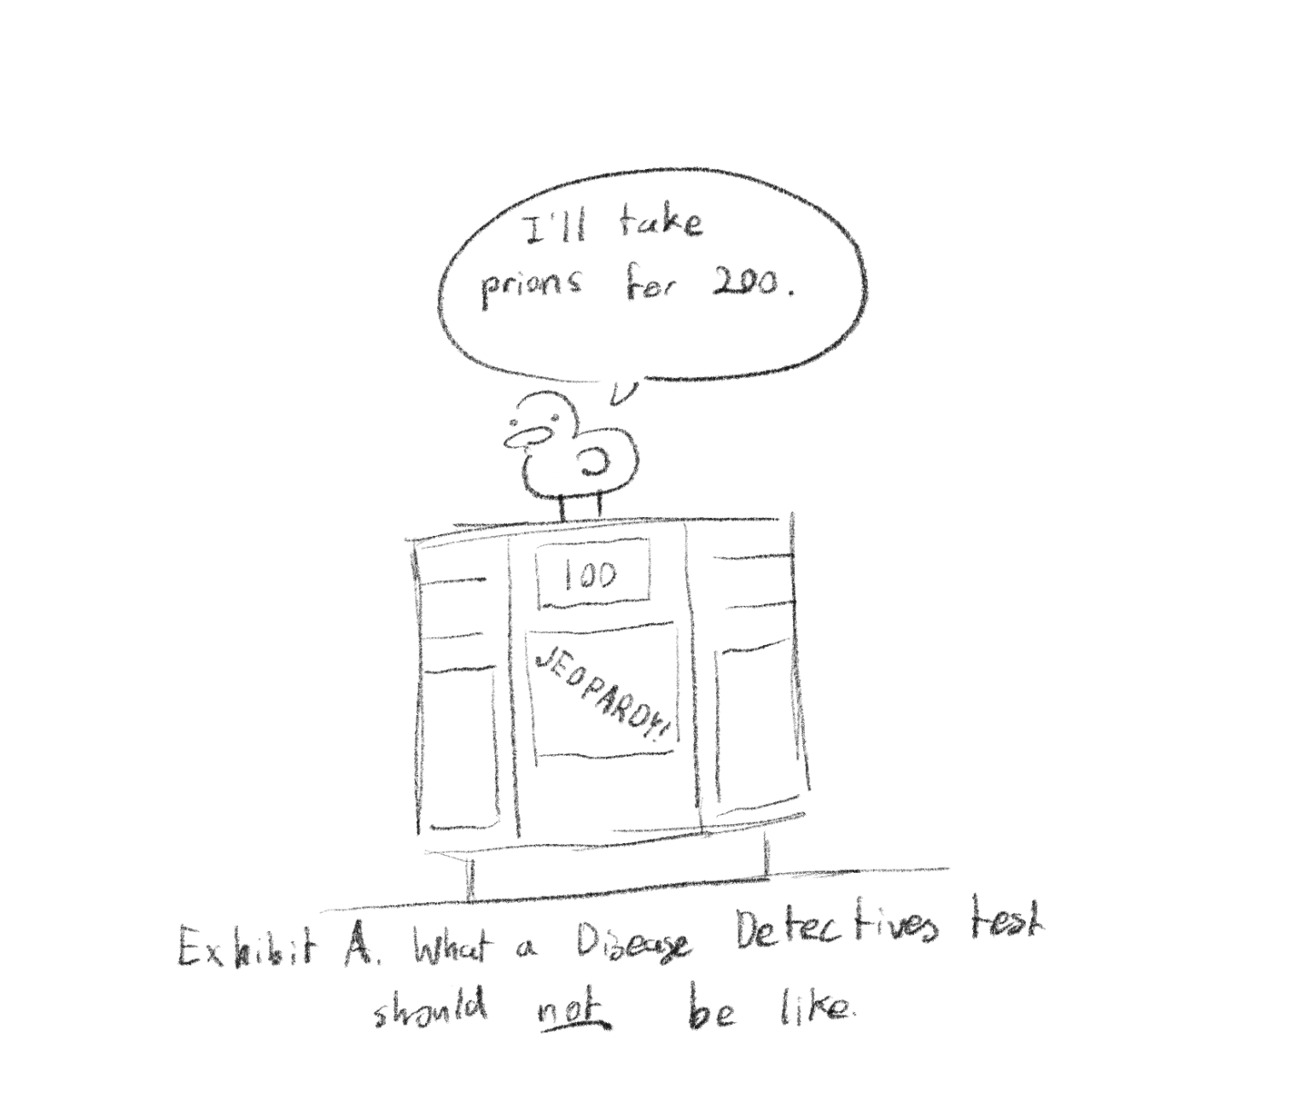
Topic 3: Trivia B/C
Rules explicitly state that knowledge of specific diseases should be not tested for this event!
So why do we care about trivia?

Slide 23
Topic 3: Trivia B/C
Tests will almost always expect some level of background knowledge of things not explicitly stated in rules
Tests may ask for examples
These are good things to know / have on your notes if you have room (see following slides for more details)
Foodborne illnesses
History
Vectorborne diseases
General pathogen knowledge
Studying these should come after you already have all the basic knowledge nailed down! You do not need to know any of these topics in detail, just being aware of them is more than often enough.
Notes:
Will speed through this section just so ppl have a general idea of what to put on their notes/cheatsheet

Slide 24
Topic 3: Trivia B/C
Foodborne illness + food safety
Know what foods are associated with each (maybe put on cheatsheet)
Good ones to have
Salmonella, Norovirus, E. Coli (Shiga-like and non shiga-like), Listeria, Campylobacter, Cryptosporidium, B. Cereus, Shigella, giardia, trichinella
On the test: if in doubt, it’s salmonella or E. Coli
“Oh no! There’s a new E. Coli outbreak!”
Disease detectives:

Slide 25
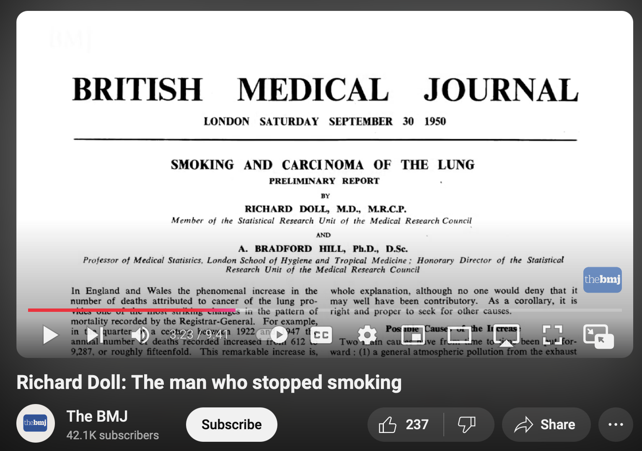
Topic 3: Trivia B/C
History
Timeline and diseases of major pandemics
Plague, HIV/AIDS, SARS and COVID-19, influenza (Do you notice something in common about most of these diseases?)
Other historically important diseases
TB, Cholera, smallpox (and any disease that we have a vaccine against), malaria
Non-infectious diseases: 4 big pollution diseases of Japan
Important studies
John Snow’s Cholera study
Doll and Hill’s British Physicians study
Check out this page: History of epidemiology - CDC
Notes:
Mention some current diseases

Slide 26
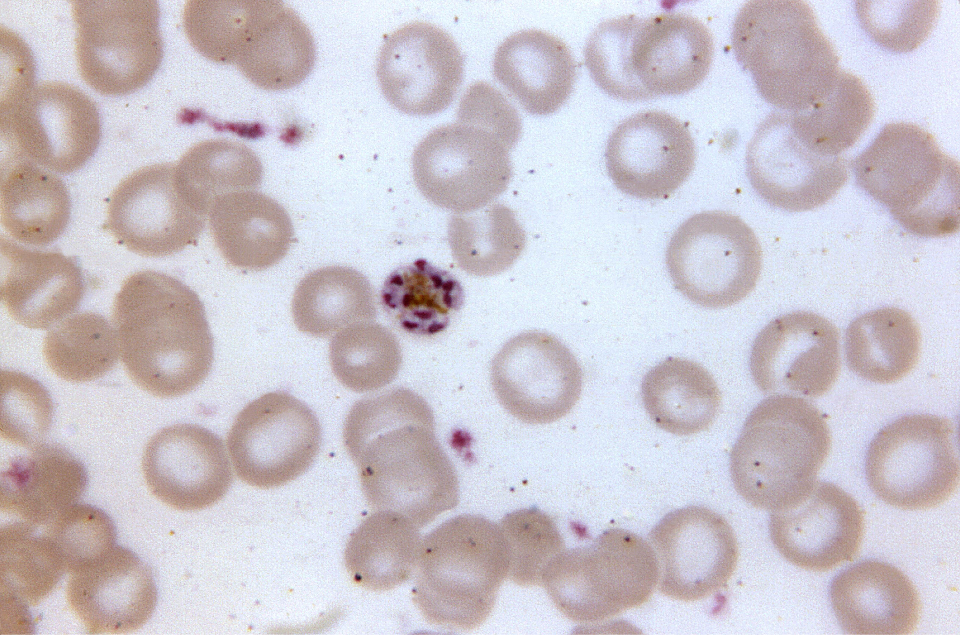
Topic 3: Trivia B/C
Vectorborne diseases
Mosquitoes
Malaria, dengue, zika virus
Ticks
Lyme, RMSF
Others
Chagas disease - kissing bug
Sleeping sickness - tsetse fly
Why do we care about these?
Significant cause of human morbidity
Huge impact on communities that lack sufficient healthcare resources
Climate change is predicted to make some of these more prevalent
Notes:
Mention some current diseases

Slide 27
Topic 3: Trivia B/C
Pathogens
Viruses - retroviruses vs general viruses
Bacteria
Gram +/-/none
Antibiotic resistance
Parasites
Can be macroscopic (dracunculiasis) or microscopic (malaria)
Prions
UK Beef BSE / TSE outbreak
Fungi
Rare to see on tests
Mostly dangerous to people with weakened immune system
Notes:
Mention some current diseases

Slide 28
COMMON QUESTIONS
All of the following questions have been pulled from past YJI exams (which can be found on our website) or the Text Exchange on SciOly Wiki
Notes:
\

Slide 29
Question 1 - Case Study
Azure-Sky’s test from SSSS 2023
On August 3, 2022, 209 students of Disease Detective Academy headed toward the dining hall. However, a few days later, many students reported symptoms of diarrhea, fever, and stomach cramps. The school has established this as an outbreak.
26. Write a case definition for this outbreak. (4 pts)
After a few hours, you conduct a survey where participants with and without the disease report what foods they ate. For each food, here is the data.
33. What type of study are you conducting, and why? (3 pts)
(Continued on next page)
Notes:
Pull some questions from exams on the scioly wiki test exchange, first give attendees a couple minutes to read over them/work through them, then walk them through the answers. Try to get a mix of multiple choice and short answer or matching

Slide 30
Question 1 - Case Study
 | Ate (ill) | Didn’t eat (ill) | Ate (not ill) | Didn’t eat (not ill)
Sweet Mango | 82 | 41 | 17 | 69
Steamed Mushrooms | 86 | 37 | 63 | 23
Calculate the risk measure for the two foods.
Which food likely caused the outbreak, and how do you know?
Name 3 ways to prevent future foodborne illnesses.
OR: Odds for case/odds for control
(82/41)/(41/69)=8.118
(86/37)/(63/23)=0.849
Notes:
Pull some questions from exams on the scioly wiki test exchange, first give attendees a couple minutes to read over them/work through them, then walk them through the answers. Try to get a mix of multiple choice and short answer or matching

Slide 31
Question 2 - Vocab
Ariose’s 2023 Disease SSSS
Doll and Hill conducted a prospective cohort study that demonstrated a link between smoking and lung cancer. (Descriptive epidemiology | Analytic epidemiology | Public health surveillance)
After feeling nauseous and abnormally fatigued for two days, Alexander goes to visit his primary care physician. Alexander is exhibiting _______. (Signs | Symptoms | Sequelae)
55% of symptomatic people infected with Dragon Pox will die. 20% of symptomatic people infected with Dragon Flu will die. Dragon Pox has higher ________ than Dragon Flu. (Infectivity | Pathogenicity | Virulence)
Amir went to a party yesterday and then learned that someone else at the party tested positive for COVID-19. Amir does not have any symptoms but he goes to get tested and then stays in his room away from his family while he waits for his results. (Control | Isolation | Quarantine)
There are 0 cases of neonatal tetanus in the United States due to efforts in promoting the tetanus vaccine in pregnant women. (Elimination | Eradication | Extinction)
A bat enters a church through an open window and bites a girl, giving her rabies. The bat is a ______. (Fomite | Vector | Vehicle)
The Vaccine Adverse Effect Reporting System (VAERS) is a national surveillance program where anyone can fill out a form to report a health issue post-vaccination. (Passive | Active | Sentinel)
Notes:
Pull some questions from exams on the scioly wiki test exchange, first give attendees a couple minutes to read over them/work through them, then walk them through the answers

Slide 32
Question 2 - Vocab
Doll and Hill conducted a prospective cohort study that demonstrated a link between smoking and lung cancer. (Descriptive epidemiology | Analytic epidemiology | Public health surveillance)
After feeling nauseous and abnormally fatigued for two days, Alexander goes to visit his primary care physician. Alexander is exhibiting _______. (Signs | Symptoms | Sequelae)
55% of symptomatic people infected with Dragon Pox will die. 20% of symptomatic people infected with Dragon Flu will die. Dragon Pox has higher ________ than Dragon Flu. (Infectivity | Pathogenicity | Virulence)
Amir went to a party yesterday and then learned that someone else at the party tested positive for COVID-19. Amir does not have any symptoms but he goes to get tested and then stays in his room away from his family while he waits for his results. (Control | Isolation | Quarantine)
There are 0 cases of neonatal tetanus in the United States due to efforts in promoting the tetanus vaccine in pregnant women. (Elimination | Eradication | Extinction)
A bat enters a church through an open window and bites a girl, giving her rabies. The bat is a ______. (Fomite | Vector | Vehicle)
The Vaccine Adverse Effect Reporting System (VAERS) is a national surveillance program where anyone can fill out a form to report a health issue post-vaccination. (Passive | Active | Sentinel)
Notes:
Pull some questions from exams on the scioly wiki test exchange, first give attendees a couple minutes to read over them/work through them, then walk them through the answers

Slide 33
Question 2 - Vocab
Doll and Hill conducted a prospective cohort study that demonstrated a link between smoking and lung cancer. (Descriptive epidemiology | Analytic epidemiology | Public health surveillance)
After feeling nauseous and abnormally fatigued for two days, Alexander goes to visit his primary care physician. Alexander is exhibiting _______. (Signs | Symptoms | Sequelae)
55% of symptomatic people infected with Dragon Pox will die. 20% of symptomatic people infected with Dragon Flu will die. Dragon Pox has higher ________ than Dragon Flu. (Infectivity | Pathogenicity | Virulence)
Amir went to a party yesterday and then learned that someone else at the party tested positive for COVID-19. Amir does not have any symptoms but he goes to get tested and then stays in his room away from his family while he waits for his results. (Control | Isolation | Quarantine)
There are 0 cases of neonatal tetanus in the United States due to efforts in promoting the tetanus vaccine in pregnant women. (Elimination | Eradication | Extinction)
A bat enters a church through an open window and bites a girl, giving her rabies. The bat is a ______. (Fomite | Vector | Vehicle)
The Vaccine Adverse Effect Reporting System (VAERS) is a national surveillance program where anyone can fill out a form to report a health issue post-vaccination. (Passive | Active | Sentinel)
Notes:
Pull some questions from exams on the scioly wiki test exchange, first give attendees a couple minutes to read over them/work through them, then walk them through the answers

Slide 34
Question 2 - Vocab
Doll and Hill conducted a prospective cohort study that demonstrated a link between smoking and lung cancer. (Descriptive epidemiology | Analytic epidemiology | Public health surveillance)
After feeling nauseous and abnormally fatigued for two days, Alexander goes to visit his primary care physician. Alexander is exhibiting _______. (Signs | Symptoms | Sequelae)
55% of symptomatic people infected with Dragon Pox will die. 20% of symptomatic people infected with Dragon Flu will die. Dragon Pox has higher ________ than Dragon Flu. (Infectivity | Pathogenicity | Virulence)
Amir went to a party yesterday and then learned that someone else at the party tested positive for COVID-19. Amir does not have any symptoms but he goes to get tested and then stays in his room away from his family while he waits for his results. (Control | Isolation | Quarantine)
There are 0 cases of neonatal tetanus in the United States due to efforts in promoting the tetanus vaccine in pregnant women. (Elimination | Eradication | Extinction)
A bat enters a church through an open window and bites a girl, giving her rabies. The bat is a ______. (Fomite | Vector | Vehicle)
The Vaccine Adverse Effect Reporting System (VAERS) is a national surveillance program where anyone can fill out a form to report a health issue post-vaccination. (Passive | Active | Sentinel)
Notes:
Pull some questions from exams on the scioly wiki test exchange, first give attendees a couple minutes to read over them/work through them, then walk them through the answers

Slide 35
Question 2 - Vocab
Doll and Hill conducted a prospective cohort study that demonstrated a link between smoking and lung cancer. (Descriptive epidemiology | Analytic epidemiology | Public health surveillance)
After feeling nauseous and abnormally fatigued for two days, Alexander goes to visit his primary care physician. Alexander is exhibiting _______. (Signs | Symptoms | Sequelae)
55% of symptomatic people infected with Dragon Pox will die. 20% of symptomatic people infected with Dragon Flu will die. Dragon Pox has higher ________ than Dragon Flu. (Infectivity | Pathogenicity | Virulence)
Amir went to a party yesterday and then learned that someone else at the party tested positive for COVID-19. Amir does not have any symptoms but he goes to get tested and then stays in his room away from his family while he waits for his results. (Control | Isolation | Quarantine)
There are 0 cases of neonatal tetanus in the United States due to efforts in promoting the tetanus vaccine in pregnant women. (Elimination | Eradication | Extinction)
A bat enters a church through an open window and bites a girl, giving her rabies. The bat is a ______. (Fomite | Vector | Vehicle)
The Vaccine Adverse Effect Reporting System (VAERS) is a national surveillance program where anyone can fill out a form to report a health issue post-vaccination. (Passive | Active | Sentinel)
Notes:
Pull some questions from exams on the scioly wiki test exchange, first give attendees a couple minutes to read over them/work through them, then walk them through the answers

Slide 36
Question 2 - Vocab
Doll and Hill conducted a prospective cohort study that demonstrated a link between smoking and lung cancer. (Descriptive epidemiology | Analytic epidemiology | Public health surveillance)
After feeling nauseous and abnormally fatigued for two days, Alexander goes to visit his primary care physician. Alexander is exhibiting _______. (Signs | Symptoms | Sequelae)
55% of symptomatic people infected with Dragon Pox will die. 20% of symptomatic people infected with Dragon Flu will die. Dragon Pox has higher ________ than Dragon Flu. (Infectivity | Pathogenicity | Virulence)
Amir went to a party yesterday and then learned that someone else at the party tested positive for COVID-19. Amir does not have any symptoms but he goes to get tested and then stays in his room away from his family while he waits for his results. (Control | Isolation | Quarantine)
There are 0 cases of neonatal tetanus in the United States due to efforts in promoting the tetanus vaccine in pregnant women. (Elimination | Eradication | Extinction)
A bat enters a church through an open window and bites a girl, giving her rabies. The bat is a ______. (Fomite | Vector | Vehicle)
The Vaccine Adverse Effect Reporting System (VAERS) is a national surveillance program where anyone can fill out a form to report a health issue post-vaccination. (Passive | Active | Sentinel)
Notes:
Pull some questions from exams on the scioly wiki test exchange, first give attendees a couple minutes to read over them/work through them, then walk them through the answers

Slide 37
Question 2 - Vocab
Doll and Hill conducted a prospective cohort study that demonstrated a link between smoking and lung cancer. (Descriptive epidemiology | Analytic epidemiology | Public health surveillance)
After feeling nauseous and abnormally fatigued for two days, Alexander goes to visit his primary care physician. Alexander is exhibiting _______. (Signs | Symptoms | Sequelae)
55% of symptomatic people infected with Dragon Pox will die. 20% of symptomatic people infected with Dragon Flu will die. Dragon Pox has higher ________ than Dragon Flu. (Infectivity | Pathogenicity | Virulence)
Amir went to a party yesterday and then learned that someone else at the party tested positive for COVID-19. Amir does not have any symptoms but he goes to get tested and then stays in his room away from his family while he waits for his results. (Control | Isolation | Quarantine)
There are 0 cases of neonatal tetanus in the United States due to efforts in promoting the tetanus vaccine in pregnant women. (Elimination | Eradication | Extinction)
A bat enters a church through an open window and bites a girl, giving her rabies. The bat is a ______. (Fomite | Vector | Vehicle)
The Vaccine Adverse Effect Reporting System (VAERS) is a national surveillance program where anyone can fill out a form to report a health issue post-vaccination. (Passive | Active | Sentinel)
Notes:
Pull some questions from exams on the scioly wiki test exchange, first give attendees a couple minutes to read over them/work through them, then walk them through the answers

Slide 38
Question 2 - Vocab
Doll and Hill conducted a prospective cohort study that demonstrated a link between smoking and lung cancer. (Descriptive epidemiology | Analytic epidemiology | Public health surveillance)
After feeling nauseous and abnormally fatigued for two days, Alexander goes to visit his primary care physician. Alexander is exhibiting _______. (Signs | Symptoms | Sequelae)
55% of symptomatic people infected with Dragon Pox will die. 20% of symptomatic people infected with Dragon Flu will die. Dragon Pox has higher ________ than Dragon Flu. (Infectivity | Pathogenicity | Virulence)
Amir went to a party yesterday and then learned that someone else at the party tested positive for COVID-19. Amir does not have any symptoms but he goes to get tested and then stays in his room away from his family while he waits for his results. (Control | Isolation | Quarantine)
There are 0 cases of neonatal tetanus in the United States due to efforts in promoting the tetanus vaccine in pregnant women. (Elimination | Eradication | Extinction)
A bat enters a church through an open window and bites a girl, giving her rabies. The bat is a ______. (Fomite | Vector | Vehicle)
The Vaccine Adverse Effect Reporting System (VAERS) is a national surveillance program where anyone can fill out a form to report a health issue post-vaccination. (Passive | Active | Sentinel)
Notes:
Pull some questions from exams on the scioly wiki test exchange, first give attendees a couple minutes to read over them/work through them, then walk them through the answers

Slide 39
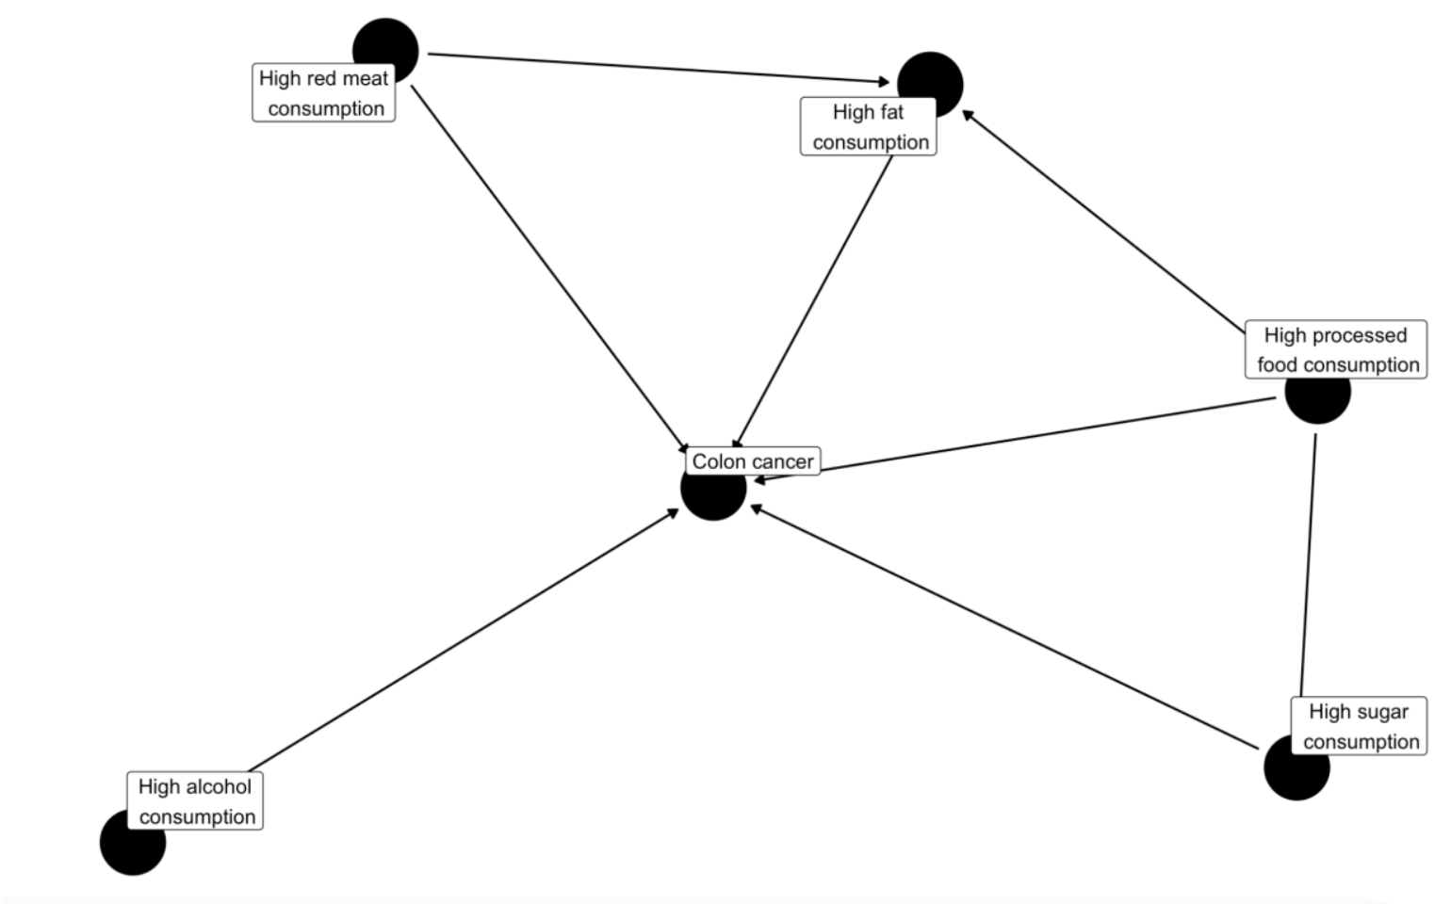
Question 3
MITSO 2024
The following is a directed acyclic graph (DAG) for the risk factors of colon cancer.
Let’s say you only wanted to look at high sugar consumption. Why would it be
especially important to control for high processed food consumption?
Notes:
Pull some questions from exams on the scioly wiki test exchange, first give attendees a couple minutes to read over them/work through them, then walk them through the answers

Slide 40
Question 3
MITSO 2024
The following is a directed acyclic graph (DAG) for the risk factors of colon cancer.
Let’s say you only wanted to look at high sugar consumption. Why would it be
especially important to control for high processed food consumption?
Processed foods have high sugar in them
Notes:
Pull some questions from exams on the scioly wiki test exchange, first give attendees a couple minutes to read over them/work through them, then walk them through the answers

Slide 41
Question 3
MITSO 2024
Redraw the DAG from 5 with the minimally sufficient adjustment set if we were only interested in high sugar consumption. Use boxes for controlled factors and circles for factors you are not controlling. You can ignore risk factors for colon cancer that
were not part of your original study.
Notes:
Pull some questions from exams on the scioly wiki test exchange, first give attendees a couple minutes to read over them/work through them, then walk them through the answers

Slide 42
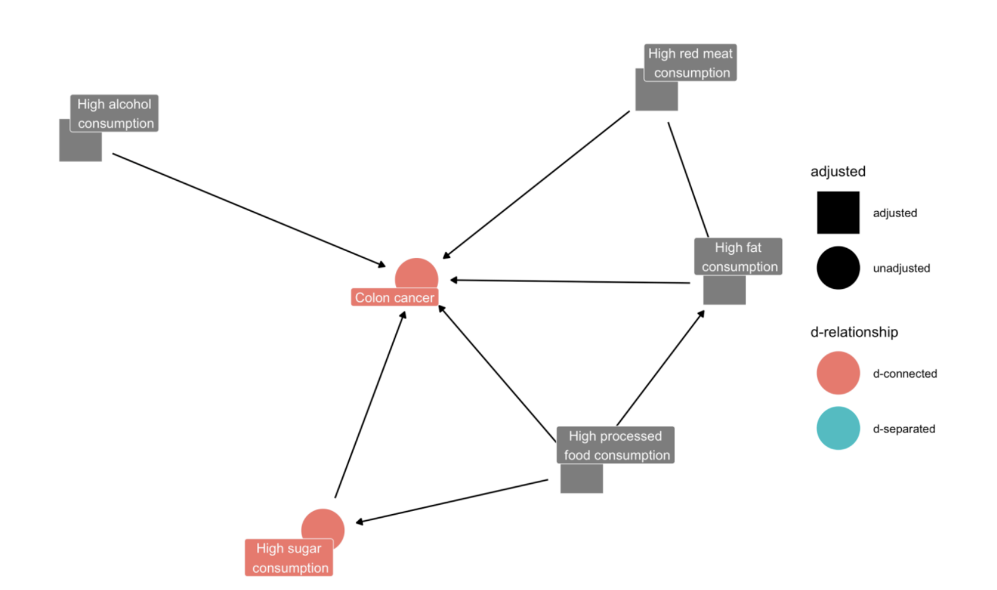
Question 3
MITSO 2024
Redraw the DAG from 5 with the minimally sufficient adjustment set if we were only interested in high sugar consumption. Use boxes for controlled factors and circles for factors you are not controlling. You can ignore risk factors for colon cancer that
were not part of your original study.
Notes:
Pull some questions from exams on the scioly wiki test exchange, first give attendees a couple minutes to read over them/work through them, then walk them through the answers

Slide 43
Tips from a Veteran
Know your basic scioly.org knowledge + vocab (or at least have it on the cheatsheet), do not miss out on the free easy points
Do practice tests! This is the most effective way to study. Try doing all non-trivia questions without your cheatsheet
There is not that much foundational knowledge in disease, so most of your cheatsheet should be dedicated to disease trivia, vocab, (and possibly statistics).
Common trivia I see people get wrong a lot: Antibiotics should not be used for viral diseases or shigatoxin producing E. Coli
Google “outbreaks” once in a while to see what the current diseases people are talking about are
Notes:
Use this section to talk about any strategies you used to navigate the event when you competed. For example, how did you manage your time, how did you organize your notes, how did you split topics up between you and your partner, etc.?

Slide 44
Additional Resources
CIDRAP
CDC TEXTBOOK
SUBWAY STATIONS
MMWR
History of epidemiology - CDC
Yes, Saturn is the ringed one. This planet is a gas giant, and it’s composed mostly of hydrogen and helium
Notes:
Here, you can link or mention any online or book resources that helped you in this event when you were a competitor. Try to avoid general resources like scioly wiki, because they probably already are familiar with it.

Slide 45
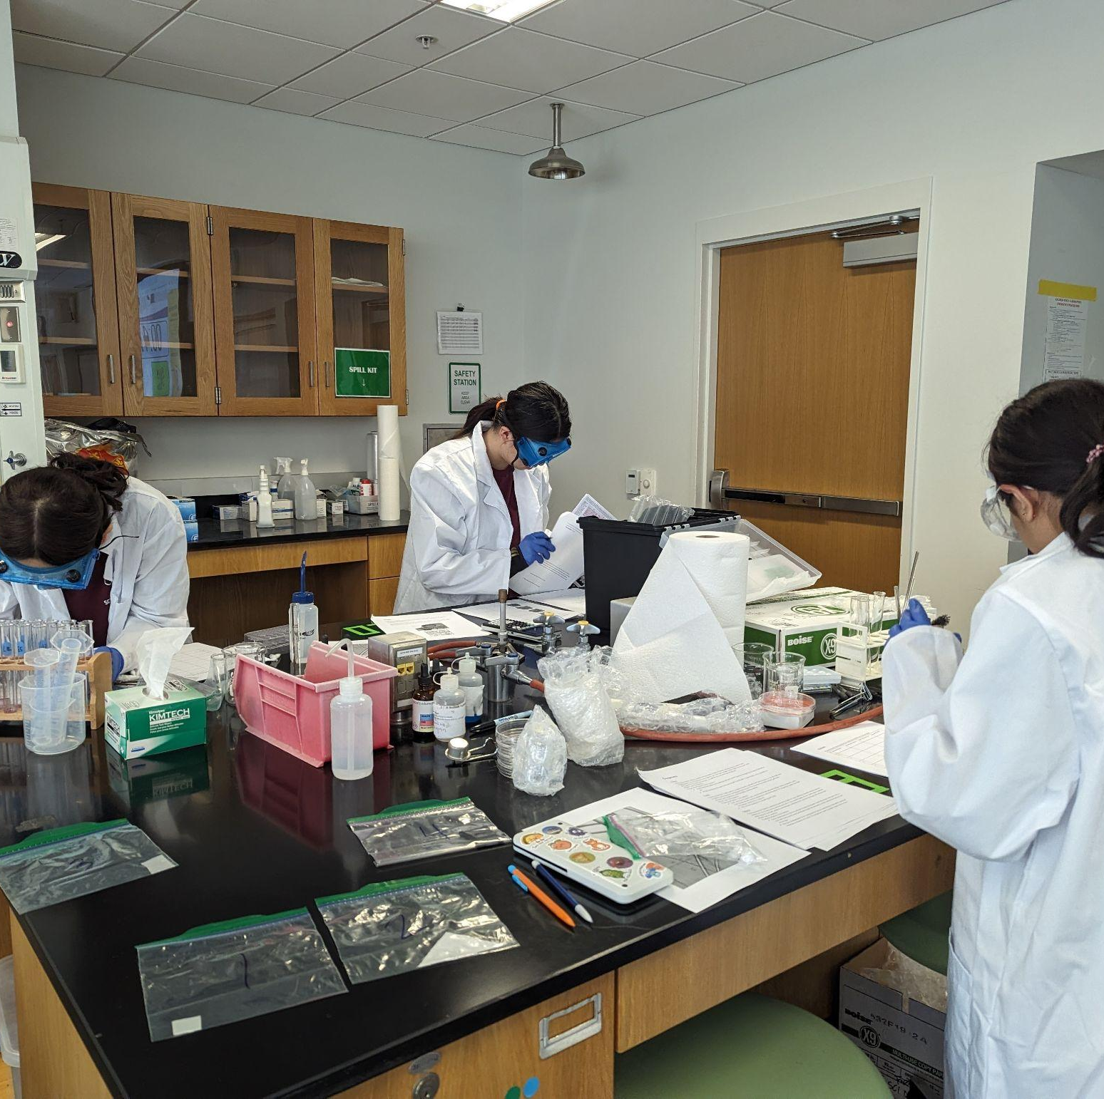
THANKS!
Notes:
(replace picture with a picture from one of our tournaments)

