Slide 1
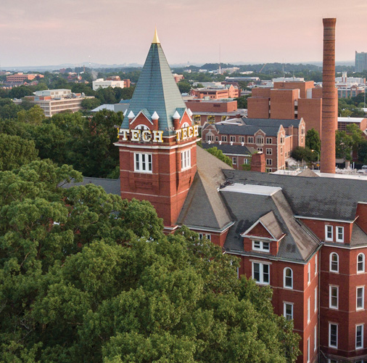
Crime Busters/Forensics
[Division B/C]
Georgia Tech Event Workshop Series 2024-25

Slide 2
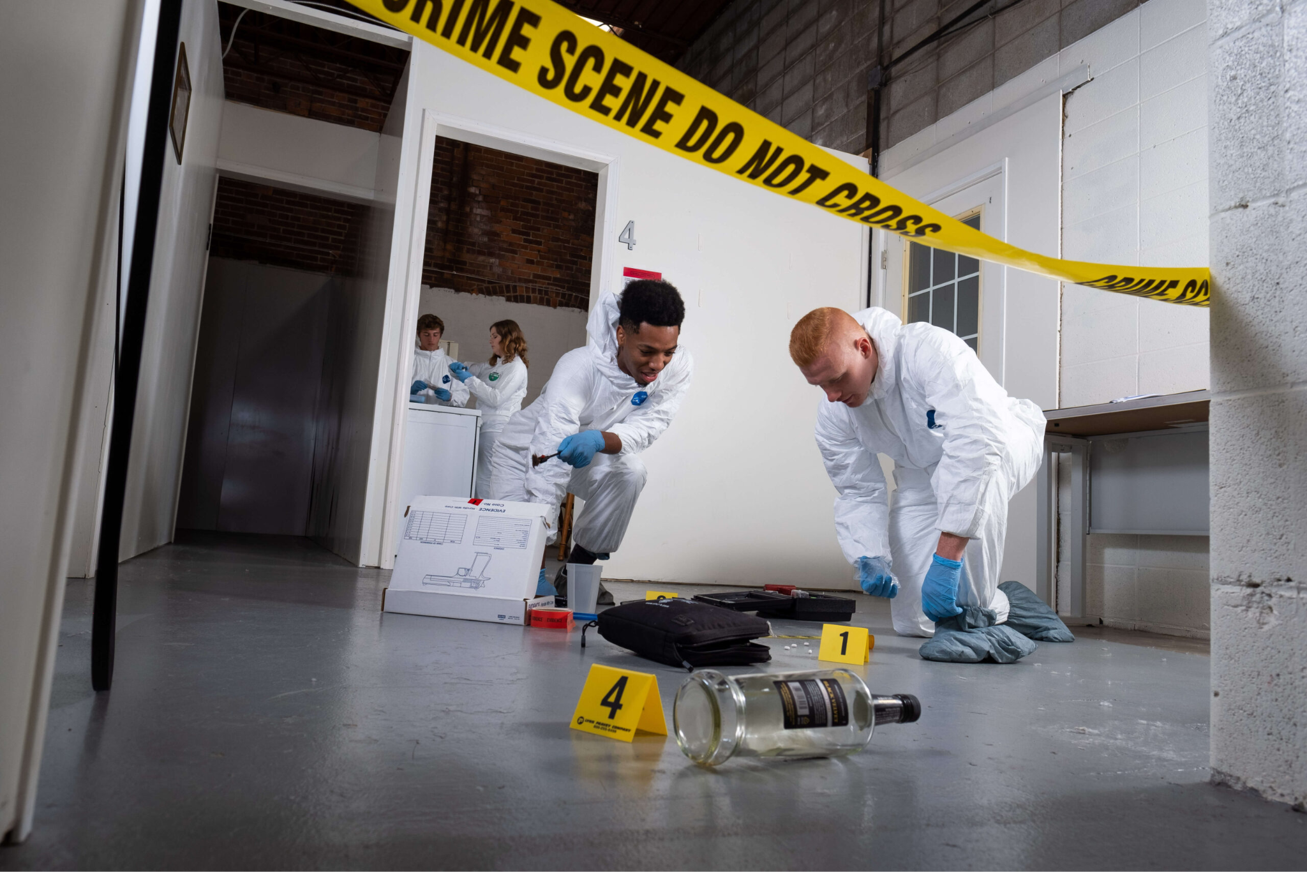
01
RULES SHEET
02
DIFFICULT TOPICS
03
COMMON QUESTIONS
04
TIPS FROM A VETERAN
05
OTHER FREE RESOURCES
Notes:
For Builds: Replace difficult topics with physical principles involved in the build and replace common questions with common designs

Slide 3
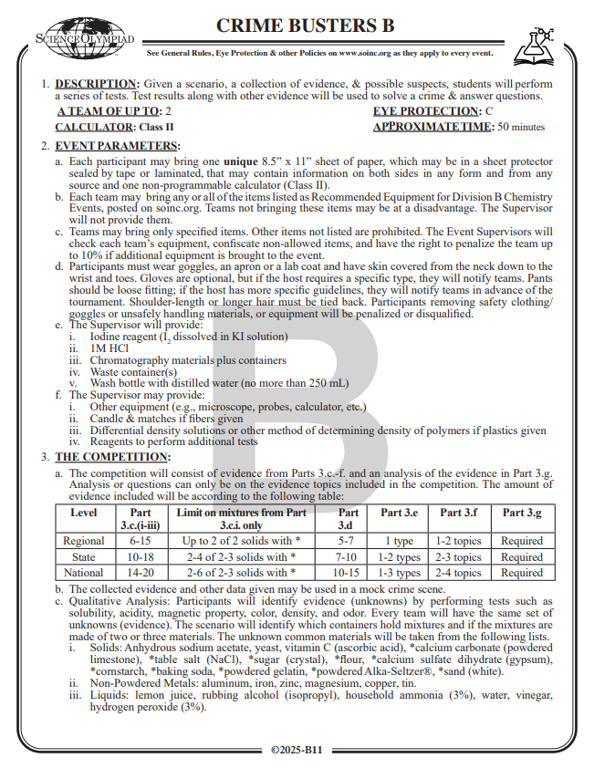
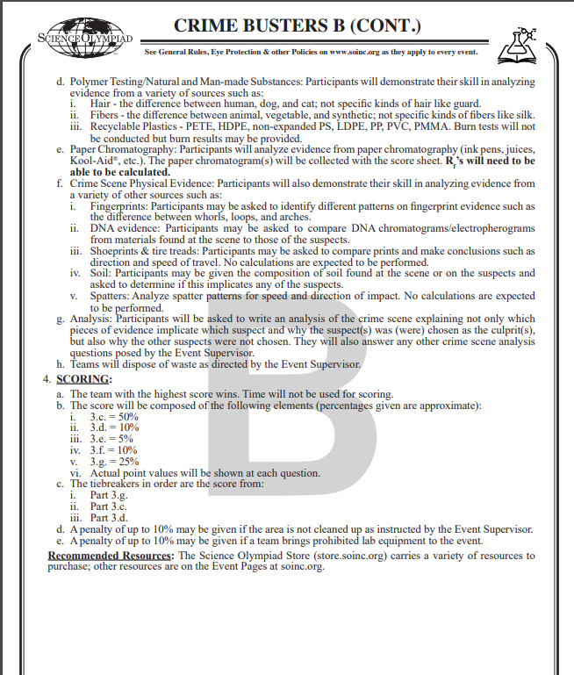
The Rules Sheet (B)
1 8.5” x 11” sheet of paper per person
1 non-programmable calculator (no TI-84)
Wear proper clothing!
Guaranteed to be tested on powders, polymers (hair, plastics, fibers), and chromatography
Check the Chemistry Equipment List!
Beakers, test tubes, petri dishes, slides/cover slips, spatulas, stirring rods, ruler, etc.
Analysis of powders/solids has the most points!! (~50%)
Notes:
Highlight key points from the rules sheet: DESIGN LOGS that basically grant free points, most tested-on topics, point distribution so that competitors know what to prioritize, allowed notes and equipment, etc.

Slide 4
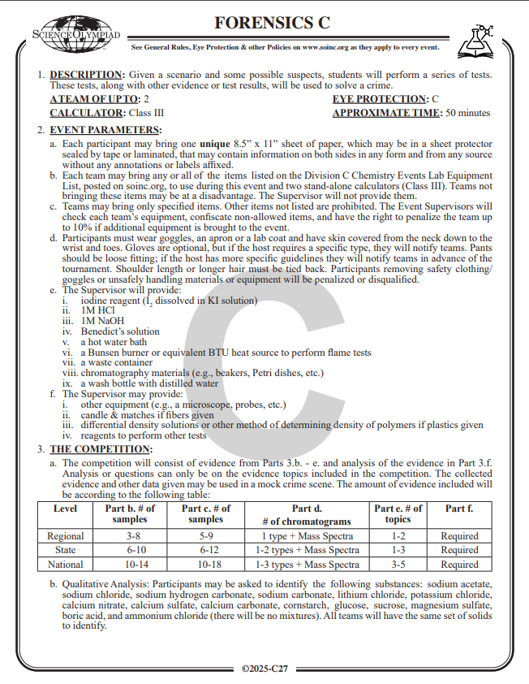
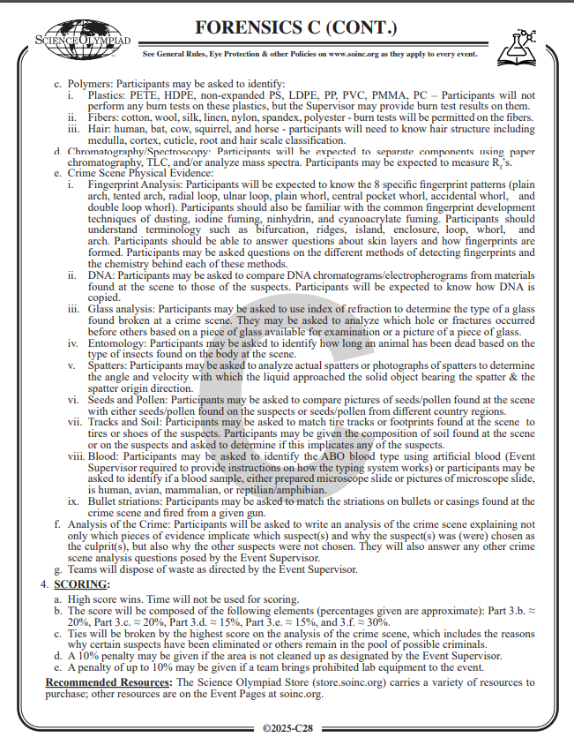
The Rules Sheet (C)
1 8.5” x 11” sheet of paper per person
1 programmable calculator per person
Make sure to check the Chemistry Lab Equipment List!
Beakers, test tubes, petri dishes, cover slips, flame loop, ruler, calculator, etc.
Analysis of the crime has the most points - make sure to write something down for this!
Notes:
Highlight key points from the rules sheet: DESIGN LOGS that basically grant free points, most tested-on topics, point distribution so that competitors know what to prioritize, allowed notes and equipment, etc.

Slide 5
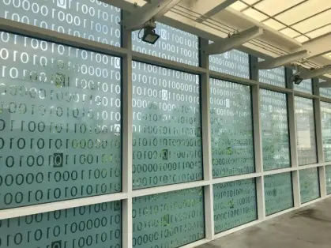
DIFFICULT TOPICS
Notes:
This section should focus on topics that are more math-based (harder to self-teach), concepts that come only usually up in college level courses, or concepts that you struggled with when you competed in this event

Slide 6
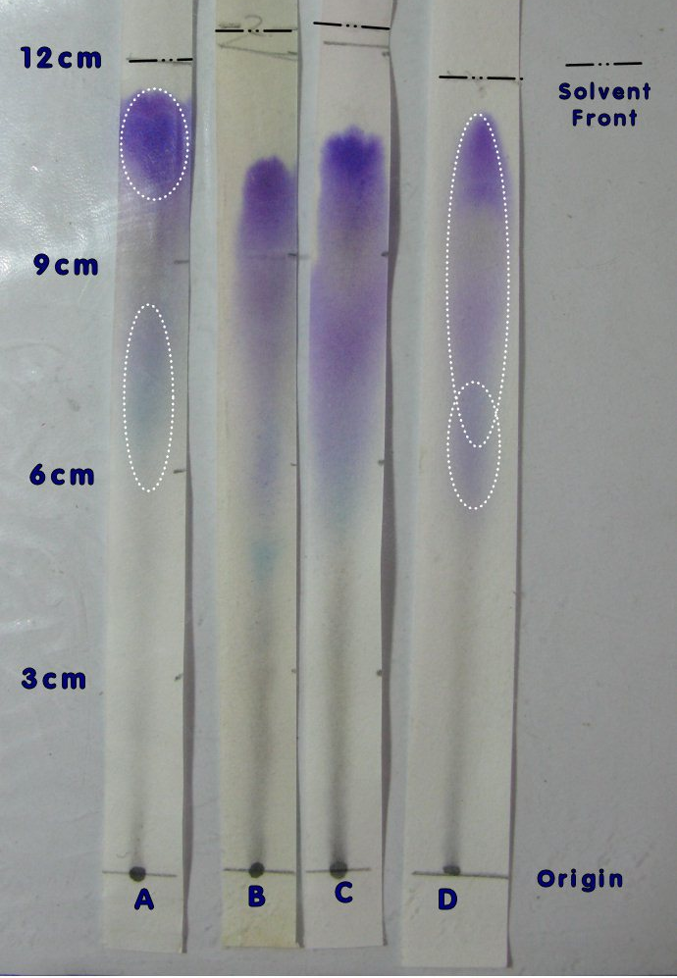
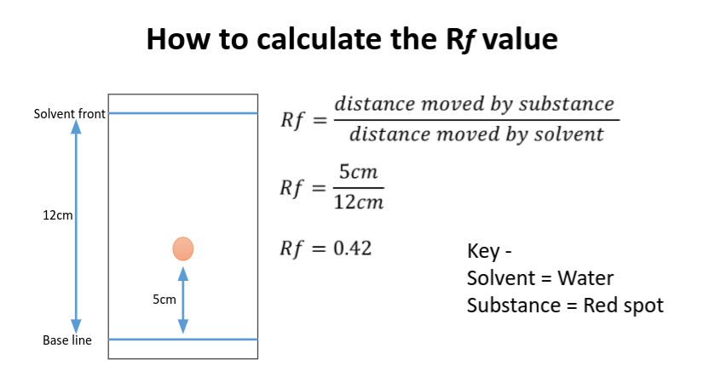
Topic 1: Chromatography
Relies on capillary action and polarity
Rf - Retention Factor
Measure from the base line to the center of the compound (how far the compound traveled)
Measure from the base line to the solvent front
Find their ratio
Mobile phase - solvent
Stationary phase - paper
Start this at the beginning of the test

Slide 7
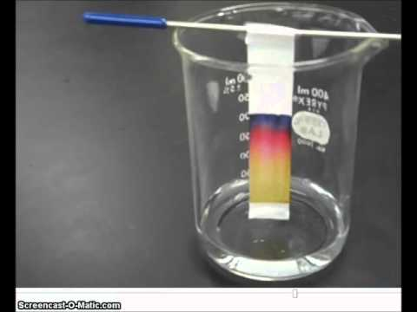
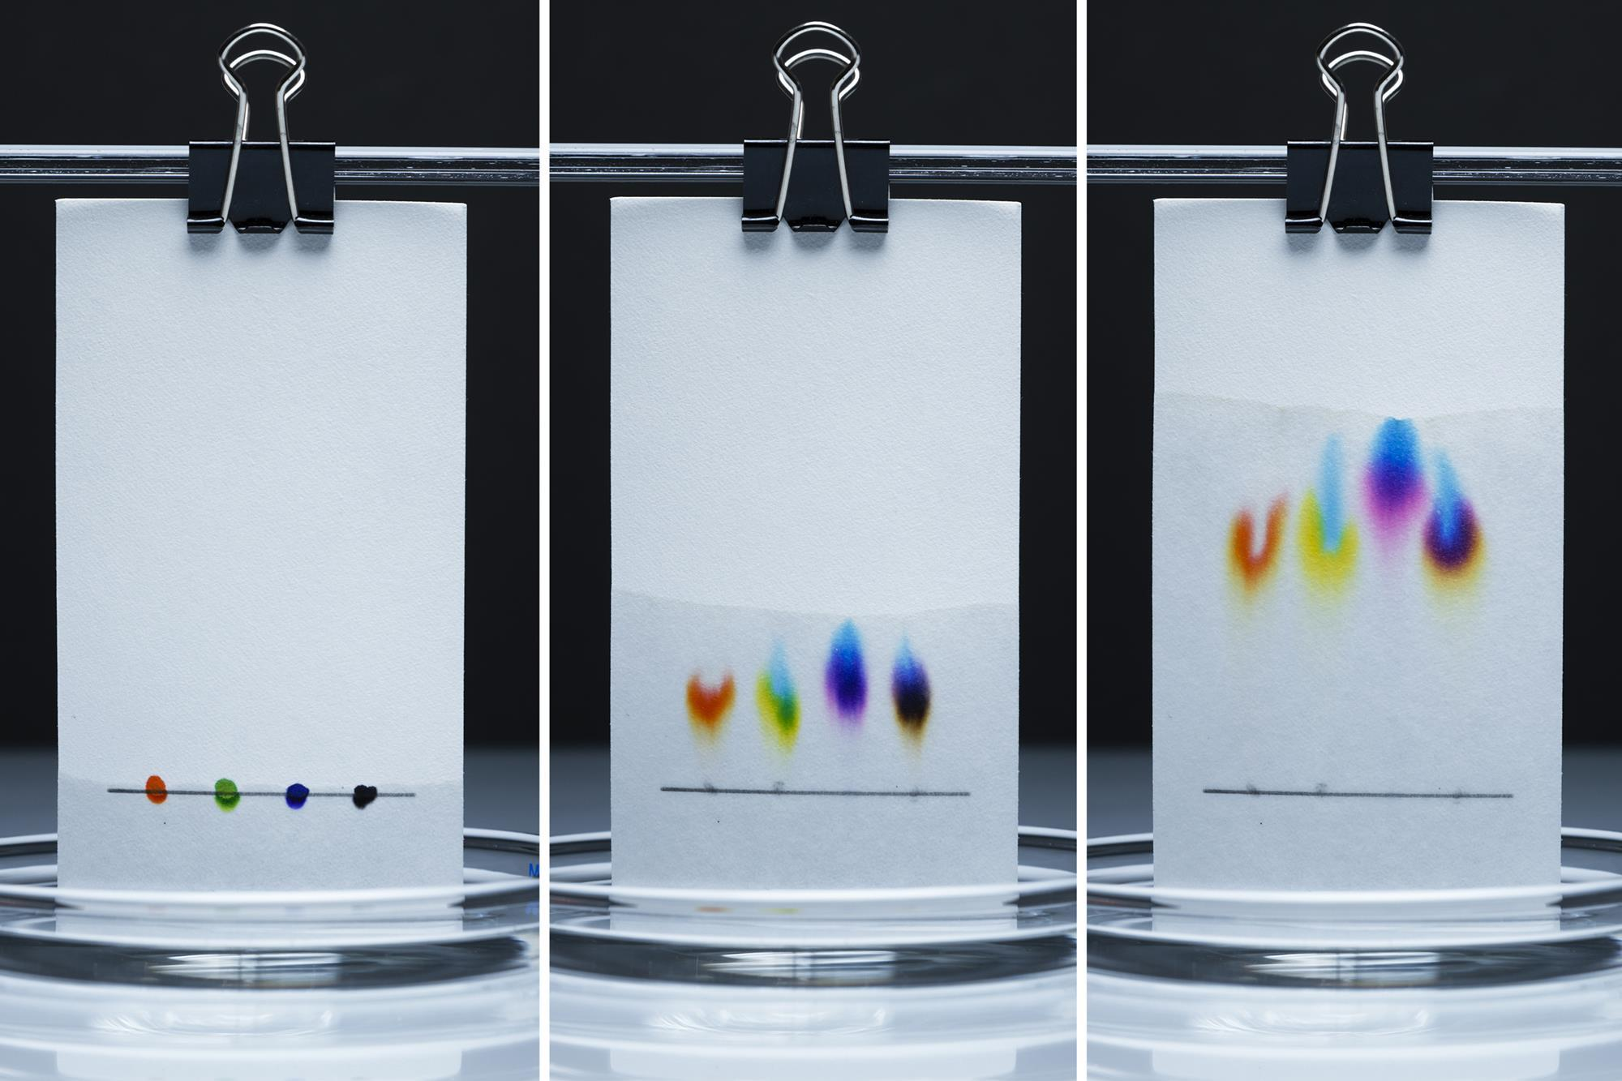
Topic 1: Chromatography
Practice with this!
Sometimes it might not work, but that’s okay - do what you can

Slide 8
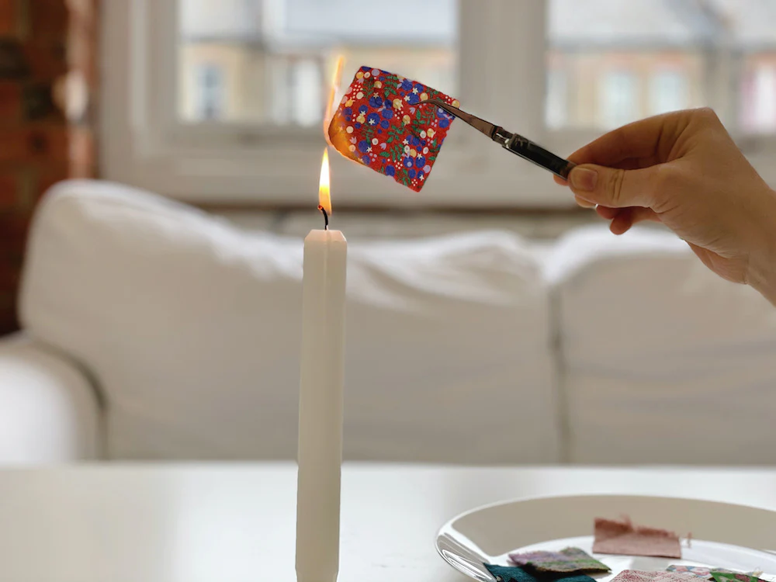
Topic 2: Fibers
Animal (wool, silk)
Shrivel and form a grainy ash under heat
Smell like burning hair
Self-extinguish
Made of keratin
Plant (cotton, linen)
Smell like burning paper
Catch on fire even without touching the flame
Synthetic (nylon, polyester, spandex)
Melt and produce a hard bead of plastic

Slide 9
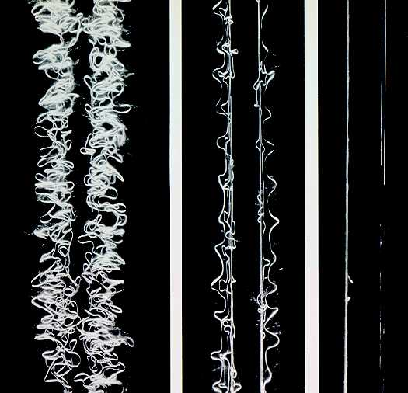
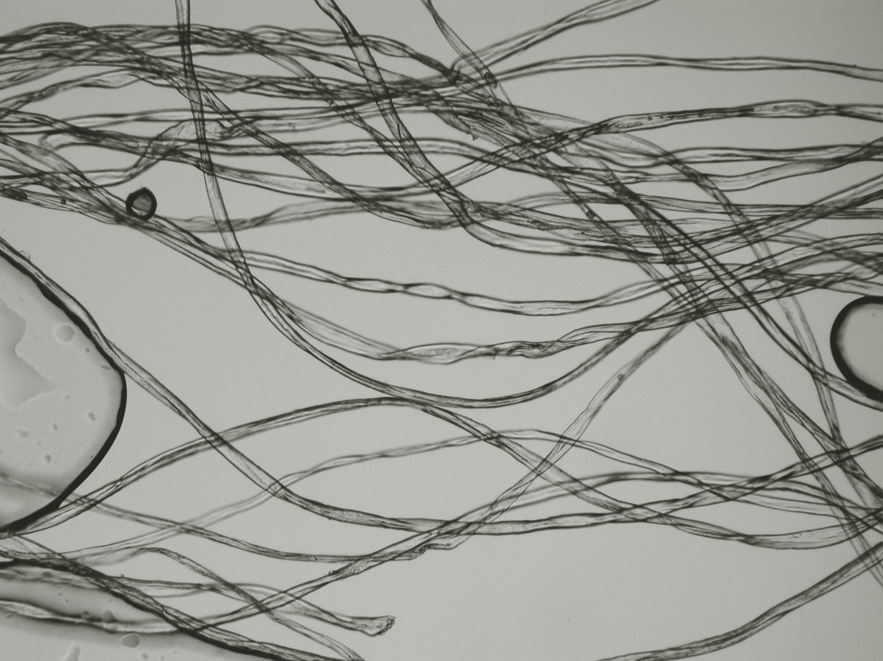
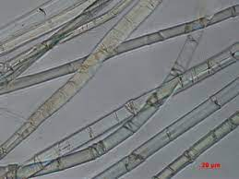
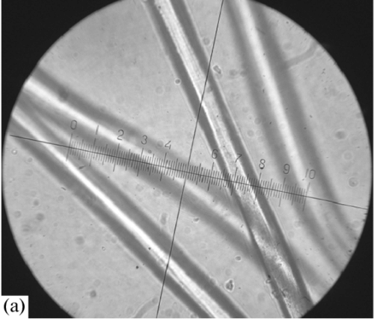
Topic 2: Fibers
Be familiar looking at microscope images of fibers!
Linen
Silk
Synthetics
Cotton

Slide 10
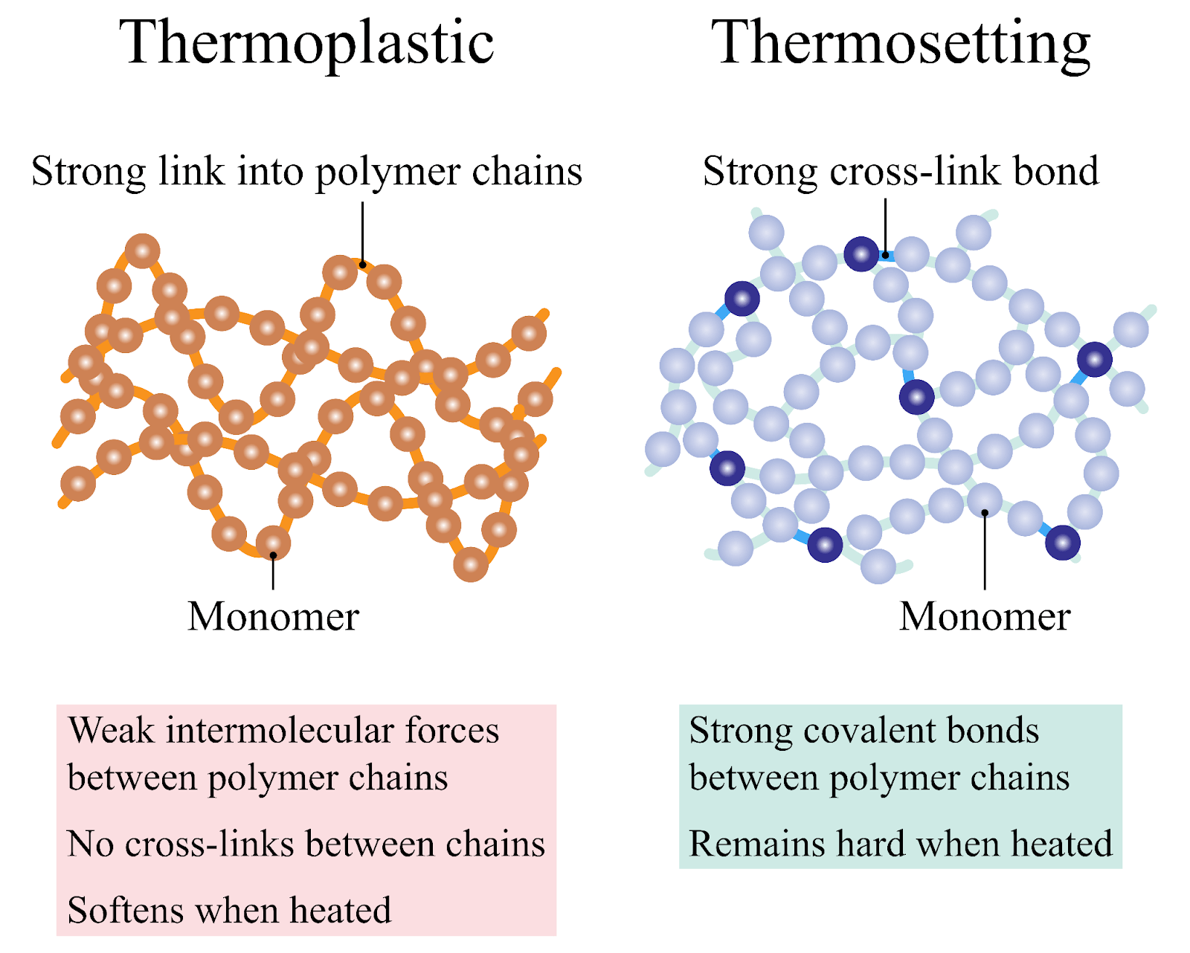
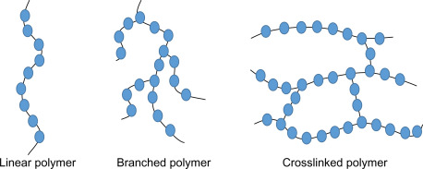
Topic 3: Plastics
Be familiar with density tests!
Thermoplastics - pliable after heating
Made of branched polymer chains
Recyclable
Thermosets - can’t be returned to their original states
Made of cross-linked polymer chains

Slide 11
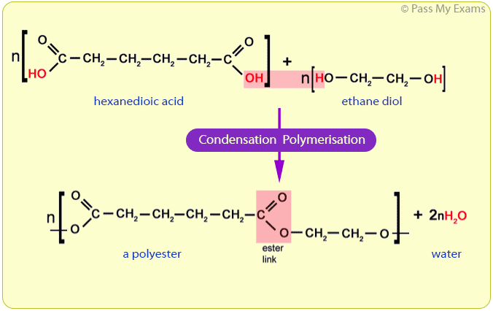
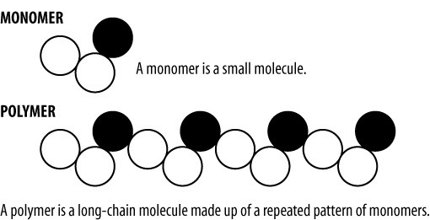
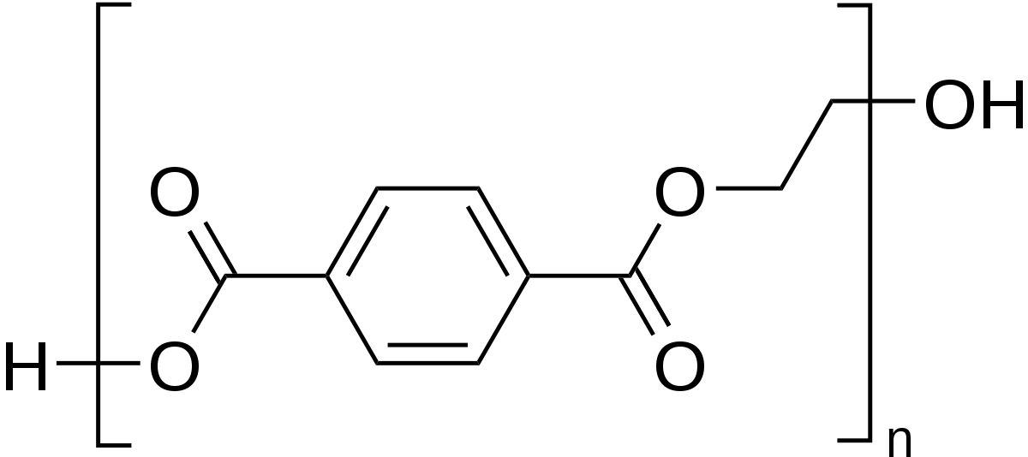
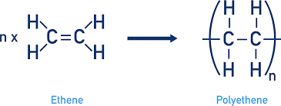
Topic 3: Plastics
Polymerization - synthesis of polymers
Addition/chain growth - polymers added one step at a time
Condensation/step growth - chain doubles with each step (exponential growth)
Condensation
V.S.
Addition
Monomer of PETE (Polyethylene Terephthalate)

Slide 12
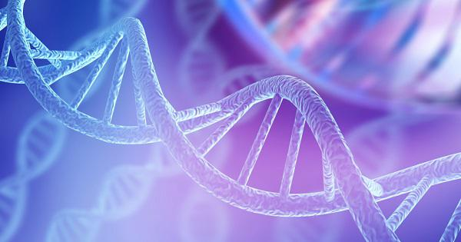
COMMON QUESTIONS
All of the following questions have been pulled from past YJI exams (which can be found on our website) or the Text Exchange on SciOly Wiki
Notes:
\

Slide 13
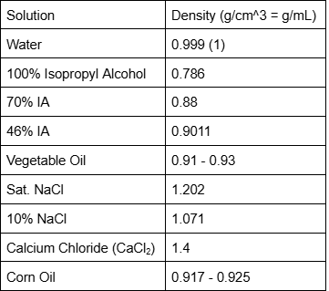
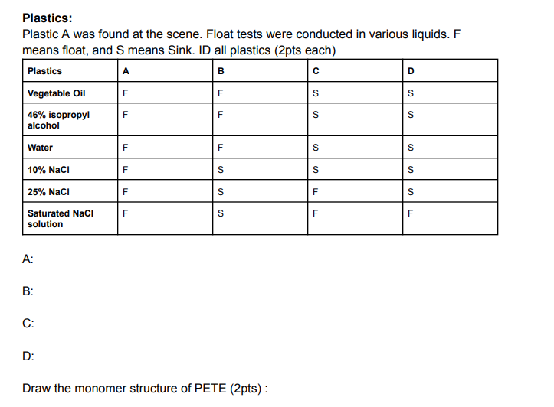
Question 1
Plastic -- density (g/cm^3)
PETE -- 1.37
HDPE -- 0.95
LDPE -- 0.92
PVC -- 1.38
PP -- 0.9
PS -- 1.05
PMMA -- 1.16
PC -- 1.2
Notes:
Pull some questions from exams on the scioly wiki test exchange, first give attendees a couple minutes to read over them/work through them, then walk them through the answers. Try to get a mix of multiple choice and short answer or matching

Slide 14
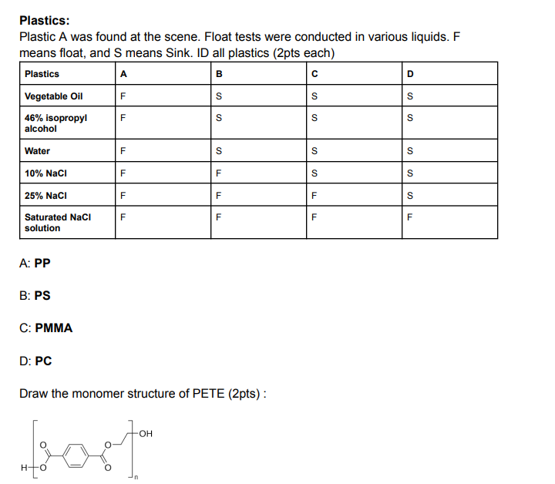
Question 1: ANSWERS
Lightest density, floats in everything
More dense than water, less dense than 10% NaCl
Plastic -- density (g/cm^3)
PETE -- 1.37
HDPE -- 0.95
LDPE -- 0.92
PVC -- 1.38
PP -- 0.9
PS -- 1.05
PMMA -- 1.16
PC -- 1.2
More dense than 10% NaCl, less dense than saturated NaCl
More dense than PMMA
Notes:
Pull some questions from exams on the scioly wiki test exchange, first give attendees a couple minutes to read over them/work through them, then walk them through the answers. Try to get a mix of multiple choice and short answer or matching

Slide 15
Question 2
Notes:
Pull some questions from exams on the scioly wiki test exchange, first give attendees a couple minutes to read over them/work through them, then walk them through the answers

Slide 16
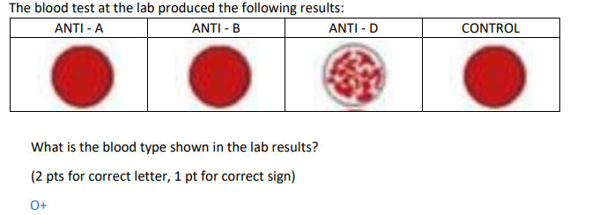
Question 2: ANSWERS
Keratin, melanin
Ratio of the medulla width to the cortex width, animals have larger medullary indices than humans
Notes:
Pull some questions from exams on the scioly wiki test exchange, first give attendees a couple minutes to read over them/work through them, then walk them through the answers

Slide 17
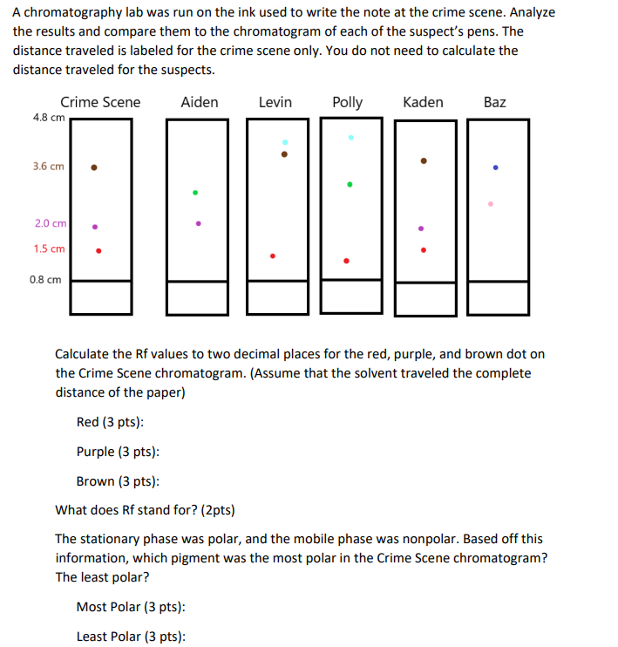
Question 3
Notes:
Pull some questions from exams on the scioly wiki test exchange, first give attendees a couple minutes to read over them/work through them, then walk them through the answers

Slide 18
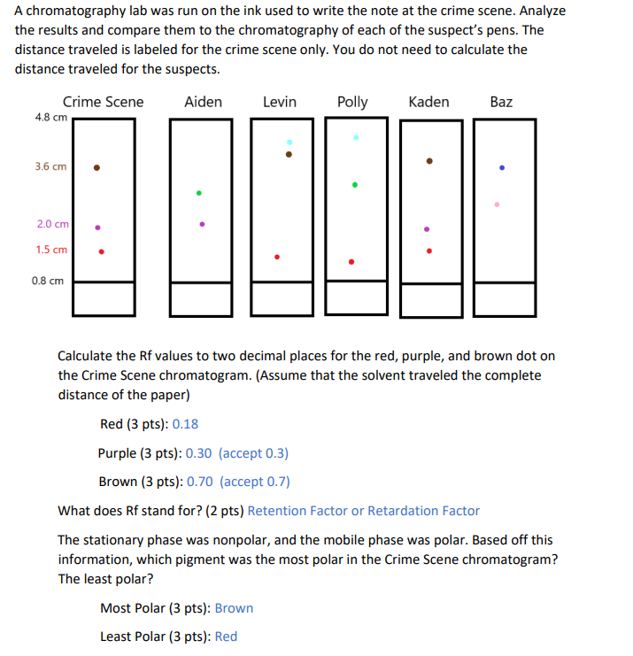
Question 3: ANSWERS
Notes:
Pull some questions from exams on the scioly wiki test exchange, first give attendees a couple minutes to read over them/work through them, then walk them through the answers

Slide 19
Tips from a Veteran
Practice with your cheatsheet
Split up the workload - I recommend the powder/polymer split for Forensics
Timing is key - maximize your points no matter what
Keep organized notes - these are key to understanding some concepts so you don’t have to overfill your cheatsheet
Practice, practice, practice (tests)!!
Notes:
Use this section to talk about any strategies you used to navigate the event when you competed. For example, how did you manage your time, how did you organize your notes, how did you split topics up between you and your partner, etc.?

Slide 20
Additional Resources
NC State SO
Some practice tests + notes
SUBWAY STATIONS
Forensic Science Simplified
Wikipedia (lol)
Yes, Saturn is the ringed one. This planet is a gas giant, and it’s composed mostly of hydrogen and helium
Notes:
Here, you can link or mention any online or book resources that helped you in this event when you were a competitor. Try to avoid general resources like scioly wiki, because they probably already are familiar with it.

Slide 21
Resources: Chemicals/Lab Equipment
Ward’s Science Forensics kits
Ward’s Science Crime Buster kit
Ward’s Science Crime Buster Lab Equipment
Official soinc.org website also links to these kits!
Notes:
Use this section to talk about any strategies you used to navigate the event when you competed. For example, how did you manage your time, how did you organize your notes, how did you split topics up between you and your partner, etc.?

Slide 22
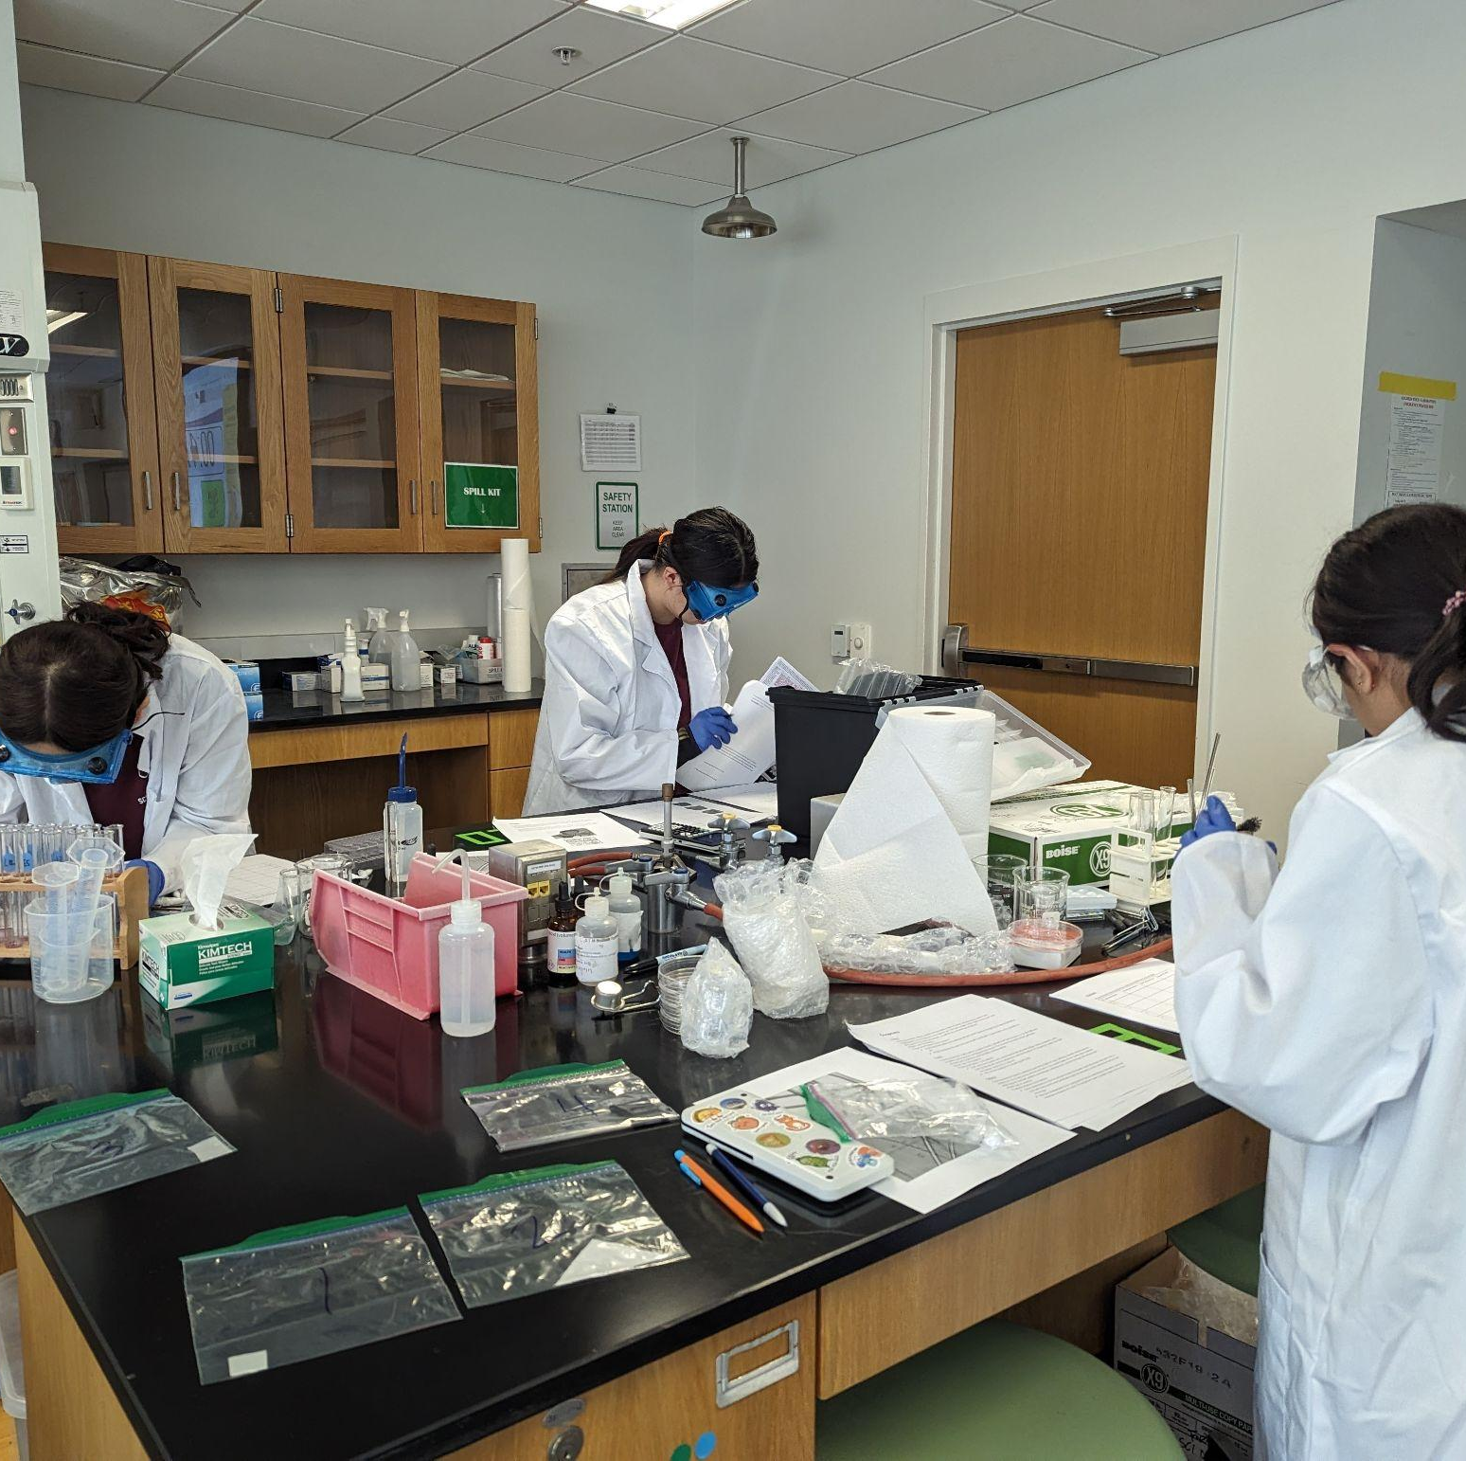
THANKS!
Notes:
(replace picture with a picture from one of our tournaments)

