Slide 1
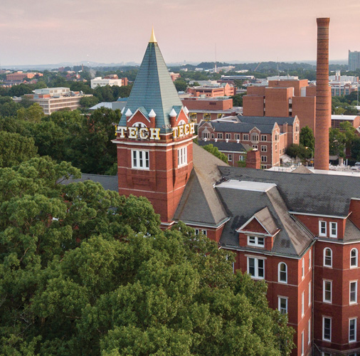
Chem Lab
Division C
Georgia Tech Event Workshop Series 2024-25
By: Jason Wang (GT Neuroscience Major)

Slide 2
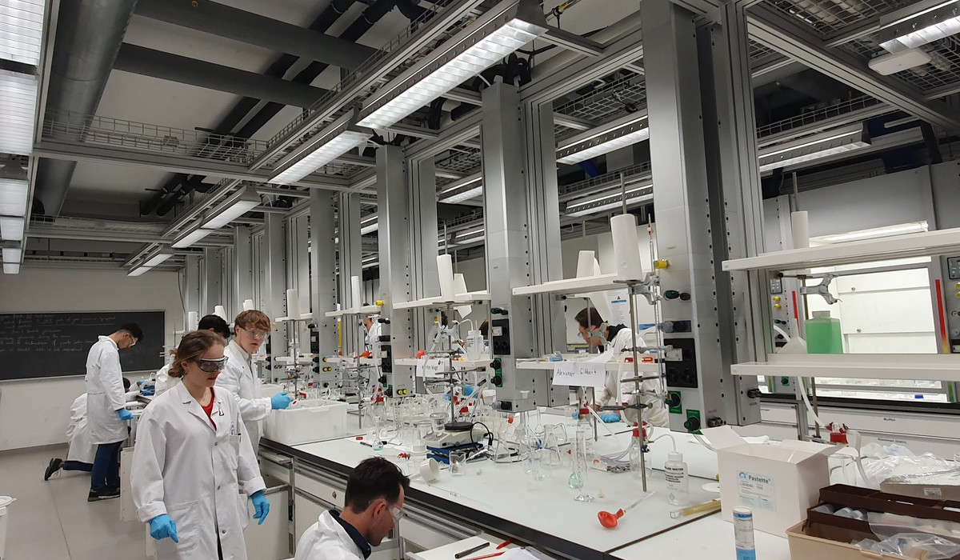
01
RULES SHEET
02
NEED TO KNOW
03
DIFFICULT TOPICS
04
COMMON QUESTIONS
05
OTHER FREE RESOURCES and Q&A
Notes:
For Builds: Replace difficult topics with physical principles involved in the build and replace common questions with common designs

Slide 3
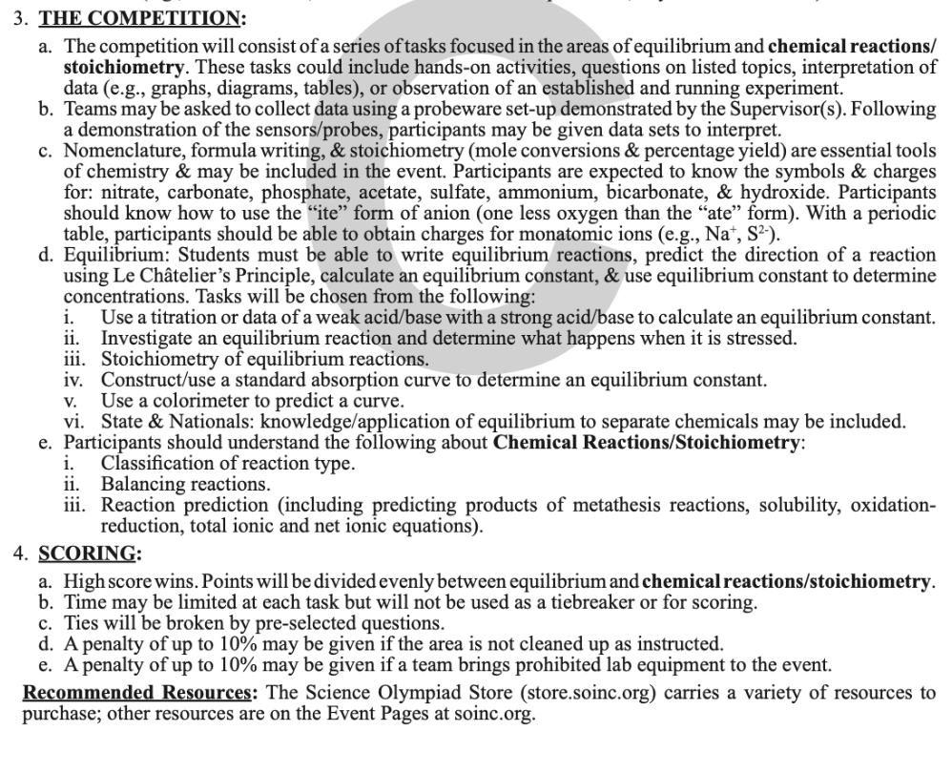
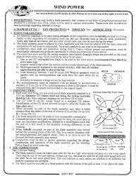
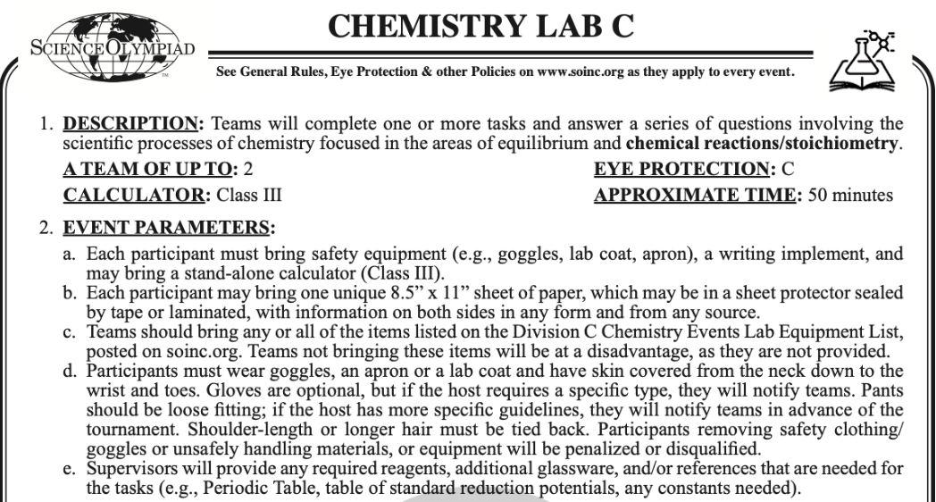
The Rules Sheet
Rules Sheet for Event
Notes:
Highlight key points from the rules sheet: DESIGN LOGS that basically grant free points, most tested-on topics, point distribution so that competitors know what to prioritize, allowed notes and equipment, etc.

Slide 4
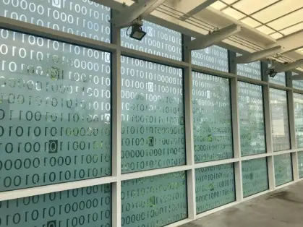
NEED TO KNOW
Notes:
This section should focus on topics that are more math-based (harder to self-teach), concepts that come only usually up in college level courses, or concepts that you struggled with when you competed in this event

Slide 5
Topic 1: [Chemistry Basics]
Naming for Compounds, Acids, Bases, including with Polyatomics
Perform calculations about mole conversions (Avogadro’s rule) and stoichiometry (with gases, acid/base, thermochemistry, etc)
Determine the charges and valence electrons of ions
Expect that regional and state competitions include extensions of topics, such as properties of compounds, periodic trends, VSEPR/molecular structure, and bonding theory.

Slide 6
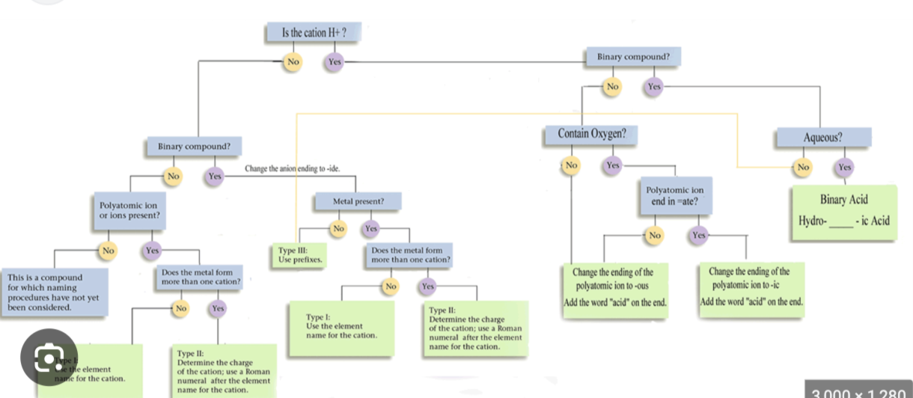

Slide 7
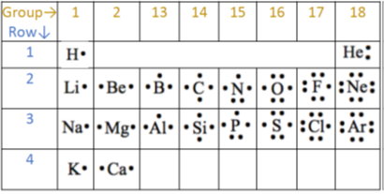

Slide 8
Topic 2: [Equilibrium]
Understand Le Chatelier’s Principle and predict reactions
Be familiar with Ka, Kb, pKa, and pKb
Prepare to perform a titration with weak/strong acids and bases
Analyze titration curves and perform calculations based on data gathered
Understand standard absorption curves and colorimeters
Expect that regional and state competitions include extensions of topics, such as buffers, Gibbs free energy constant, and equilibrium concepts of organic compounds.

Slide 9
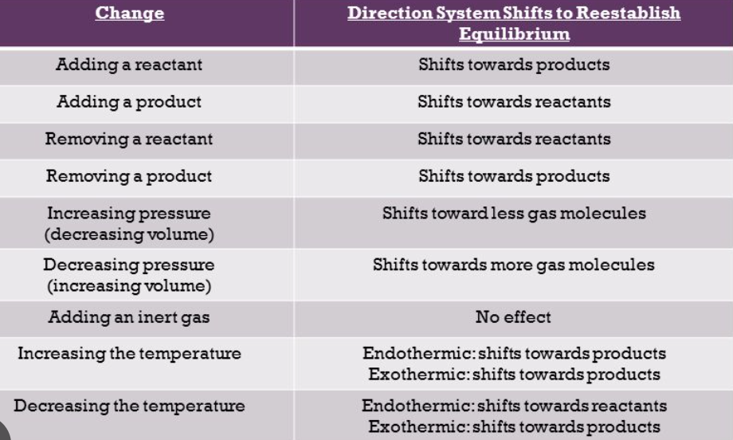
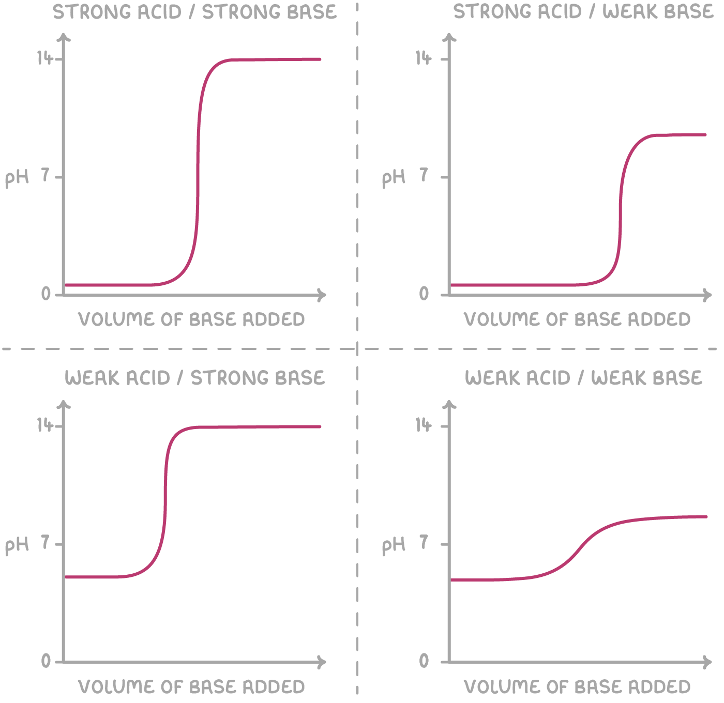
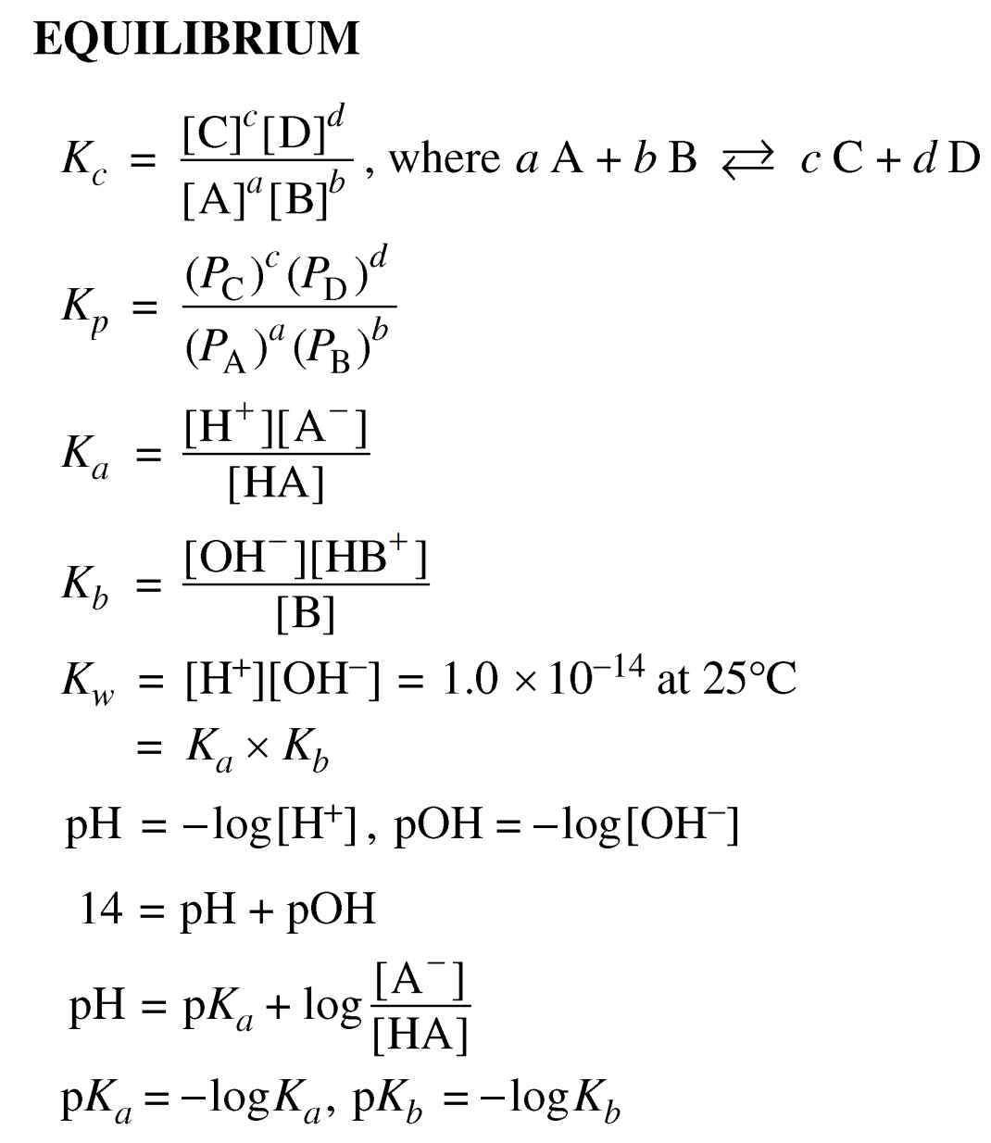
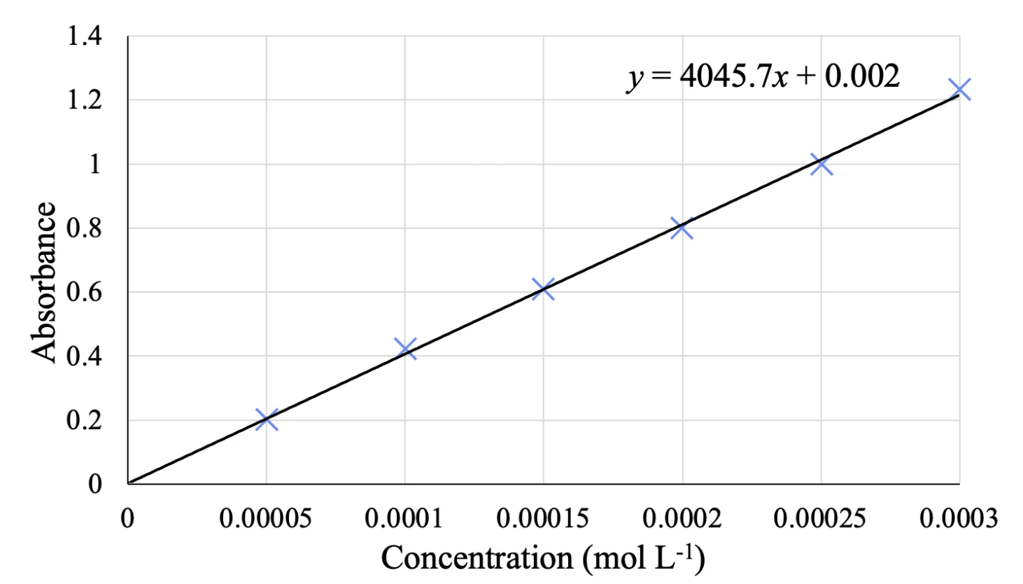
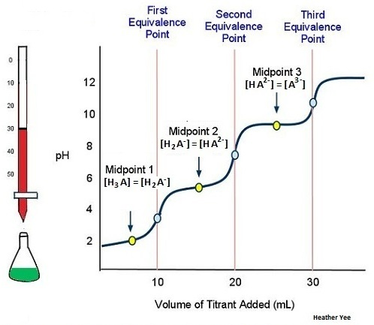

Slide 10
Topic 3: [Reactions]
Understand synthesis, decomposition, single replacement, double replacement, combustion, oxidation-reduction, metathesis, and acid and base reactions
Know how to balance reactions
Be familiar with writing out equations!
For example, write out the net ionic equation for oxidation and reduction reactions (half-reactions for redox)
Know your solubility rules!

Slide 11
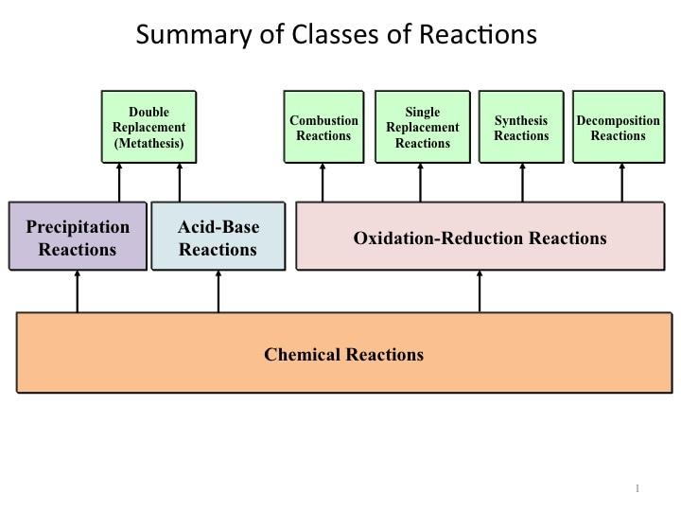
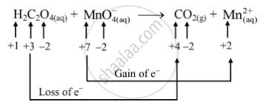
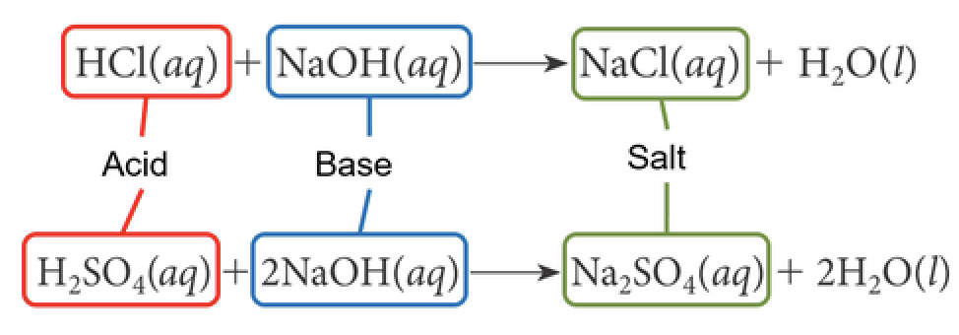
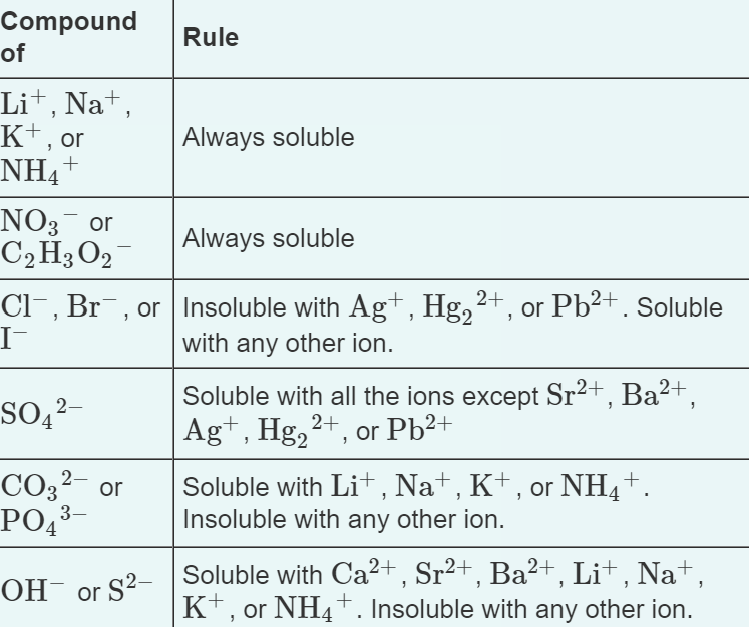
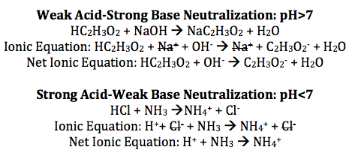
Need to know how to balance in acidic and basic solutions!

Slide 12
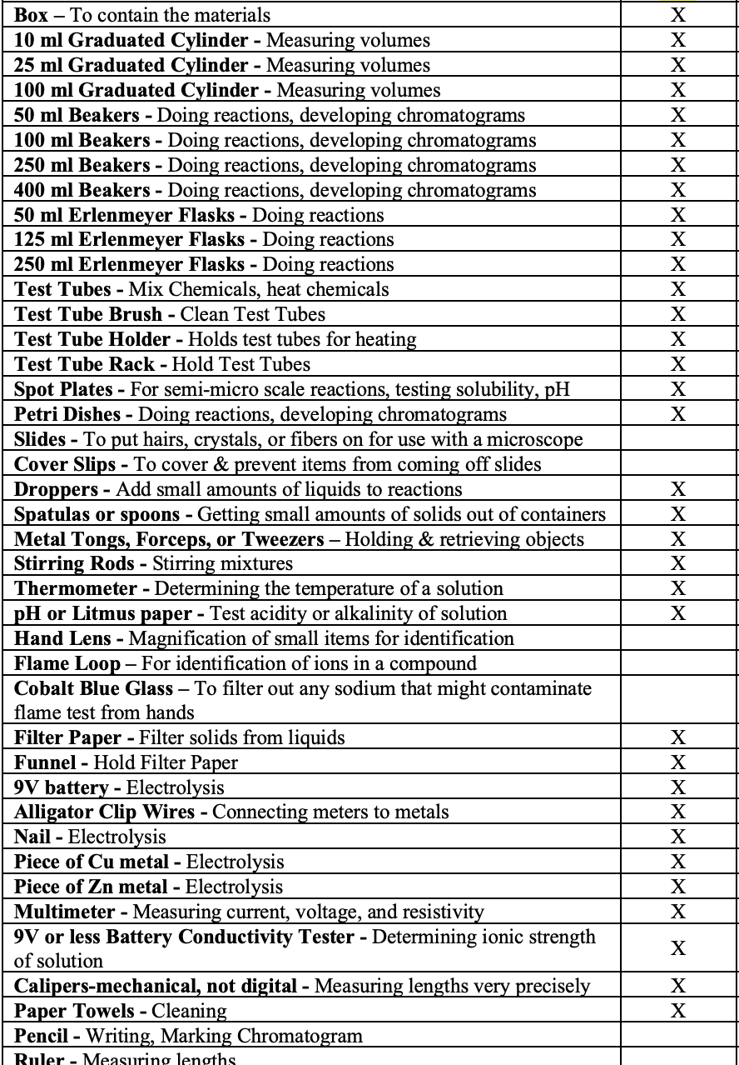
Lab Materials Check!

Slide 13
DIFFICULT TOPICS
Notes:
This section should focus on topics that are more math-based (harder to self-teach), concepts that come only usually up in college level courses, or concepts that you struggled with when you competed in this event

Slide 14
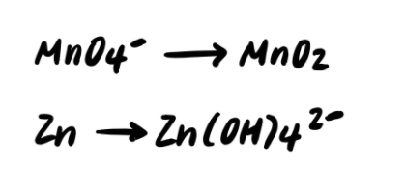
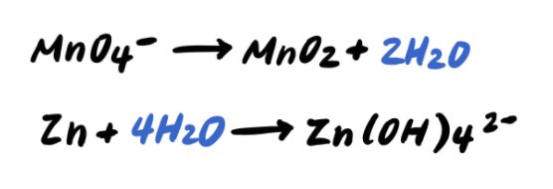
Topic 1: [Redox]
Acidic Solution

Slide 15
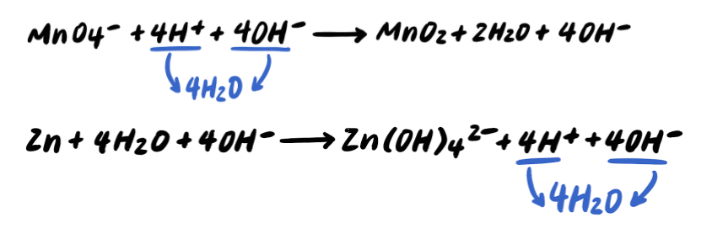
Topic 1: [Redox]
Basic Solution
!
!
!

Slide 16
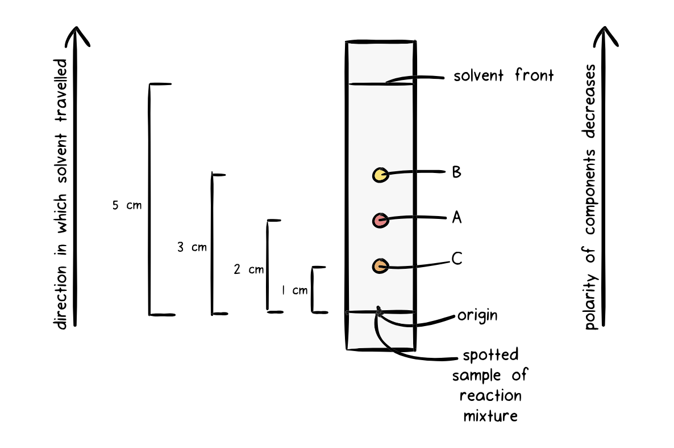
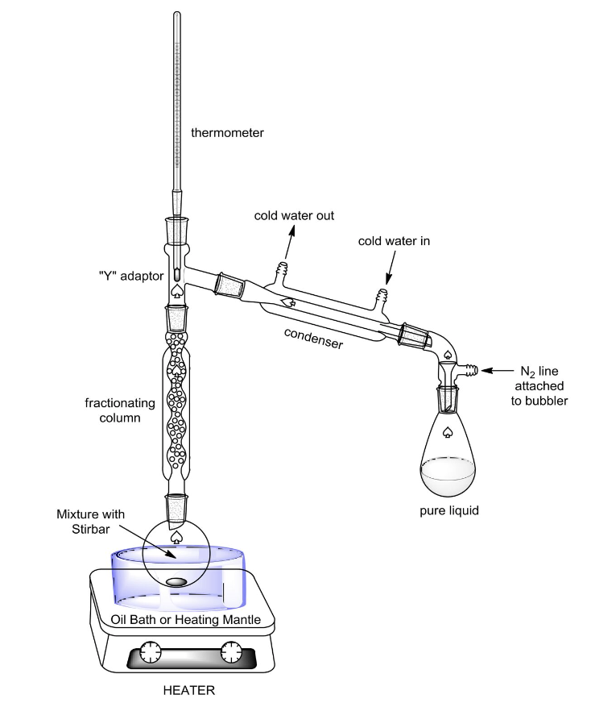
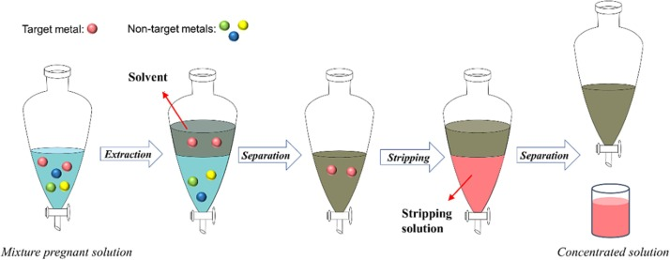
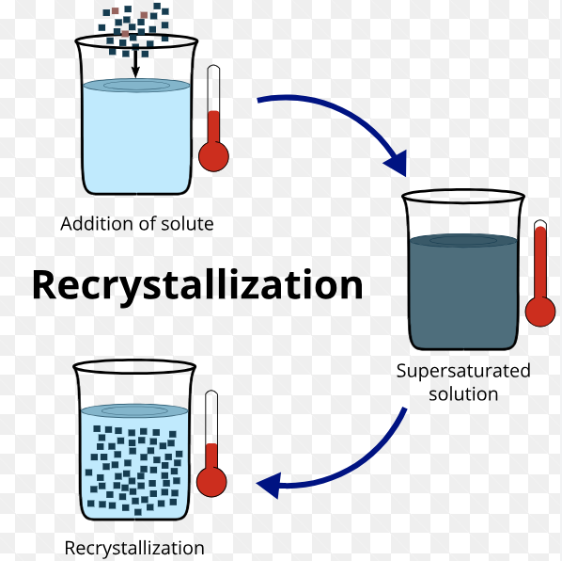
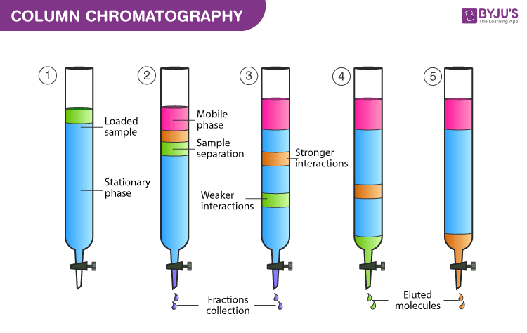
Topic 2: [Compound Sep.]
Notes:
Feel free to add more topics and make sure that there are plenty of pictures/diagrams!

Slide 17
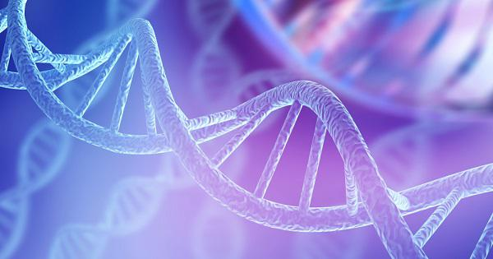
COMMON QUESTIONS
All of the following questions have been pulled from past YJI exams (which can be found on our website) or the Text Exchange on SciOly Wiki
Notes:
\

Slide 18
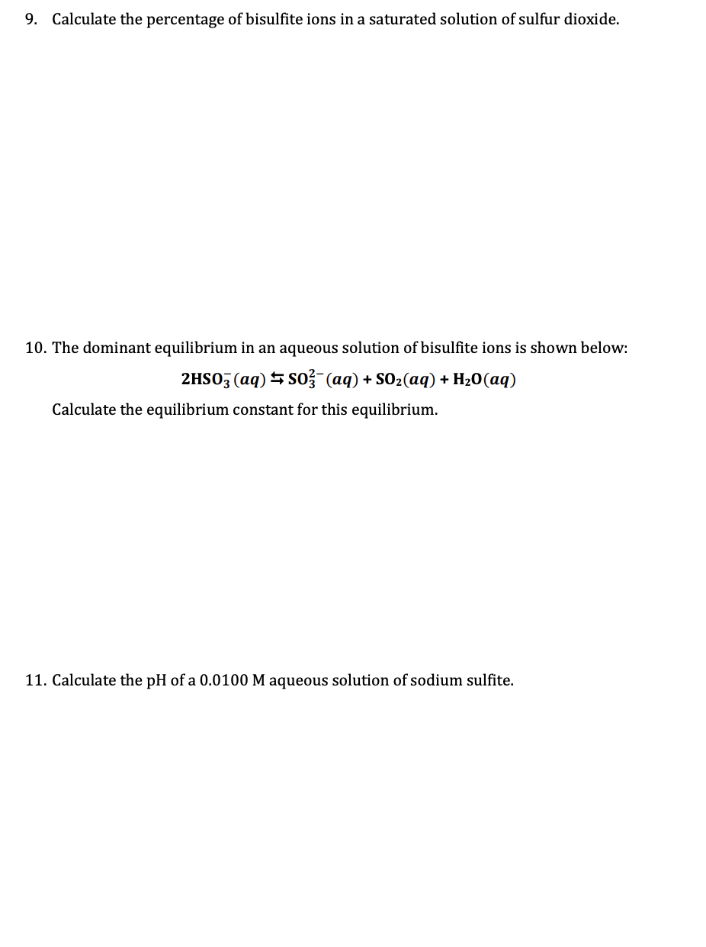
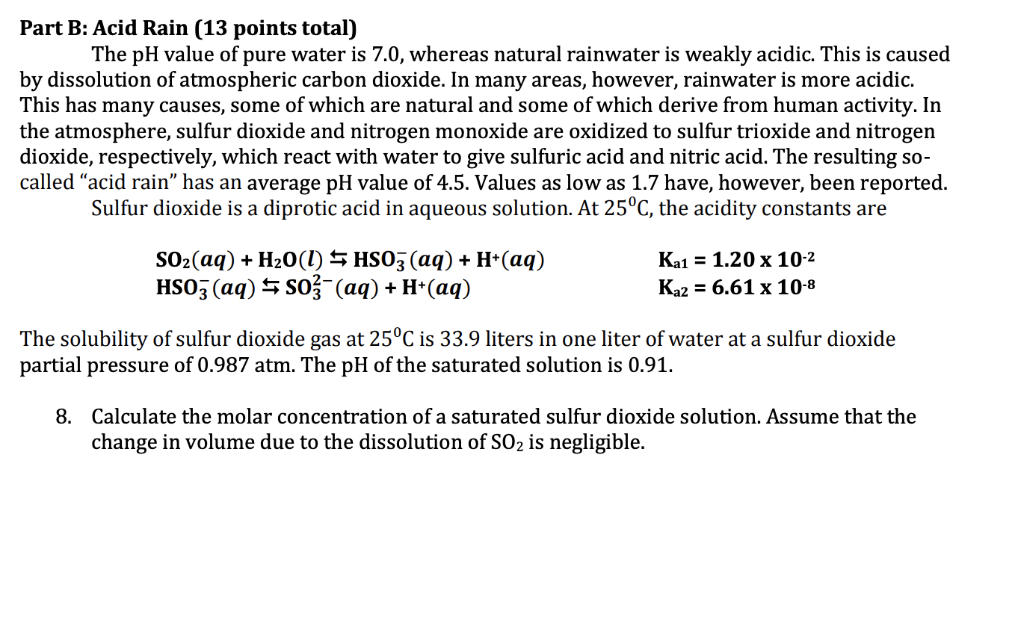
Question 1: Equilibrium
Add text here
Notes:
Pull some questions from exams on the scioly wiki test exchange, first give attendees a couple minutes to read over them/work through them, then walk them through the answers. Try to get a mix of multiple choice and short answer or matching

Slide 19
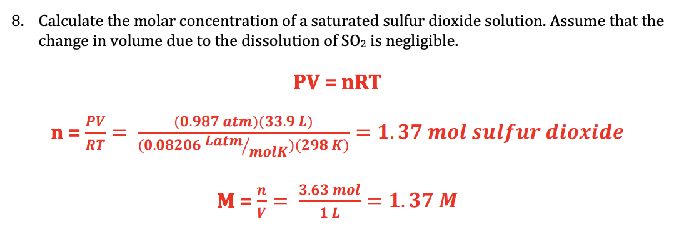
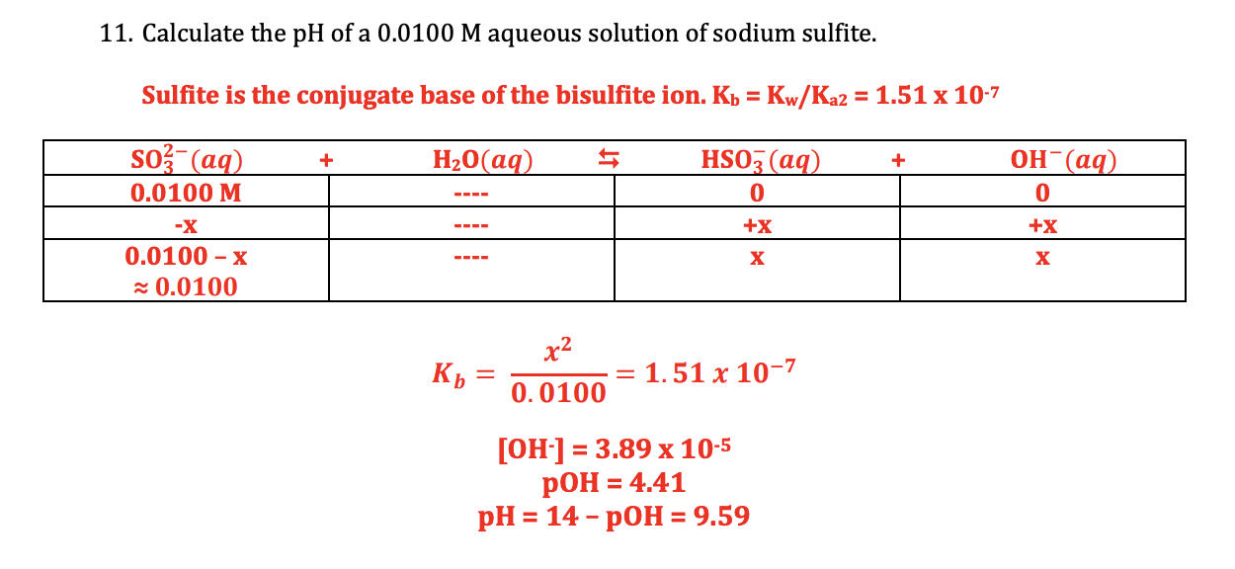

Slide 20
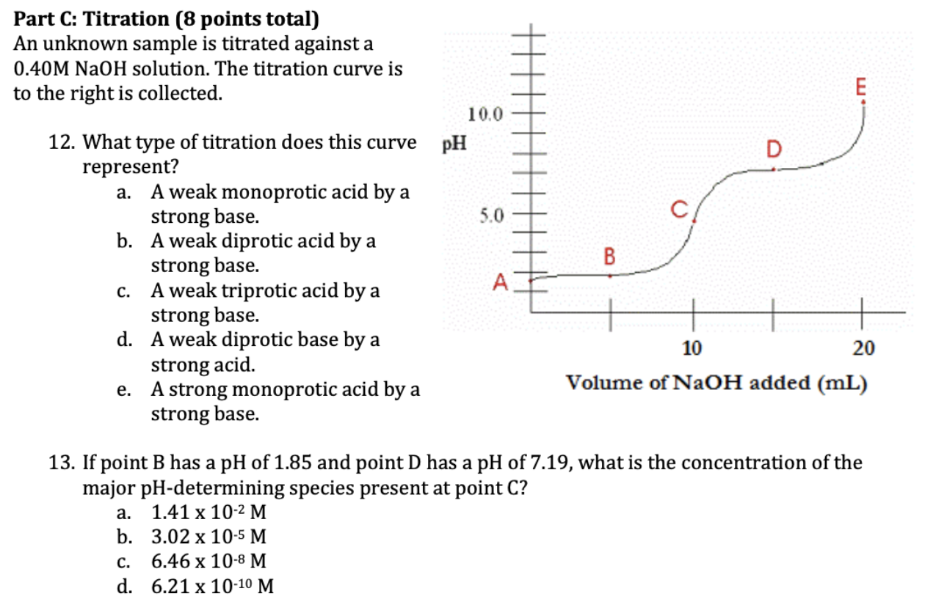
Question 2: Titrations
Add text here
Notes:
Pull some questions from exams on the scioly wiki test exchange, first give attendees a couple minutes to read over them/work through them, then walk them through the answers

Slide 22
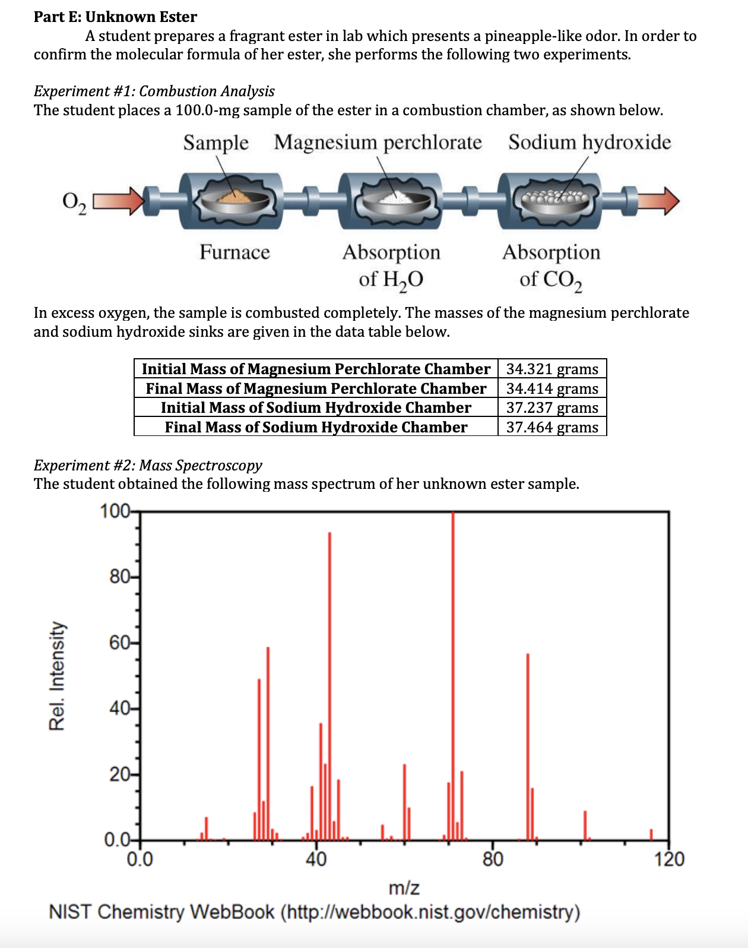
Question 3: Stoichiometry
Add text here
Notes:
Pull some questions from exams on the scioly wiki test exchange, first give attendees a couple minutes to read over them/work through them, then walk them through the answers

Slide 23
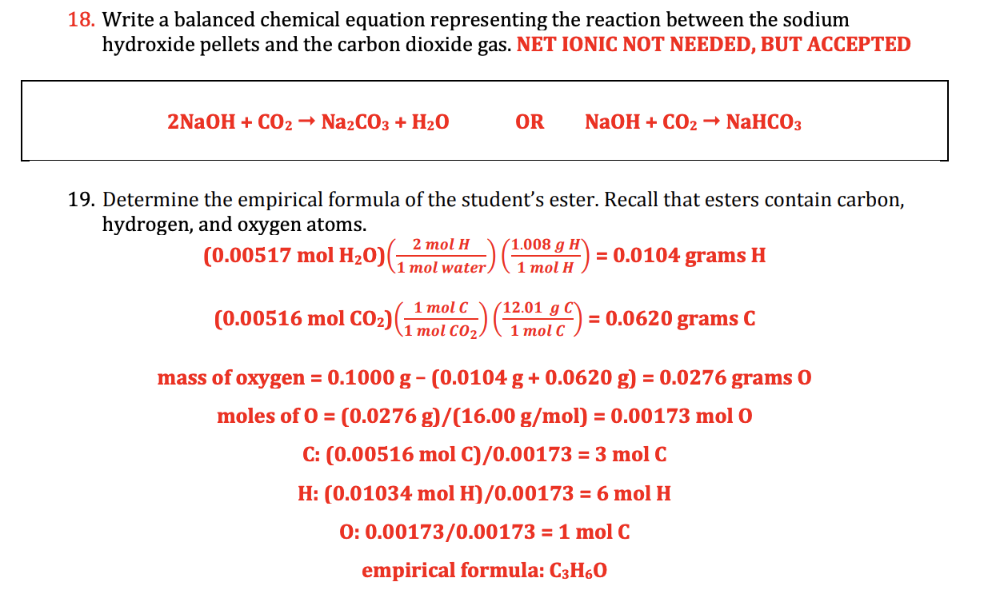

Slide 24
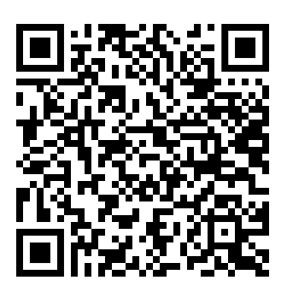
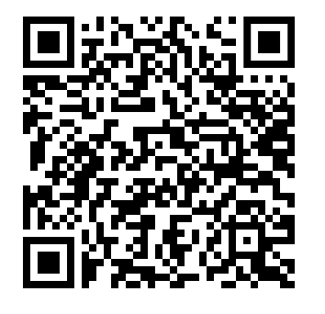
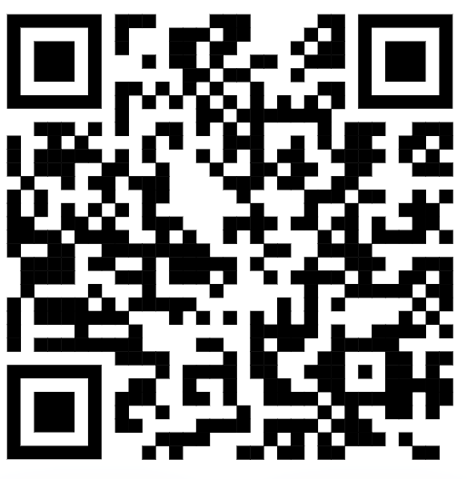
Additional Resources
Scioly Test Bank
Practice Exam
Key
SUBWAY STATIONS
Resource 3: Youtube Videos
Resource 4: (AP) Chemistry Prep Books
Yes, Saturn is the ringed one. This planet is a gas giant, and it’s composed mostly of hydrogen and helium
Notes:
Here, you can link or mention any online or book resources that helped you in this event when you were a competitor. Try to avoid general resources like scioly wiki, because they probably already are familiar with it.

Slide 25
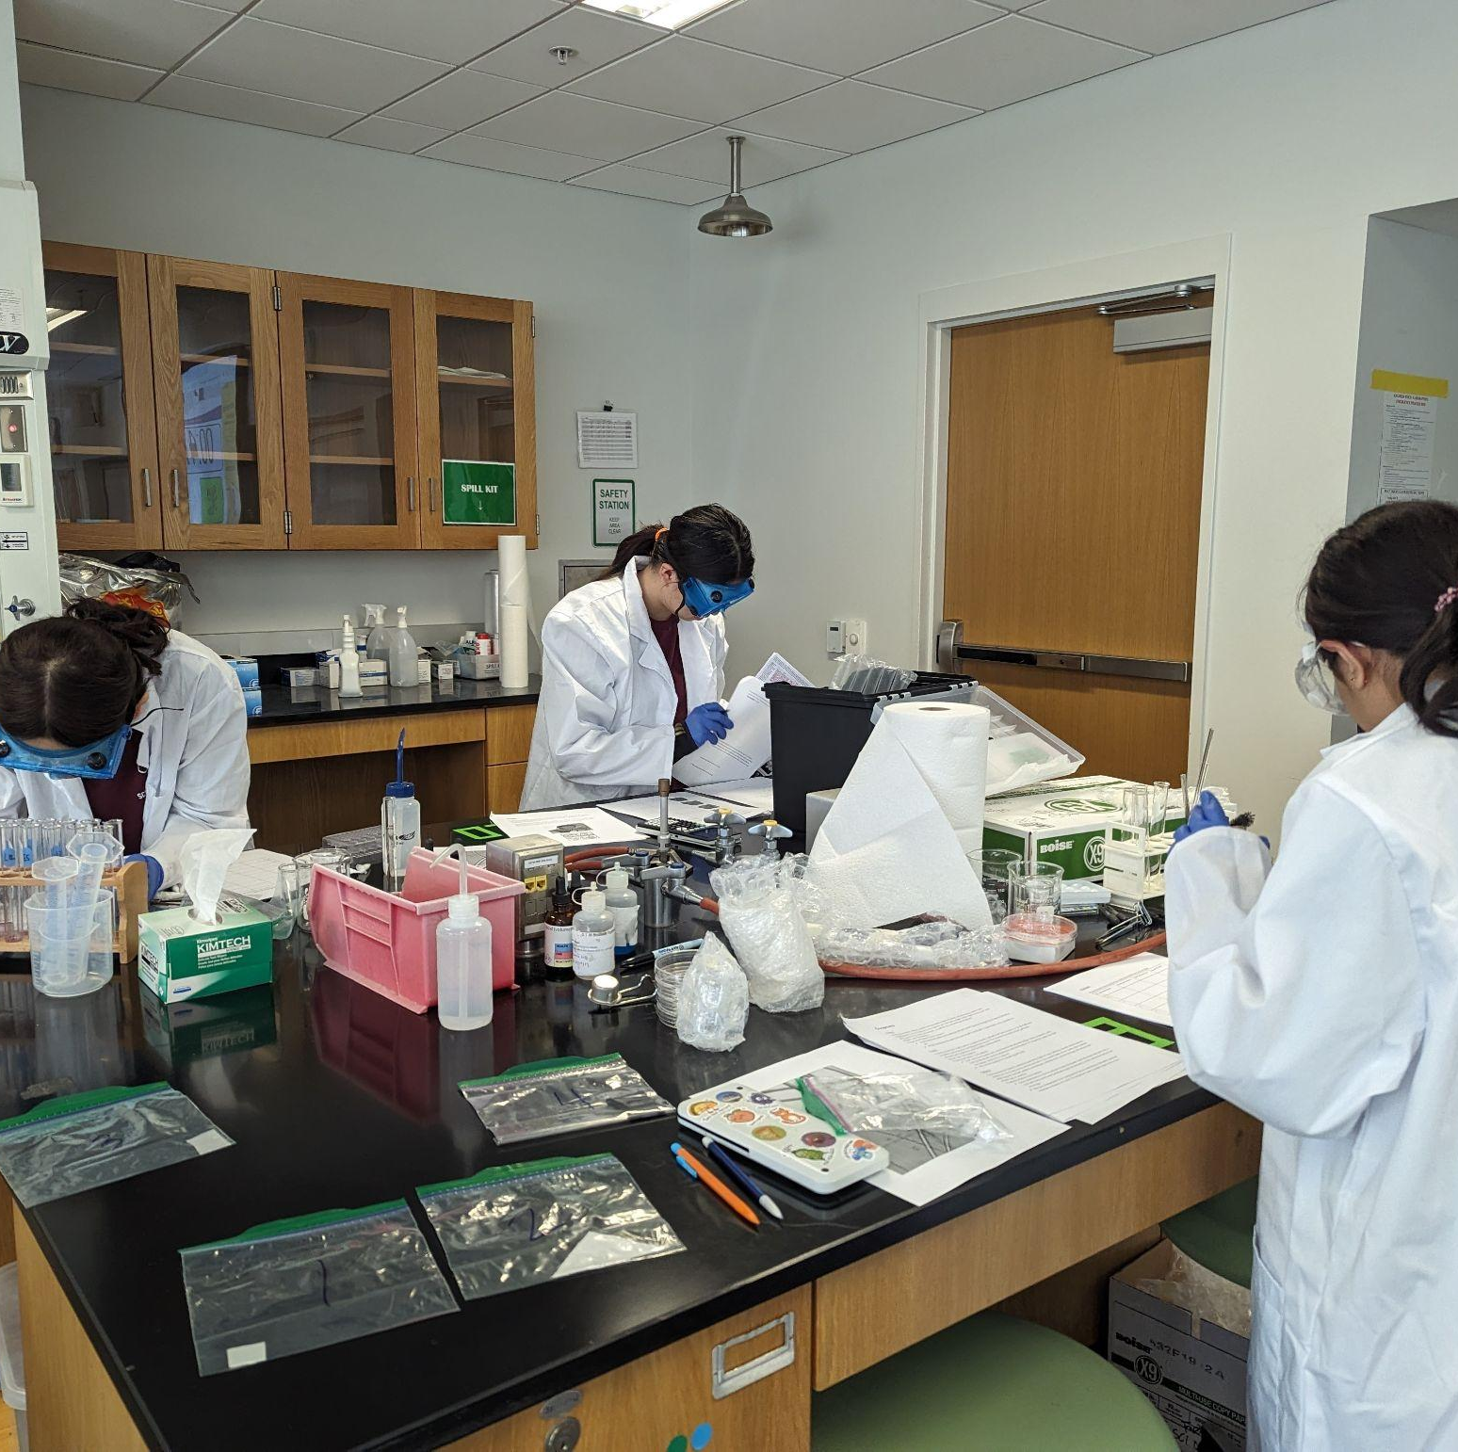
THANKS!
Notes:
(replace picture with a picture from one of our tournaments)

