Slide 1
Bungee Drop
Div. C
Georgia Tech Event Workshop Series 2024-25

Slide 2
Victor Hesu
The Westminster Schools
Georgia Tech BSME ‘26
Competed in scioly for 4 years
Helped with 20+ tournaments
SO@GT build director
Notes:
Highlight key points from the rules sheet: DESIGN LOGS that basically grant free points, most tested-on topics, point distribution so that competitors know what to prioritize, allowed notes and equipment, etc.

Slide 3
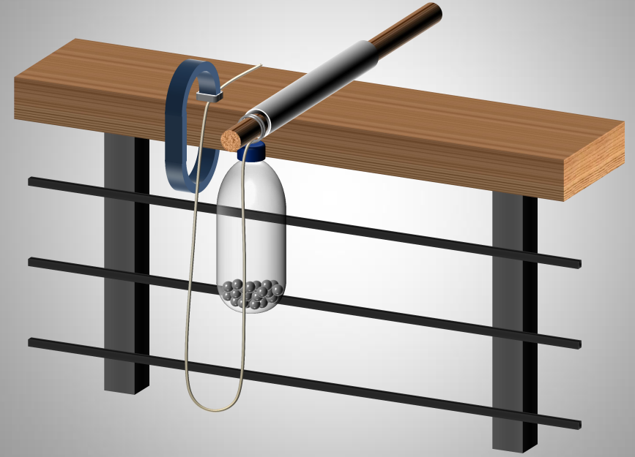
01
RULES SHEET
02
PHYSICAL PRINCIPLES
[Event-Related Image]
03
COMMON DESIGNS
04
TIPS FROM A VETERAN
05
OTHER FREE RESOURCES
Notes:
For Builds: Replace difficult topics with physical principles involved in the build and replace common questions with common designs

Slide 4
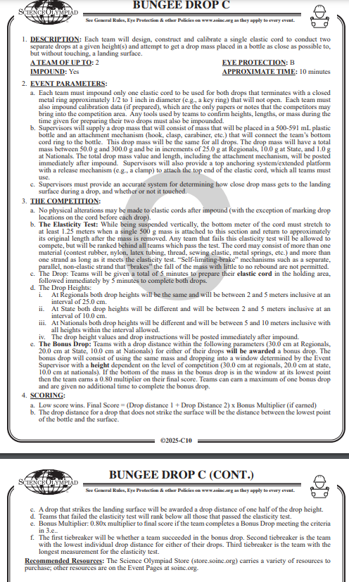
The Rules Sheet
Device: elastic cord which meets elasticity test
Goal: Have the bottom of the drop as close to ground as possible without touching
Weight 50-300 g and same between drops
Distance 2-5 m or 5-10 m depending on competition level
Penalty for touching landing surface
Bonus multiplier: try and hit
Notes:
Highlight key points from the rules sheet: DESIGN LOGS that basically grant free points, most tested-on topics, point distribution so that competitors know what to prioritize, allowed notes and equipment, etc.

Slide 5
PHYSICAL PRINCIPLES
Notes:
This section should focus on topics that are more math-based (harder to self-teach), concepts that come only usually up in college level courses, or concepts that you struggled with when you competed in this event

Slide 6
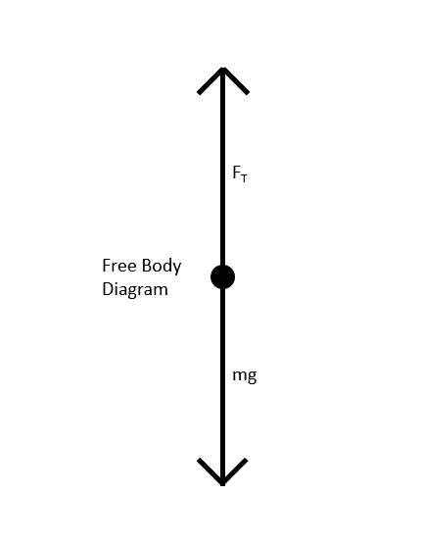
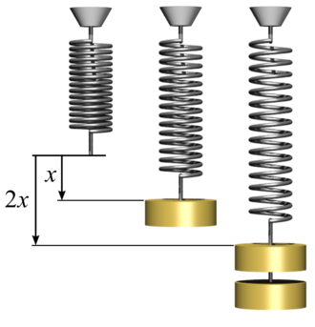
Topic 1: Testing/Physics
Math can be found on wiki: https://scioly.org/wiki/index.php/Bungee_Drop
Experimentally determine modulus of elasticity for device
Differs by height
F=k*x, x=½ bottom distance=equilibrium position
Balance with F=m*g

Slide 7
Topic 3: Competition Day
Impounded event!
Using testing determine where along the cord to drop from
Notes:
Feel free to add more topics and make sure that there are plenty of pictures/diagrams!

Slide 8
COMMON Designs
Notes:
\

Slide 9
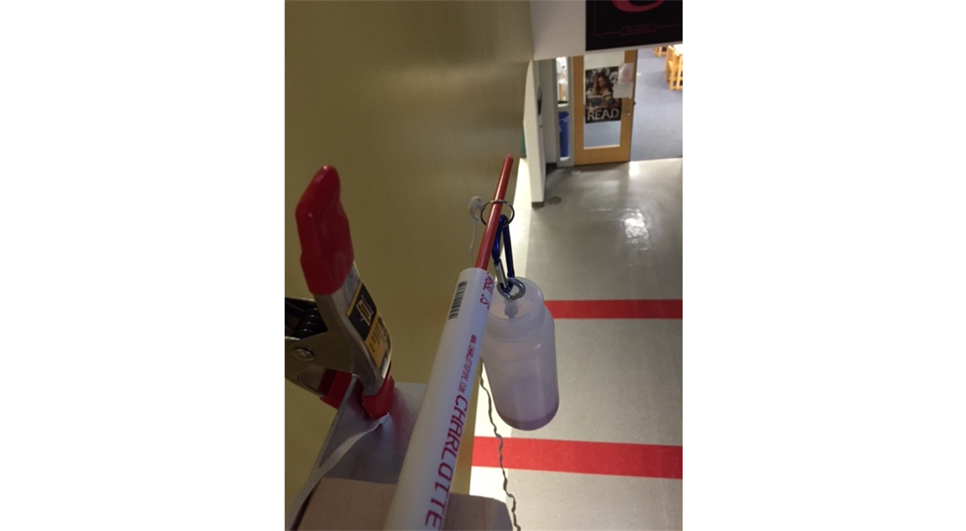
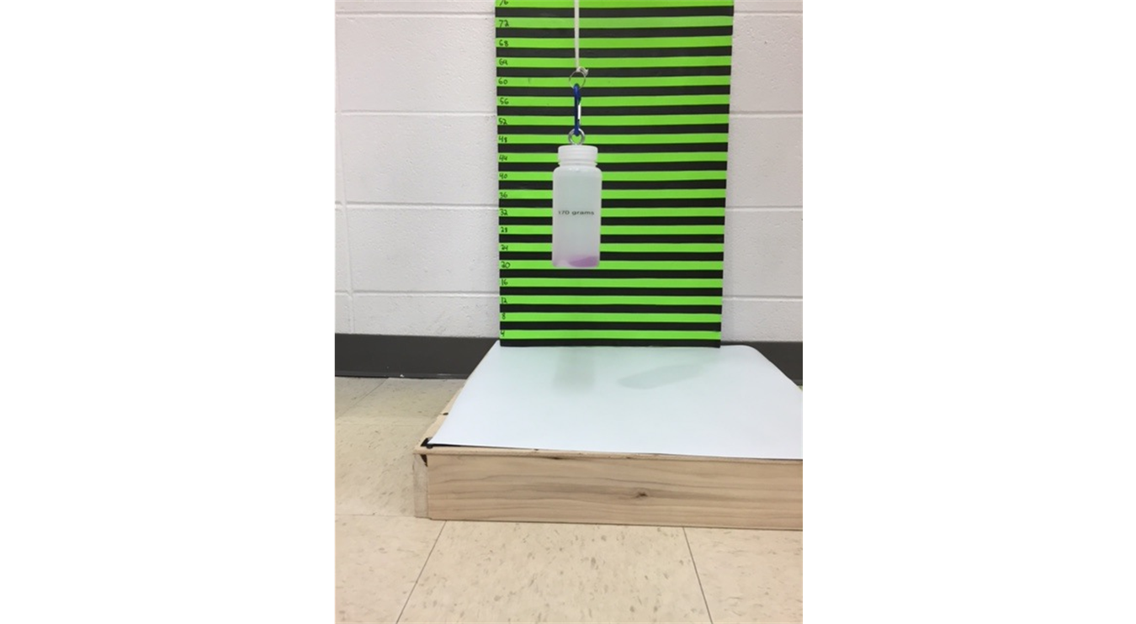
Topic 1: Test Stand
Found on: https://www.soinc.org/bungee-drop-c

Slide 10
Topic 2: Partially Elastic
First of two main designs
Notes:
Pull some questions from exams on the scioly wiki test exchange, first give attendees a couple minutes to read over them/work through them, then walk them through the answers. Try to get a mix of multiple choice and short answer or matching

Slide 11
Topic 3: Fully Elastic
Second of two main designs
Notes:
Pull some questions from exams on the scioly wiki test exchange, first give attendees a couple minutes to read over them/work through them, then walk them through the answers

Slide 12
Topic 4: Material Choice
Material: Tan super sport rubber
Bigger cross section the better
Stay away from weak springs that permanently deform
Notes:
Pull some questions from exams on the scioly wiki test exchange, first give attendees a couple minutes to read over them/work through them, then walk them through the answers

Slide 13
Tips from a Veteran
Temperature and humidity will affect elasticity
Springs will stretch out over time
Springs will become less elastic over time
Notes:
Use this section to talk about any strategies you used to navigate the event when you competed. For example, how did you manage your time, how did you organize your notes, how did you split topics up between you and your partner, etc.?

Slide 14
Additional Resources
Scioly.org:
Soinc.org:
https://www.soinc.org/bungee-drop-c https://scioly.org/wiki/images/6/63/Bernard%27s_Bungee_Drop_Notes.pdf
SUBWAY STATIONS
https://www.soinc.org/bungee-drop-c
Yes, Saturn is the ringed one. This planet is a gas giant, and it’s composed mostly of hydrogen and helium
Notes:
Here, you can link or mention any online or book resources that helped you in this event when you were a competitor. Try to avoid general resources like scioly wiki, because they probably already are familiar with it.

Slide 15
THANKS!
Notes:
(replace picture with a picture from one of our tournaments)

