Slide 1
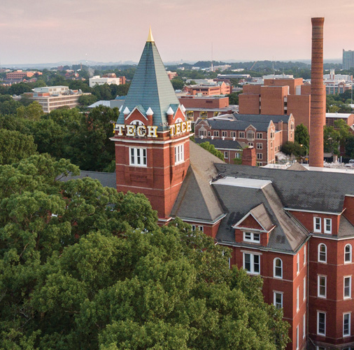
Reach for the Stars/ Astronomy
[Division B/C]
Georgia Tech Event Workshop Series 2024-25

Slide 2
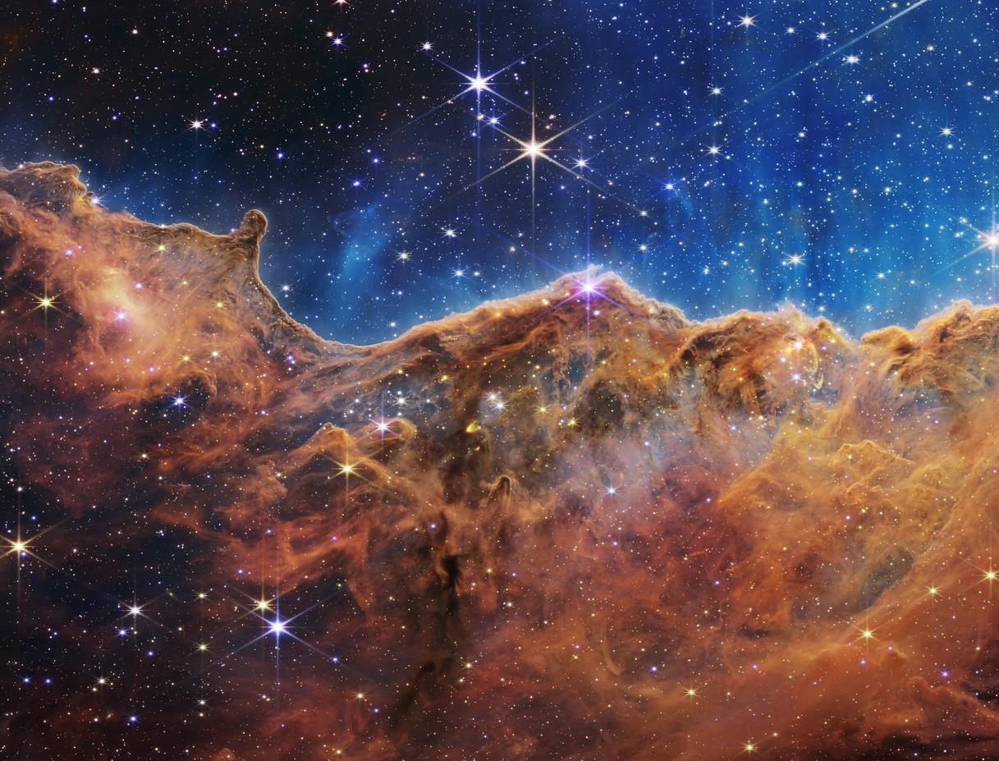
01
RULES SHEET
02
DIFFICULT TOPICS
[Event-Related Image]
03
PRACTICE QUESTIONS
04
TIPS FROM A VETERAN
05
OTHER FREE RESOURCES
Notes:
For Builds: Replace difficult topics with physical principles involved in the build and replace common questions with common designs

Slide 3
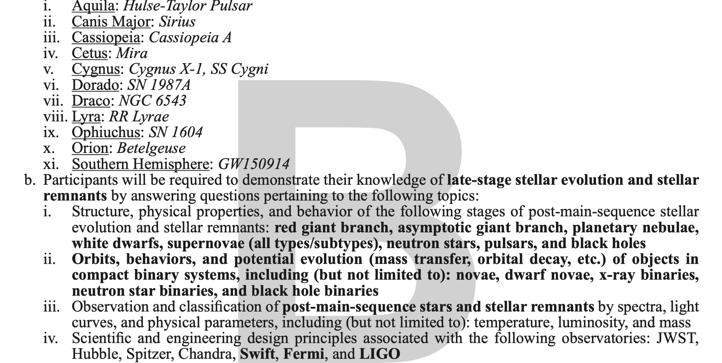
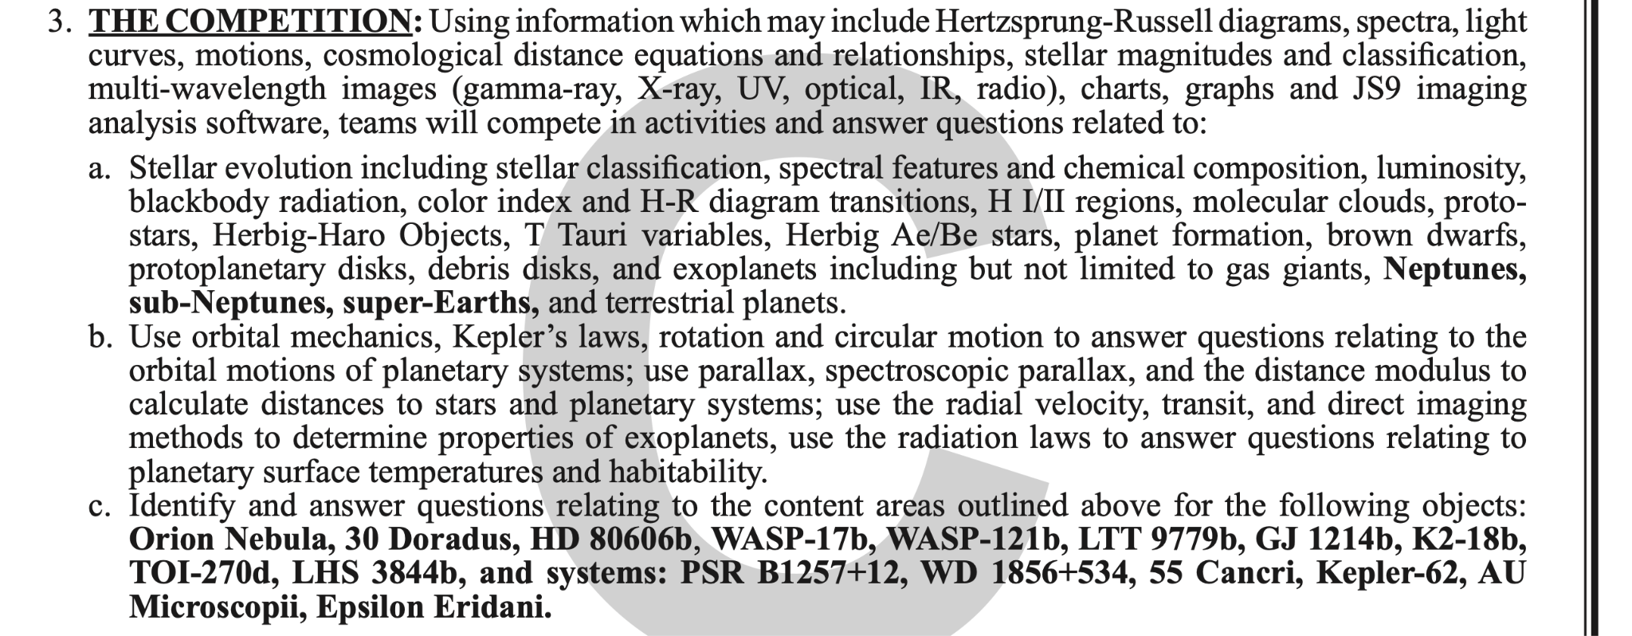
The Rules Sheet
Every single word mentioned even briefly should be somewhere in your notes, and even some topics that aren’t mentioned
[Div C] JS9 usually doesn’t come up until higher level tournaments, but if you have the time, even the basics gets you far
Pay attention when it says “not limited to” they may test you on other objects not listed!
Spam specific object images! ID is free points AND the most important step
Sections: Specific Objects, General Astronomy, Math/Physics, [Div C] JS9
Notes:
Highlight key points from the rules sheet: DESIGN LOGS that basically grant free points, most tested-on topics, point distribution so that competitors know what to prioritize, allowed notes and equipment, etc.

Slide 4
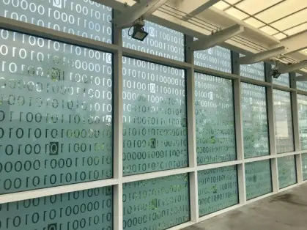
DIFFICULT TOPICS
Notes:
This section should focus on topics that are more math-based (harder to self-teach), concepts that come only usually up in college level courses, or concepts that you struggled with when you competed in this event

Slide 5
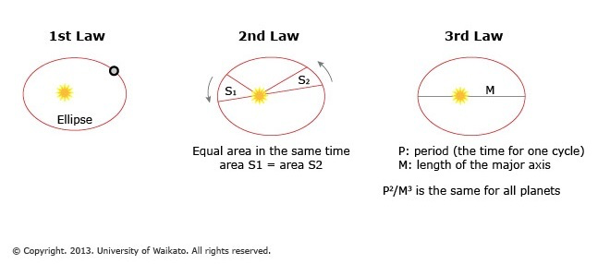
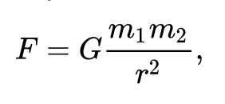
Topic 1: Physics [Div B]
My recommendation: get the formulas (units are very important!!!!), find out what all the variables stand for, understand the relationship it is establishing
Ex: Kepler’s laws: 3rd Law is incomprehensible alone. Tests will try to overwhelm you with info - just plug in numbers where they should go, and a lot of it will fall into place.
Part of that is recognizing what is a measure of period (answer: time), what is the gravitational constant (unit of (N * m^2) / kg^2) - recognizing units and where they go in the formula
Remember that any physics is useful physics!
Notes:
Example problem: Neptune has a period of about 165 Earth days. Approx how far in AU from the Sun is Neptune?

Slide 6
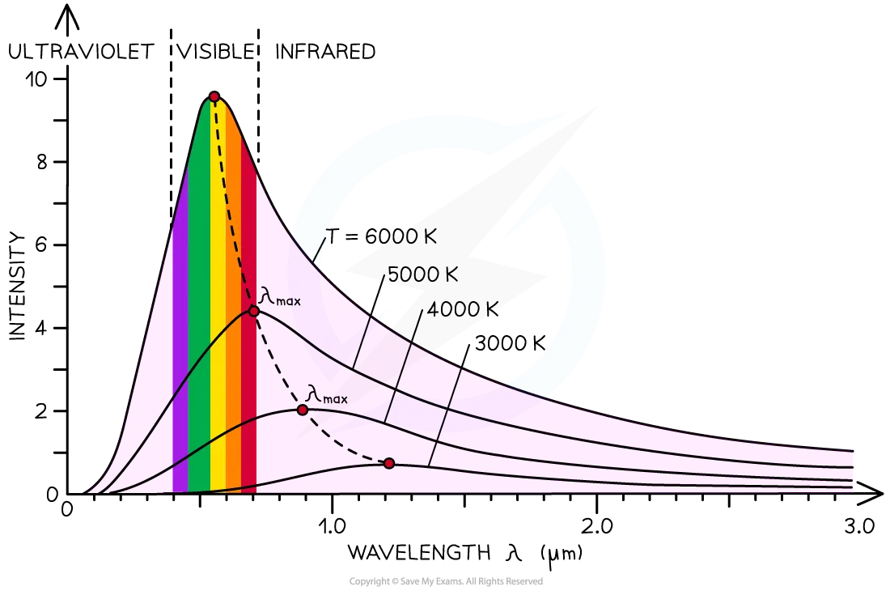
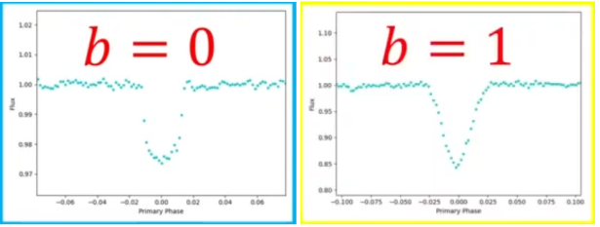
Topic 2: Physics+ [Div C]
Same as for Div B - make sure you know how and when to use the formulas, don’t just dump them into your notes and INCLUDE UNITS!!!
Take a physics class :)
Specifically helpful for Kepler’s Laws/rotation/circular motion/orbits
Note that to some extent (like with circular orbits), you can sometimes find the answer to physics problems using simple geometry formulas.
Ex: Period is time for a full orbit; if you have the radius of orbit and you can find orbital velocity, then you have speed and circumference = distance/time and distance, solve for time
Same with distances - parallax is kind of just trigonometry but with ridiculously small angles
Note, “Radiation laws” → Wien’s Law, Stefan-Boltzmann Law, luminosity, magnitude

Slide 7
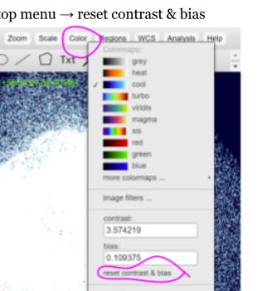
Topic 3: JS9 [Div C]
Don’t be scared of JS9 - a little preparation goes a long way
Very useful resource: https://chandra.harvard.edu/js9/index.html - work through “Guide for using JS9” (Pt. 1 and 2), do some of the other activities
Don’t just copy-paste, actually go through the activities in the guide!
Note: Actual competition interface might be https://js9.si.edu/ or https://js9.si.edu/js9/js9.html (basically same, loading in images is slightly different)!
Write down how to do things and where to find buttons in your notes - annotated screenshots are great
For image metadata, look at the FITS header
File → display → FITS header
Includes observation date/time, telescope, instrument, obs. ID, object name, title of proposal of observation, etc.
Note: trying to pan around the image will just mess up the colors
To fix: Color (in top menu)→ reset contrast & bias
Notes:
(these are just my elaborations on the things above not like what I think you should say)
For the thing about panning - when I say “trying to pan around the image” I mean trying to drag around the image as you would intuitively do from working with any other application online - there is a way to pan (View → Panner → drag the green box until it is over the part of the image you want to look at)
If they do nothing else to prepare for JS9 they should go through the chandra guide (the big bolded link) it is very useful and not unreasonably long!
“Don’t just copy-paste” is probably true in 99% of scioly note-taking circumstances but I think it’s especially true here they need to actually know how to use JS9 (ex. It is not the most modern website so I struggled for a while when practicing to find a particular menu item before realizing it was just getting cut off and I had to zoom out the browser, this is not something any guide mentions)
The bullet point about the actual competition interface and loading in images might be a lie? I really thought it was true but all the tests I can find from last year that use js9 use either the chandra interface or something custom. I also am not sure if the loading images is true. In general the first thing to try when loading in an image is to drag the link over the canvas on js9 (downloading the files is not recommended they can be very big)

Slide 8
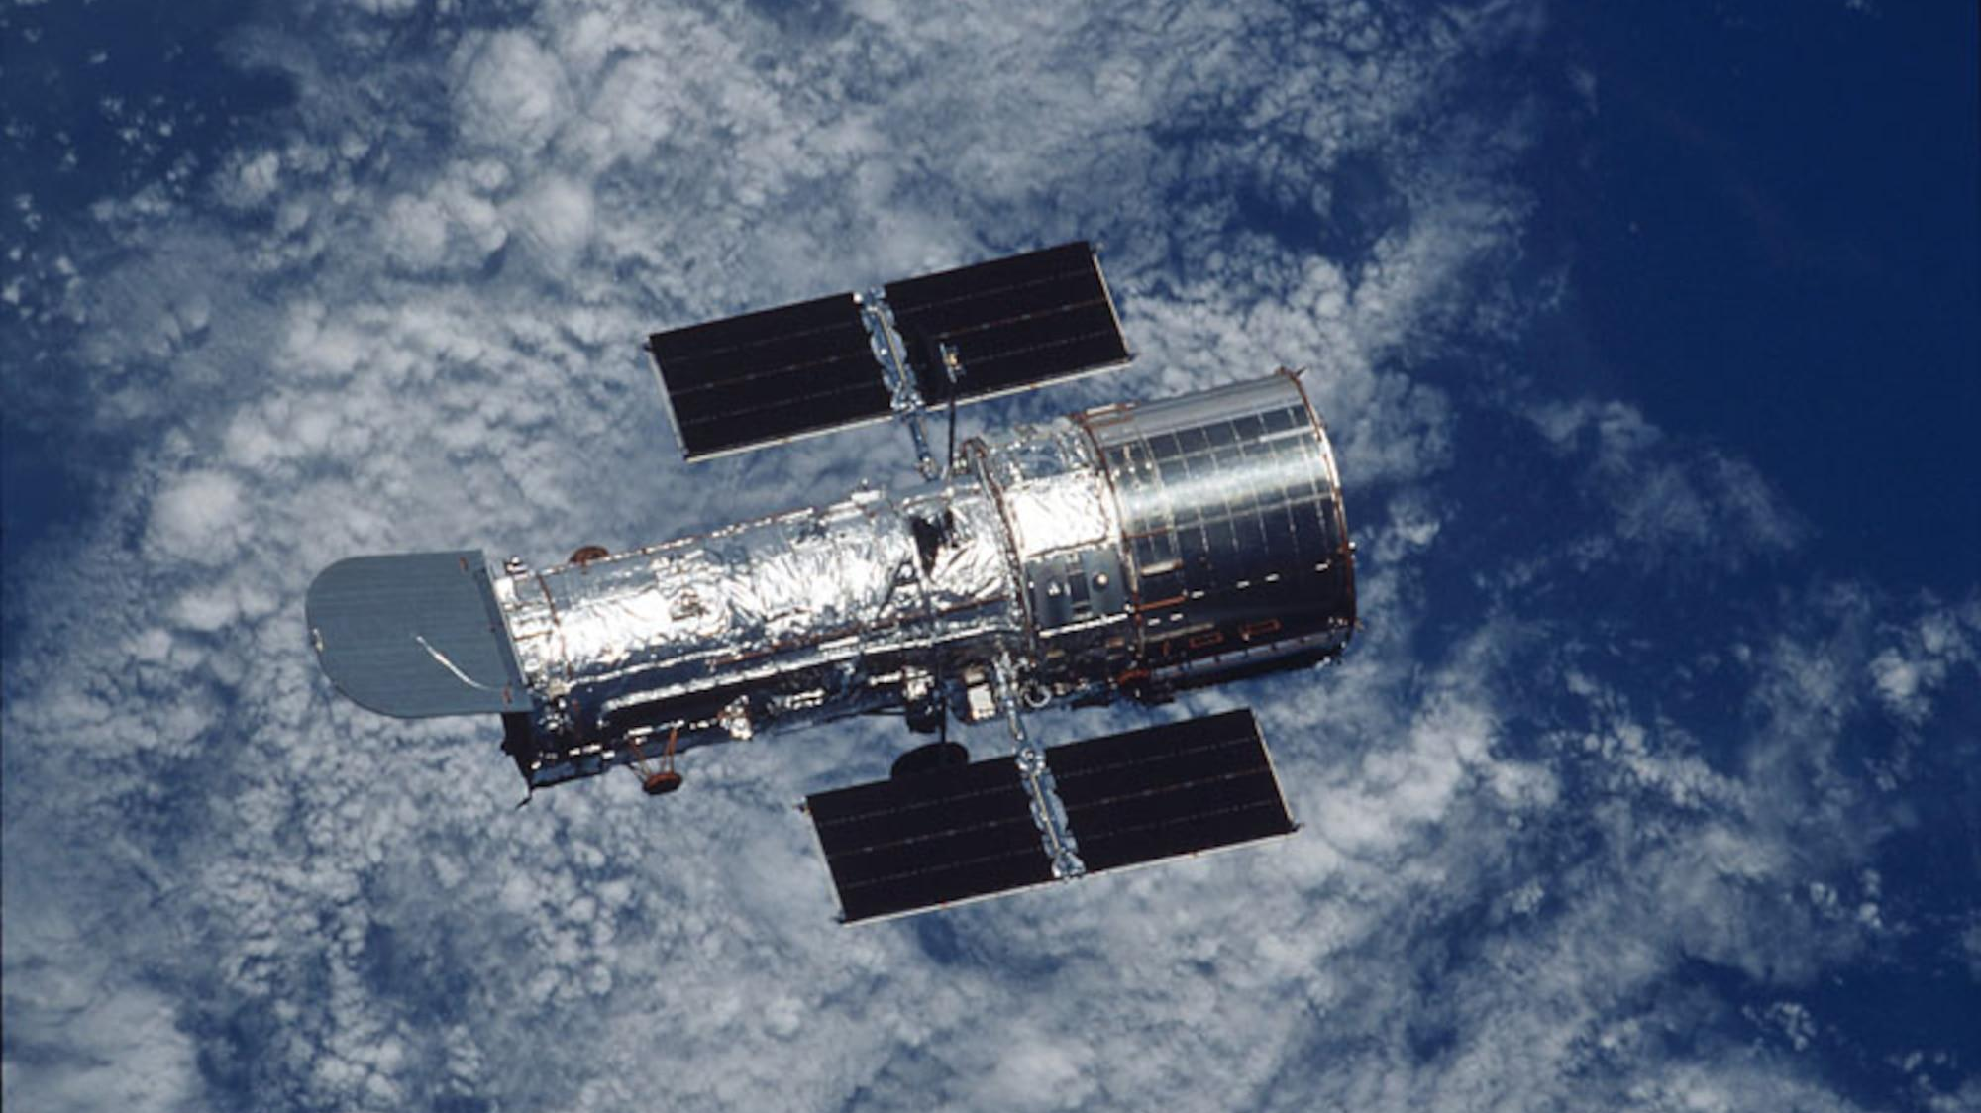
PRACTICE QUESTIONS
All of the following questions have been pulled from past YJI exams (which can be found on our website) or the Text Exchange on SciOly Wiki
Notes:
\

Slide 9
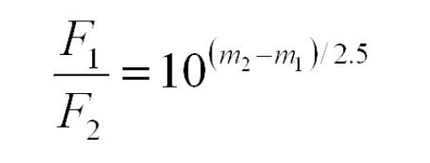
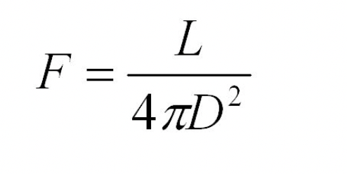
Question 1
Q1: Provide a 2-3 step explanation of how you can derive the distance modulus (third equation) from the formulas for flux.
F1 is flux 1, F2 is flux 2, m2 is magnitude 1, m1 is magnitude 2
F is flux, L is luminosity, D is distance in parsecs
M is absolute magnitude, m is apparent, r is radius/distance in parsecs from Earth
Hint: taking the square root is the same as going to the ½ power
Hint 2: Absolute magnitude is the magnitude from a distance of 10 parsecs away
Hint 3: Apparent magnitude is the magnitude as seen from Earth
Notes:
Pull some questions from exams on the scioly wiki test exchange, first give attendees a couple minutes to read over them/work through them, then walk them through the answers. Try to get a mix of multiple choice and short answer or matching

Slide 10
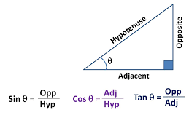
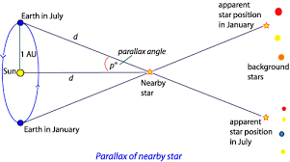
Question 2
Q2: Parallax is usually measured in arcseconds. If a star has a parallax of 0.2 arcseconds, how far is this star from the Sun in parsecs?
1 degree = 3600 arcseconds
1 parsec = 206265 AU
Hint: Distance from Earth to Sun is 1 AU
Hint 2: don’t forget to convert units!
Hint 3: “parallax” is the parallax angle p in the
diagram to the right →
Notes:
Pull some questions from exams on the scioly wiki test exchange, first give attendees a couple minutes to read over them/work through them, then walk them through the answers

Slide 11
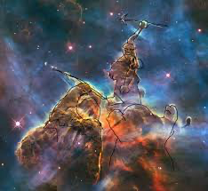
Common Questions
What stage of stellar evolution is the Sun in right now?
Identify the stellar object in the top right. What nebula is it in?
Which of these phases is most likely to immediately follow a (small) red giant:
A. Planetary nebula B. white dwarf C. neutron star D. black hole
What stellar object can produce a Type 1a supernova, and when does it occur?
What is the heaviest element produced by nuclear fusion?
Main sequence
Mystic Mountain, in Carina Nebula
White dwarf, when it exceeds Chandrasekhar mass limit
Iron
Notes:
Pull some questions from exams on the scioly wiki test exchange, first give attendees a couple minutes to read over them/work through them, then walk them through the answers

Slide 12
Tips from a Veteran
Note-taking for specific objects: know statistics, what makes them special, fun facts, what kind of object they are. And a BILLION images, more than you think you need
You NEED a formula/constants/conversions sheet for math (esp Div C)
Usually, tests run long and difficult - split up work, make sure you answer every single multiple choice (just guess!), then spend remaining time on long math problems. Don’t get hung up on problems, check worth if it’s taking too long
Personal process: I handled multiple choice, specific object questions, general astronomy topics. My partner did the math problems, and JS9 if they had it
This is a good way to split up doing tests, a very bad way to split up taking notes/preparation (i.e. very unfair to the person taking notes on all of the specific objects & all of general astronomy)
Notes:
Use this section to talk about any strategies you used to navigate the event when you competed. For example, how did you manage your time, how did you organize your notes, how did you split topics up between you and your partner, etc.?

Slide 13
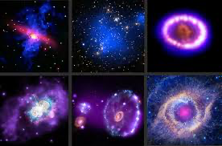
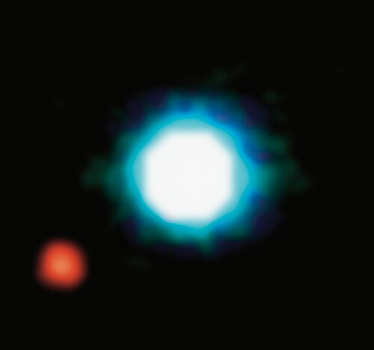
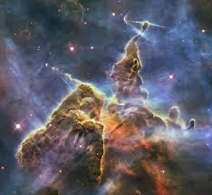
Tips from a Veteran
Tests may care about information concerning specific photos as well
Ex: it may ask to identify a nebula, then in what light wave it was taken in, or what telescope was used to photograph it, or even when it was taken (not necessary knowledge but you can kind of tell the wavelength from the photo’s colors)
Make sure to also research if your specific objects have different names/have smaller parts within them! You’ll find many more photos/info, and having knowledge about the parts within the object is important
Ex: Keyhole Nebula or Cosmic Cliffs are WITHIN the Carina Nebula - many photos of the “Carina Nebula” are actually specific parts of it
Notes:
Use this section to talk about any strategies you used to navigate the event when you competed. For example, how did you manage your time, how did you organize your notes, how did you split topics up between you and your partner, etc.?

Slide 14
Tips from a Veteran
Make sure you have thorough notes on very important stellar objects!! (ex: the Sun, Earth, Solar System - have the mass, radius, magnitude, classification, orbital radius, period, etc) Example questions: absolute magnitude of sun?
Stellar Evolution & classification is also an extremely important topic, just generally easier than physics
Make sure to check that your information is updated/credible/has not been disproven!
Do too many practice tests, but also make sure to write down what you lack or got wrong! This is a great way to see what you’re missing
[Div C] Take advantage of computers! Hyperlink stuff! Save the trees!
Take real, solid, thorough notes - not just ChatGPT or copy-pasting Wikipedia. If you blindly copy-paste, you won’t understand anything on the test - won’t know where to look, what to look for, what any of your “notes” mean
Notes:
Use this section to talk about any strategies you used to navigate the event when you competed. For example, how did you manage your time, how did you organize your notes, how did you split topics up between you and your partner, etc.?

Slide 15
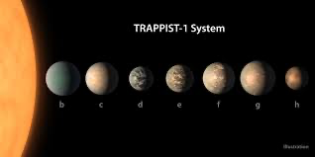
Disclaimer:
I may be mildly overstating the importance of physics to Astronomy
ID is still probably a good ¼ to ½ of your points
General astronomy is going to be another ⅓ to ½ of your points
Physics is usually ⅓ or less - but also often the difference-maker and the hardest points to earn (basically, a tie-breaker)
Also, depending on what competitions you go to - JS9 often doesn’t show up at all (personally last year JS9 wasn’t on my local invitationals, regionals, or state)
Hopefully you will have all the notes and photos and knowledge to answer everything else on the test already! Physics is just a little more involved than Ctrl + F
It is still much more important that you get solid notes on every other topic, and can comfortably identify every specific object (I’m talking having every image in existence of that exoplanet in your notes, “artistic interpretation” or not)
Hopefully I didn’t scare you off of astronomy yet! I promise it’s cool!
Notes:
Use this section to talk about any strategies you used to navigate the event when you competed. For example, how did you manage your time, how did you organize your notes, how did you split topics up between you and your partner, etc.?

Slide 16
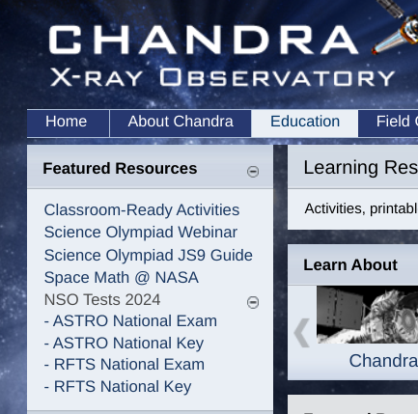
Additional Resources
Chandra website!!!
https://chandra.harvard.edu/edu/olympiad.html
https://chandra.harvard.edu/edu/
https://chandra.harvard.edu/js9/index.html
https://apod.nasa.gov/cgi-bin/apod/apod_search
SUBWAY STATIONS
You might already know this one but: https://scioly.org/tests/
Practice tests! Just Ctrl + F for all astronomy/reach for the stars tests
(also more here! https://scioly.org/wiki/index.php/Scioly.org:Test_Exchange#Tournament-Released_Sets)
For specific objects: press/image releases from telescopes/NASA/ESA
The descriptions in image releases are one of the best sources of specific but still readable information about the objects!
Yes, Saturn is the ringed one. This planet is a gas giant, and it’s composed mostly of hydrogen and helium
Notes:
Here, you can link or mention any online or book resources that helped you in this event when you were a competitor. Try to avoid general resources like scioly wiki, because they probably already are familiar with it.

Slide 17
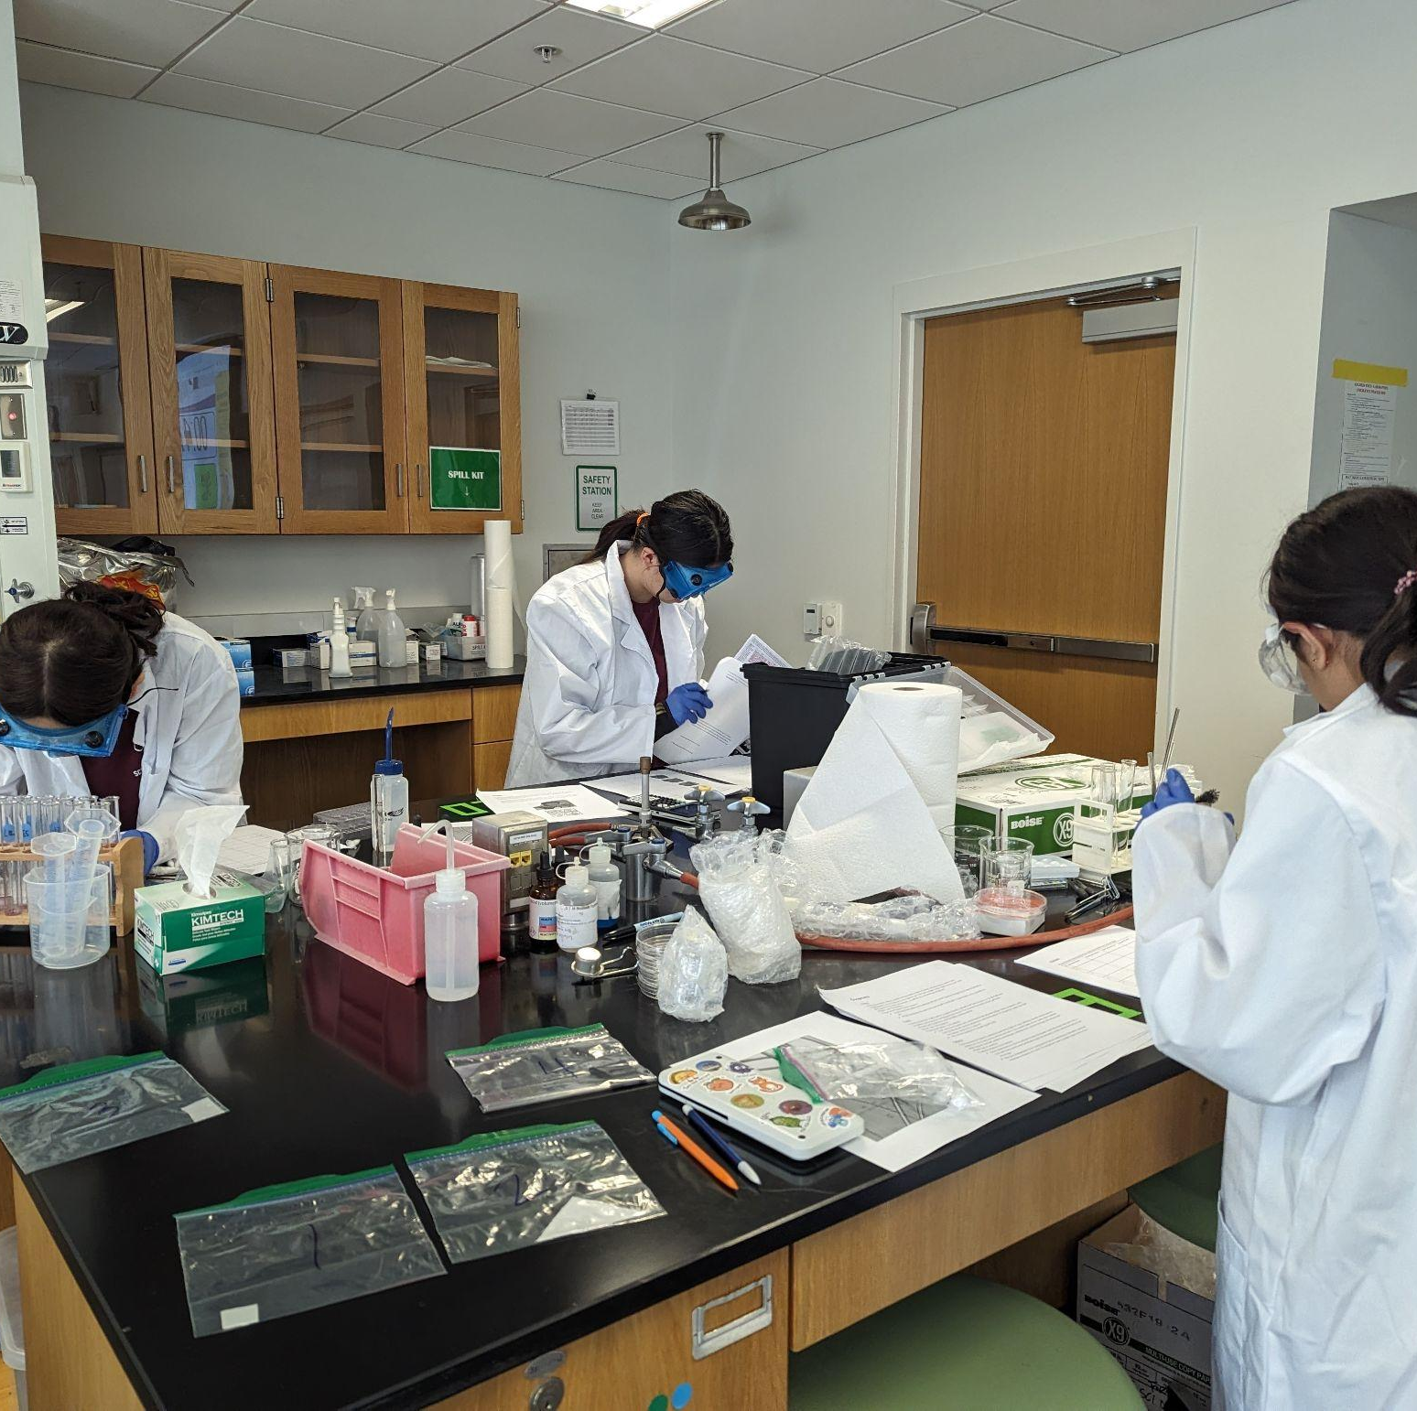
THANKS!
Notes:
(replace picture with a picture from one of our tournaments)

