Slide 1
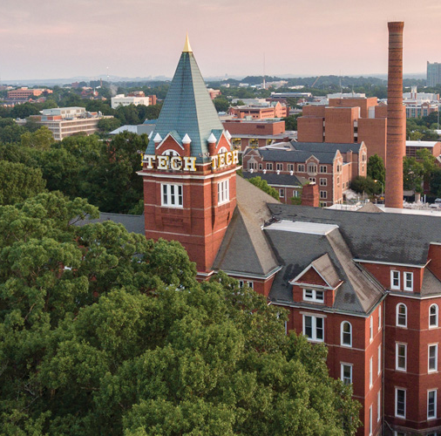
Anatomy & Physiology
Division B/C
Georgia Tech Event Workshop Series 2024-25
Notes:
https://docs.google.com/document/d/14K1vdRYZ22wrAPBrUnnrMII-7cG13QkWU_ETLs84cuo/edit?usp=sharing

Slide 2
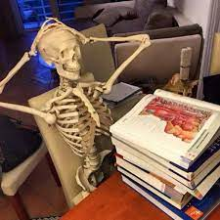
01
RULES SHEET
02
DIFFICULT TOPICS
03
COMMON QUESTIONS
04
TIPS FROM A VETERAN
05
OTHER FREE RESOURCES
https://www.facebook.com/AnatomyEducation/photos/a.281228008571834/1098311303530163/?_rdr
Notes:
For Builds: Replace difficult topics with physical principles involved in the build and replace common questions with common designs

Slide 3
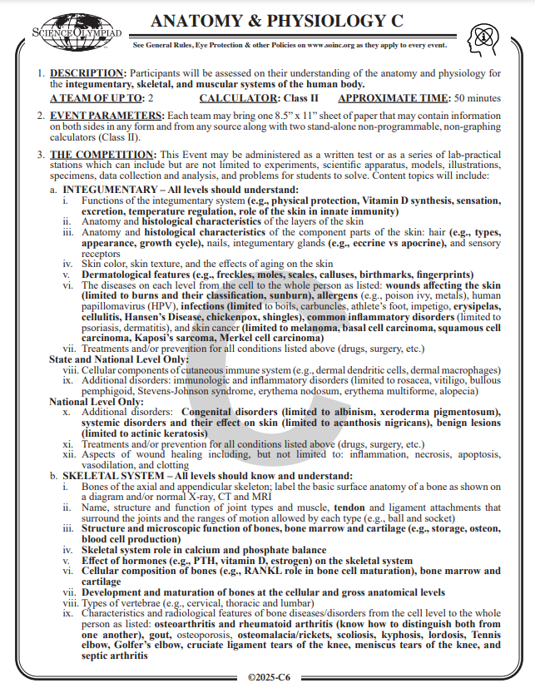
The Rules Sheet
Div B
Div C
1 page front and back
2 calculators
Bold shows changes
3 systems
Integ, Skel, and Musc
At least 20 MCQ for each system
At least one labelling for each system
Points are somewhat equal across each system
Labeling > MCQ > FRQ in terms of simplicity
Labeling should be free from memory/notes | mcq is usually basic knowledge
Notes:
Highlight key points from the rules sheet: DESIGN LOGS that basically grant free points, most tested-on topics, point distribution so that competitors know what to prioritize, allowed notes and equipment, etc.

Slide 4
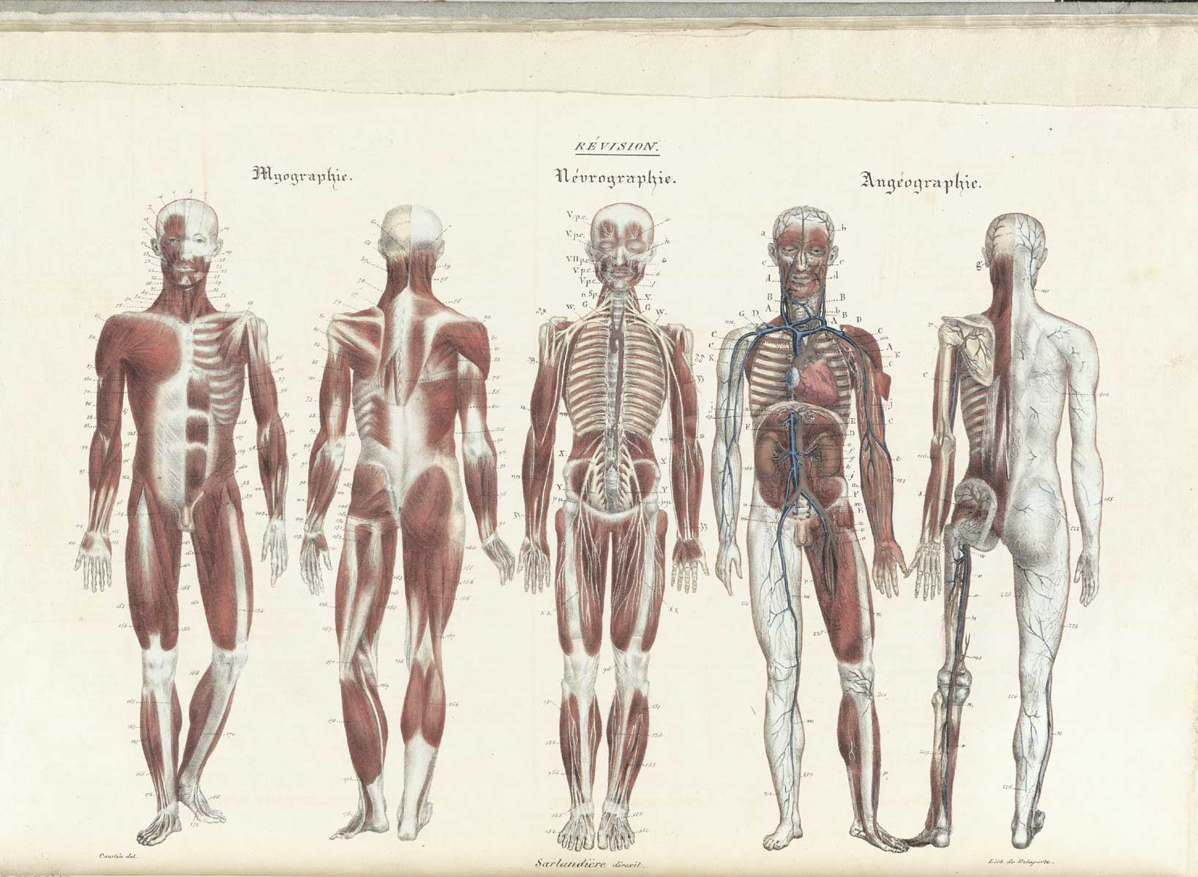
DIFFICULT TOPICS
Notes:
This section should focus on topics that are more math-based (harder to self-teach), concepts that come only usually up in college level courses, or concepts that you struggled with when you competed in this event

Slide 5
Topic 1: Detailed Anatomy and Histology of the Integumentary System
Challenge: Mastering the microscopic and gross anatomy of the skin's layers, glands, and receptors, along with understanding diseases at the cellular level.
Advice:
Start by creating detailed diagrams of the skin layers, glands, and sensory receptors to visualize how each part is structured.
Use color-coded flashcards to match specific diseases with their histological features and treatments.
Practice connecting the structure of each component to its function in protection, sensation, and immunity, and learn how conditions like burns and infections affect each layer differently.

Slide 6
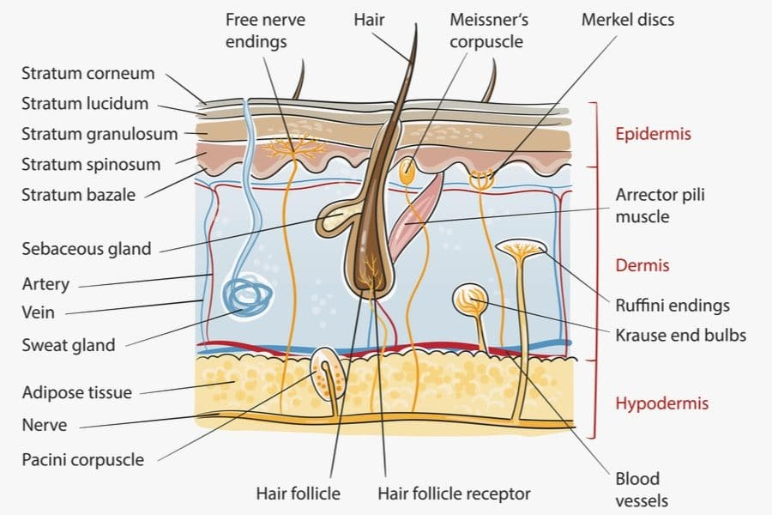
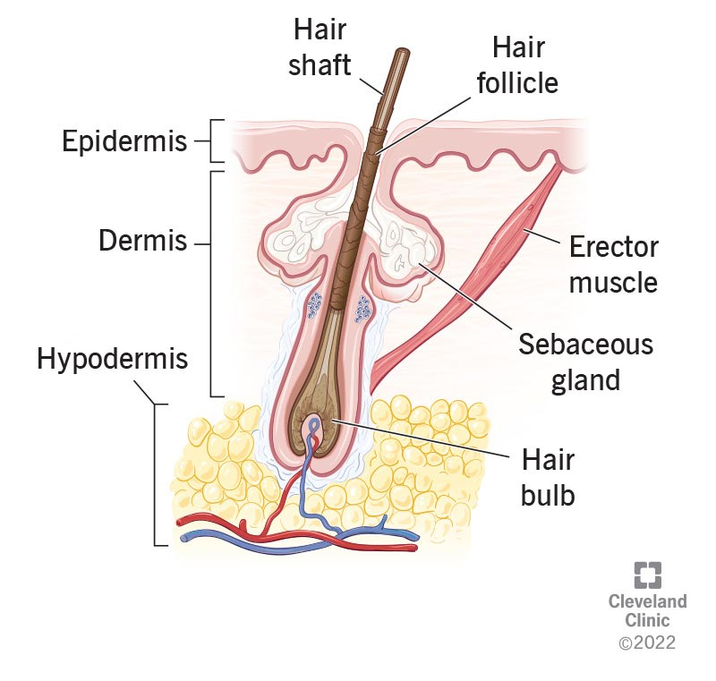
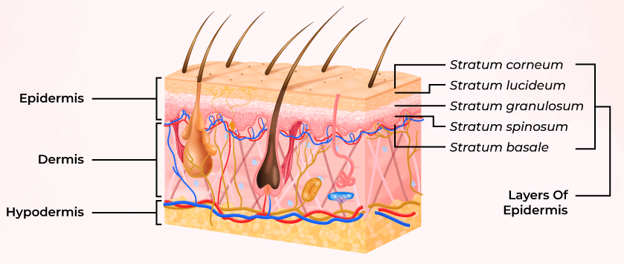

Slide 7
Topic 2: Bone Diseases and Disorders, Including Radiological Features
Challenge: This topic includes understanding a range of skeletal diseases (e.g., osteoarthritis, osteoporosis) and how they present in radiographs, CT, and MRI images.
Advice:
Focus on the basic visual patterns associated with different disorders by studying sample images of X-rays, CT scans, and MRIs for each condition.
Identify key features, such as bone density changes in osteoporosis or joint space narrowing in arthritis.
Practice with diagrams to learn bone structure, then expand to radiographs and MRI interpretations for a full understanding of disease progression and characteristics.

Slide 8
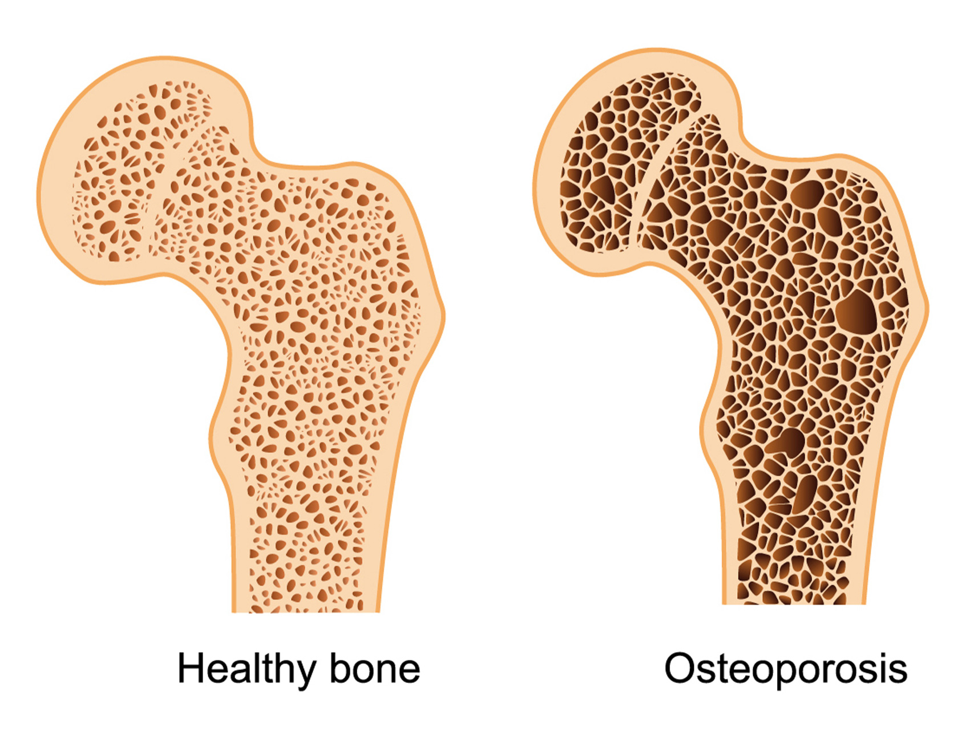
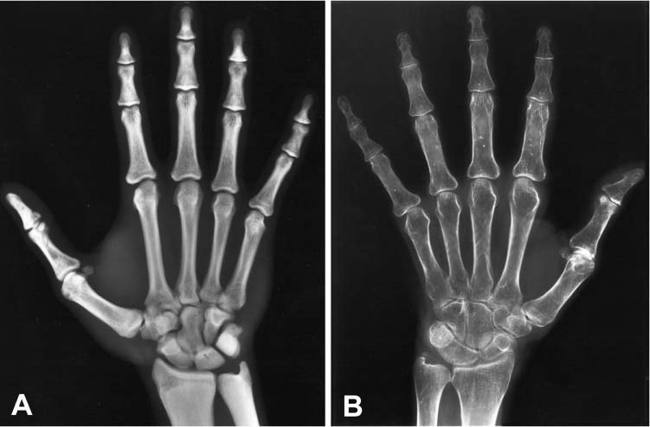

Slide 9
Topic 3: Physiology of Muscle Contraction and Muscle Metabolism
Challenge: Understanding the complex process of muscle contraction (neuromuscular junction, cross-bridge cycling) and energy metabolism (phosphocreatine system, glycogen usage).
Advice:
Break down each step of the muscle contraction process into small, memorable stages (e.g., signal transmission, sarcomere shortening, relaxation).
Create flowcharts to visualize each phase of muscle metabolism and how energy sources are used during different types of exercise.
Practicing case studies of exercise physiology can help reinforce these pathways, showing how different energy systems are used based on exercise intensity and duration.

Slide 10
Cross-bridge cycling is a sequence of molecular events that underlies the sliding filament theory. A cross-bridge is a myosin projection, consisting of two myosin heads, that extends from the thick filaments.[1] Each myosin head has two binding sites: one for adenosine triphosphate (ATP) and another for actin. The binding of ATP to a myosin head detaches myosin from actin, thereby allowing myosin to bind to another actin molecule. Once attached, the ATP is hydrolyzed by myosin, which uses the released energy to move into the "cocked position" whereby it binds weakly to a part of the actin binding site. The remainder of the actin binding site is blocked by tropomyosin.[26] With the ATP hydrolyzed, the cocked myosin head now contains adenosine diphosphate (ADP) + Pi. Two Ca2+
ions bind to troponin C on the actin filaments. The troponin-Ca2+
complex causes tropomyosin to slide over and unblock the remainder of the actin binding site. Unblocking the rest of the actin binding sites allows the two myosin heads to close and myosin to bind strongly to actin.[26] The myosin head then releases the inorganic phosphate and initiates a power stroke, which generates a force of 2 pN. The power stroke moves the actin filament inwards, thereby shortening the sarcomere. Myosin then releases ADP but still remains tightly bound to actin. At the end of the power stroke, ADP is released from the myosin head, leaving myosin attached to actin in a rigor state until another ATP binds to myosin. A lack of ATP would result in the rigor state characteristic of rigor mortis. Once another ATP binds to myosin, the myosin head will again detach from actin and another cross-bridge cycle occurs.

Slide 11
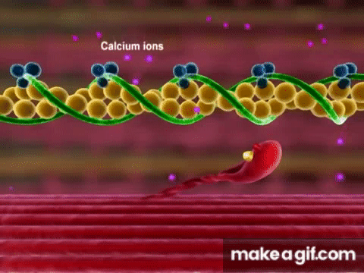

Slide 12
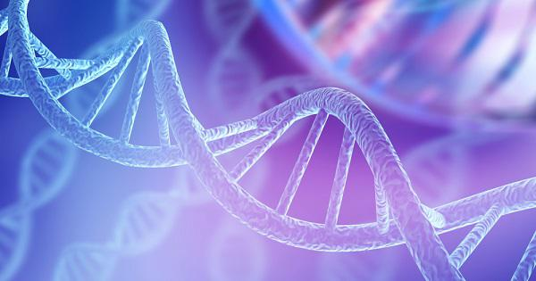
COMMON QUESTIONS
All of the following questions have been pulled from past YJI exams (which can be found on our website) or the Text Exchange on SciOly Wiki
Notes:
\

Slide 13
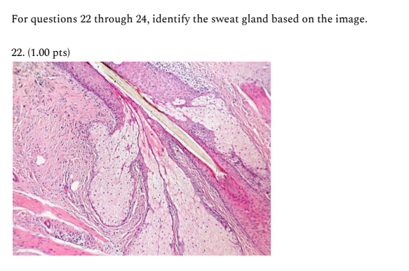
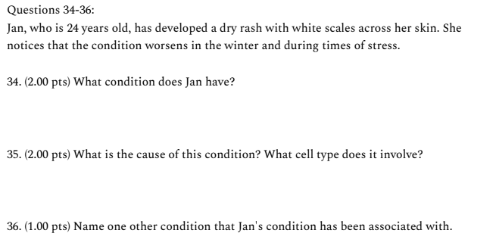
Question 1
Notes:
Pull some questions from exams on the scioly wiki test exchange, first give attendees a couple minutes to read over them/work through them, then walk them through the answers. Try to get a mix of multiple choice and short answer or matching

Slide 14
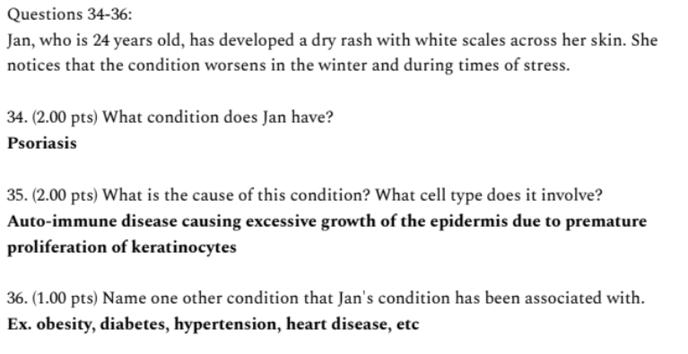
Question 1
Notes:
Pull some questions from exams on the scioly wiki test exchange, first give attendees a couple minutes to read over them/work through them, then walk them through the answers. Try to get a mix of multiple choice and short answer or matching

Slide 15
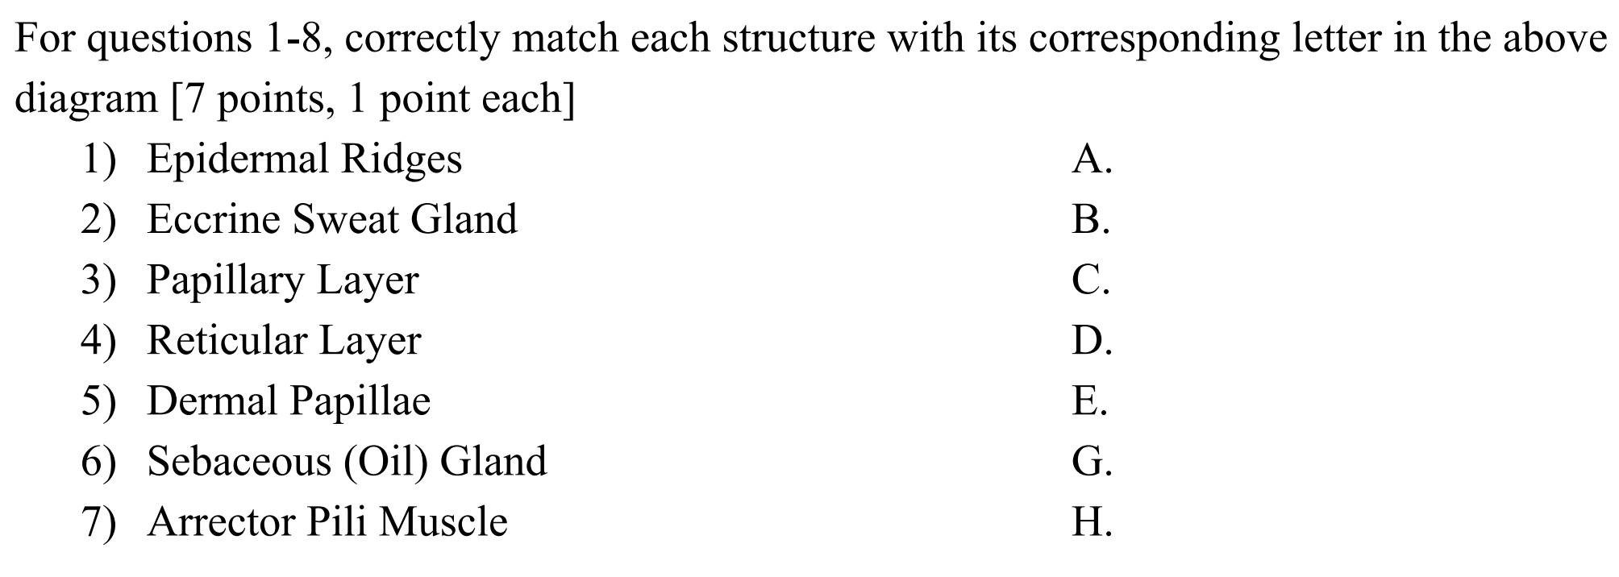
Question 2
Notes:
Speedrun these 2 slides - just indicate that this is common

Slide 16
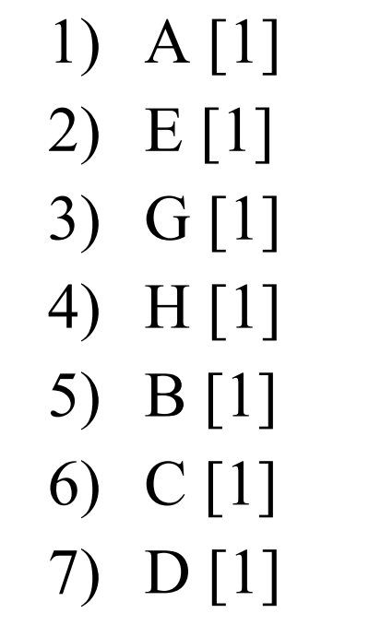
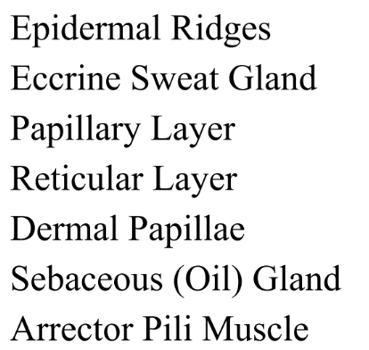
Question 2

Slide 17
Question 3
Notes:
Integumentary system made up of 22 sq ft of skin
Thin skin is ~1-2 mm thick
It takes 10 days following sunlight exposure to reach maximum production of melanin

Slide 18
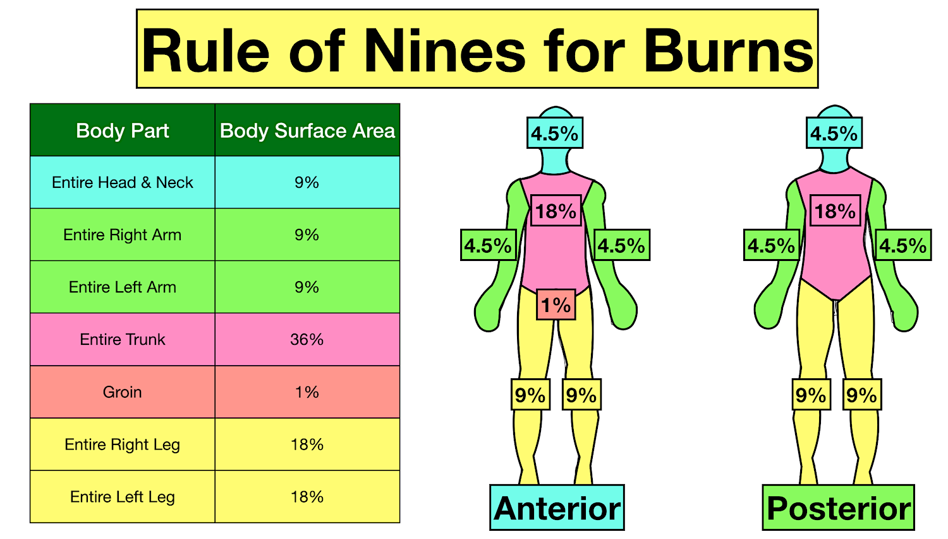
Question 3
https://www.ezmedlearning.com/blog/rule-of-nines-burn-chart-child-adult
Notes:
Integumentary system made up of 22 sq ft of skin
Thin skin is ~1-2 mm thick
It takes 10 days following sunlight exposure to reach maximum production of melanin

Slide 19
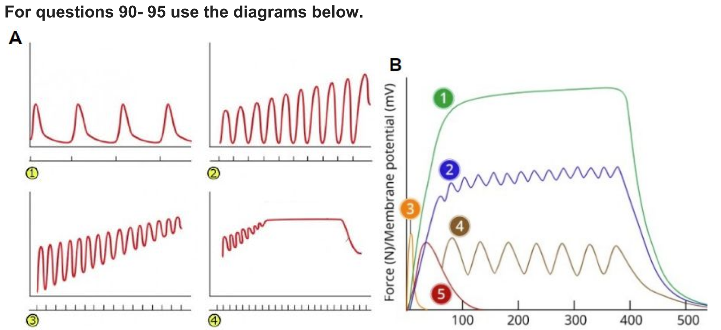
Question 4
What type of muscle contraction do each of the images in Figure A show?
Which number represents the action potential in Figure B?
At about how many milliseconds (shown on the x axis) does the relaxation phase for line 1 begin?
Notes:
Pull some questions from exams on the scioly wiki test exchange, first give attendees a couple minutes to read over them/work through them, then walk them through the answers

Slide 20
Question 4
What type of muscle contraction do each of the images in Figure A show?
Twitch, Treppe, Incomplete tetanus, Tetanus
Which number represents the action potential in Figure B?
3
At about how many milliseconds (shown on the x axis) does the relaxation phase for line 1 begin?
400 ms
Notes:
Twitch - standalone peaks
Treppe = stairs in german, resting points between each peak
Incomplete tetanus - usually build-up to tetanus, h.freq, summation-like
Tetanus - sustained, strong musc contr after repeated stimulation at high rate (freq); force plateaus bc actin and myosin filaments working at their greatest potential (max power strokes); uninterrupted musc contr w/o resting phases

Slide 21
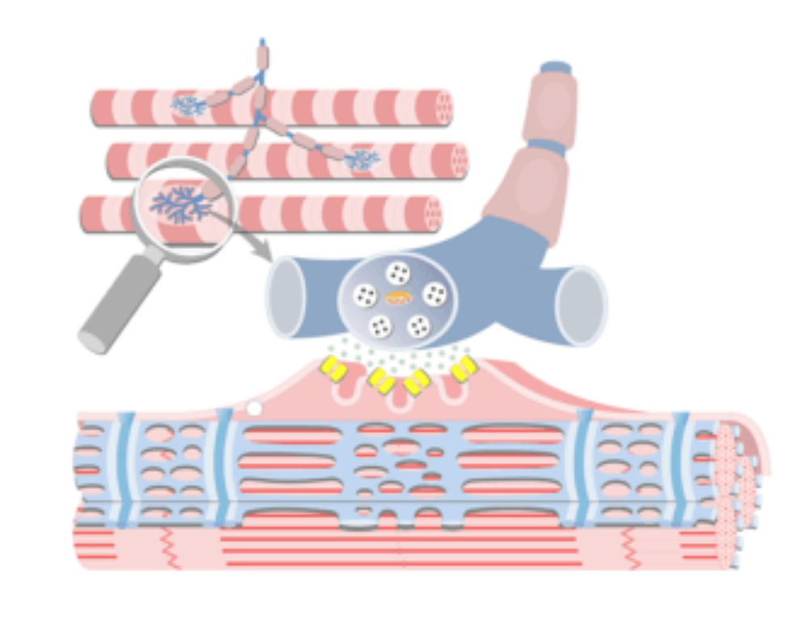
Tips from a Veteran
Prep:
Study the content; don’t just rely on your reference sheet!
Know the basics for all 3 systems; become an expert in just 1-2 (split with your partner)
Verbalize concepts
Lots and lots of practice tests
https://www.getbodysmart.com/muscle-physiology/
Notes:
Use this section to talk about any strategies you used to navigate the event when you competed. For example, how did you manage your time, how did you organize your notes, how did you split topics up between you and your partner, etc.?
Essentials of Anatomy and Physiology 7th Edition by Gerard J. Tortora

Slide 22
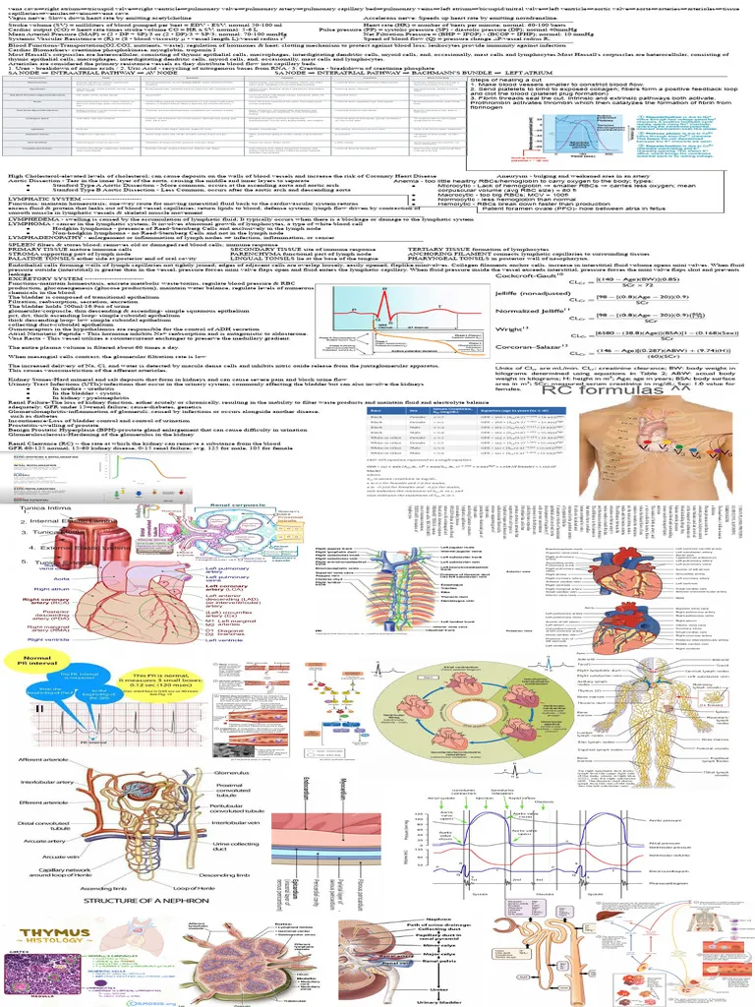
Tips from a Veteran
Reference sheet:
Color code
Diagrams
Know where everything is!
Be “organized”
Memorize what you can
https://www.scribd.com/document/709686871/Anatomy-and-Physiology-Science-Olympiad-2024-Cheat-Sheet
Notes:
Use this section to talk about any strategies you used to navigate the event when you competed. For example, how did you manage your time, how did you organize your notes, how did you split topics up between you and your partner, etc.?

Slide 23
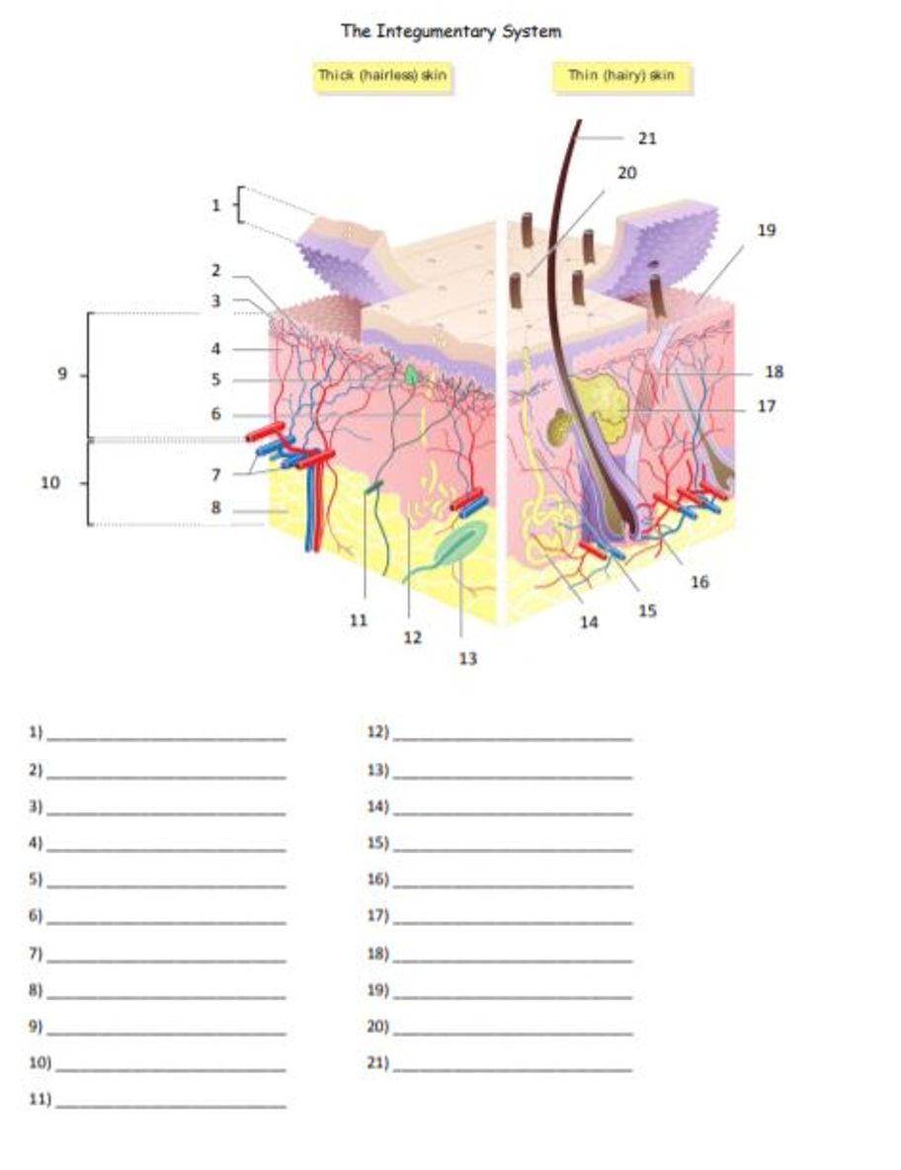
Tips from a Veteran
Test:
Split it up (tests are long)
If you’re in a time crunch, focus on easy points and questions worth most point values (usually diagrams and mcq)
Guess if you have to; don’t leave anything blank
https://ampeduplearning.com/the-integumentary-system-quiz-or-worksheet/
Notes:
Use this section to talk about any strategies you used to navigate the event when you competed. For example, how did you manage your time, how did you organize your notes, how did you split topics up between you and your partner, etc.?

Slide 24
Additional Resources
Visible Body Anatomy Learn Site
OpenStax A&P
SUBWAY STATIONS
GetBodySmart Interactive A&P
AnatomyTOOL
Yes, Saturn is the ringed one. This planet is a gas giant, and it’s composed mostly of hydrogen and helium
Notes:
https://www.visiblebody.com/learn/
3d models, basic a&p, term/vocab/relevance
https://openstax.org/details/books/anatomy-and-physiology-2e/
Online textbook
https://www.getbodysmart.com/
Interactive a&p, good visuals, good for reviewing basics
https://anatomytool.org/
More random, diagrams/dissection images
sciolywiki.org
Everything you need tbh
soinc.org

Slide 25
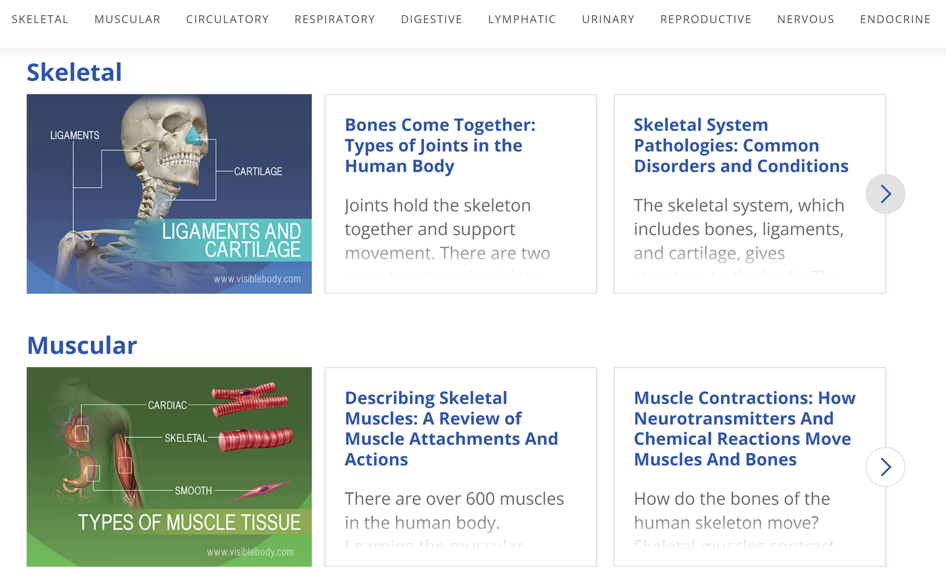
Visible Body
Notes:
Use this section to talk about any strategies you used to navigate the event when you competed. For example, how did you manage your time, how did you organize your notes, how did you split topics up between you and your partner, etc.?

Slide 26
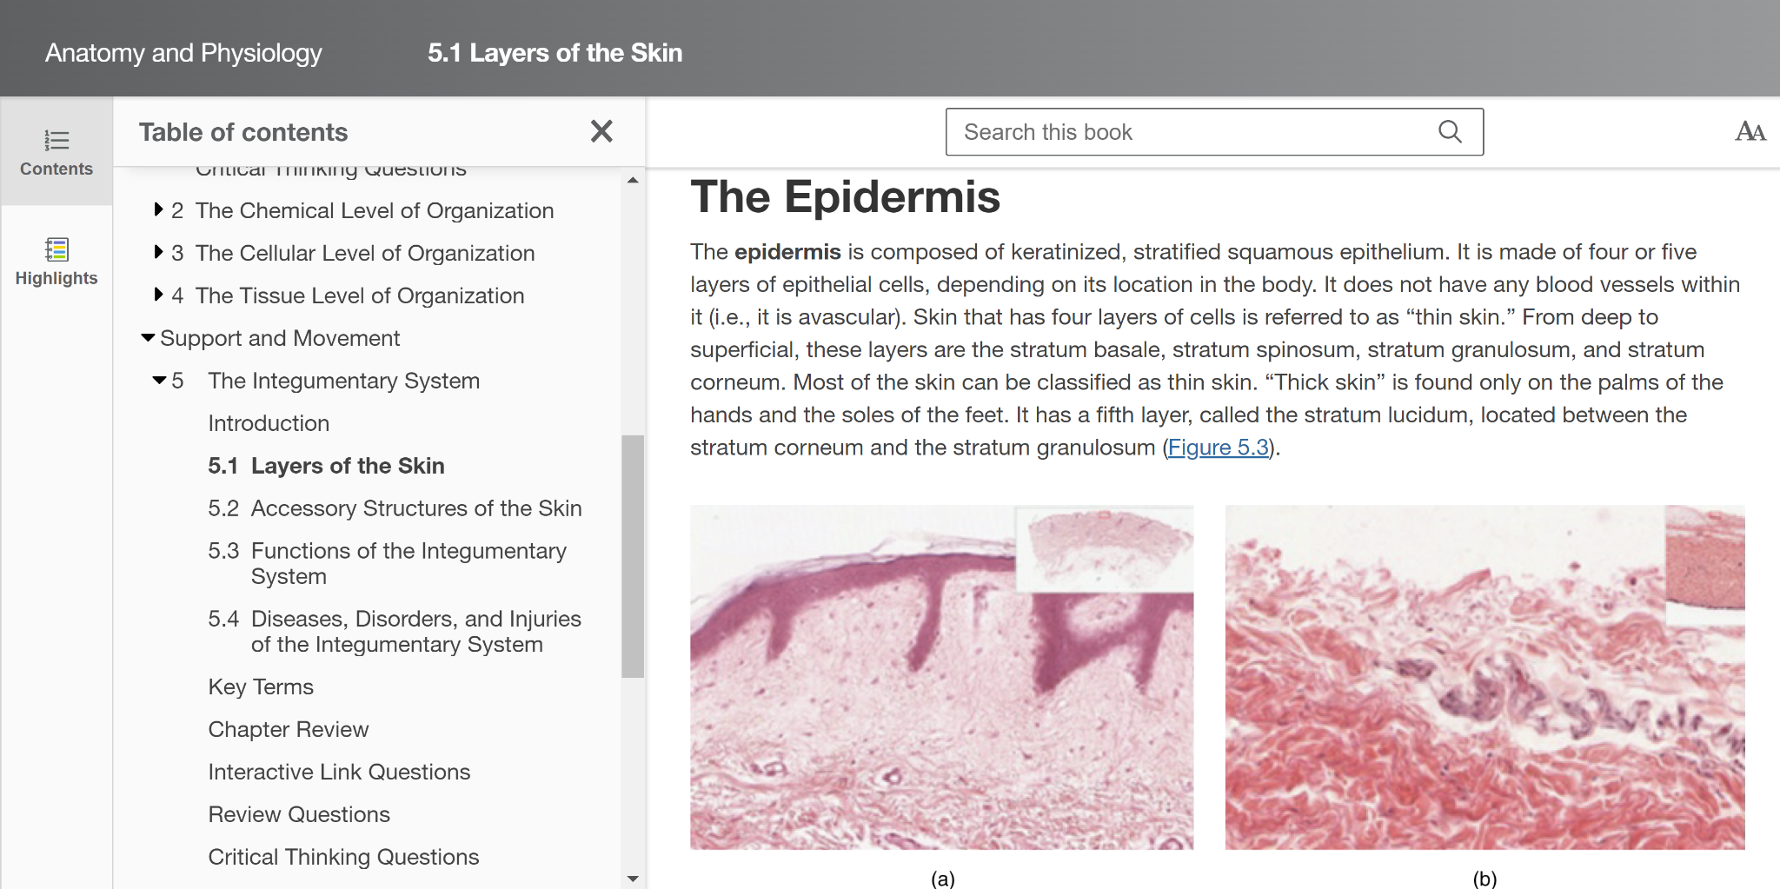
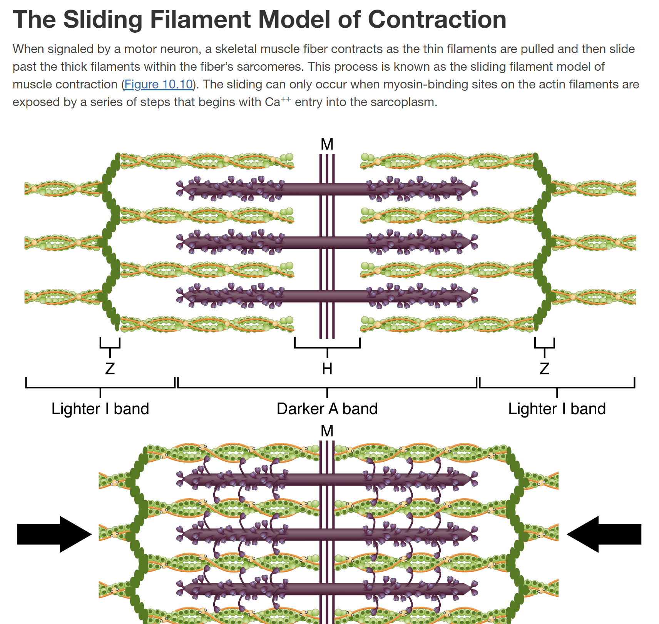
OpenStax
Notes:
Use this section to talk about any strategies you used to navigate the event when you competed. For example, how did you manage your time, how did you organize your notes, how did you split topics up between you and your partner, etc.?

Slide 27
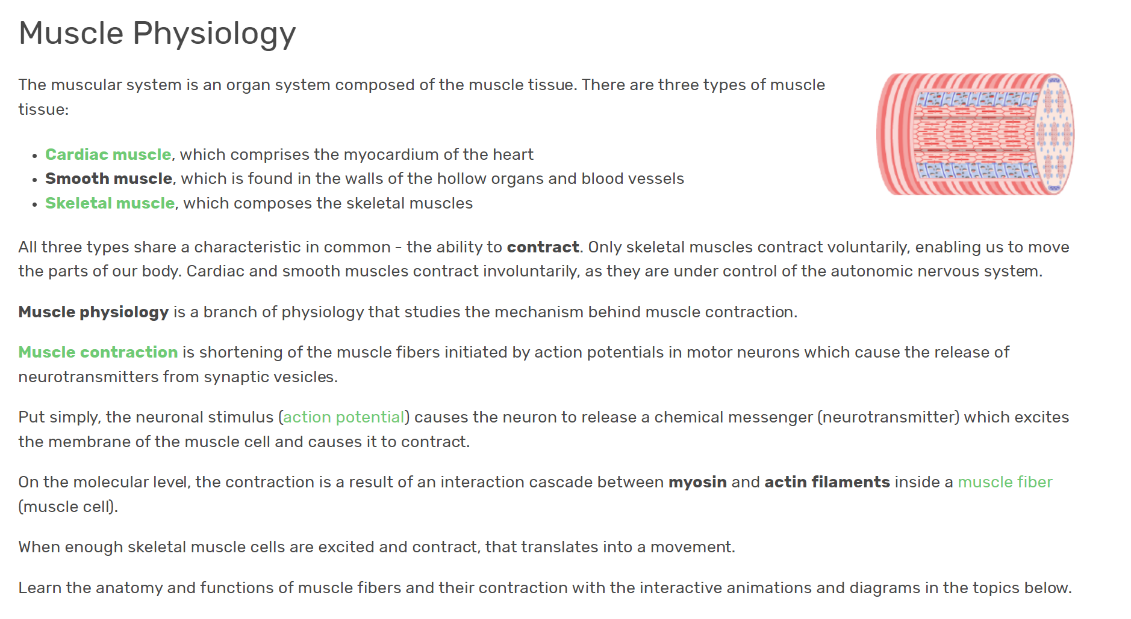
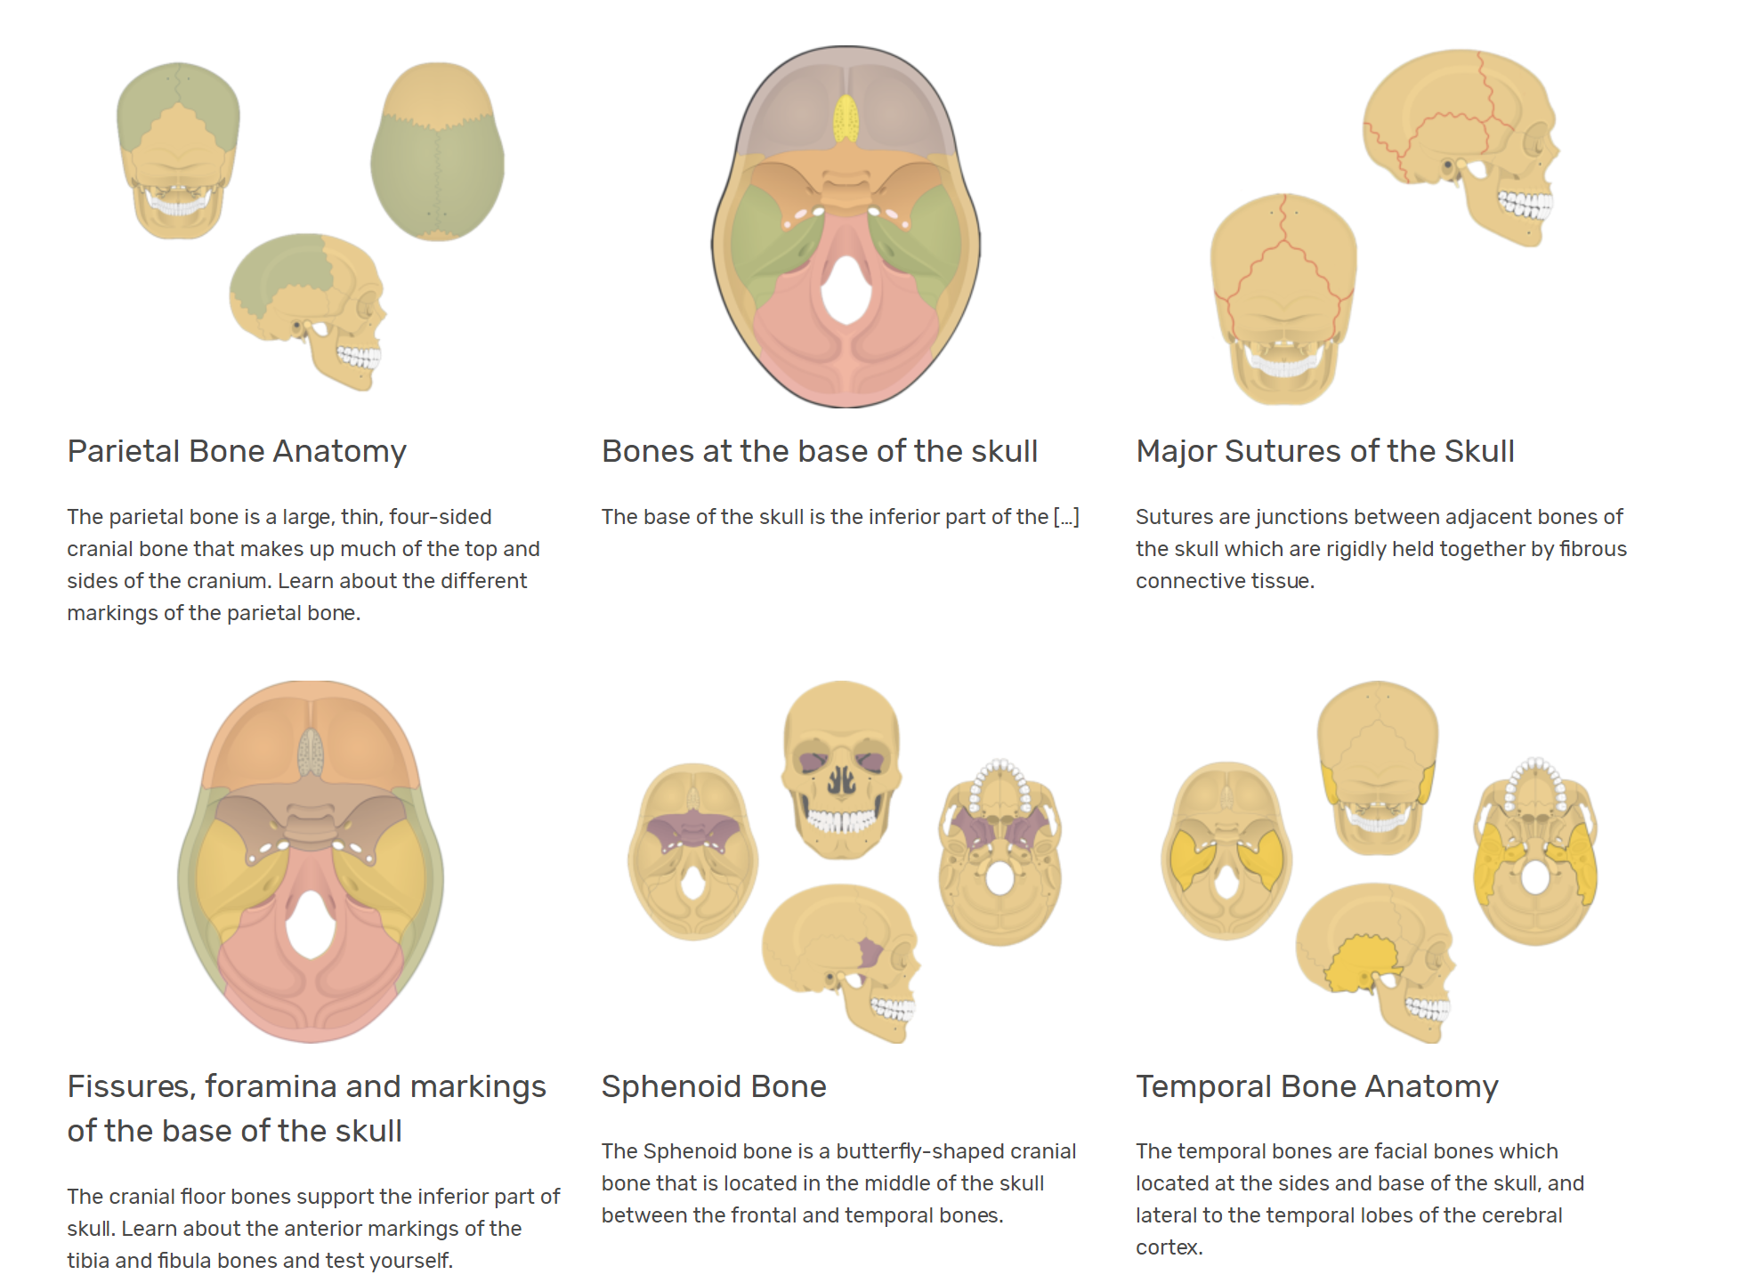
GetBodySmart
Notes:
Use this section to talk about any strategies you used to navigate the event when you competed. For example, how did you manage your time, how did you organize your notes, how did you split topics up between you and your partner, etc.?

Slide 28
AnatomyTOOL
Notes:
Use this section to talk about any strategies you used to navigate the event when you competed. For example, how did you manage your time, how did you organize your notes, how did you split topics up between you and your partner, etc.?

Slide 29
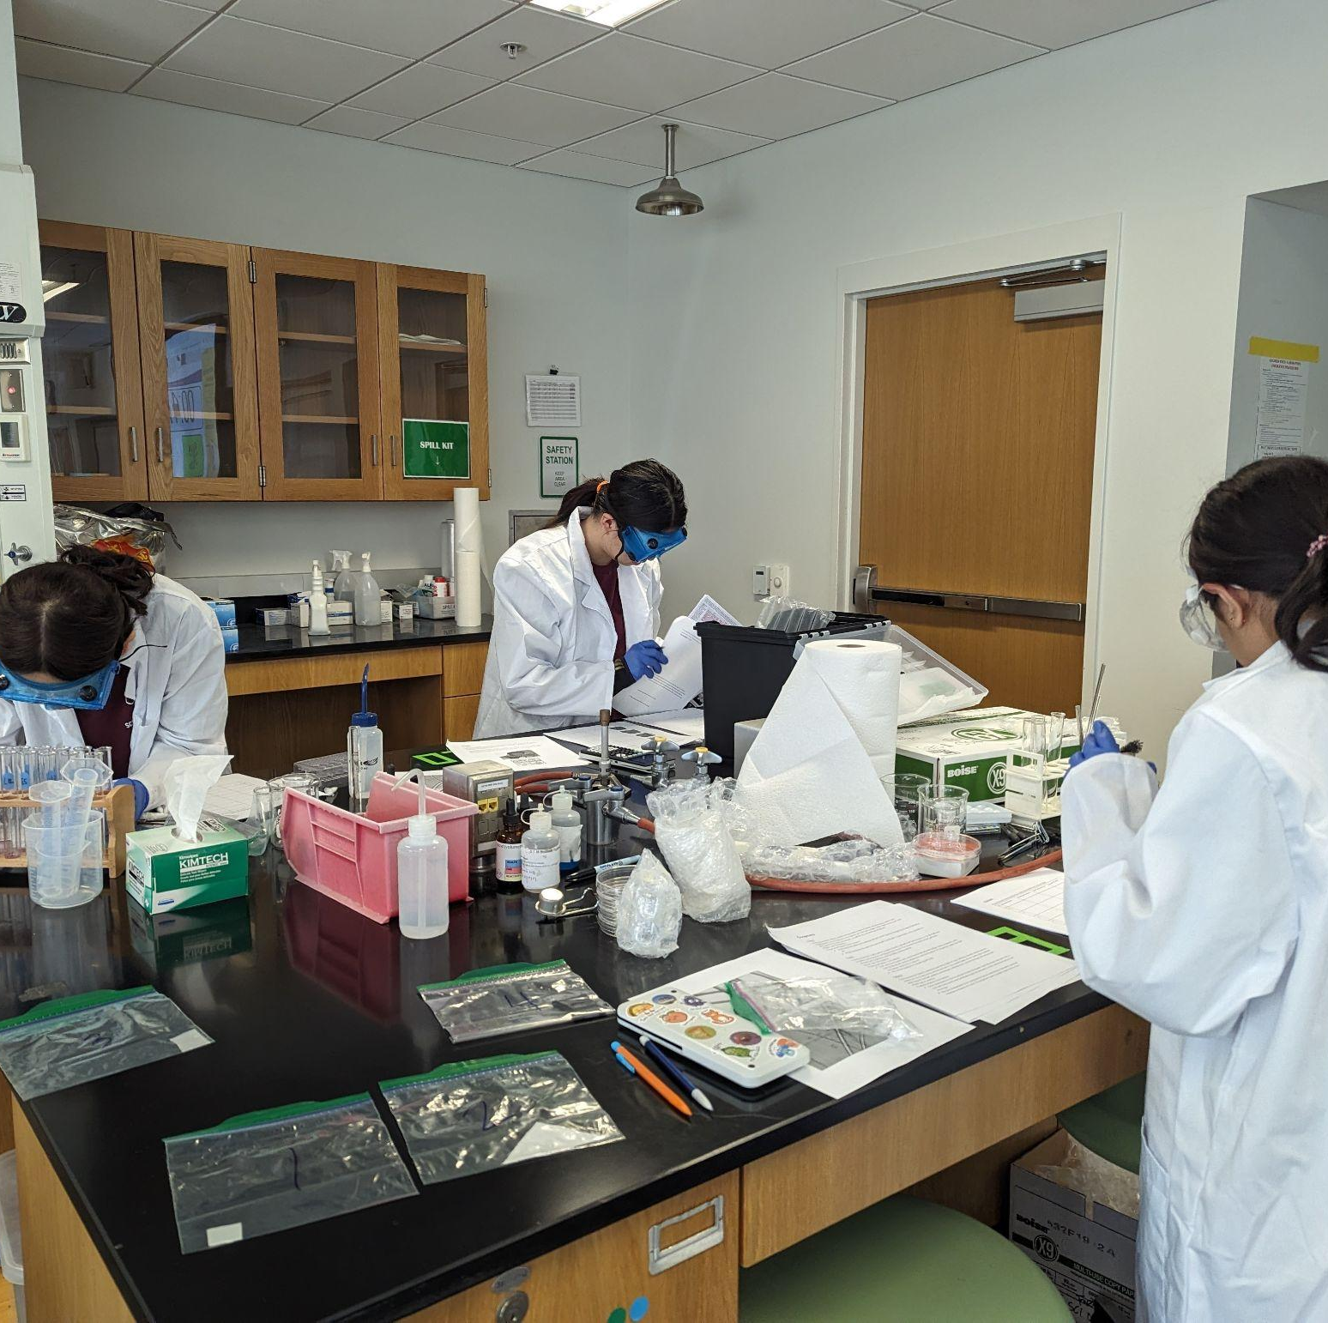
THANKS!
Notes:
(replace picture with a picture from one of our tournaments)

Slide 30
Cheat Sheets
The one showed on the presentation: https://docs.google.com/document/d/14K1vdRYZ22wrAPBrUnnrMII-7cG13QkWU_ETLs84cuo/edit?usp=sharing

